Slide 1
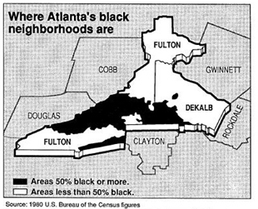
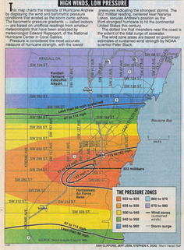
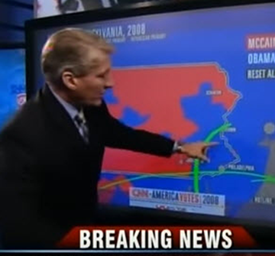

Data Journalism
Michael Friendly
Psych 6135
https://friendly.github.io/6135/

Slide 2
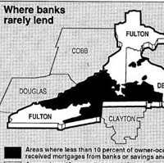
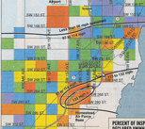
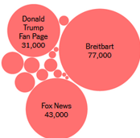

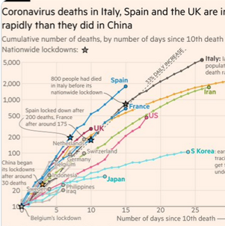
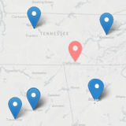
Today’s Topics
What is DDJ?
Some early examples
Modern examples
  election reporting
  health statistics
  social media
Best examples??
  Panama Papers
  Our World in Data
Satellite journalism
Software for DDJ

Slide 3
What is data journalism?
Data journalism reflects the increased role of numerical data for reporting in the digital era. Data driven or DDJ more useful
  Reflects increased interaction between journalists and {visualization design, computer science and statistics}.
Aspects:
  Database analysis: FOI requests on topics like crime, racial discrimination, judicial sentencing, toxic pollution, …
  Visualization: infographic←→data vis., emphasis on the story
  Increasing use & development of data vis. software tools
    analysis: R, python, …
    visualization libraries: R, D3, javascript, …
  Increasing use of dynamic updating of data sources
    election polls / prediction
    disease tracking

Slide 4
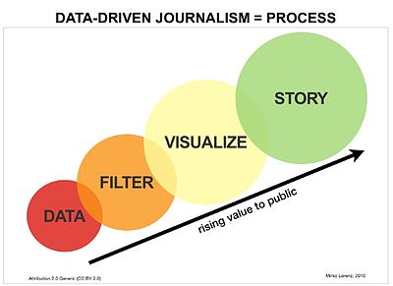
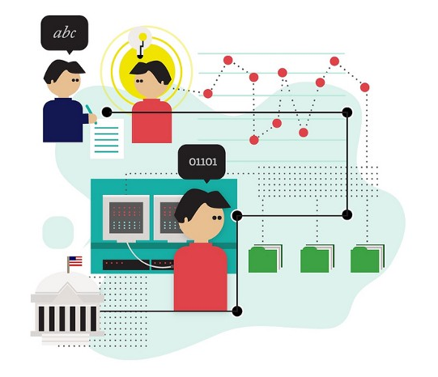
What is data journalism?
To an outsider, it is often hard to tell concretely what #DDJ is, or is not
Two motivational infographics of #DDJ as a process
How does it actually work?
What makes it successful?

Slide 5

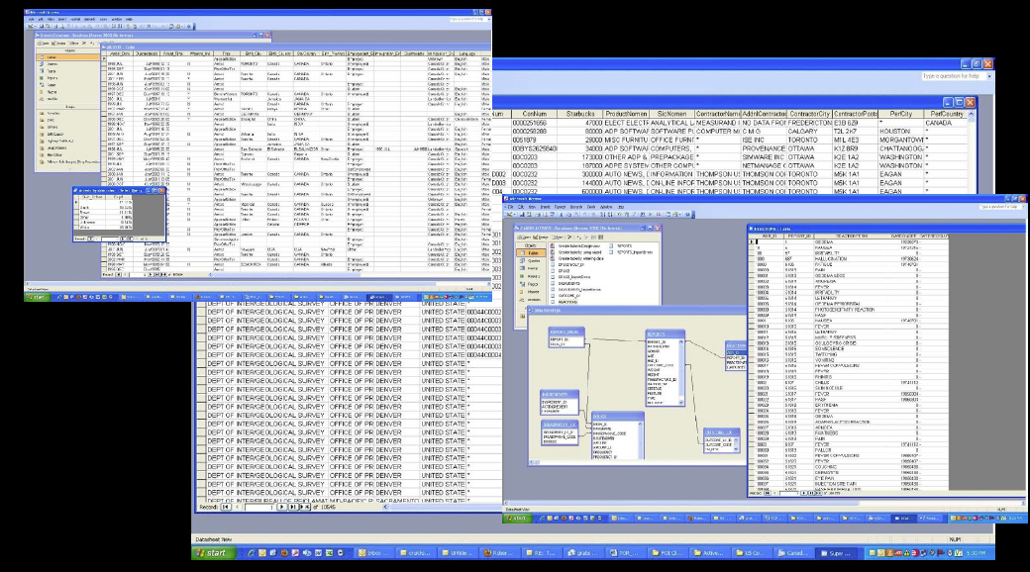
“Data” in Data Journalism
Investigative reporting generates messy databases from various sources
Challenges: Organize, clean, filter, …
Goals: Find the story; but mostly: make it credible
From: Jim Rankin, Data Successes, 6135 Guest lecture, 2020

Slide 6
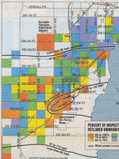
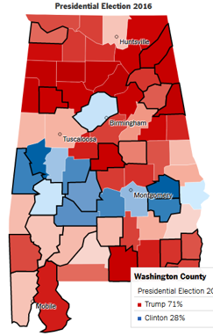
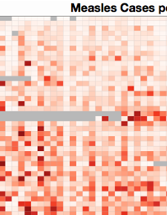
Examples of #DDJ
The color of money
Hurricane Andrew
Predicting elections
Election reporting
Measles, vaccines, COVID
Truth & Lies
Gun deaths

Slide 7
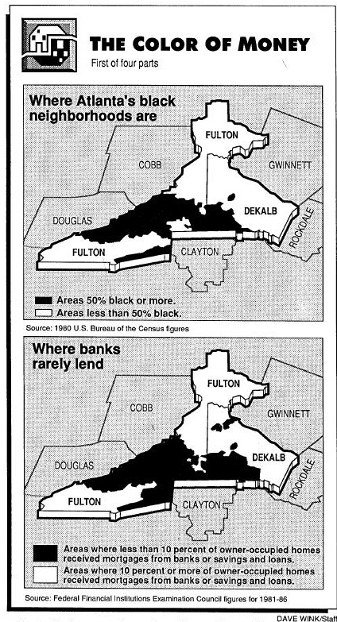
Bill Dedman: The Color of Money
Bill Dedman of The Atlanta Journal-Constitution analyzed racial discrimination by banks and other lenders in middle-income black neighborhoods of Atlanta, GA.
In a series of articles, May 1-4, 1988, The Color of Money, he showed that although banks made loans in even the poorest white neighborhoods, they did not lend in middle-class or more affluent black neighborhoods.
This work won the Pulitzer prize in investigative reporting in 1989.
It helped establish the idea of computer-assisted reporting and the importance of compelling visualizations in telling the story.
See: http://powerreporting.com/color/ for all the articles and images

Slide 8
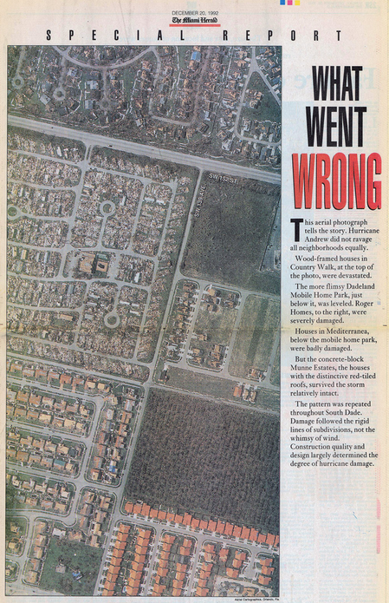
Hurricane Andrew
In Aug. 1992, a category 5 hurricane hit Miami-Dade county
Huge numbers of houses were destroyed, but this varied by neighborhood
Investigative reporters at the Miami Herald discovered why:
  Building codes and inspection became lax after 1980.
  Older homes survived.
This report by Liz Balmaseda et al. won the Pulitzer Prize in 1993.
newer destroyed
older undamaged
Source: https://www.flickr.com/photos/juggernautco/sets/72157607210036175/

Slide 9
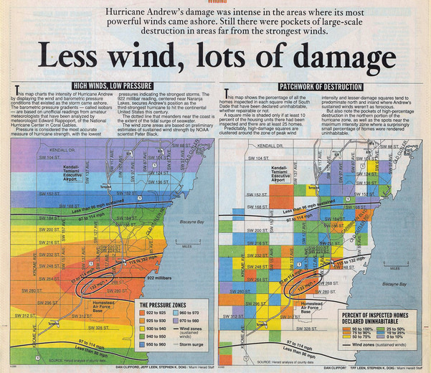
Hurricane Andrew
The report in the Miami Herald contained many detailed analysis maps
Overwhelming evidence for cause of destruction beyond wind
The combination of investigative reporting, analysis and graphics was seen as powerful & compelling
Data-driven journalism had arrived
“Still there were pockets of large-scale destruction in areas far from the strongest winds”

Slide 10
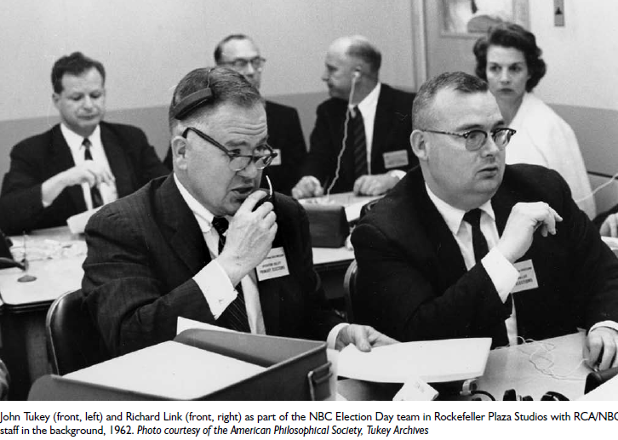
Predicting elections
In 1962, John Tukey and a statistical team joined with NBC to attempt to predict the congressional election
Over time, they developed new methods to combine past results with exit polls and current returns to give up-to-date estimates and measures of uncertainty as the numbers came in.
  Key idea: “borrowing strength”
Now known as “hierarchical Bayes”
NBC execs were freaked out when the Tukey team began to call elections quite early with 95%, then 97.5% certainty.
They waited until it reached 99%, and missed the scoop.

Slide 11
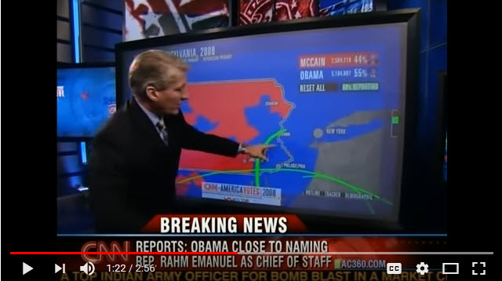
CNN Magic Wall
Direct, interactive visualization of election news on TV took a big jump in 2008 with the development of the Magic Wall, a large touch-screen display, tied to databases of election results & with on-screen controls to zoom in/out, compare, highlight, etc.
John King with the Magic Wall
Video: https://www.youtube.com/watch?v=rpLHnK-MSy4

Slide 12
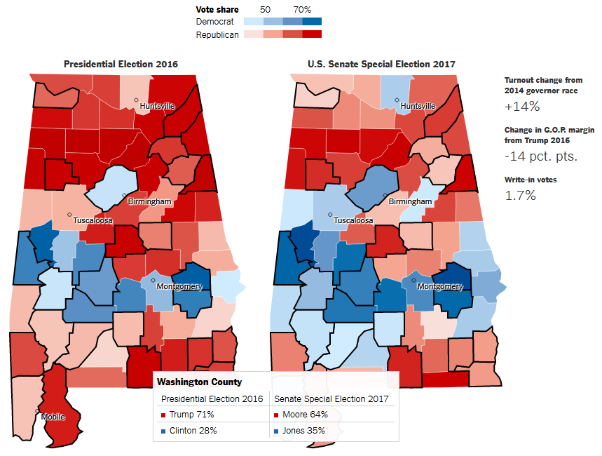
Election reporting: NYT
In the special election for the Alabama U.S. Senate, Dec. 12, 2017, The New York Times used dynamic, interactive maps to compare the vote to the 2016 Presidential election
Hovering the mouse over a county showed the details
A map-based display is natural & easy
Q: What other graphic might show the comparison better?

Slide 13
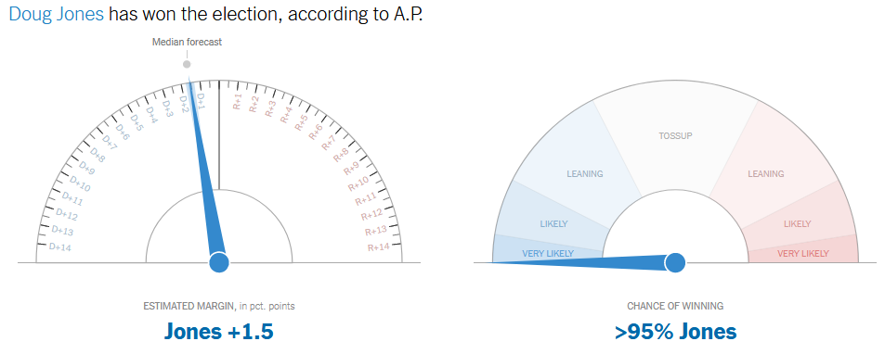
Election reporting: Election needle
In the 2017 election, the NYT used dynamically updated dashboard displays of the election returns and model-based predictions of the winner of the Alabama Senate race, predicting a win by the Democrat, Doug Jones, over rival Republican, Roy Moore.
Two dials:
Predicted outcome
Certainty

Slide 14
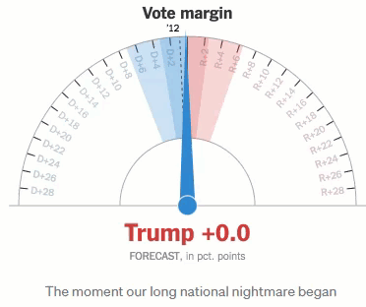
The jittery icon of liberal trauma
But in the 2016 Hilary Clinton – Donald Trump contest the needle earned a place in media infamy.
“For much of the night, ‘the needle’ — a quivering indicator of which candidate is more likely to win— showed Hillary Clinton as the favorite. And then, suddenly, it didn’t.”
uncertainty now in shading
“As the needle swung in Trump’s direction around 9 p.m., it became much more than a data visualization.
For Clinton voters, it became an encapsulation of everything that was going terribly, unfathomably wrong: The fate of the country and democracy distilled to a lone meter that was suddenly pointing to ‘red alert.’”
Will Oremus, https://gen.medium.com/how-i-learned-to-stop-worrying-and-love-the-needle-9bfed8f41023

Slide 15
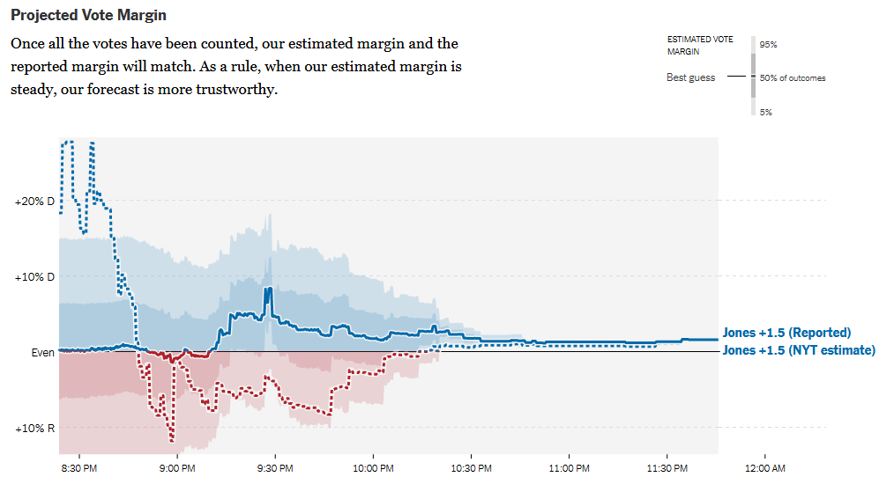
Election reporting: Dashboards
Another dynamically updated chart showed the projected vote margin, together with two levels (50%, 95%) of uncertainty intervals for the current estimate.

Slide 16
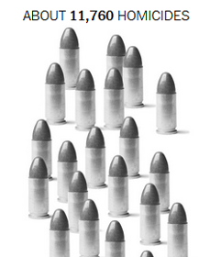
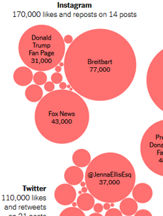
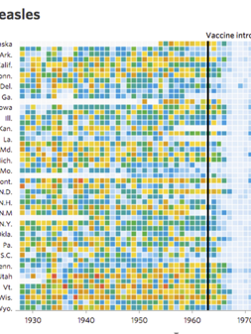
Novel graphic designs
#DDJ has led journalists to team with graphic designers to create novel forms of visualization

Slide 17
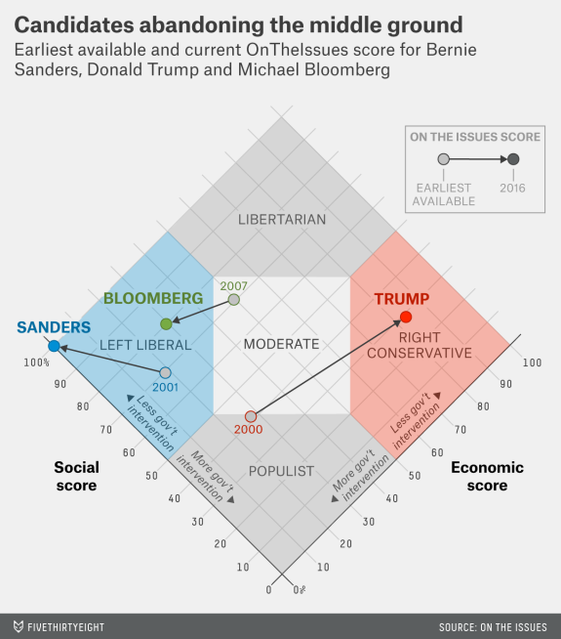
Novel graphic designs: Zone chart
This graph, from fivethirtyeight.com was designed to show how some presidential candidates had shifted positions before the 2016 election.
The axes are a score on social and economic policy, but they rotated the axes by 45º to create zones related to political thought.
This info graphic is eye-catching and self-explanatory:
colored/labeled zones
interpretive labels on axes
arrows showing movement to extremes
Trump 2.0

Slide 18

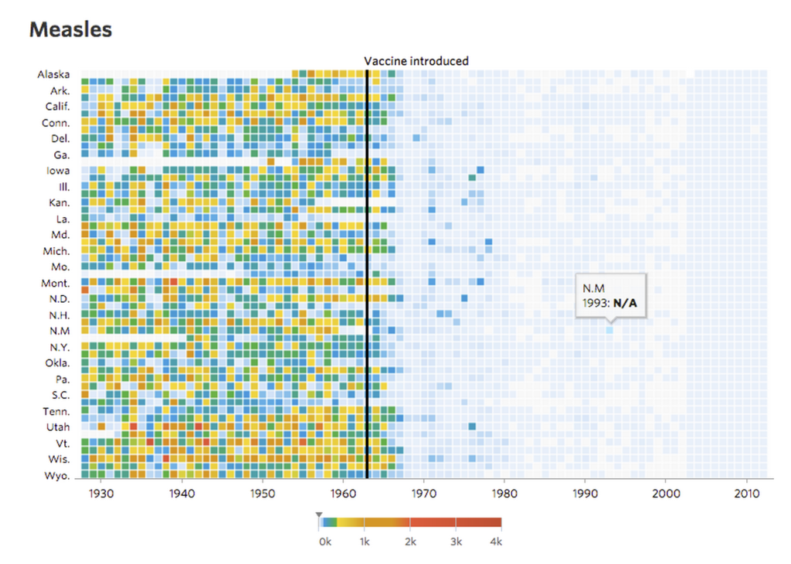
Measles and vaccines
Visualizing the impact of health policy interventions
In 2015 Tynan DeBold & Dov Friedman in the Wall Street Journal tried to show the effect of the introduction of vaccination programs in the US states on disease incidence, using color-coded heat maps for a variety of diseases
The long time series ~70 years made this work.
The heat map color scale is not exemplary, but the message is still clear: disease incidence declined after vaccines were introduced.
The images are “interactive,” in the weak sense that tool-tips are shown on mouse movement.
Source: http://graphics.wsj.com/infectious-diseases-and-vaccines/

Slide 19
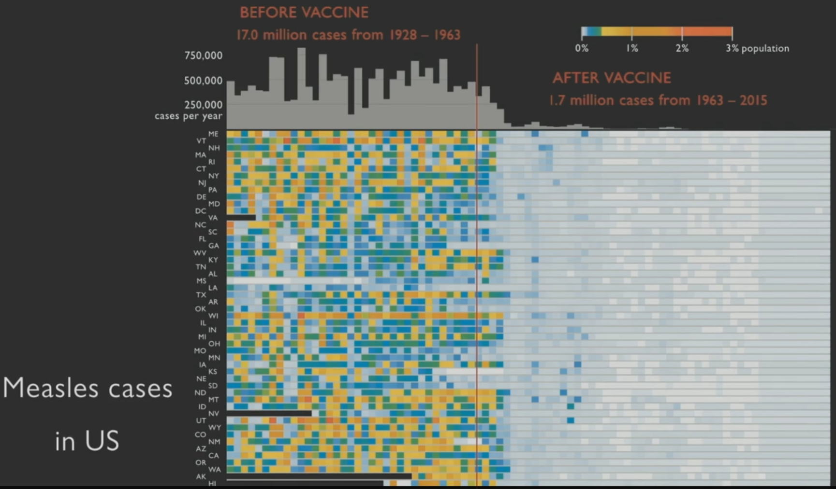
Making the message more explicit
What you should try to show here in an Info graphic is the overall impact of vaccination on measles
Ed Tufte did this by adding a histogram at the top showing total # of cases by year
With the overall impact made clear, details about individual states can now be explored
Ben Schneiderman:
“Overview first; details on demand”

Slide 20
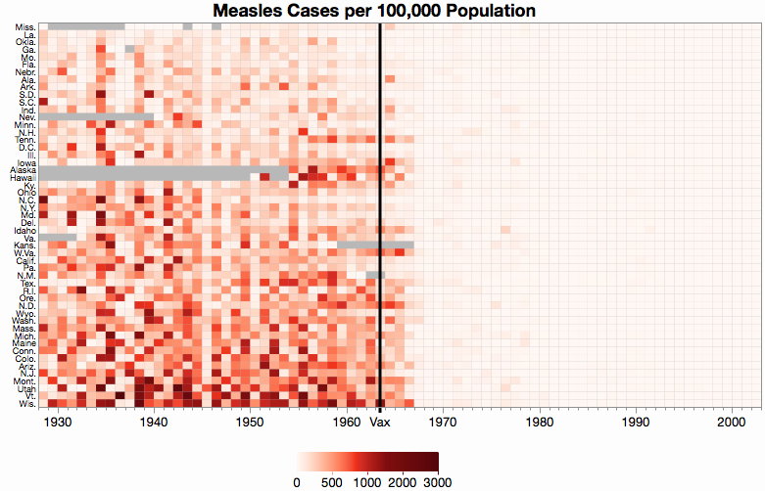
Effect ordering & color scales
Ordering the states by an overall measure of measles incidence makes it easier to study details.
A uni-dimensional scale of color is more effective than the ad-hoc scale used in the original
This chart, by Xan Gregg also shows missing data explicitly.
Color scales for data graphs is a growing topic.
What’s wrong in Wis. & VT?
increasing incidence
From: https://community.jmp.com/t5/JMP-Blog/Graph-makeover-Measles-heat-map/ba-p/30550

Slide 21
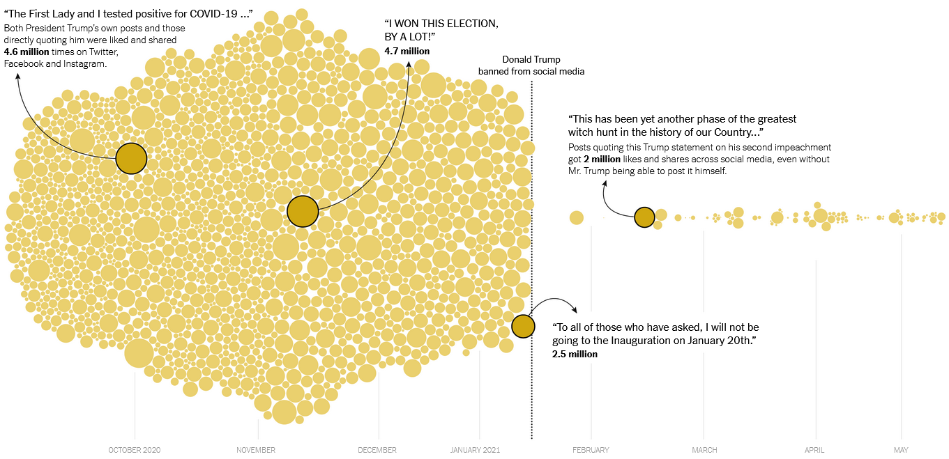
Before – After Circle Charts
What Happened When Trump Was Banned on Social Media?
Circles are statements by Trump.
Circle size ~ likes & shares on social media
https://www.nytimes.com/interactive/2021/06/07/technology/trump-social-media-ban.html

Slide 22
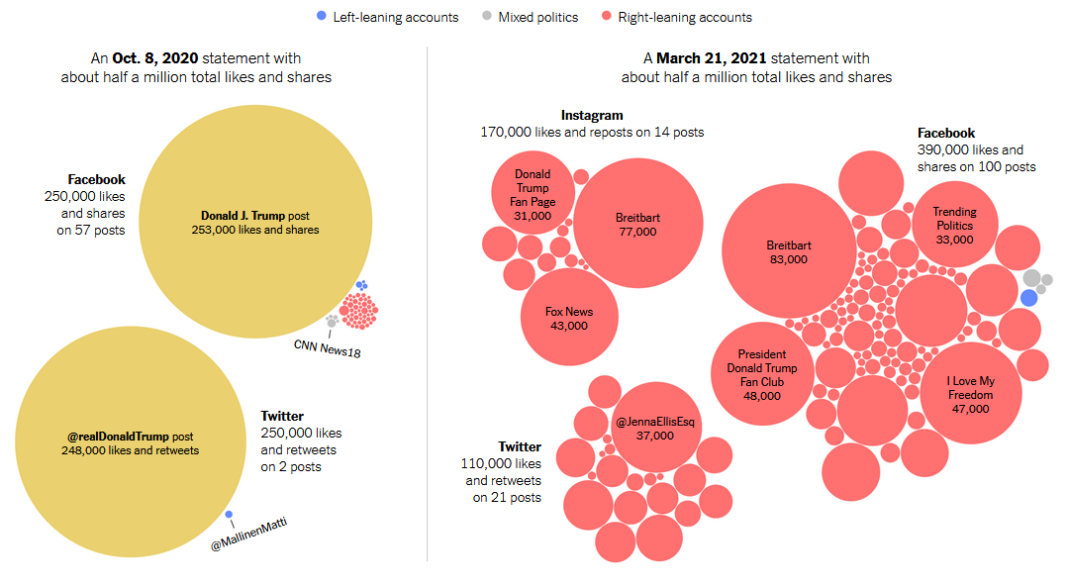
Before – After: Who pushed the lies?
How/Who Spread Trump statements before and after the ban
Posts referencing each Trump statement, sized by total number of likes and shares

Slide 23
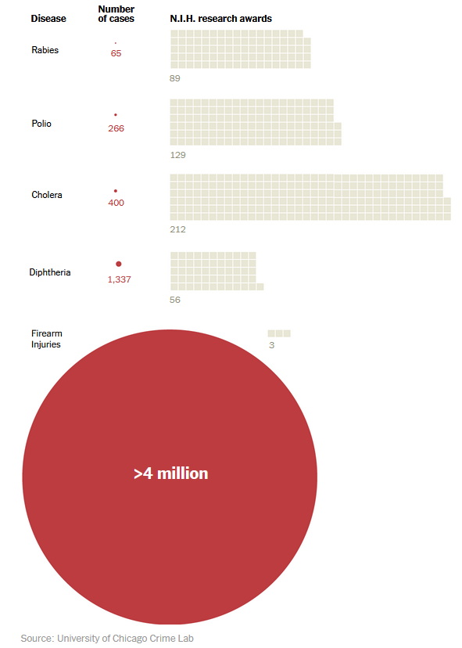
Health & research funding
Rabies
Polio
Cholera
This powerful? NYT chart compares cases of diseases and firearm injuries to the number of N.I.H. research awards.
How well do you like this design?
Is it a fair depiction of the data?
Can you suggest anything different?
Diptheria
Firearms

Slide 24
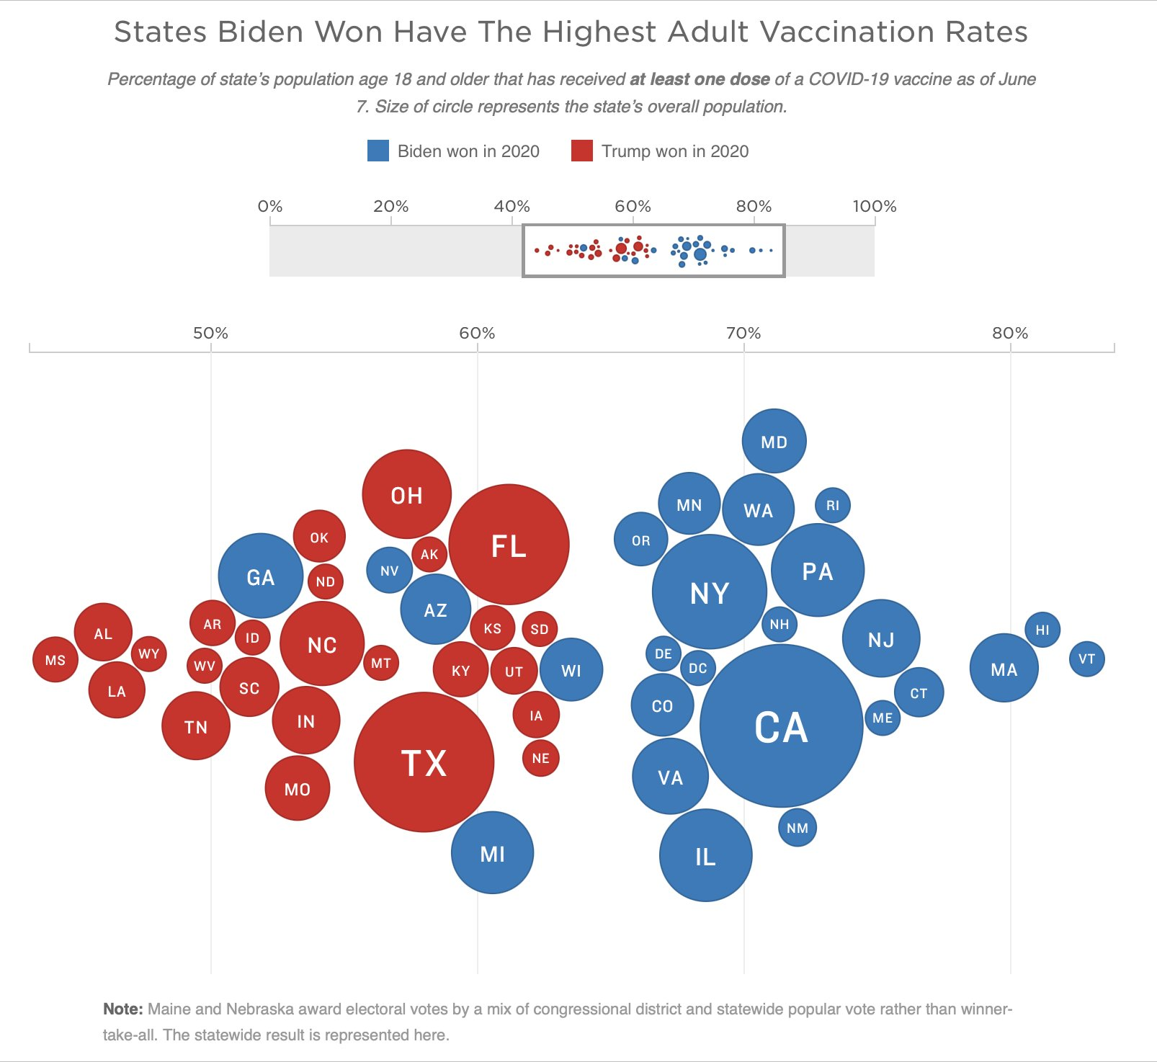
Votes for vs. COVID vaccinations
% of state pop. with at least one dose, vs. who won (Biden, Trump) in 2020
circle size ~ state pop.
What makes this chart effective?
From: https://twitter.com/kjhealy/status/1402691186826039301

Slide 25
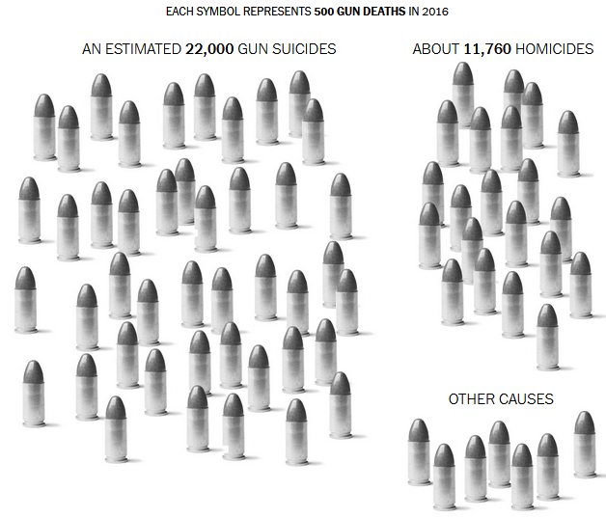
NYT Infographic: Gun deaths
“a single death is a tragedy, a million deaths are a statistic” – Joseph Stalin
Infographics use simple icons to give emotional impact to raw numbers
But journalists always use the ‘single death’ in the lede

Slide 26
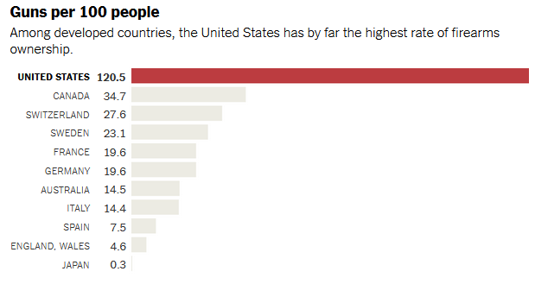
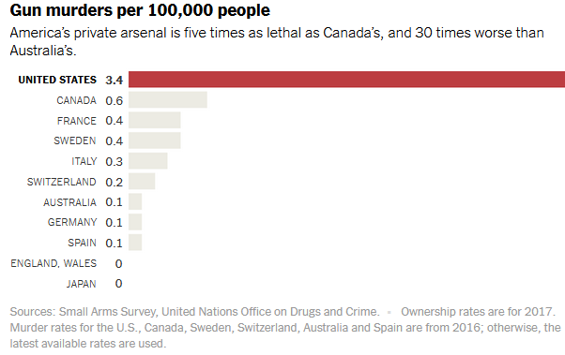
NYT: Gun deaths & policy
How does the US compare to other Western countries in gun ownership & murders?
These simple barcharts have a grim conclusion
What makes them effective?
Could they be done better?
See: NYT, “Guns in America” for other stories

Slide 27
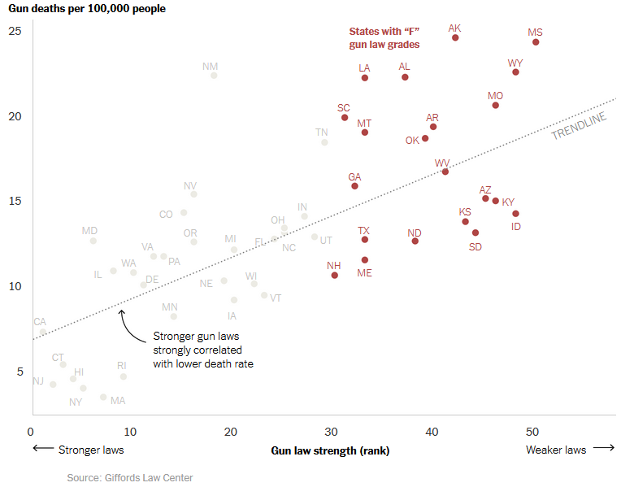
NYT: Gun deaths & gun laws
This graph directly linked gun deaths to the strength of states’ laws on gun ownership
Highlighting the “F” grades to make the point

Slide 28
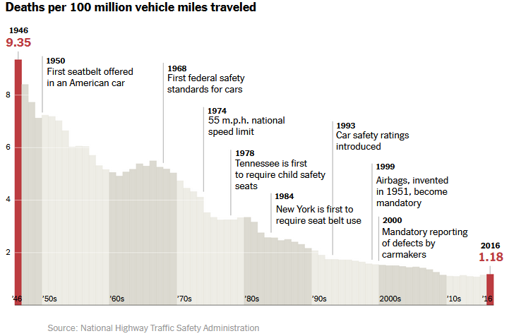
Seatbelts: Story telling
New York Times: An annotated chart of vehicle deaths in relation to seatbelts
Telling the story of a public safety policy with explanatory milestones

Slide 29

Race & Crime
Toronto Star investigation of racial disparities in treatment by Toronto Police Services
FOI request → ½ M arrests, 1997—2002
Evidence for racial profiling?
Only look at discretionary charges:
Simple marijuana possession
Non-moving auto infractions
Lede case
Headline, summary
HOW TO WRITE THIS STORY?
Simple graphic
Notes:
- Began with press release in 1999 - yellow skin, FOI in 2000, two years to get data, cost $800
- looked at differences in treatment in situations where police have discretion
- 5 reporters, two editors, one stats expert, three database specialists, one lawyer

Slide 30
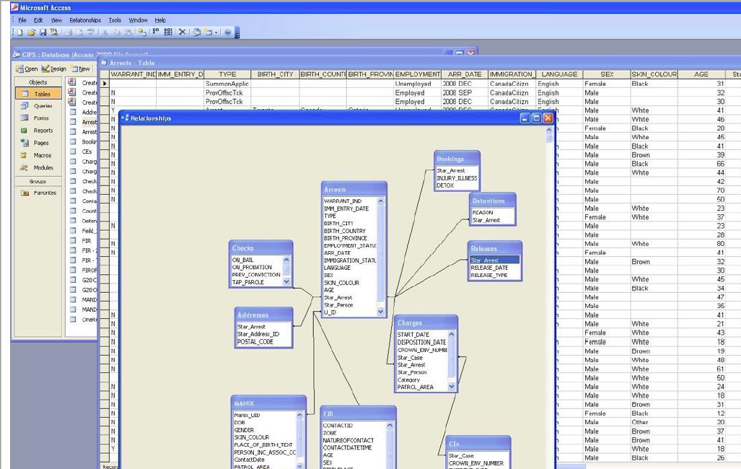
Data: Entered in a MS Access database, with tables for arrests, charges, checks, …
Processing: Used SQL queries ⟹ counts of arrests x {sex, skin color, age, …}

Slide 31
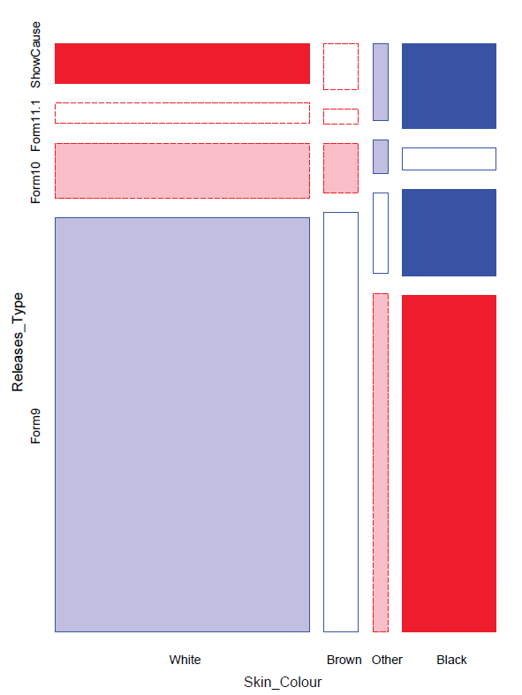
Racial profiling: Analysis graph
Police actions on a charge of simple possession of marijuana
  release with a summons (Form 9) vs. hold for bail (Show cause)
  Evidence for racial bias?
First graph: mosaic display
  area ~ frequency
  shading: ~ residual
    Obs > Expected in blue
    Obs < Expected in red

Slide 32
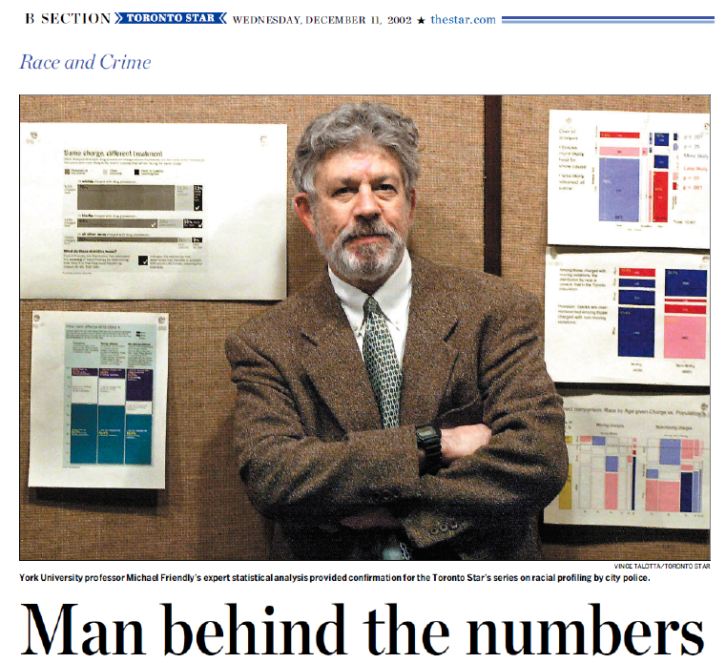
Racial profiling: The process
How to communicate these results most effectively?
What is the message? What features are directly comprehensible to the audience?
Graphic designer’s early attempts
My early attempts

Slide 33
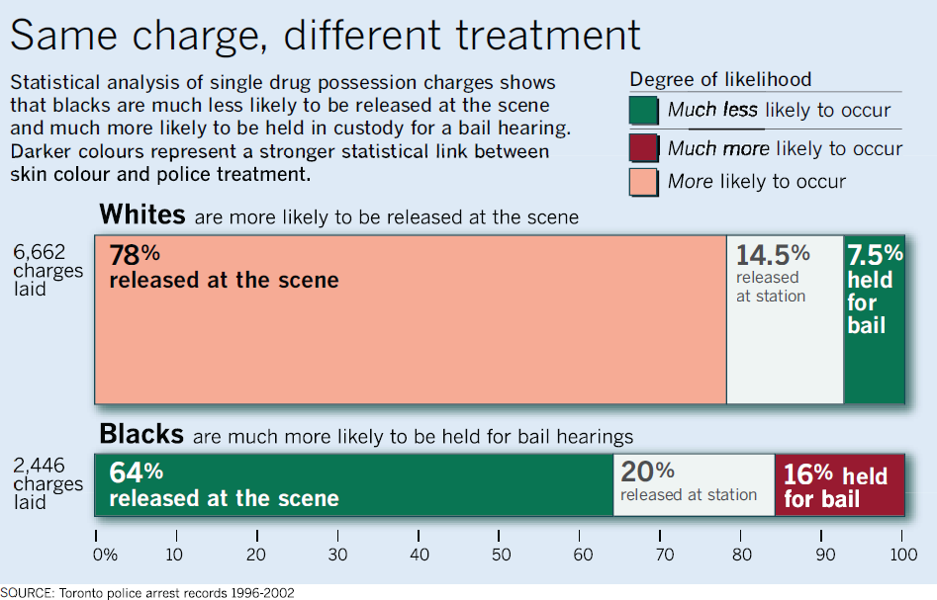
Racial profiling: Presentation graphic
Together, we created this (nearly) self-explaining infographic
Legend gives a layman’s description of shading levels
Title gives the main conclusion
Text description gives details
Bar width ~ charges
Divided by % release
numbers shown in the cells

Slide 34
Marijuana data: Analysis
Fit a glm() model to account for all predictors, plus interactions with skin color
> data(Arrests, package=“carData”)
> Arrests$year <- as.factor(Arrests$year)
> arrests.mod <- glm(released ~ employed + citizen + checks +
colour*year + colour*age,
family=binomial, data=Arrests)
BIG Q: How large is the effect of skin color, controlling for other factors?
> plot(Effect("colour", arrests.mod), lwd=3, ci.style="bands”, ...)
Effect plot shows average effect controlling (adjusting) for all other factors simultaneously
(Star analysis controlled for these one at a time.)
Strong evidence for different treatment of blacks & whites
But effect size smaller than reported by the Star

Slide 35
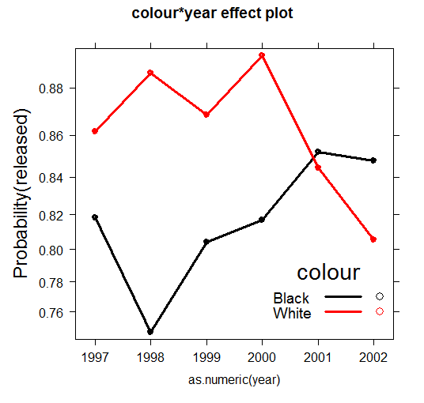
Effect plots: Interactions
The story turned out to be more nuanced than reported by the Toronto Star
> plot(Effect(c("colour","year"), arrests.mod), multiline=TRUE, ...)
Up to 2000, strong evidence for differential treatment of blacks & whites
Also: evidence to support Police claim of effect of training to reduce racial effects in treatment

Slide 36
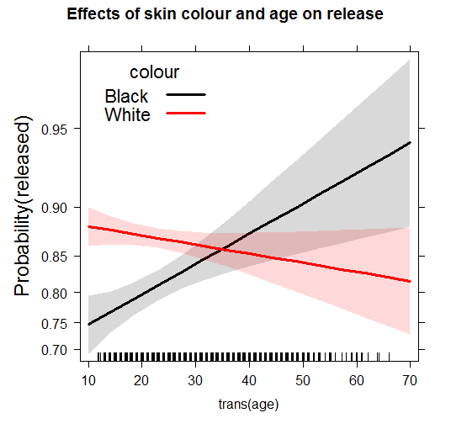
Effect plots: Interactions
A more surprising finding …
> plot(Effect(c("colour","year"), arrests.mod), multiline=TRUE, ...)
Opposite age effects for blacks & whites:
Young blacks treated more harshly than young whites
Older blacks treated less harshly than older whites
News organizations generally present main effects.
Interactions: harder to explain

Slide 37
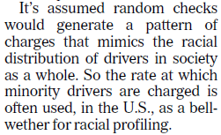

Traffic stops
Analysis of traffic tickets issued for discretionary (non-moving) violations
Argument: Proportion of tickets to Blacks >> proportion in the population

Slide 38
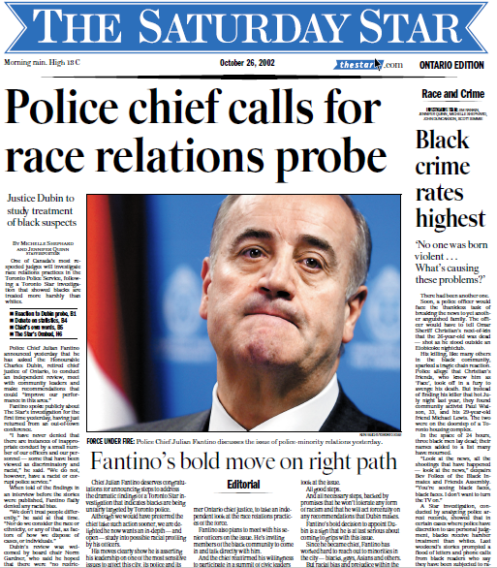
Star gets action
Among the most satisfying outcomes for data journalists is when their stories lead to concrete attention & action
Front page editorials are reserved for big events

Slide 39
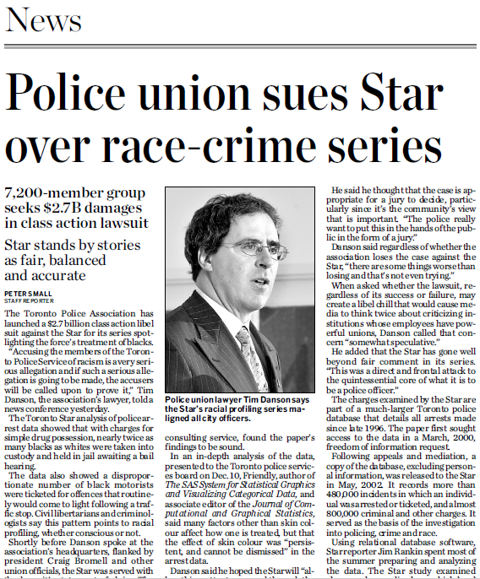
But not without pushback
7200 “members” = $375K / member
Cops: 5120 + parking enf + cadets + …
Goal? “Libel-chill to cause media to think twice…”
Judge: TOSSED!
“You can’t libel an entire class”
“many factors other than skin color affect how one is treated, but the effect of skin colour was persistent and cannot be dismissed”

Slide 40
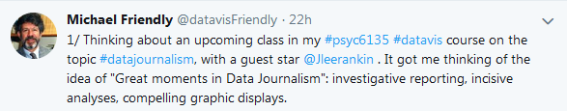

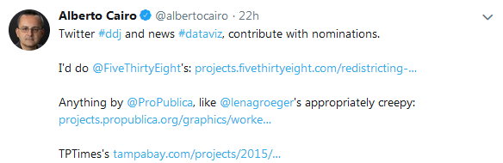

Best examples of DDJ? Ask Twitter

Slide 41

Now trending …
Digital publishing and online, interactive media
  Many news organizations have interactive graphic developers or entire online departments
  A revenue stream responding to less from print & ads
Story telling frames a wider enterprise
  A new focus and techniques for data visualization
  New online forms: scrollytelling
Opening data
  Maps-GIS (Google, Open Street maps)
  Gov’t data: census, health, crime, …
  NGO initiatives: Our World in Data
  Unsealed: WikiLeaks, Panama Papers
Software infrastructure
  Javascript as base for online, interactive methods
  Libraries, frameworks building on this (D3.js, Processing, …)

Slide 42

538: Atlas of Redistricting
There’s a lot of complaining about gerrymandering, but what should US Congressional districts look like? What would they look like to serve various goals?
This map shows the current boundaries, with expected wins by Rep and Dem.
Why do I find this app appealing?
From: https://projects.fivethirtyeight.com/redistricting-maps/

Slide 43

538: Atlas of Redistricting
How could district boundaries be re-drawn to promote more competitive elections?
Election district boundaries are consequential & highly political. They can be changed by state legislatures.
Different scenarios show the changes in representation, w/o a single voter switching parties!
From: https://projects.fivethirtyeight.com/redistricting-maps/

Slide 44

538: Atlas of Redistricting
What if the Democrats could control election districts to favor themselves?
Note that the overall impression of the map is still Rep. overall.
Changes in representation take place largely on the east/west coasts
From: https://projects.fivethirtyeight.com/redistricting-maps/

Slide 45



WP: Segregation in U.S. Cities
Aaron Williams & Armand Emamdjomeh at the Washington Post studied changes in racial composition and diversity in U.S. cities over 30+ years
They relate these to demographic, policy, and urban/suburban issues using well-designed thematic maps.
distribution
diversity
From: https://www.washingtonpost.com/graphics/2018/national/segregation-us-cities/

Slide 46


Our World in Data
An impressive range of social & environmental issues presented by Our World in Data

Slide 47

Our World in Data
What is the main message of this chart?
Why is it effective?
Would using log expenditure be better or worse?

Slide 48


Financial Times COVID tracker
This series of charts from the Financial Times was hailed for best-practices in the early stages of the pandemic.
Log scale make it easy to compare rates of increase
Visual meaning for “leveling the curve”
Labels for interventions (lockdown)
Sensible (relative) origin – days since 10th death

Slide 49

Reuters COVID tracker
Data journalists at Reuters created live trackers, pulling data from different sources to generate real-time graphics with text, telling the story of the pandemic.
An interactive globe serves as a novel way to explore vaccination rates.

Slide 50

Other interactive displays provide the possibility to compare countries by geographic region and income level
“Reuters also took on the
hard task of tracking the vaccination policies that determined who had access to COVID-19 vaccines in countries around the world.
That meant creating a unifying structure to catalogue the different phases of each country's vaccination
rollout plan.”
-- Prasanta Kumar Dutta
https://graphics.reuters.com/world-coronavirus-tracker-and-maps/vaccination-rollout-and-access/

Slide 51

Flatten the curve
Infographic created by epidemiologist Dr. Siouxsie Wiles & illustrator Toby Morris for the New Zealand publication The Spinoff.
✓
Animated, rather than separate panels
Clear, memorable title
Simple drawing rather than messy data
Cases vs. capacity
✓
✓
✓
See: Robert Kosara, https://eagereyes.org/blog/2020/the-visual-evolution-of-the-flattening-the-curve-information-graphic

Slide 52


Toronto Star: Trump Lies
Daniel Dale & Ed Tubb at the Toronto Star maintained a database of every false claim made by Donald Trump since the Inauguration on Jan. 20, 2017
(as of 3-13-2019)
Interactive filter at: http://projects.thestar.com/donald-trump-fact-check/

Slide 53

Toronto Star: Trump Lies
Every false claim is documented: place, claim, truth, “slug”, categories
claim
truth
inauguration
media
voter fraud

Slide 54


Jelle Geertsma: Trump Lies
Graphic artist Jelle Geertsma designed this animated graphic showing the top 5 claim “slugs” & the top 20 categories over time, by month.
Bars at right show cumulative totals
This animation uses the gganimate package.
A TrumpLies package is in progress. Ugh! Not so.
https://github.com/friendly/TrumpLies
cumulative totals

Slide 55

Scrollytelling: The Impatient List
What it’s like waiting for a kidney transplant in the U.S.?
More importantly: What can I do?
Waitlist length / Donors & blood type, by state
From https://xujunjiejack.github.io/

Slide 56

Scrollytelling: The Impatient List

Slide 57

Scrollytelling: The Impatient List

Slide 58

Drill-down to tell a story
The Wall Street Journal published this interactive story of potential conflicts of interest in the business holdings of Donald Trump and his family (2017)
“The most difficult part of many visualization projects, and certainly of this one, was distilling a complex, messy dataset into a clean visualization with a clear takeaway,” says Eastwood.
https://www.wsj.com/graphics/donald-trump-potential-conflicts-of-interest/

Slide 59



In each part of the story, hovering with the mouse reveals the details of a particular investment and links to others

Slide 60

British MP Expense Scandal
In May 2009, an unknown government employee copied a terabyte of documents on MP expenses and released these to The Daily Telegraph

Slide 61

The Guardian: Crowd sourcing
In June 2009, The British House of Commons released 700,000 documents detailing every expense claim over for 4 years by all 644 MPs.
The Guardian launched a crowd sourced experiment inviting readers to investigate these claims
https://www.theguardian.com/news/datablog/2009/sep/18/mps-expenses-westminster-data-house-of-commons

Slide 62

Crowd sourcing: The App
“Using our system, you will be able to find your MP - or any member - and look at their records directly. For every page for every MP, you will be able to:”
  comment on individual expenses
  highlight ones of interest
  tell us how interesting that receipt is
  Help by entering the numbers on the page
“Using that information, we will begin to be able to piece together a unique picture of how MPs claims have changed over time.”

Slide 63


Slide 64


Panama Papers
In January 2017, The International Consortium of Investigative Journalists released the “Panama Papers”, exposing the tax avoidance schemes of the Panama-based firm Mossack Fonseca.
Two terabytes of data, over 40 years, 210,000 companies in 21 offshore jurisdictions
IJIC: 280 top investigative journalists, >100 media partners, >100 countries
https://www.icij.org/investigations/panama-papers/

Slide 65

Panama Papers
Key findings:
Files reveal offshore holdings of 140 politicians & public officials around the world
Current & former world leaders include: PM of Iceland, the king of Saudi Arabia, …
>214,000 offshore entities, connected to people in more than 200 countries
Major banks have driven the creation of hard-to-trace companies in offshore havens
How could this graph be improved?

Slide 66




Visual explainers: The fentanyl route
Reuters: How narcos sneak deadly chemicals through the U.S.
This scrolly story shows the process used by Chinese drug suppliers to ship supplies – hiding them in “plain sight” among millions of imports
Hidden in mislabeled pkgs
Each step is morphed into the next
Packed in “master cartons”
Prepared for shipping
https://www.reuters.com/investigates/special-report/usa-fentanyl-supply-chain-shipping/

Slide 67


Visual explainers: The fentanyl route
How drugs escape detection
How they are shipped to final destination (drug lab)

Slide 68

Satellite Journalism
An exponential growth in the number of small, privately owned satellites has opened wide new vistas for investigative reporting.
Media access to satellite company images data bases → journalists gaining near real-time reporting source for breaking stories.
From: Mark Corcoran (2018), Satellite Journalism – The Big Picture

Slide 69
Satellite Journalism: Smoking Guns
Satellite imagery has provided ‘smoking-gun’ evidence for:
  investigative reporting of human rights abuses (Htusan et al., 2015)
  exposure of environmental destruction in remote locations (e.g., the Amazon: Weir, 2017)
  before & after imagery of natural disasters (Murphy, 2018)
  analyses of military build-ups (e.g.: China’s construction of artificial islands in the South China Sea Wu et al., 2018)
  missile launches and nuclear testing in North Korea (Fifield and Taylor, 2018)
Source: Mark Corcoran (2018), Satellite Journalism – The Big Picture, https://reutersinstitute.politics.ox.ac.uk/sites/default/files/2018-10/ Mark%20Corcoran%2C%20Satellite%20Journalism_1.pdf

Slide 70


Cuban Missile Crisis: Before vs. After
Not DDJ, but: U-2 photographs on Oct 14-15, 1962 were used to identify the build-up of Soviet medium-range ballistic missiles in sites in Cuba, providing VISUAL PROOF
Missile trailer
Launcher
Before
After
Analysts were able to identify: missile trailers, launching equipment, …
https://nsarchive.gwu.edu/document/29153-oct-14-first-u-2-photographs-soviet-missiles-cuba-1962

Slide 71

Before-After Sweeps
A moving window technique allows one to see before-after comparisons directly
Effect of Ammonium Nitrate explosion at the port of Beirut, Lebanon, Aug. 5, 2020
https://www.planet.com/gallery/#!/post/ammonium-nitrate-explosion

Slide 72

The La Pampa gold mine, Peru
In 2016, mining operations were extended
S. of the Malinowski River, illegally entering the Tambopata National Reserve—a protected forest.
The Amazon Conservation Association used Planet Labs data to track 100s of
hectares of illegal expansion and mapped alterations to the course of the Malinowski River.
The Peruvian government intervened and actively targeted illegal mining operations inside the reserve.
Images: Planet Labs https://www.planet.com/

Slide 73


Remote sensing tools for telling stories
Satellite data provides context to the news, documents events, and a tool for investigation.
U.S. spy satellite image of a Soviet shipyard
3D rendering of Hurricane Linda (NOAA)
Taken from: Rob Simmon, From Space to Story in Data Journalism

Slide 74

Satellite image of smoke from wildfires provides the context & scope for this story, justifying the title
Zoë Schlanger & Daniel Wolfe, The fires in the Amazon were likely set intentionally, Quartz, Aug. 2019

Slide 75


Software for DDJ
Of those who program, most use Python & HTML, followed by R
Data analysis & dataviz mostly done with Excel & Google sheets, followed by Datawrapper, Flourish, Tableau
https://datajournalism.com/survey/2022/skills-and-tools/

Slide 76

Popular DDJ software
OpenRefine: Like Excel, but includes data wrangling tools
Tableau Public: Menu-driven data vis tool
Datawrapper: Open source tool for easy charts, maps, tables
Flourish: DDJ tool for creating interactive, dynamic stories
Google Data Studio: web-based data visualization tool
Ask Google: “software for data journalism”:

Slide 77


Open Refine
https://openrefine.org/ free, open source tool for working with messy data: cleaning it; transforming it from one format into another; and extending it with web services and external data.

Slide 78


Tableau Public
A free platform to explore, create, and publicly share data visualizations online.
https://public.tableau.com/app/discover

Slide 79


Popular DDJ tool for creating interactive, dynamic stories and datavis
See: https://flourish.studio/

Slide 80


Flourish
Drag & drop data import
Animated graphics

Slide 81


Datawrapper
Menu-driven
Copy/paste, import data
Choose chart/map/table type, edit (JS under the hood)
Emphasis on responsive, interactive charts/maps/tables
Embed responsive code in web or export as static images

Slide 82

Datawrapper demo

Slide 83
Closeread
Closeread is a custom format for Quarto that enables scrollytelling features for HTML documents.
  Docs & examples: https://closeread.dev/
---
title: My First Closeread
format: closeread-html
---
Hello World! Please read my Closeread story below.
:::{.cr-section}
Closeread enables scrollytelling.
Draw your readers attention with focus effects. @cr-features
:::{#cr-features}
1. Highlighting
2. Zooming
3. Panning
:::
:::
Features:
Combine scrolly text with images, tables, code, …
Build up code & plots
Highlighting, linking
Zoom in / out
…

Slide 84

Closeread
Example from Nicola Rennie: English Monarchs and Marriages
http://nrennie.rbind.io/scrollytelling/
Source code: https://github.com/nrennie/scrollytelling

Slide 85


Learning more
The DataJournalism.com blog presents a roundup of the best data journalism projects in 2022, https://datajournalism.com/read/blog/best-data-journalism-projects-2022

Slide 86

Learning more
The Global Investigative Journalism Network awards it’s top picks each year, https://gijn.org/stories/2024-editors-pick-best-data-journalism/

Slide 87
Summary
DDJ reflects increased interaction between journalists and {visualization design, data science and statistics} in the digital age.
New data sources:
  FOI requests
  Open Data initiatives
  Crowd sourcing
  Satellite journalism
New graphic forms & reporting
  Novel graphic displays
  Interactive story telling
  Stimulating developments in software
⟶ Powerful impact

Slide 88

What have you learned?
Take the quiz: https://friendly.github.io/6135/quiz/data-journalism.html

