Slide 1
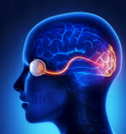
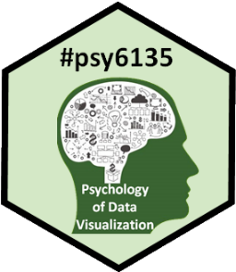
Graphical Perception
encode
view
decode
Michael Friendly
Psych 6135
https://friendly.github.io/6135

Slide 2
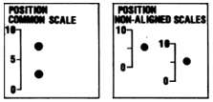
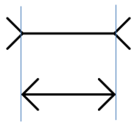
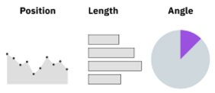
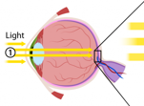
Topics
Perception & Cognition
Encoding, decoding
Top-down vs. bottom-up processing
Perceptual aspects
Illusions
Gestalt factors
Accuracy of decoding
Cognitive aspects
Memory
Color

Slide 3
Graphical Perception
In constructing a graph, quantitative and categorical information is encoded by visual attributes:
Length
Position along axis
Angle
Area
Color, shape, line style
What determines the ability of graph viewers to:
Make comparisons (which is larger?)
Estimate a magnitude?
See patterns, trends, unusual features?

Slide 4
Encoding & decoding
When we construct a graph, we encode a numerical or categorical variable as a graphical attribute
When we view a graph, the goal is to decode the graphical attributes and extract information about the data that was encoded
Encoding should rely on features that can easily be decoded
Often, easier said than done! The devil is in the details
encode
view
decode

Slide 5
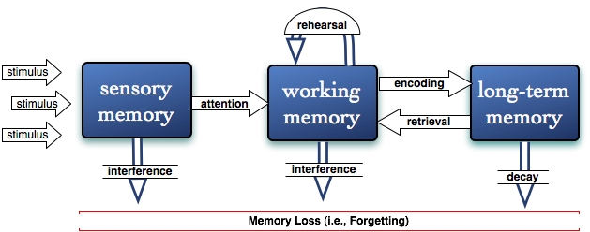
Visual & cognitive systems
A simplified model: Three stages
Sensory (iconic) memory
pre-attentive, automatic, feature detection
massively parallel, short duration, easily fooled (“thinking fast”)
Working memory
requires attention, limited capacity (~ 4-6 “chunks”)
memory aids: rehearsal; imagery
Long-term memory
real-world knowledge, ~ unlimited capacity, inference (“thinking slow”)
How to preserve info?
How is info lost?

Slide 6
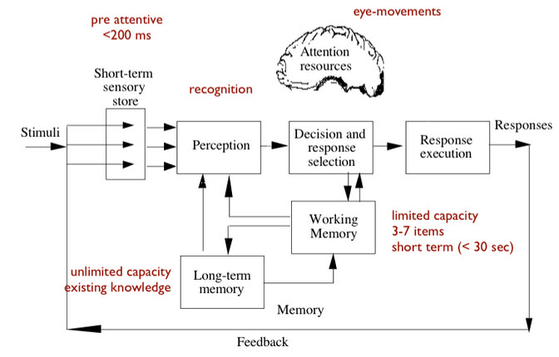
Perception vs. cognition
Another coarse distinction:
Perception: Processing of the signals coming in: what you “see”
Cognition: How you understand and interpret what you see
A nice scientific or textbook diagram
But where is cognition?
Based on slide from G. Grinstein

Slide 7
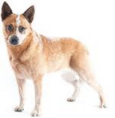
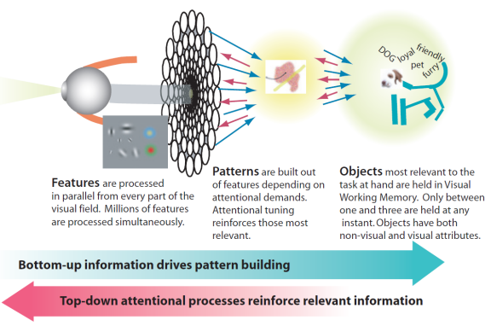
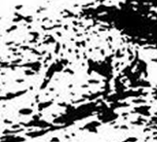
Perception: Bottom-up & Top-down
Bottom-up processing
Low level: features → pattern → object
Detect edges, contours, color, motion
Top-down processing
Driven by goals, expectations
Uses prior knowledge, experience, filters what we “see”
Epistemology
Empiricism
Aristotle
Rationalism
Plato

Slide 8
Perception: Bottom-up
How many 5s in this display?
How many 5s in this display?
Numerals differ only in shape, and are high-level symbols
You have to literally scan them all & count the 5s.
The distinction of color is immediate & pre-attentive
You only have to scan for 5s & count them.
This is why color is an important visual attribute for a categorical variable in graphs

Slide 9
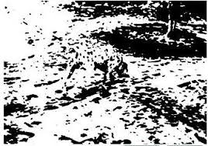
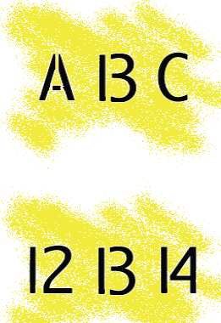
Perception: Top-down
What is in this scene?
What is the middle character?
What here?
An ambiguous figure!
What is the middle letter in each word?
All of these are demonstrations of the role of expectations (top-down) in determining what we “see”
Gregory (’70): perception as constructive, depends on prior knowledge

Slide 10
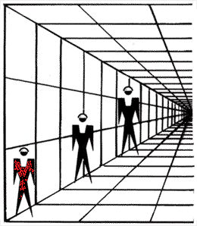
Illusions: The Eye-Brain Barrier
Perceptual illusions give some guidance on what not to do in data graphics

Slide 11
Illusions: Length
Surrounding context matters in judging the length of objects.
Which line is longer? Or are they the same?
A
B
Surrounding context pulls perception of length in its direction
This is the famous Müller-Lyre illusion

Slide 12
Illusions: Area
Surrounding context matters in judging the area of objects.
Which red circle is larger? Or are they the same?
Surrounding context pulls perception of area against the background
This is often called the Ebbinghaus illusion or the Tichener illusion

Slide 13
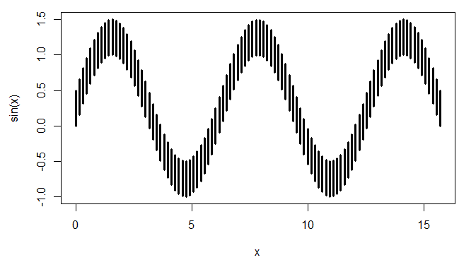
Illusions: Length
Which of the bars are longer? Or, are they all the same length?
R code:
x <- seq(0, 5 * pi, length.out = 100)
w <- 0.5
plot(x, sin(x), ylim = c(-1, 1 + w), type = "n")
segments(x0 = x, y0 = sin(x), y1 = sin(x) + w, lwd = 3)

Slide 14
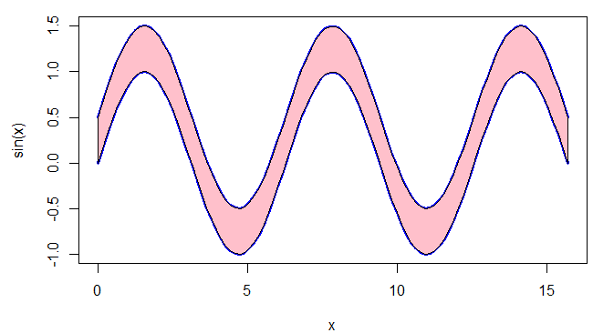
Illusions: Difference
Where are differences between curves are larger? Or, are they all the same?
This is sometimes called the “sine illusion”

Slide 15
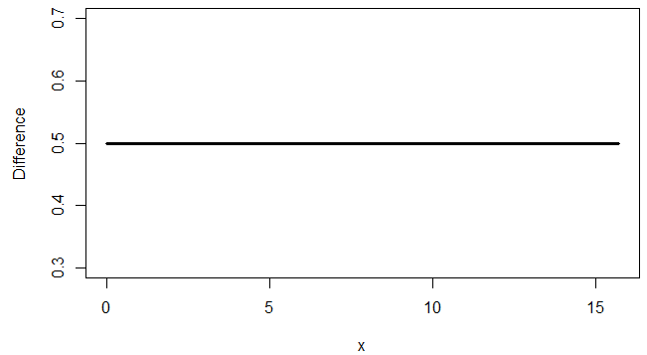
Illusions: Difference
Plotting the difference directly gives the answer.
OMG!
Why does this matter?

Slide 16
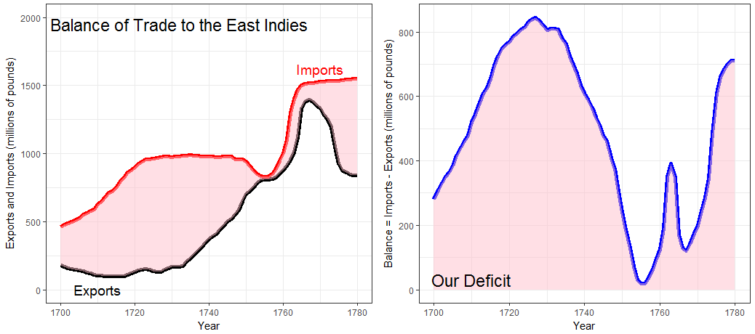
Distances between curves
Playfair didn’t know that judgments of distance between curves are biased
We tend to see the perpendicular distance rather than the vertical distance
Original graph
Plot of difference
where did this spike come from?

Slide 17
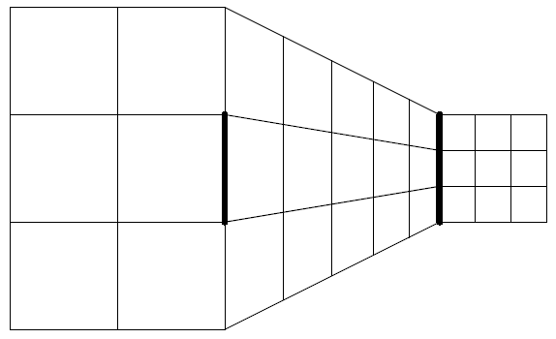
Illusions: Perspective
Which thick line is longer? Or, both the same?
Which figure is tallest?
Or, all the same?
This is often called the Ponzo illusion: We judge the size of real-world objects relative to their background and perspective.

Slide 18
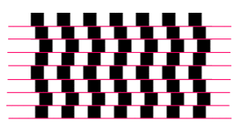
Context illusions: Lines, shapes
Perception of elements of a scene is affected by context, background, etc.
Are the squares straight or tilted?
Are the pink lines straight or curved?
Does the rectangle change in darkness?
It is hard not to be fooled by these!

Slide 19
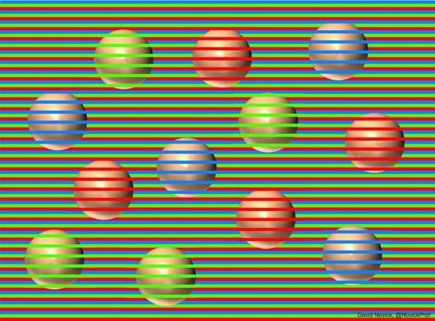
Context illusions: Color
Are the balls different colors or are they all the same color?
https://twitter.com/novickprof/status/1139342022551191553

Slide 20
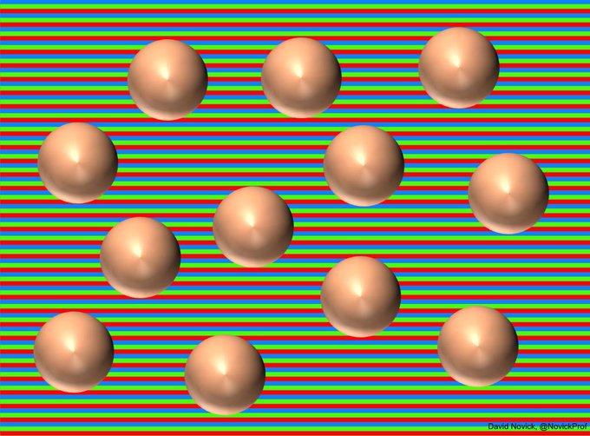
Context illusions: Color
Removing the foreground stripes shows them all the same
(Munker illusion: perception of color is influenced by neighborhood )
More examples: http://engineering.utep.edu/novick/colors/

Slide 21
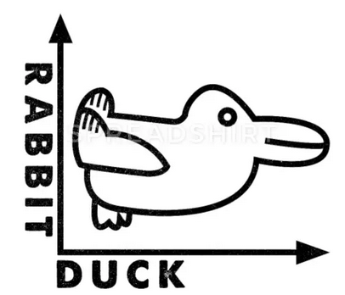
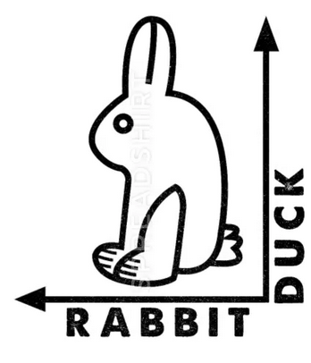
Illusions: Semantic/cognitive
Perception of object figures often shows a preference for orientation in nature
Is this image a duck, or a rabbit? Duck or rabbit?

Slide 22
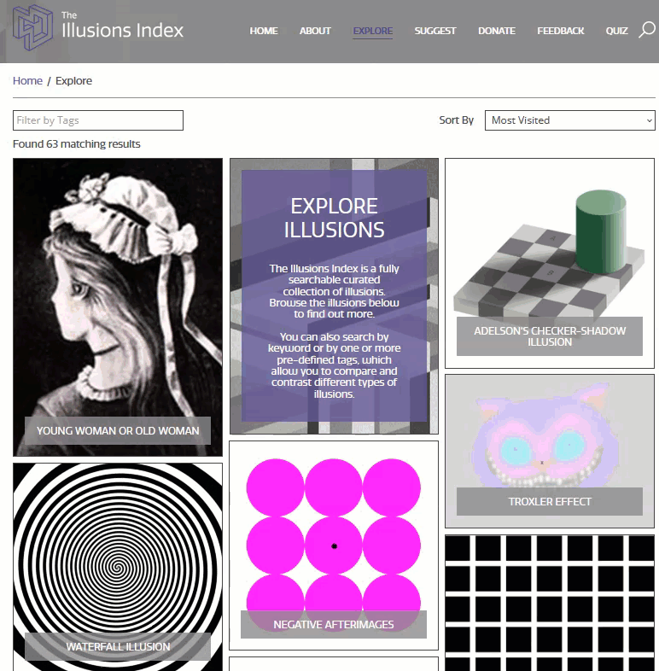
Catalog of visual/auditory illusions
https://www.illusionsindex.org/illusions
A large collection of illusions with references to research studies.

Slide 23
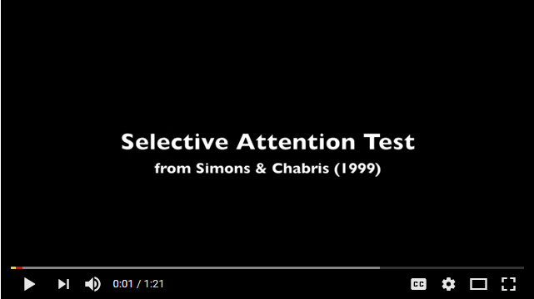
Selective attention
https://www.youtube.com/watch?v=vJG698U2Mvo
Attention strongly focused on some feature(s) steals attention from others

Slide 24
Magnitude estimation
How large are transport accidents?
How much bigger than non-transport accidents?
transport
non-transport
Estimation of length or ratios of length are more accurate than the same judgments of area.

Slide 25
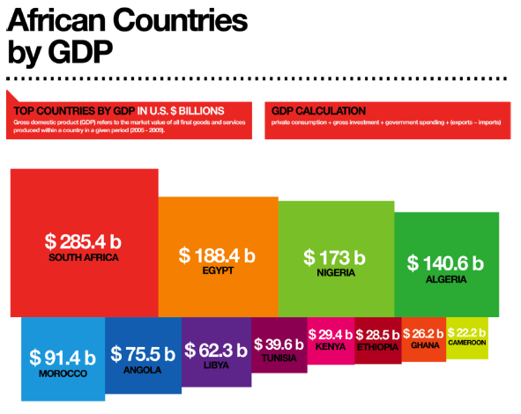
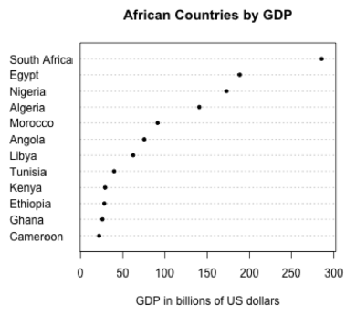
Area vs. length judgments
Easy: Which is larger– South Africa or Egypt?
Harder: How much larger is South Africa than Egypt? (% or ratio)
Judgments here based on area
Judgment here based on position along a scale

Slide 26
Theory: Stevens’ Power Law
How does perceived magnitude of a sensation relate to stimulus intensity?
S. S. Stevens (1957) showed that, for many domains
These provide ways to assess the accuracy of magnitude estimation for visual encodings
length: most accurate (p ≈ 1)
area, depth: sub-sensitive (p <1 )
electric shock: hyper-sensitive (p > 1)
But: graph perception is not always a matter of estimating magnitudes.
Fig. 5.7 from: Munzner, Visualization Analysis & Design

Slide 27
Practice: Scale of accuracy
A commonly used “scale” of accuracy of magnitude judgments of relative size
How much smaller/larger is A compared to B?
Not necessarily the same for other tasks (Part-whole: What % is A of total?)

Slide 28
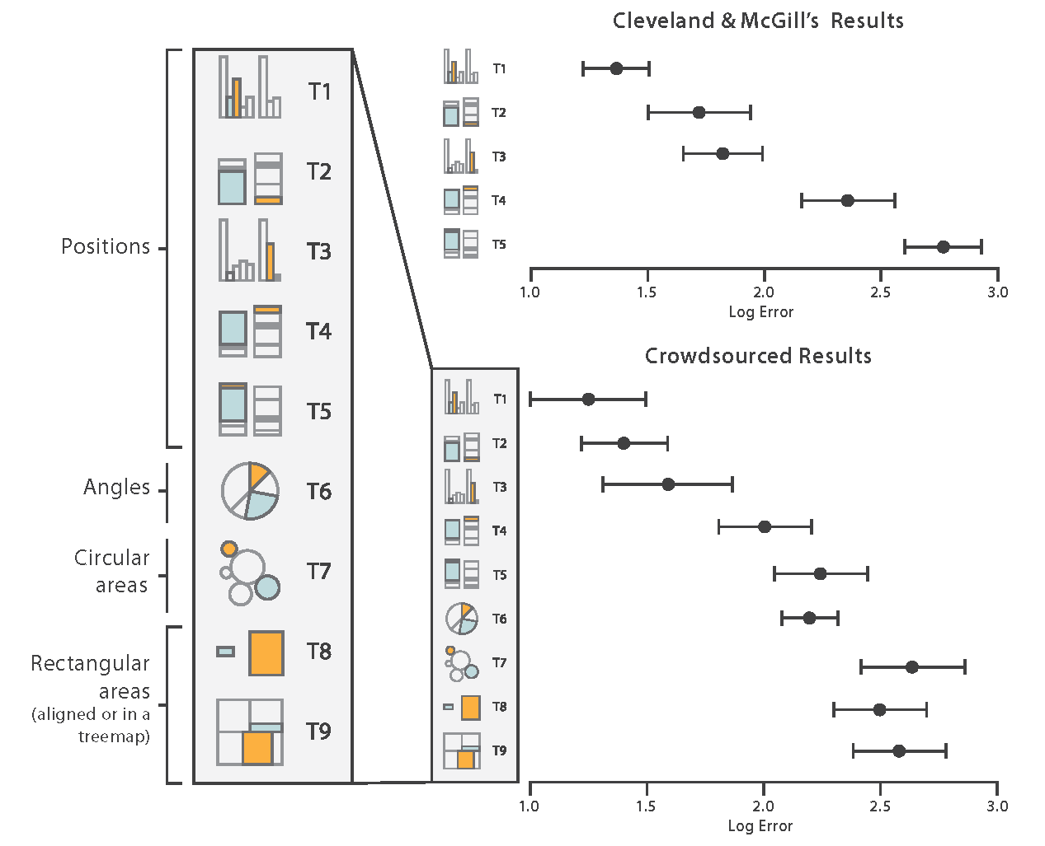
Accuracy: Experimental evidence
Cleveland & McGill (1984) and later Heer & Bostock (2010) carried out experiments to assess the relative accuracy of magnitude judgments for different visual encodings
The task here is to estimate the %age of the smaller highlighted portion.
The details of these studies are interesting & important – more next week
The graph of these results is a great model for data display
Error →
Fig. 5.8 from: Munzner, Visualization Analysis & Design

Slide 29
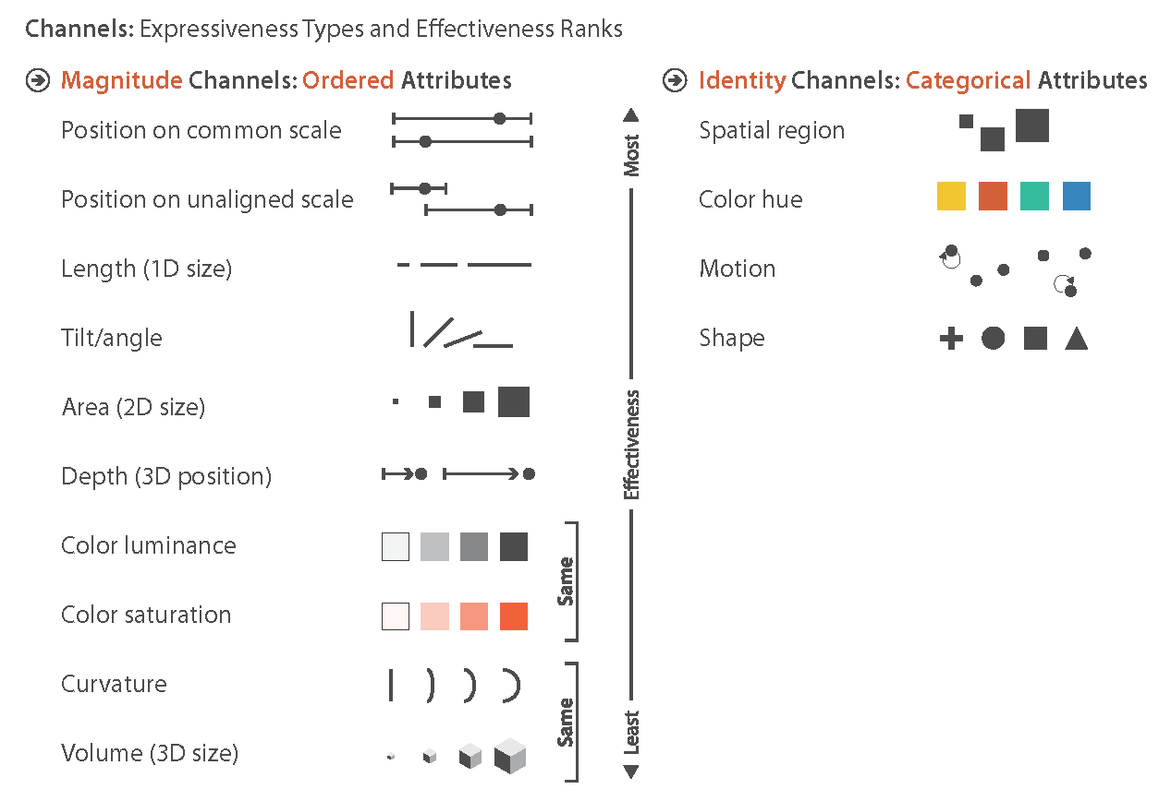
Encodings: Types & ranks
Based on this, Munzner (2015) proposes a ranking of visual attributes for ordered & categorical variables in data displays, with different channels
These hold when the task is to estimate a magnitude.
A different ranking may occur for other graph-based tasks.
angle (pie charts) – good for % of total judgments
color (mosaic plots) – good for pattern perception
Fig. 5.6 from: Munzner, Visualization Analysis & Design

Slide 30
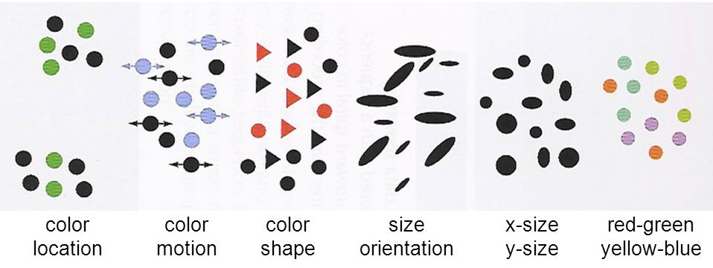
Integral & separable encodings
Some encodings can be viewed independently
two different variables can be decoded separately
Some combine with each other to some degree.
different variables cannot be easily decoded separately
← Separable Integral →
From: Ware, Information visualization: Perception for Design

Slide 31
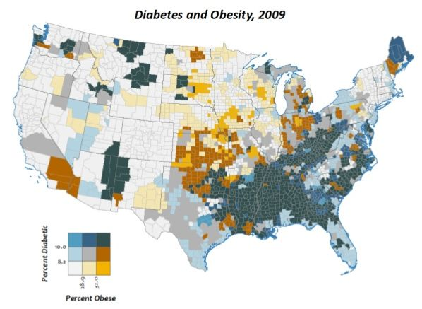
Integral dimensions
A bivariate U.S. county-level map showing:
% diabetic (saturation) and % obese (hue)
It is difficult to see variations in diabetes separately from obesity
The eye is attracted to the positive correlation between these dark (blue, red) vs. light color

Slide 32
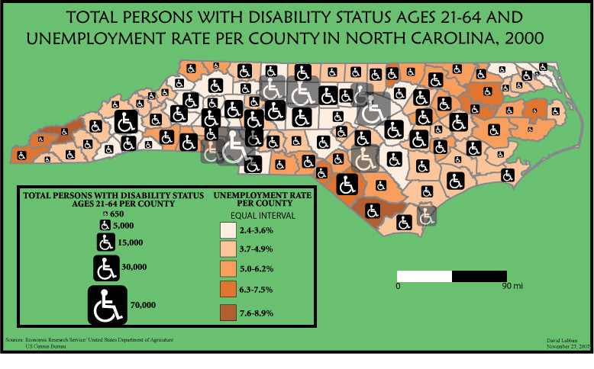
Separable dimensions
Bivariate map of N. C.: disability (size) and unemployment rate (saturation)
These an be seen separately
(However, TOTAL disability is confounded with population density)

Slide 33
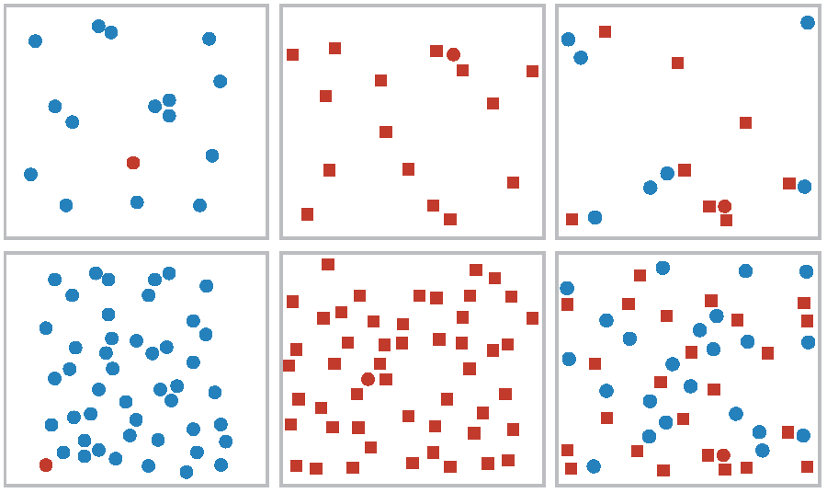
Anomaly detection
Find the red dot in each of the following displays
This task is easiest when all the rest are blue dots
Next easiest when only shape distinguishes the red dot
Hardest when both color and shape vary
Easy
Middle
Hard
Sometimes called “popout” effect.
Not a good term.
This is important in designing graphs to highlight some points.

Slide 34
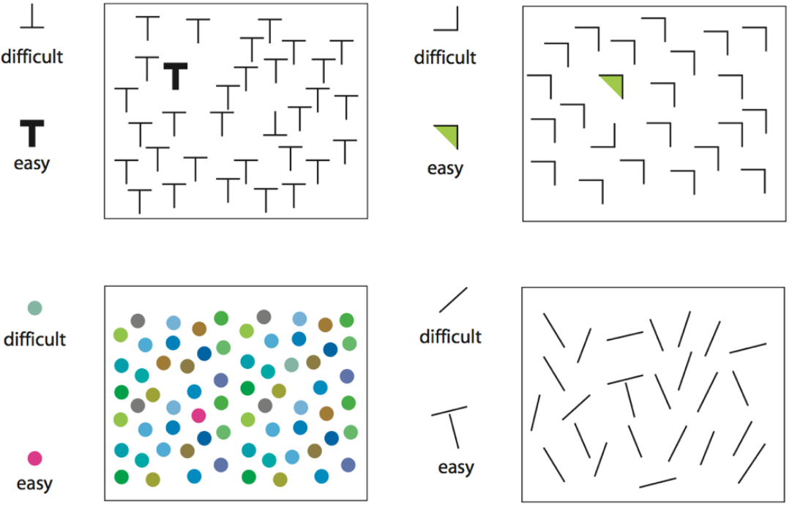
Anomaly detection
For each display, find the anomaly shown at the left
Color and shape: What is easy or hard depends on the background

Slide 35
Encodings: Lessons
Ordered variables
Prefer encodings at the top of the hierarchy (position along a scale) to those at the bottom (color saturation, curvature)
Favor separable encodings
Use color and another attribute--- shape, size, orientation
Don’t overload symbols--- probably two at most
Avoid mixing two aspects of color or two aspects of shape
Small multiples
Reduces the need for multiple encodings within a panel
But, makes direct comparison more difficult
Highlighting: to draw attention to one group, use a pre-attentive attribute

Slide 36
Encodings: Lessons
Best to show quantitative variables with position or length
Bar charts:
Best encoding via length → start at 0
Avoid stacked bars (not aligned), where possible
Dot charts:
Best encoding via position along a scale → start at 0
Frequency data:
area/color encoding to show patterns
sqrt or log scale often useful to show magnitude
Color: choose sensibly ordered hues or saturation
Arrangement
make comparisons easier by placing things to be compared nearby

Slide 37
Gestalt principles of graph perception

Slide 38
Gestalt principles
Perception as top-down process governed by holistic principles. “Gestalt” = “form”
proximity: elements close together likely to belong to the same unit
similarity: more common visual elements increases belonging together
good continuation: elements that blend together are likely in the same unit
common region: elements in the same region likely belong together
closure: elements that make a meaningful whole belong together

Slide 39
Gestalt principles
(a) proximity creates impression of 2 groups
(b) similarity: 3 groups via color & shape
(c) good continuation gives impression of 2 groups
(a)
(b)
(c)

Slide 40
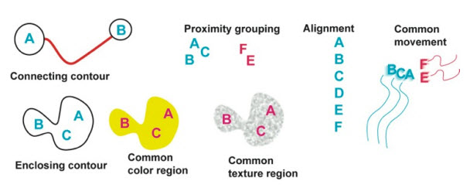
Gestalt principles
More gestalt ideas
From: http://blog.yhwu.me/notes/visualizations/cs171.html
Why lines are good in time series graphs

Slide 41
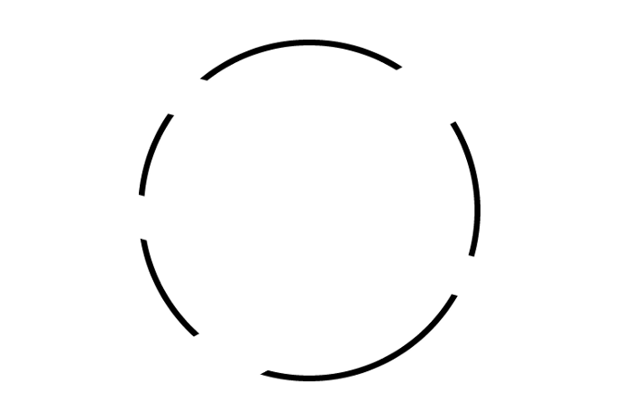
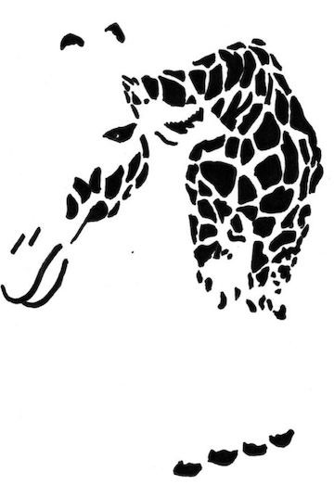
Closure
The Gestalt brain “wants” to make perception simpler by joining up disparate elements into coherent, meaningful wholes
Logos: Empty space or a symbol?
5 arcs or a circle?
blobs or an animal?
Q: Are these top-down or bottom-up?

Slide 42
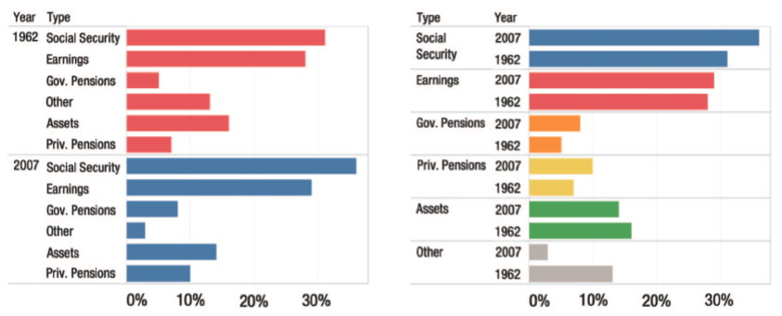
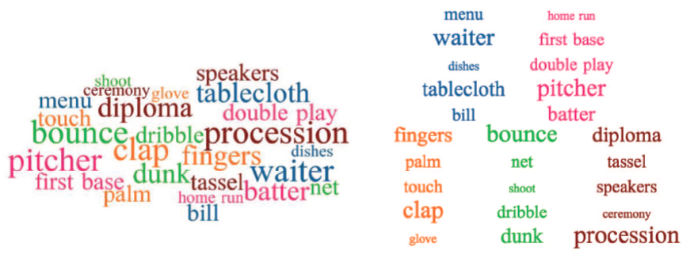
Visual grouping & comparisons
Did earnings increase or decrease from 1962-2007?
Combination of color & proximity grouping → different visual comparisons are easier or harder
What was the most frequent baseball term?
Which terms go together?
Comparisons in a word cloud:
weakly controlled by color;
better controlled by proximity
From: Franconeri etal (2021) Source DOI: 10.1177/15291006211051956.

Slide 43
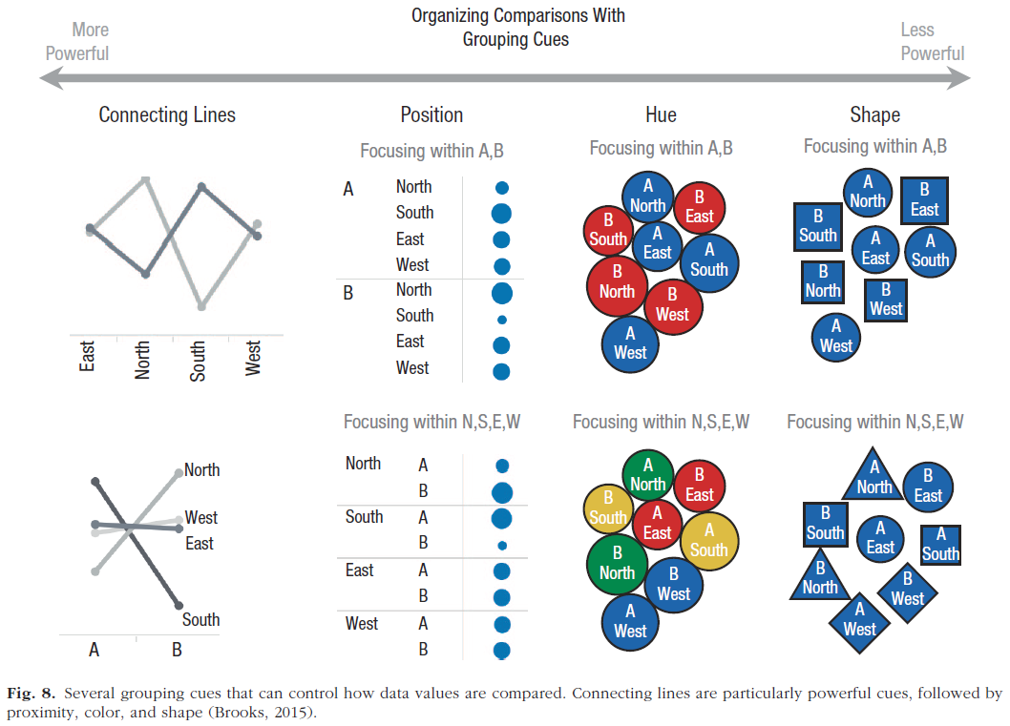
Visual grouping & comparisons

Slide 44
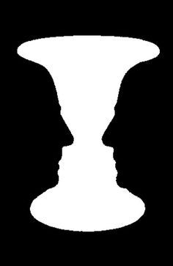
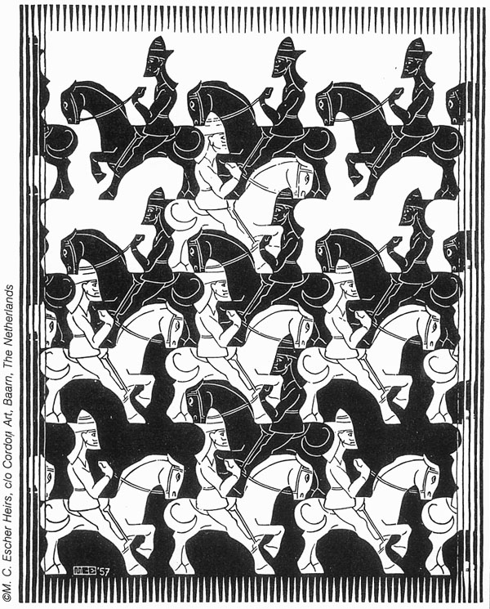
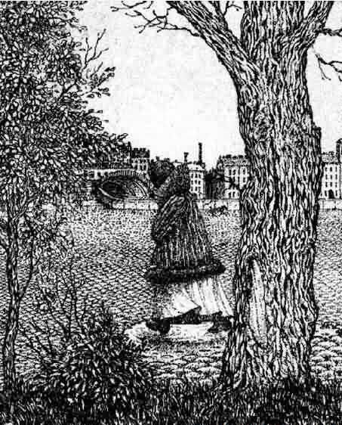
Figure - Ground
What is the figure? What is the background?
Face or vase?
Black or white soldiers?
Face or park?
These examples all use different techniques to create ambiguous figures

Slide 45
Ambiguous figures: Priming
Can you see the poodle in this scene?
What about the man?
Semantic priming: Suggestion increases likelihood of perception

Slide 46
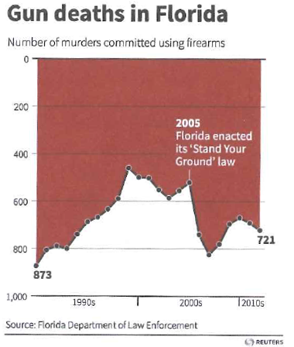
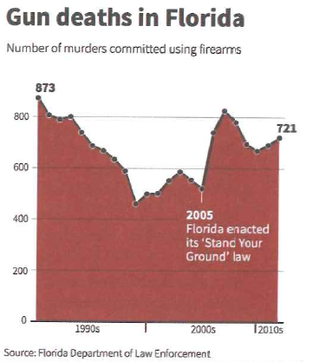
Figure - Ground
This graph inverts the y-axis, and shades the area above the curve
A more conventional version of the same graph
We tend to see 1999 & 2005 as high points
Gun deaths increased after the ‘Stand your ground’ law
From: Andy Kirk, Data Visualization: A Handbook for Data Driven Design

Slide 47
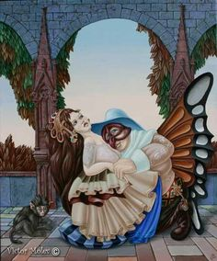
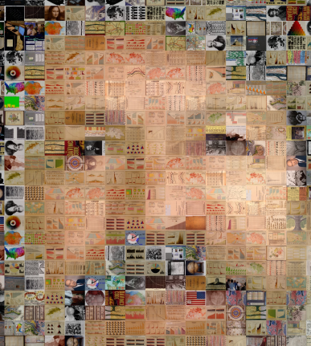
Discussion
What perceptual features or principles are involved in your reading or understanding of these figures?
or this?
or this?
Top-down ?
Bottom-up?
Gestalt?
What about this?

Slide 48
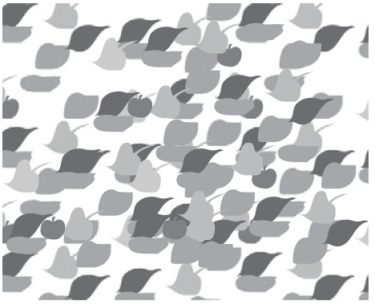
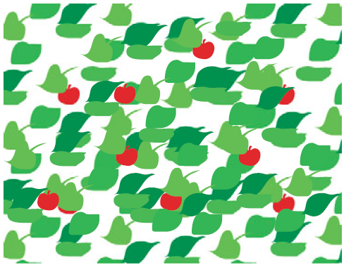
Color: Functions in data graphics
Color serves to: highlight, identify, and group elements in a visual display
Find the cherries in this display:
Color acts as a preattentive attribute here
From: Colin Ware, Information Visualization: Perception for Design

Slide 49
Nice graphic, naïve about color
W.E.B. DuBois presented this as part of an exhibition on The American Negro at the 1900 Paris Exposition.
It is a landmark graphic, but shows no understanding of the use of color for a quantitative variable.
Q: Are there more Negroes per sq. mile in Texas (TX) or Louisiana (LA)?
<1 1-4 4-8 8-15 15-25
TX
LA

Slide 50
Object color
What makes an orange look orange, a green apple look green, or a strawberry red?
Objects absorb colors from the rainbow, but reflect their own
sunlight
sunlight
sunlight
From: Miriah Meyer, lecture notes, cs6330, https://miriah.github.io/teaching/cs6630/

Slide 51
Is this a color photo?

Slide 52
Is this a color photo?
Graphic artist Øyvind Kolås overlaid red, orange, yellow, blue, and green
grid lines over a B/W photo.
The colored grid causes us to perceive it as having smooth color
Color perception is influenced by top-down processes of scene recognition
https://petapixel.com/2019/07/31/this-black-and-white-photo-uses-color-grid-lines-to-trick-your-brain/

Slide 53
Color: Aspects in data graphics
Perception: trichromatic theory
How the eye sees color
Color spaces:
RGB (additive), CMYK (subtractive)
HSV, HCL: perceptually based
Color palettes for computer graphics
ColorBrewer: sequential, diverging, qualitative
Color-blind safe ?
Photocopy safe ?
Transparency

Slide 54
Perception: The human eye
Retina:
rods (monochromatic),
cones (R, G, B)
It is of interest to see the wide variety of ways this is conveyed in scientific diagrams:

Slide 55
Perception: color sensitivity
Cells in the retina are differentially sensitive to colors of different wavelength
Each have a distribution of sensitivity for short, medium & long
Their peaks are used to name them as Blue, Green, Red or Rods
This figure also stimulates questions of scientific visualization
Rods & cones are “normalized”
Are they all equal in what we see?

Slide 56
Perception: color sensitivity
Color sensitivity, shown on three different scales
most sensitive to red
from: http://slideplayer.com/slide/6329532/

Slide 57
Perception: Contrast
Color perception, even of gray, is influenced by contrast against a background
Q: Which gray square at right is most similar to that at the left?
A: it is the same gray square against a changing background
gray square
Most people say A, because it is shown on a light background
A
B
C
D

Slide 58
Luminance contrast
Showing blue text on a black background doesn’t work very well.
There is insufficient luminance contrast.
Showing blue text on a white background works better.
There is sufficient luminance contrast.
Showing yellow text on a white background doesn’t work very well.
There is insufficient luminance contrast.
Showing yellow text on a black background works better.
There is sufficient luminance contrast.
TIP: For presentations, light text on a dark background is often preferred.
I don’t do this, because I’m also concerned with printing slides.
(With LaTeX Beamer, it is easy to have separate setups for presentation & print)

Slide 59
Brightness illusion
Is the white at the center the same brightness as the white at the edges?
Or, is it brighter?
They are the same. We interpret the center as a source of light relative to the surrounding bright yellow.
The illusion also affects pupil size! https://www.pnas.org/content/109/6/2162

Slide 60
Discovery of color
Feb 8, 1672: Isaac Newton reads his Optics paper to the Royal Society of London
“light is not homogeneous,… but rather consists of rays of different forms”

Slide 61
Early color theory
Tobias Mayer (1755) – color theory composed of (blue, red, yellow) as basic colors
Johannes Lambert (1772) – A color pyramid, composed of 7 layers
Introduces the idea of color “primaries”
Introduces the idea of color saturation

Slide 62
Color space: Munsell colors
Color space is 3D
How to specify a given color in perceptual terms?
Albert Munsell (~1930): hue, chroma, lightness (HCL)
These form perceptually uniform & independent dimensions
By SharkD - CC BY-SA 3.0, https://commons.wikimedia.org/w/index.php?curid=8401562

Slide 63
Munsell’s color scheme was highly influential in Psychology research
Nearly every lab investigating color used standard sets of Munsell color chips

Slide 64
CIE color space
How do we know about the perceptual properties of colors, taking spectral sensitivity into account?
Experiments used a color-matching task:
Adjust the intensity of pure R, G, B lights to match a given color
This defines a new color theory connecting physical properties and human perception (spectral sensitivity).
The CIE (International Commission on Illumination) becomes the standard to calibrate color in scientific instruments and human experiments

Slide 65
CIE color space
The International Commission on Illumination (CIE) in 1931 defines a color space of (x,y,z) coordinates based on color-matching experiments combining R, G, B light sources in additive mixtures, and a “standard colorimetric observer”
This defines a new color theory connecting physical properties and human perception (spectral sensitivity).
There are eventually a variety of CIE color spaces (CIElab, CIEluv, …) and lots of formulas for converting among them.

Slide 66
Color space: RGB & CMYK
Enter technology: how to produce color?
RGB:
Combine light: R + G + B = white
Used in computer monitors, TV, film
CMYK:
Combine ink: Cyan + Magenta + Yellow = Black
Used in color laser printers, the print industry
Caution: R, SAS, SPSS use RGB by default
TIP: for publishing, you may need to convert graphics from RGB to CMYK.
Some software offer useful tools for this:
Adobe Acrobat Pro
ImageMagik

Slide 67
Color space: RGB & CMYK
The standard gamut of colors available for different display media are a restricted subset of what the human eye can see.
Print (CMYK) is most restricted, and requires a more careful choice of color in graphics
Always check the display on different media.

Slide 68
Color in DataViz Design
There are several commonsense rules & guidelines for use of color in statistical graphics, maps & info vis
From: Alicja Gosiewska, Data Visualization Techniques, https://bit.ly/3RZWw0t

Slide 69
Software: Color specification
Color is often hard to use effectively in software, because the ways to specify it are so varied:
Color names: “black”, “red”, “green3”, “skyblue“, “cyan”
RGB: black=(0,0,0); green3=(0, 205, 0), cyan=(0, 255, 255)
Hex: black=“#000000”; cyan=“#00FFFF”
See: http://research.stowers.org/mcm/efg/R/Color/Chart/ for R color charts

Slide 70
Software: Color specification
WTF! Give me a break, please:
Make it easier to compute with colors: define blends of colors or a color ramp
Make it easier to specify color schemes with decent perceptual properties
Make it easier to map colors to data features I want to show
Every time you are forced to say “#008B8B” or “cyan4” a puppy dies somewhere
-- MF, 2018

Slide 71
Software: palettes
R (and other software) provide palettes of colors used for defaults in graphs
Not all are nice– depends on your purpose
But, there are lot of choices – maybe too many!
You can change them once for all graphs in a session or paper
> (pal <-palette())
[1] "black" "red" "green3" "blue" "cyan" "magenta" "yellow" "gray"
> pie(rep(1, length(pal)), labels = sprintf("%d (%s)", seq_along(pal), pal), col = pal)
palette(rainbow(8)); pie(…)

Slide 72
R: basic palettes
n <- 12
pie(rep(1, n), col=rainbow(n))
pie(rep(1, n), col=heat.colors(n))
hot
cold
pie(rep(1, n), col=terrain.colors(n))
pie(rep(1, n), col=topo.colors(n))
low
high

Slide 73
R: basic palettes
rainbow
heat
Discussion Q:
Which of these seem better for quantitative variables?
Which for categorical?
These are shown for area fill. How effective would they be for:
point colors
line colors
E.g., yellow is bright as an area, but nearly invisible as points (•) or lines ( ) or text on a white background
terrain
topo

Slide 74
palettes: ColorBrewer
ColorBrewer, by Cynthia Brewer provides an interactive application for choosing color pallets, http://colorbrewer2.org
This is one example of a multi-hue scheme for a quantitative, sequential variable, shown from low to high with 4 color classes
variable type
choose different versions of the scheme
export color specs
to HEX, RGB, CMYK
This example: http://colorbrewer2.org/#type=sequential&scheme=BuGn&n=4

Slide 75
palettes: ColorBrewer
Diverging schemes are designed to show a quantitative variable, where we want to see what is low vs. what is high, leaving the middle of less visual impact – difference from average, residuals, …
there are different schemes within this rubric
there are tools to filter for colorblind, print & B/W
Warnings when not friendly
This example: http://colorbrewer2.org/#type=diverging&scheme=RdBu&n=5

Slide 76
palettes: ColorBrewer
Qualitative schemes are designed to show a categorical variable, where we want to see differences among unordered categories
choose # classes
various schemes
see other context
add transparency
These are all available in the RColorBrewer package
This example: http://colorbrewer2.org/#type=qualitative&scheme=Accent&n=5

Slide 77
palettes: RColorBrewer
RColorBrewer::display.brewer.all()
sequential
qualitative
diverging

Slide 78
R: choose_palette()
The colorspace package in R has an interactive palette widget.
It also provides functions for many kinds of color manipulations.
The R Color cheatsheet, by Malcolm Fraser is a goto source for all aspects of color in R:
https://www.nceas.ucsb.edu/~frazier/RSpatialGuides/colorPaletteCheatsheet.pdf

Slide 79
Viridis palettes
Designed by Stéfan van der Walt and Nathaniel Smith for Python; ported to R in the viridis package.
Goals:
Colorful, spanning as wide a palette as possible so as to make differences easy to see
Perceptually uniform: values close to each other have similar-appearing colors and values far away from each other have more different-appearing colors
Robust to colorblindness: these properties hold true for people with common forms of colorblindness, as well as in grey scale printing
Pretty: much nicer as a defaults in software
These assertions are largely untested. Perhaps a good research topic!

Slide 80
Comparing quantitative palettes
For a quantitative variable and a continuous color scale, there are many choices.
How well do they work?
✗
R base palettes
✗
✗
ggplot default palette
✓
ColorBrewer palettes
?
✓
viridis palettes
?
This is a bit tricky: ideally, we want a wide range of color

Slide 81
Comparing palettes
What is shown in this map?
Now we can see it– elevation in the Florida coast: above or below 0
The rainbow color scale obscures the main features
This color scheme was designed to reveal the essential topography of the map & to have perceptually equal elevation steps
From: http://www.research.ibm.com/people/l/lloydt/color/color.HTM

Slide 82
Comparing palettes
ggplot default palette
viridis default palette
df <- data.frame(x = rnorm(10000), y = rnorm(10000))
g <- ggplot(df, aes(x = x, y = y)) +
geom_hex(bins=40) + coord_fixed() + theme_bw()
g
library(viridis)
g + scale_fill_viridis()

Slide 83
WEB Du Bois’ sense of color
Goal: Show Negro population of counties in Georgia from 1870 to 1880 & change
Which counties had largest Negro pop?
Which had lowest?
Where was the change greatest? (HARD: need to plot the diff^{ce}

Slide 84
RColorBrewer to the rescue

Slide 85
Metbrewer palettes
Artistic palettes inspired by works at the Metropolitan Museum of Art in New York
Cypresses, 1889, Vincent van Gogh
Cap Nègre, 1909, Henri-Edmond Cross

Slide 86
Color → B/W ?
Graphics designed in color often must consider what happens when graphs are reproduced in B/W: grayscale
This is particularly hard for a diverging color scale
My original design for mosaic plots used solid vs. dashed lines to distinguish + vs. -
mosaic(haireye, labeling=labeling_residuals, gp=shading_Friendly)

Slide 87
Color → B/W ?
The design of this graphic table was crafted to preserve readability if printed in B/W.
NB: text for numbers changes from black to white depending on background color.
Background shading works equally well in color or B/W
A+ for visual design!
Source: Friendly, A. R. (2017). Land Value Capture and Social Benefits: Toronto and São Paulo Compared. IMFG Papers on Municipal Finance and Governance, No 33, University of Toronto, https://munkschool.utoronto.ca/imfg/

Slide 88
Colorblindness
Most common forms are genetic, and involve a deficiency in one of the cone type sensitivities
Protanopia (red deficient)
Deuteranopia (green deficient)
Tritanopia (blue deficient)
Some form of red-green insensitivity is most common
about 6-8% of population
more common in males
TIP: Avoid color scales with main variation between red & green

Slide 89
Colorblindness
What an image looks like with various forms of color deficiency
Red-green colorblindness: -R (protan) ≈ -G (deuteran)

Slide 90
Goal: Show employment growth, 2013—2015
Original design, using
green: above average
red: below average
How this looks to someone with red-green colorblindness
red & green become indistinguishable
From: http://www.mena-forum.com/category/u-s-a/

Slide 91
colorblindr package
myfig
What would my graph look like to someone with color deficiency?
colorblindr simulates a graph under various conditions
library(colorblindr)
cvd_grid(myfig)
NB: The default ggplot colors aren’t colorblind or B/W friendly

Slide 92
See: http://colorspace.r-forge.r-project.org/

Slide 93
colorspace: palette visualization
swatchplot(): display collections of palettes in flexible ways
Effect of varying hue, chroma and luminance individually
swatchplot(
"Hue" = sequential_hcl(5, h = c(0, 300), c = c(60, 60), l = 65),
"Chroma" = sequential_hcl(5, h = 0, c = c(100, 0), l = 65, rev = TRUE, power = 1),
"Luminance" = sequential_hcl(5, h = 260, c = c(25, 25), l = c(25, 90), rev = TRUE, power = 1),
off = 0
)
Emulate different types of color vision deficiency for one or more palettes
swatchplot(palette.colors(), cvd = TRUE)

Slide 94
colorspace: demoplot()
demoplot(sequential_hcl(5, “Heat”))
See how color palettes work in different kinds of statistical displays

Slide 95
Color Buddy
McNutt etal (2024) Mixing Linters with GUIs: A Color Palette Design Probe
→ Color Buddy Application for color palette editing, with usability testing
Palette is evaluated along a set of criteria
test scatterplot
Choose color palette
McNutt etal. https://arxiv.org/abs/2407.21285
Color Buddy App: https://color-buddy.netlify.app/

Slide 96
Color: Lessons
Use colors to represent differences in meaning
Avoid gratuitous use of multiple colors
Use consistent color scheme across multiple graphs of the same data (set your palette())
Consider presentation goal:
Highlight one subset against the rest?
Group a categorical variable
Encode a quantitative variable
Consider differences in color perception, B/W printing

Slide 97
Color: Lessons
Consider encoding scheme:
Categorical: Use a wide range of hues, of ~ same saturation
Sequential: use a small range of hues of varying intensity
Diverging: Use two sequential schemes, decreasing toward the middle
Images from: Stephen Few, http://www.perceptualedge.com/articles/visual_business_intelligence/rules_for_using_color.pdf

Slide 98
Transparency
Colors can be made partially transparent, by adding an “alpha” channel,
0 ≤ α ≤ 1 (opaque)
Filled areas combine to look more saturated
What do you see here?
Increasing polarization of votes in the US House
This also works well with filled point symbols, which would otherwise be obscured when they overlap
Different colors “blend”
What do you see here?
Reading level of US State of the Union Addresses

Slide 99
Transparency: Adding another layer
Transparency also works well to combine different graphical features in a plot
Here, a filled boxplot and dots representing individual observations
What number would you assign to the following phrases?
From: https://github.com/zonination/perceptions

Slide 100
Summary
In designing data graphics, consider the viewer
Info → encoding → image → decoding → understanding
Perception: much is known, with ~ links to graphics
↑ Bottom up: perceptual features, what grabs attention
↓ Top down: expectations provide a context
Encoding attributes must consider what is to be seen
Color: What is the presentation goal?
Color palettes for different purposes
Transparency increases the effective use of color

