Slide 1
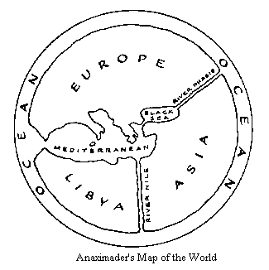
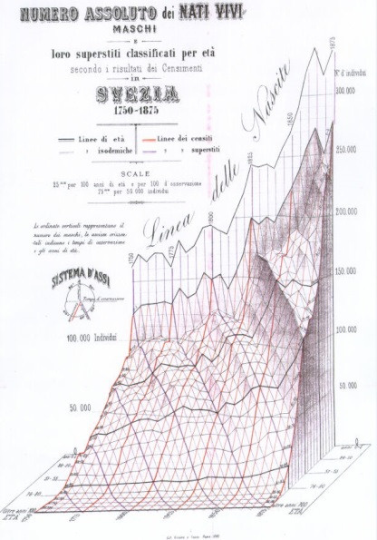
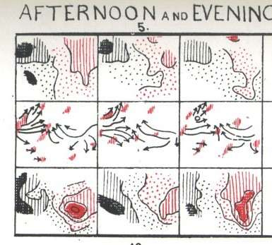
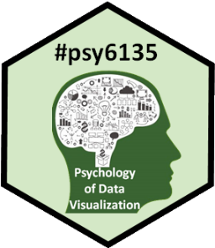
History of Data Visualization
Galton (1863)
Michael Friendly
Psych 6135
https://friendly.github.io/6135

Slide 2
Outline
Overview:
Roles of graphics in scientific discovery
Visualizing history: The Milestones Project
Milestones tour of the history of data vis
Pre-history of visualization
The first statistical graph
The Big Bang: William Playfair
Influence of data, technology & visual thinking
Other topics (later):
Moral statistics: the birth of social science
Graphs in the public interest: Nightingale, Farr and Snow
The Golden Age of statistical graphics

Slide 3
Orienting questions
What motivated graphical inventions?
What was the communication goal?
How does it relate to other developments?
What were the pre-cursors?
How has this idea been used or re-invented today?
History in context
Notes:
Many historical graphs are objects of beauty.
But to understand their role and impact, we must see history in context.

Slide 4
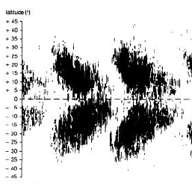
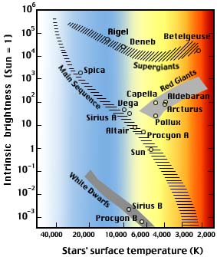
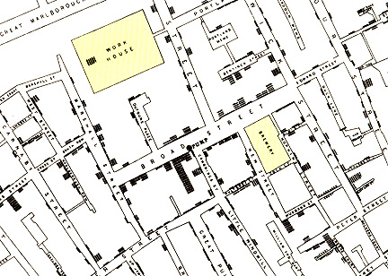
Orienting Q: Visualization-based discoveries ??
When have graphics led to discoveries that might not have been achieved otherwise?
Snow (1854): cholera as a water-borne disease
Galton (1883): anti-cyclonic weather patterns
E.W. Maunder (1904): 11-year sunspot cycle
Hertzsprung/Russell (1911): spectral classes of stars
Snow (1854)
Galton (1863)
Maunder (1904)
H/R (1911)
Notes:
I’d like to frame this talk in terms of the relationship between Data and scientific questions in the history of data vis.
I’ll begin with a meta-Question …
… there are quite a few candidates, but I just show a few …

Slide 5
Orienting Q: Visualization-based discoveries ??
In the history of graphs, what features, and data led to such discoveries?
What were they thinking??
What visual ideas/representations were available?
What was needed to see/understand something new?
As we go forward, are there any lessons?
What are the Big Questions for today?
How can data visualization help?
Notes:
This leads to a few other meta questions …

Slide 6
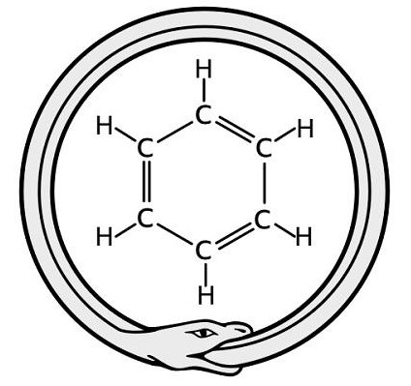
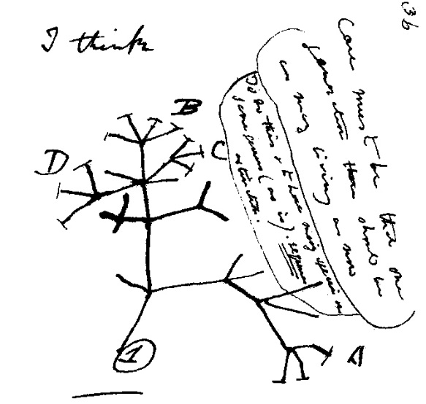
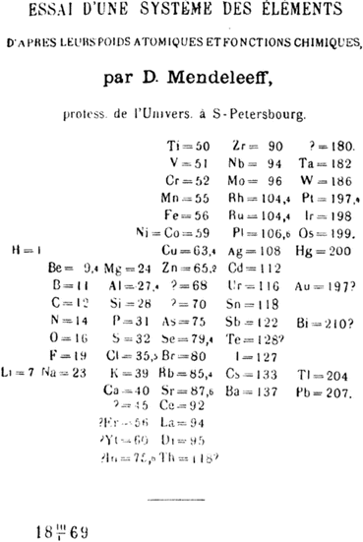
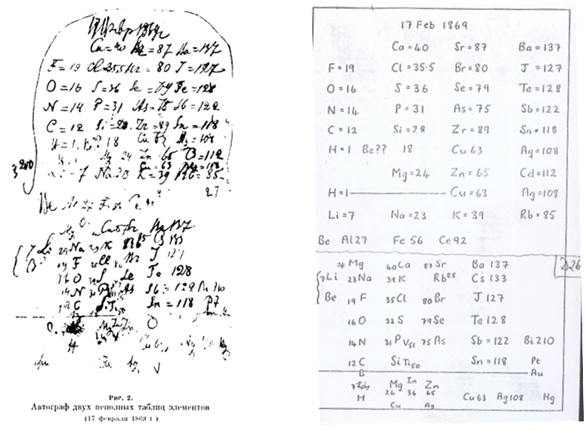
Visual thinking & scientific discovery
Dreams and snakes
August Kekulé (1862) discovers the structure of benzene in a dream
Tree of evolution
Darwin (1859) imagines generations of species – “I think”
Solitaire and the periodic table
Mendeleev (1869) organized chemical elements after a mental image of cards on a table.
See: https://medium.com/@michael.friendly/visual-thinking-graphic-discoveries-128468677592
Notes:
One can find many examples where scientific discovery was directly attributable to a cognitive ability --- visual thinking

Slide 7
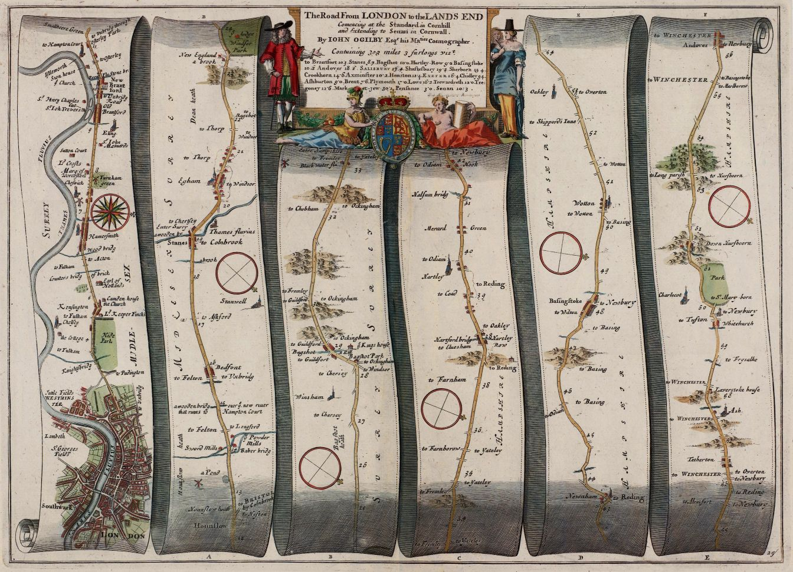
How to visualize travel? A route map!
In 1675, chartmaker John Ogliby told a graphic story of what you would see on a travel from London to Land’s End
What was he thinking?
Image: https://commons.wikimedia.org/wiki/File:Ogilby_-_The_Road_From_LONDON_to_the_LANDS_END_(1675).jpg
Notes:
A final self-referential meta Q: how can we visualize the history of data vis?
What are the salient events?
Some guidance comes from a graphic portrayal of travel by John Ogilvy

Slide 8
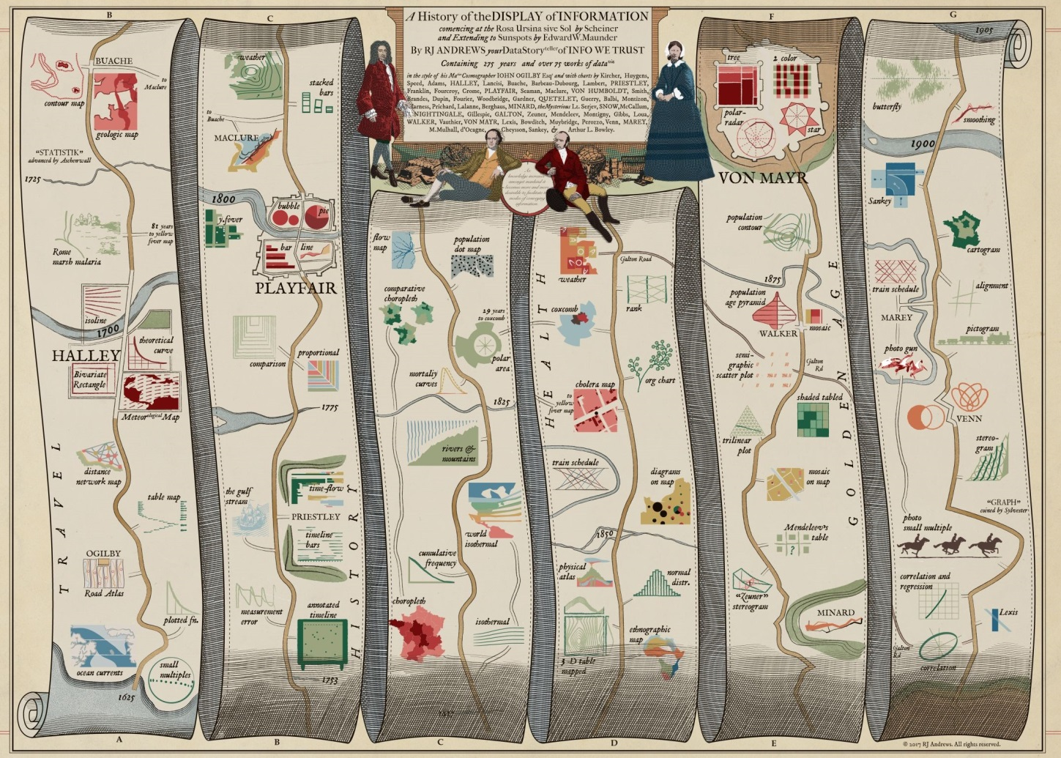
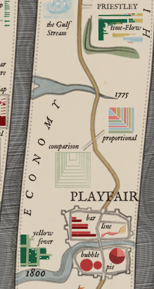
How to visualize history? A route map!
In 2017, RJ Andrews adapts Ogilvie’s form show the history of data visualization.
The online version, https://history.infowetrust.com/ is fully interactive, with details about the images on this journey.

Slide 9
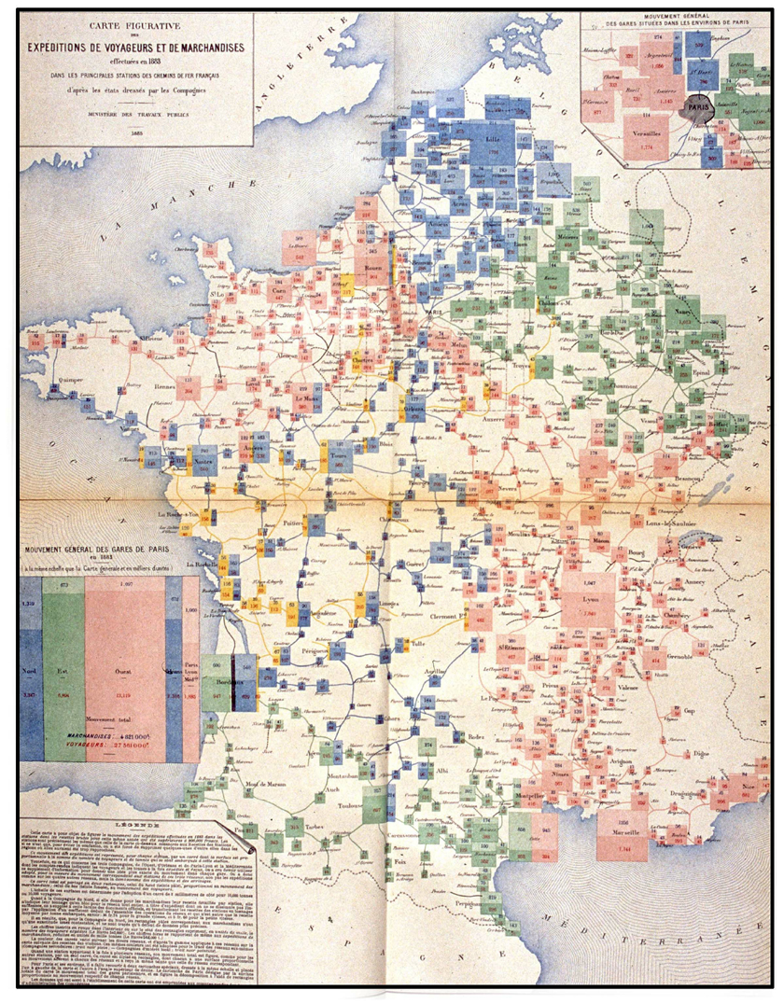
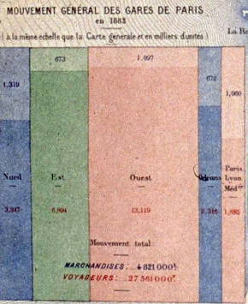
Why study history of #datavis?
Those who don’t know history are doomed to plagiarize it.
Recursive mosaic: Distribution of passengers and goods from the Paris railways to the rest of France [Album, 1884, pl. 11]
Notes:
Why should we be interested in the history of data visualization?
As a developer, I thought I had largely invented the mosaic display, at least in its’ statistical application – but those who don’t know history are doomed to plagiarize it!
I was totally floored when, in 1995, Antoine de Falguerolles showed me this amazing plate from the ASG 1884 volume.

Slide 10
Quest for the Albums
British library, BNF, Library of Congress: just a few copies
Richard Langdon, U of T Fisher Rare Book Library: check out this bookshop, 3 rue des Beaux Arts, Paris
A complete set: all albums 1879 – 1899!
Les Chevaliers
Collective purchase, owned by all, each held “in trust” by one member
“chevaliers”: Foster a spirit of collegial study of history of data visualization & thematic cartography
Conference sessions: RC33 (Cologne, 2000), GFKL (Dortmund, 2004), JSM (Toronto, 2004), …
Regular “Chevalier Lunch”
Notes:
From this encounter, I began a search for the Albums…

Slide 11
Les Chevaliers des Albums
Antoine de Falguerolles
Gilles Palsky
Antony Unwin
Ian Spence
Howard Wainer
Michael Greenacre
RJ Andrews
Sandra Rendgen
Stephen Stigler
David Rumsey
Notes:
The original group of Chevaliers included Antoine, Gilles Palsky, Antony Unwin, …
Since then, we’ve invited others to join, in recognition of their interest in the collective inquiry into the history of data visualization.
Antoine de Falguerolles passed away this summer. My title and theme for today is partly in his honor, but also to recognize the good fortune I’ve had in working with this group.

Slide 12
The Milestones Project
The web site: http://datavis.ca/milestones has an interactive timeline, allowing different kinds of search
Notes:
But I also have a passionate interest in the history of this field. Towards this end, over 20 years ago, I created what I call the “Milestones Project,” designed to document all the key developments in this history.

Slide 13
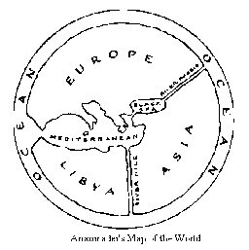
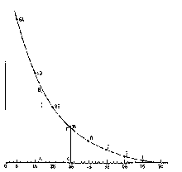
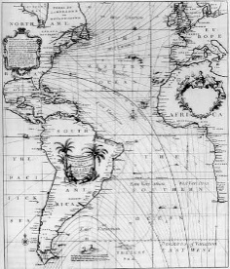
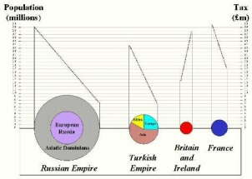
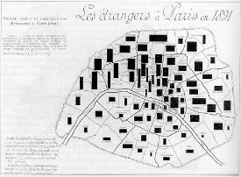
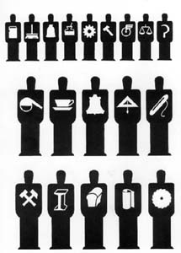
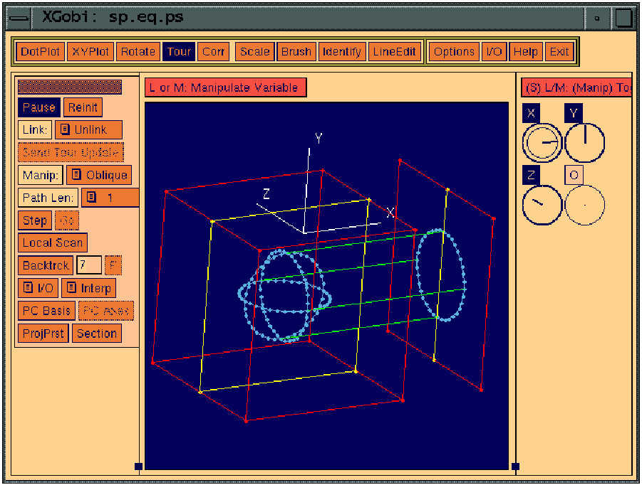
Milestones: Content Overview
Every picture has a story – Rod Stewart
c. 550 BC: The first world map? (Anaximander of Miletus)
1669: First graph of a continuous distribution function (Gaunt's life table)– Christiaan Huygens.
1801: Pie chart, circle graph - William Playfair
1701: First contour map- Edmund Halley
1924: ISOTYPE- Otto Neurath
1991-1996: Interactive data visualization systems (Xgobi, ViSta)
1896: Bivariate map- Jacques Bertillon
Notes:
Some representative images from the Milestones Project. Every one has a story: What was the communication goal? What makes it a milestone?
How does it relate to other developments?

Slide 14
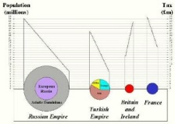
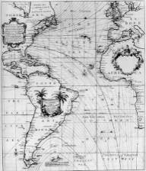
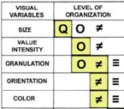
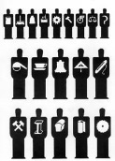
Milestones Tour: Epochs
Golden Age of Graphics
Modern graphics
High-D data vis
New graphic forms
Re-birth
Modern Dark Ages
Measurement & Theory
Early maps & diagrams
Notes:
In organizing this material, it was useful to divide history into epochs, each of which turned out to be describable by coherent themes and labels.
I’ll present only a few exemplars of each.

Slide 15
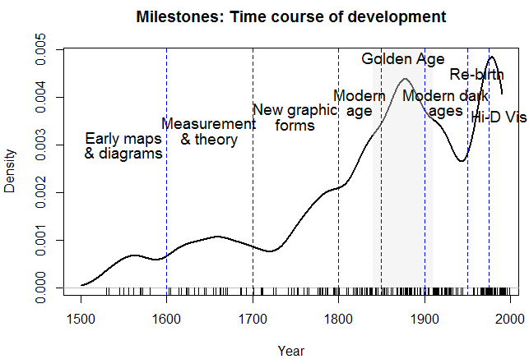
Statistical historiography
Historical information, suitably organized can be treated as data, and analyzed.
This plot shows a smoothed frequency distribution of 248 milestones items over time, in relation to the named time periods.
smooth
events

Slide 16
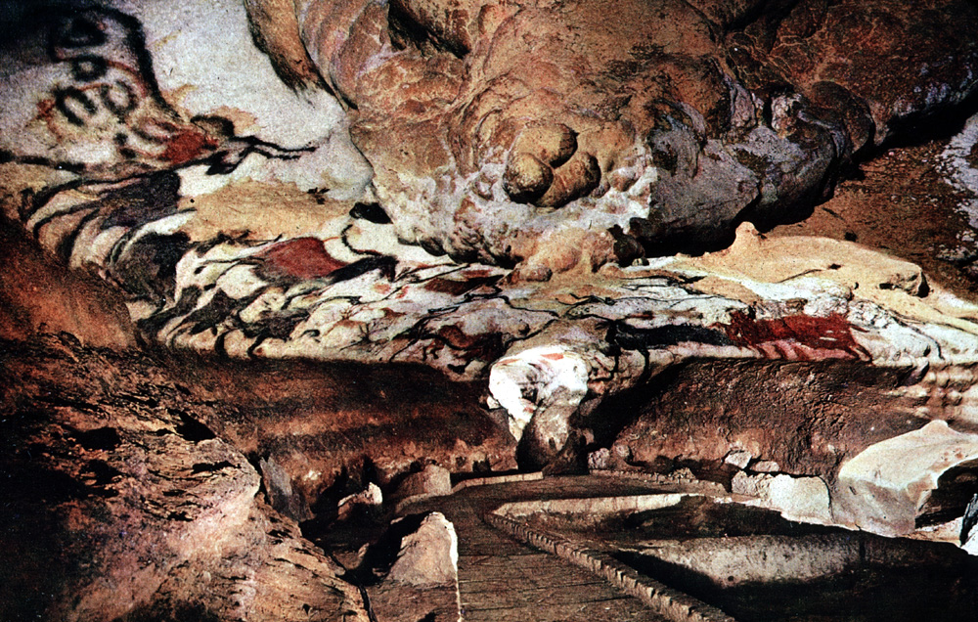
Prehistory of visualization
Lascaux Cave, ~ 15000 BCE, the “Sistine Chapel of pre-historic art”
Lascaux II, Main chamber
Notes:
To put visualization in a wider context, I’ll begin with some of the earliest examples.
Best known early examples of visualization: Lascaux cave, near Montignac, France
Nearly 2000 remarkable drawings, by the oldest modern humans, Cro-Magnon Man
Breathtakingly beautiful – sense of awe

Slide 17
Lascaux: What were they thinking?
Lascaux II, Chamber of the Bulls
Visual features:
show perspective, a sense of motion, rich use of color & texture
What was the purpose?
Hunting success? NO (they hunted reindeer)
mostly symbolic – visual language, story of communal myths
How to understand them?
A cognitive revolution: evidence for the modern human mind in Cro Magnon man
inner vision, visual thinking, mental imagery– a gleam in the mind’s eye
Other cave art [20000BC – 10000BC]: Altamira (Spain); Chauvet (France), Cueva de las Manos (Argentina), …
Notes:
The drawings in the Lascaux Caves are not unique: Altamira in Spain, Rouffignac, Chauvet caves in France,

Slide 18
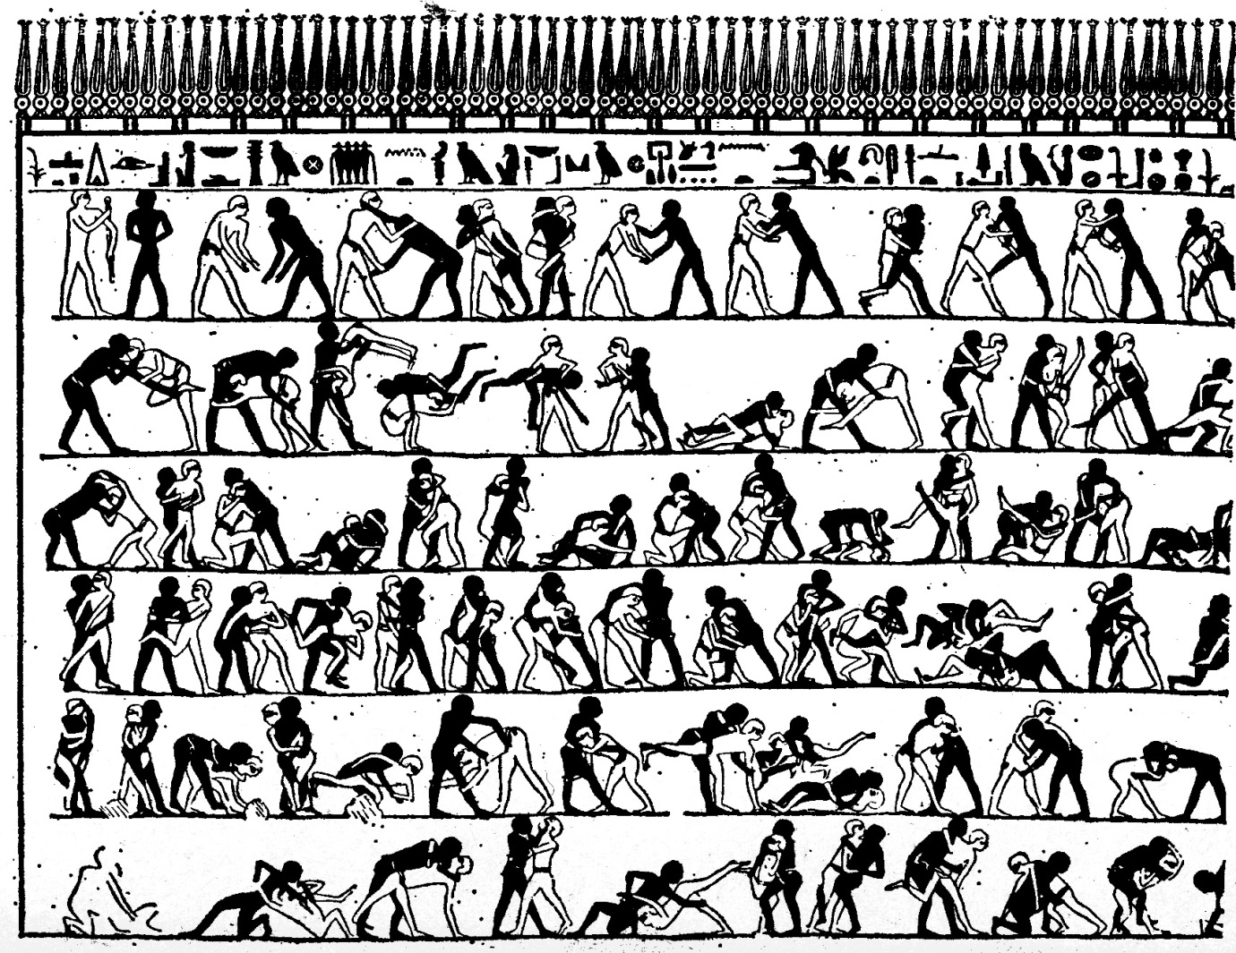
Prehistory: Diagrams, graphic stories
Early Egyptian animated graphic diagram
Wrestling scene on east wall, tomb of Baqt at Beni Hasan (ca. 2000 BCE).
A visual explanation of a wrestling match
Anticipates modern graphic novels
Why? Perhaps Baqt’s last lesson as a wrestler in his youth and later as a coach
Notes:
The next developments in visualization were diagrams and early maps--- pictorial, yet abstract, representations of information.
One of the most spectacular is this diagram of a wrestling match found on an Egyptian tomb.
Baqt or Baquet III was an Egyptian official …

Slide 19
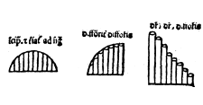
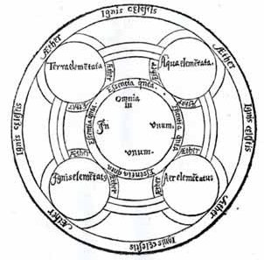
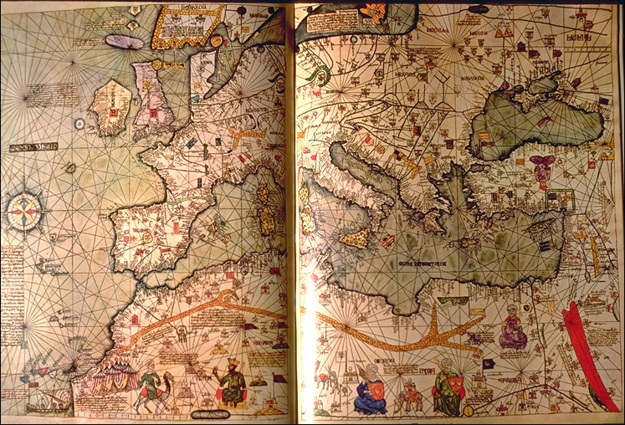
Pre 17th C.: Early maps & diagrams
c. 550 BC: The first world map? (Anaximander of Miletus)
1350: Bar graph of theoretical function N. Oresme, France
1305: Mechanical diagram of knowledge- Ramon Llull, Spain
1375: Catalan Atlas, an exquisitely beautiful visual cosmography, perpetual calendar, and thematic representation of the known world- Abraham Cresques, Spain
Notes:
The earliest seeds of data visualization arose in maps to aid navigation and exploration, and in rudimentary diagrams and tables.

Slide 20
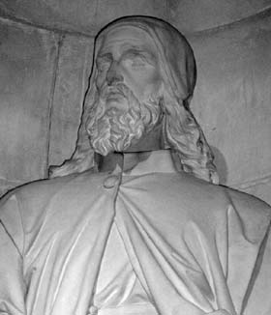
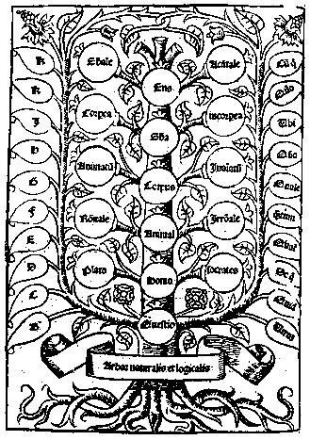
1305: Mechanical diagram of knowledge- Ramon Llull, Spain
Ars Magna → inspiration for symbolic logic (Leibnitz)
Tree of porphyry: Aristotle’s categories of knowledge (center)
Left: questions
Right: rotating disks → answers
Notes:
Llull’s Ars Magna was the first attempt to develop mechanical aids to reasoning. Served as an inspiration to Leibnitz in development of symbolic logic

Slide 21
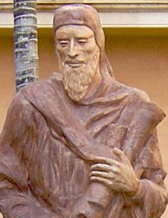
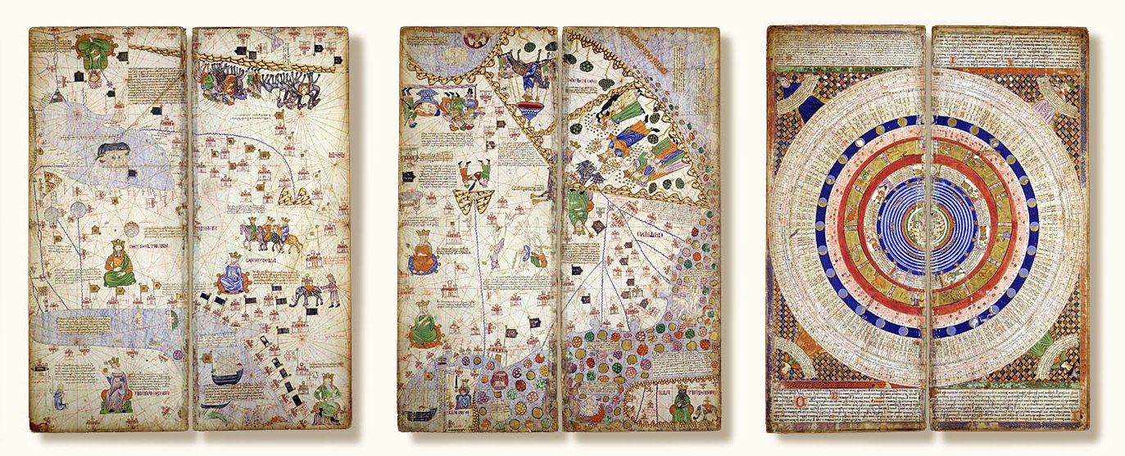
1375: Catalan Atlas, an exquisitely beautiful visual cosmography, perpetual calendar, and thematic representation of the known world- Abraham Cresques, Majorca, Spain [BNF: ESP 30]
Western world
Eastern world (Marco Polo)
Perpetual calendar
Notes:
Abraham Cresques: a visual catalog of world knowledge – visual story telling.
A Majorcan Jew, Cresques was a master map-maker and builder of clocks, compasses, and other nautical instruments
Two parts:
Geography-- Western world (Mediterranean basin), Eastern World (China, Far East--- journey of Marco Polo)
Cosmography – Tide tables, lunar tables, perpetual calendar (Catalan)

Slide 22
1600-1699: Measurement and Theory
The 17th century saw growth in theory and the dawn of attempts at visualization.
Featured in this were:
the rise of analytic geometry: (x, y) coordinates (Descartes),
theories of errors of measurement: astronomical observations (Laplace)
the birth of probability theory-- games of chance, annuities (Fermat, DeMoivre, ...),
automatic graphic recording (Scheiner)
the first graphical representations of statistical data (van Langren)

Slide 23
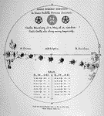
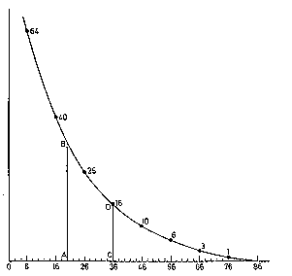
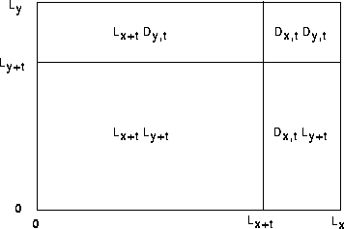
1600-1699: Measurement and Theory
1626: Visual representations used to chart the changes in sunspots over time- Christopher Scheiner
1644: First visual representation of statistical data-M.F. van Langren, Spain
1669: First graph of a continuous distribution function (Gaunt's life table)– Christiaan Huygens.
1693: First use of areas of rectangles to display probabilities of independent binary events- Edmund Halley, England
Notes:
The 17th century saw growth in theory and the dawn of practice. Featured in this were the rise of analytic geometry, theories of errors of measurement, the birth of probability theory, and the first graphical representations of statistical data.

Slide 24
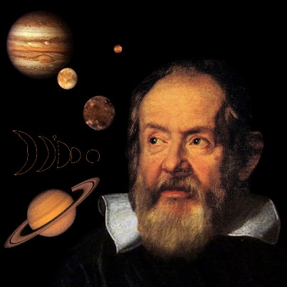
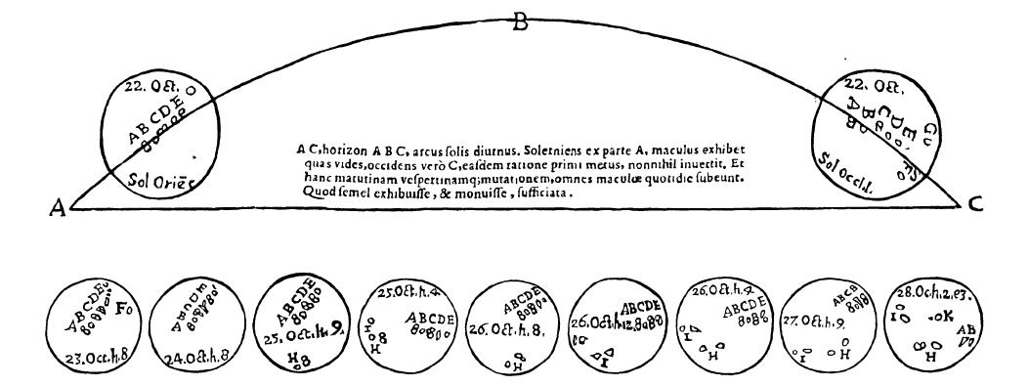
Sunspots: Galileo
1608: telescope (Hans Lippershey, NL)
1610: Galileo (Sidereus Nuncius)
1611: Galileo records movement of sunspots over time (Three letters on sunspots, 1613)
Visual ideas:
Animated graphic
“Small multiples”
Allows comparison
Self-explaining diagram
A+ for info design!
The idea of diagrams for visualizing phenomena had arrived.
Notes:
In late 1609, Galileo constructed one of the first astronomical telescopes and almost immediately made a series of important discoveries (craters on the moon, a huge number of new stars, observations on the moons of Jupiter, sunspots)
He noticed that the positions of sunspots constantly changed, and wanted to display their movement over time. The result was an early animated graphic, using “small multiples” to allow comparison over time.

Slide 25
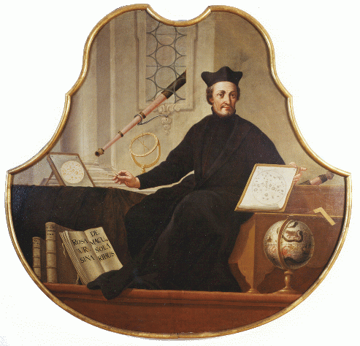
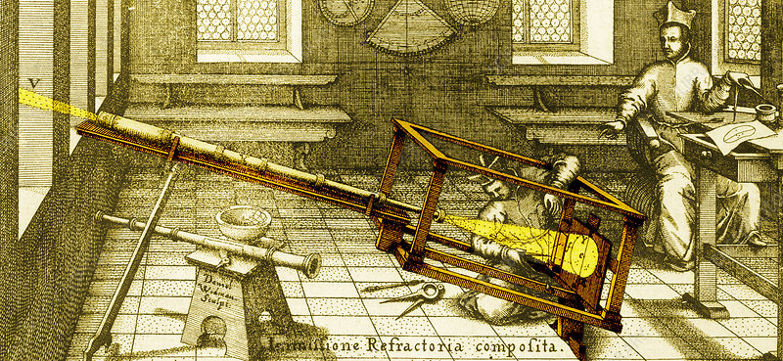
Scheiner: systematic recording
1626: Christoph Scheiner invents helioscope & camera obscura to record sunspots (Rosa Ursina sive Sol , 1626-1630)
Notes:
Christophe Scheiner [1573-1650], a Jesuit in Augsburg with talents in mathematics and instrument making, constructed a device to record the position and movement of sunspots over time.
The substantive and philosophical issue was the Jesuit-assumed perfection of the sun (could sunspots be explained as shadows cast by moons?), but the evidentiary issue was how to display changes in configurations of sunspots over time.

Slide 26
Sunspots: Great graph, wrong theory
1626: Christopher Scheiner’s graph of changes in sunspots over time.
“small multiples”
allows comparison
multiple legends
A+ for info design!
He argued (incorrectly) that these were evidence for solar satellites.
The idea of graphs for visualizing phenomena had arrived.
Notes:
In 1610, Galileo built one of the first telescopes, and quickly discovered new celestial phenomena – moons of Jupiter, craters on the moon, and spots on the sun.

Slide 27
Why the 1st statistical graph got it right
1644: First visual representation of statistical data: determination of longitude between Toledo and Rome- Michael Florent van Langren, Spain
Actual distance=16º30’
Estimated distance
Notes:
This is believed to be the first graphic representation of statistical data, by Michael van Langren, a Flemish astronomer to the court of Spain.
It shows all the known estimates of difference in longitude between Toledo and Rome. Mariners could easily reckon latitude from the sun and stars, but longitude required accurate measurement of time at sea, unsolved until 1765 (John Harrison)

Slide 28
What else could he have done?
What would occur to men of his time to convey a message to the king?
… he could used a table have sorted by year to establish priority (or show change).
Notes:
To see why this is a significant landmark, consider what else he could have done.
He could have used a table …

Slide 29
… he could have sorted by name, to show authority.
… he could have sorted by longitude to show the range.

Slide 30
Only a graph shows…
central location
bias
name labels– avoiding overplotting
wide variability
clustering, detached observations
range
bias
Actual distance=16º30’
Estimated distance
See: Friendly, M., & Kwan, E. (2003). Effect Ordering for Data Displays. Computational Statistics and Data Analysis, 43(4), 509—539; Friendly etal (2010),The First (Known) Statistical Graph: Michael Florent van Langren and the ``Secret'' of Longitude The American Statistician, 64, 185-191
Notes:
But only a graph communicates several aspects simultaneously to the king & court, and in a way that is both simple and elegant.

Slide 31
1700-1799: New graphic forms
The 18th century witnessed the germination of the seeds of visualization & visual thinking, planted earlier.
Map-makers began to try to show more than just geographical position-- the beginnings of thematic mapping of physical quantities
topographical maps
iso- contour maps
New graphic forms were invented:
bar chart,
line chart,
timelines
The Big Bang
Notes:
By the 18th century there were now reasons for visualizing phenomena. New developments in cartography were a natural progression from mapping geography to mapping other quantities.

Slide 32
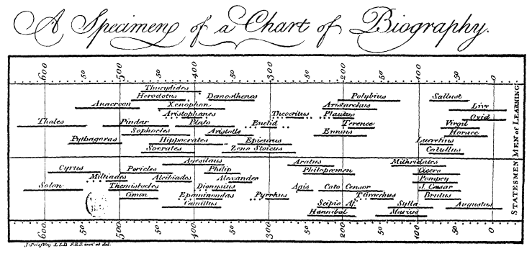
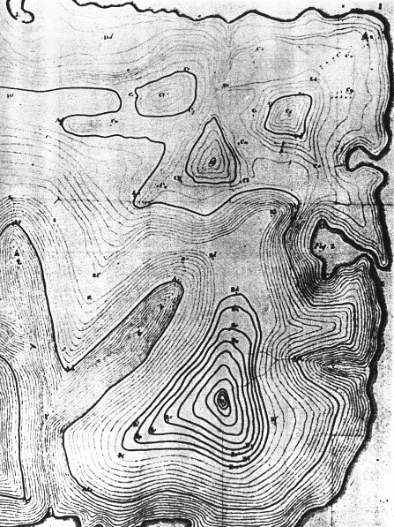
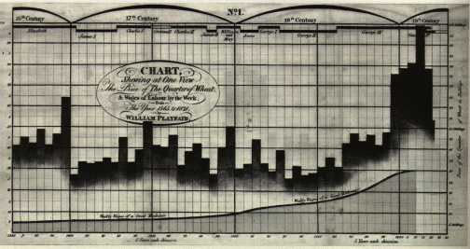
1700-1799: New graphic forms
1701: Isobar map, lines of equal magnetic declination – Edmund Halley
1765: Historical time line (life spans of famous people) Joseph Priestley
1786: Bar chart, line graphs of economic data- William Playfair
1782: First topographical map- Marcellin du Carla-Boniface
Notes:
The 18th century witnessed the initial germination of the seeds of visualization, planted earlier. Map-makers began to try to show more than just geographical position--- the beginnings of thematic mappings of physical quantities, and new graphic forms were invented.

Slide 33
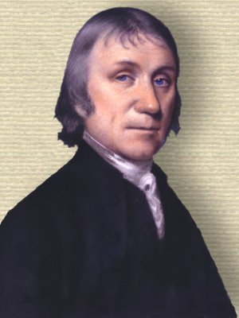
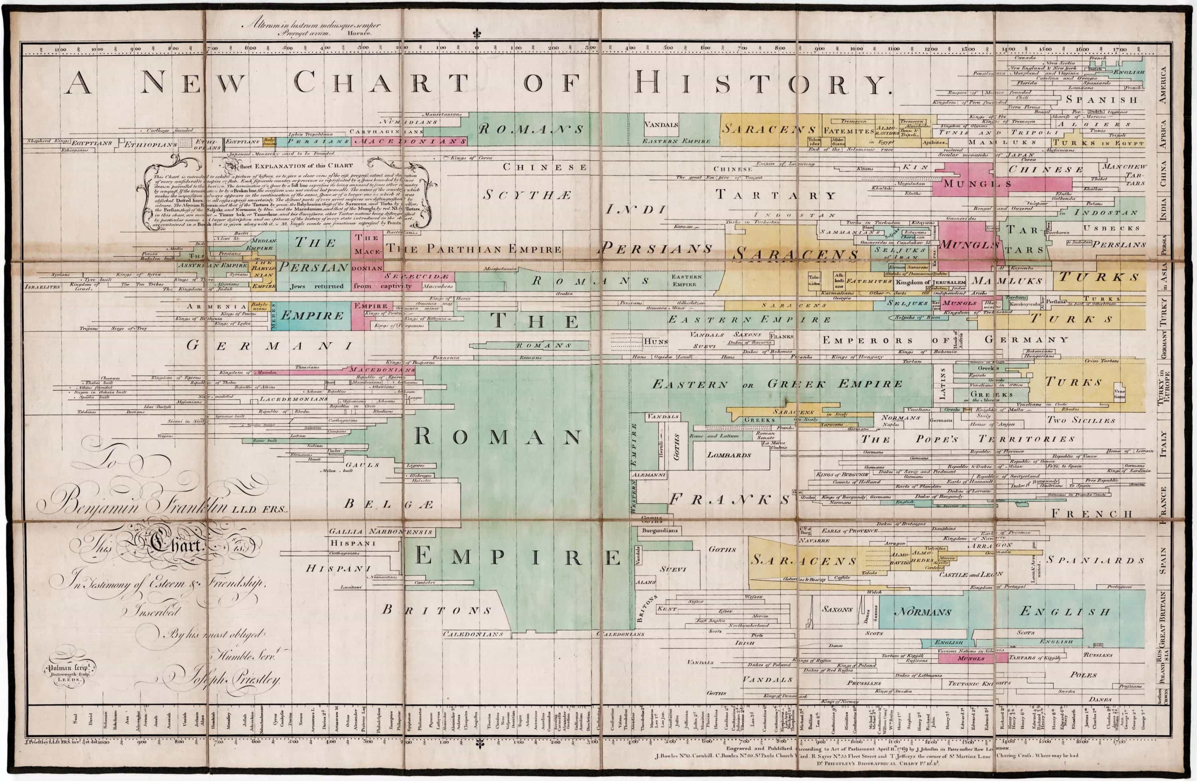
1769: Visualization of the history of civilizations & empires over ~3000 years --Joseph Priestley
America
China
Italy
France
Spain
1000 BC
0
1000

Slide 34
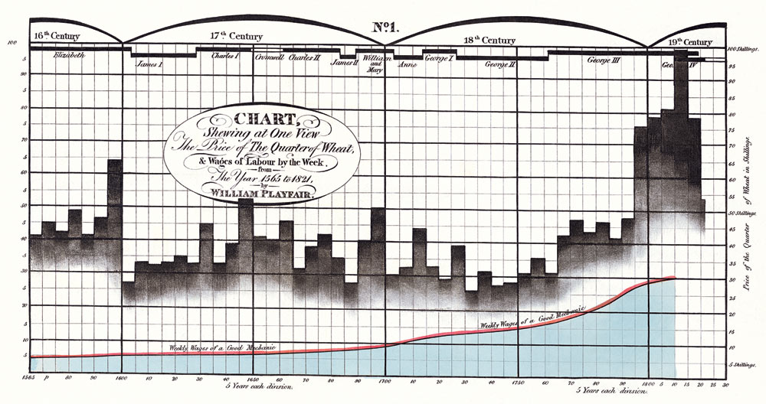
1786: Bar chart and line graph showing three time series: Price of wheat, weekly wages and reigning monarch over a 250+ year span- William Playfair
Elizabeth
George IV
monarch
price of wheat
wages
1565
1820
Notes:
Playfair wanted to compare wages (of a good mechanic) and prices. The gap between the two draws the eye, as does the volatility of the price of wheat compared with the stability of wages. The steep increase at the end of the 18th C corresponds to the American Revolution.

Slide 35
1800-1849: Beginning of modern data graphics
The first half of the 19th century witnessed an explosive growth in statistical graphics and thematic mapping
Polar coordinates, log axes
Shaded (choropleth) maps of social data (literacy, crime)
The birth of data: widespread national collection of data on social and medical issues
France: data on crime, literacy, prostitution, … collected centrally
England: Births, deaths, disease mortality collected by Registrar General (William Farr)

Slide 36
1800-1849: Beginning of modern data graphics
1801: Pie chart, circle graph invented- William Playfair
1826: First modern statistical map (illiteracy in France)- Charles Dupin
1843: Wind-rose (polar coordinates)- L. Lalanne
1844: variable-width, divided bars, area ~ cost of transport- C. J. Minard
Notes:
In the first half of the 19th C, we see an explosive growth in the development of new graphic forms, in statistical graphics and thematic cartography.

Slide 37
1801: Pie chart, circle graph invented- William Playfair
(But with a graphic sin & fallacy – What are they?)
British are overtaxed!!
Slope =$\frac{taxes}{pop} ?$
pop
taxes
Notes:
The use of two separate scales for different quantities is today considered a sin in statistical graphics.
But Playfair used this device here to compare population and taxes in various nations and argue that the British were overtaxed compared with others.
The slope of the lines is supposed to depict the rate of taxation per capita.

Slide 38
1826: The 1st choropleth map, showing the distribution of literacy in France – Baron Charles Dupin
Social variables became:
visual
subject to scientific discussion

Slide 39
1844: Tableau-graphique: variable-width, divided bars, area ~ cost of transport- Charles Joseph Minard
Notes:
One of Minard’s earliest works, designed to compare the price rates of transportation along the canal routes of France.
Width of each bar ~ distance, height ~ amount of goods, so area of each bar ~ cost.

Slide 40
1850-1900: Golden Age
By the last half of the 19th century the conditions for rapid growth of visualization had been established:
widespread data collection for planning, commerce, social theory
the beginnings of statistical theory and visual thinking
a wide range of graphic forms, reasonably well understood
technology:
lithography and color printing
automatic recording devices
calculation: machines & graphical calculators
The result was a perfect storm-- among the most exquisite graphics ever produced.

Slide 41
1850-1900: Golden Age
1855: Dot map of disease data (cholera)- John Snow
1879: Stereogram (3D population pyramid)- Luigi Perozzo
Broad St. pump
1884: Recursive multi-mosaic on a map- Emile Cheysson
1896: Area rectangles on a map to display two variables and their product- Jacques Bertillon
Notes:
I’ll focus on the Golden Age of Graphics next class. Here are just some highlights.
There were many innovations in data collection, technology & visual thinking that contributed to produce some of the most exquisite statistical maps and diagrams – the Perfect Storm for data vis.

Slide 42
E.-J. Marey: La Méthode Graphique
How to make human and animal motion subject to precise scientific study?
e.g., aerial locomotion of flying insects & birds
What is the frequency of wings of different species?
What are the mechanisms of wings to produce lift and forward motion?
A harness, designed to register the trajectory, force and speed of a bird’s wing in flight
Marey (1870) Animal Mechanism

Slide 43
E.-J. Marey: Chronophotography
Rather than separate frames, Marey’s “fusil photographique” allowed one to see motion continuously in a single static image.
This provides a visual analysis of a sprint:
The runner takes about ½ second (7 frames) to make it to an upright position
Successive frames alternate between power push from the hind leg to landing on the opposite leg
Source: https://lightsmellsloud.wordpress.com/tag/etienne-jules-marey/

Slide 44
The Falling Cat Problem
Another fundamental problem answered by chronophotography:
How does a falling cat usually land on her feet? An OMG moment!

Slide 45
Nomography
1885: Charles Lallemand, graphical calculator for compass course corrections of a ship at sea
Combines: anamorphic maps, hexagonal coordinates, trigonometric scales (5 eqns)
https://deadreckonings.files.wordpress.com/2010/05/lallemandhexagonalchartstriangularcoordinates.pdf
Notes:
In this time, nomography --- the graphical representation of mathematical relationships for purposes of calculation --- was invented
by Maurice d’Ocagne.
This image is a tour-de-force example by the engineer Charles Lallemand.
The mathematical solution involves 5 separate equations and magnetic parameters for the ship.

Slide 46
1896: Area rectangles on a map to display two variables and their product- Jacques Bertillon
% foreigners
population
total #
Notes:
Heights of bars ~ population of each arrondisement; widths ~ % foreigners, so area ~ absolute number of foreigners.
Note the small total # of foreigners on the left bank, large % of foreigners in the northern region (18th), just as it is today.

Slide 47
1900-1949: The Modern Dark Ages
By the 1930s, the growth of statistical methods supplanted enthusiasm for graphics
There were few graphic innovations
In statistics: numbers were precise; graphs were just “pretty pictures”
But graphical methods had entered the mainstream & were popularized
Text books, college courses
There were several graphic-based scientific discoveries
Electronic computers were born

Slide 48
1900-1949: The Modern Dark Ages
1914: Brinton: Graphic Methods for Presenting Facts
1924: ISOTYPE method of pictorial graphics—Otto Neurath
1913: Discovery of atomic number, based on graphical analysis- H. Mosely
1911-1913: The Hertzsprung-Russell diagram & evolution of stars
1944: Harvard's Mark I, the first digital computer- Howard Aiken, Grace Hopper

Slide 49
Maunder: Butterfly diagram
1904: E.W. Maunder plots distribution of sunspots in sun’s latitude by time
Discovery of 11-year sunspot cycles (& 22-yr: reversal of sun’s magnetic field)
latitude
area
Notes:
Following Gallileo & Scheiner, the patterns of distribution of sunspots over time and space continued to be studied over the next 350 years, yielding a data-rich time series.
In 1904, E.W. Maunder thought to plot the distribution of sunspots in the sun’s latitude over time, and saw an amazingly striking pattern, resembling a set of butterflies.

Slide 50
Maunder: Butterfly diagram
1904: E.W. Maunder plots distribution of sunspots in sun’s latitude by time
Discovery of “Maunder minimum” (1645-1715): “Little Ice Age”
Smoothing reveals other extrema
Notes:
Plotting the total number of sunspots over time revealed something even more striking.
From roughly from 1645 to 1714, a period called the “Maunder minimum,” sunspots became exceedingly rare. This coincided with the middle of the so-called Little Ice Age, during which Europe and North America, were subjected to bitterly cold winters.
Whether there is a causal connection between low sunspot activity and cold winters is the subject of ongoing debate.

Slide 51
1914: Willard C. Brinton publishes Graphic Methods for Presenting Facts, the 1st popular book on the topic
heatmap
pictogram
college graduates

Slide 52
1924: Otto Neurath developed the Isotype (International System of Typographic Picture Education) method to communicate statistical information to the broad public in an intuitive, pictorial way.
✓✓
NOT pictograms
✗
even complex, multivariate data
✓

Slide 53
1950-1974: Re-birth of graphics
Visualization began to rise from dormancy in the mid 1960s, spurred largely by:
J. W. Tukey’s Exploratory Data Analysis: The power of graphics to show the unexpected in data analysis
Jacques Bertin’s Semiologie Graphique: A general theory of composing graphs and maps
computer hardware for computation and display
the advent of statistical and graphics software

Slide 54
1950-1974: Re-birth of graphics
1969: Graphical innovations for EDA (stem-and-leaf, box-plots, etc.)- J.W. Tukey
1967: Comprehensive theory of graphical symbols & graphics representation- Jacques Bertin
1967: Reorderable matrix- Jacques Bertin
Multivariate glyphs
1971: Star plots- J. H. Siegel etal
1973: Face plots- Herman Chernoff

Slide 55
Digital display devices
The biggest limitation in the early development of dynamic and interactive graphics was in graphics display devices.
Only B/W, but for the first time, dynamic displays became possible.
By the late 1950s, pen-like input devices allowed rudimentary direct interaction

Slide 56
1975-present
Technology:
Progressively more powerful computation & graphics
Mainframes → PCs → workstations → servers → cloud computing
pen plotters → CRTs → graphics hardware & firmware
stand-alone → client-server architecture
Internet
email → bitnet -> file sharing (FTP) → www (HTML) → Java → javascript
data: open data initiatives (~1995) → APIs (census, health, …)
eCommerce: Amazon, Netflix, … → BIG data, recommender systems
Software
Graphics packages: SYSTAT, Data Desk, XGobi, ViSta
Statistical packages: SAS, SPSS
Statistical programming environments: R, matlab, Stata
Contributed package archives: CTAN (latex), CPAN (perl), CRAN (R)
Collaborative development sites: github, bitbucket, …

Slide 57
1975-present
Themes in data visualization:
high-D problems of progressively higher dimensions
grand tour: n-D → 2D projections
Dimension reduction methods (PCA, MDS, biplots)
graphics & methods for other data types:
categorical, frequency data,
networks, trees, …
text (word clouds, …)
spatial data & models
interactive data vis
linked views
direct manipulation: select, zoom, filter
dynamic graphics & animation

Slide 58
1975-present
1991: Mosaic display for visual analysis of log-linear models- Michael Friendly
1985: Parallel coordinates plots for high-D data- Alfred Inselberg
1991-1996: High-interaction systems for data analysis and visualization, e.g., XGobi, ViSta
1996: Cartographic Data Visualiser – Jason Dykes

Slide 59
Tukey: PRIM-9
1973: a group at the Stanford Linear Accelerator developed PRIM-9
Picturing, Rotating, Isolation, Masking in up to 9 dimensions
$400K graphic display & keypad; computations on a mainframe, $500/hr
PRIM-9 Movie: https://www.youtube.com/watch?v=sN2gCCd2Rr8
Notes:
These initial ideas would form the basis for hardware, software, and methods for dynamic, interactive graphics.

Slide 60
Next steps: Hardware
Dynamic 3D graphics was painfully slow for larger data sets.
Specialized 3D graphics hardware:
Early 1970s: Simple LSI graphics chips for video games
70s—80s: Graphics co-processors (GPUs) with increasing graphics capabilities
80s—90s: Silicon Graphics develops high-performance 3D graphics workstations

Slide 61
Software
MacSpin – Andrew & David Donoho (1984—85). At ASA meetings 1986, “dynamic graphics became as portable as a 25-lb Macintosh”

Slide 62
Linking, brushing, 3D rotation
Paul Velleman (~1985): Data Desk provided multiple 1D, 2D, 3D views
Brushing: selection of points, regions, … via mouse
Linking: Any action in one plot reflected in all others

Slide 63
Visual Statistics
Young, Valero-Mora & Friendly (2006)
A philosophy & pedagogy for statistics based on dynamic interactive graphics
A theory of #datavis software:
objects (data, model, …)
methods (print, plot, )
manipulating plot objects & dimensions
spin plots: rotating 3D plots
spreadplots: dynamically linked views
workmaps: visual record of analysis steps
Details: https://www.uv.es/visualstats/
See: The History of ViSta: The Visual Statistics System, https://onlinelibrary.wiley.com/doi/full/10.1002/wics.1203

Slide 64
ViSta: Visual Statistics

Slide 65
Summary
Data Visualization has deep & wide roots:
Cartography: map-making, geo-measurement, thematic cartography, GIS, geo-visualization
Statistics: probability theory, distributions, estimation, models, stat-graphics, stat-visualization
Data: population, economic, social, moral, medical, …
Visual thinking: geometry, functions, mechanical diagrams, EDA, …
Technology: printing, lithography, computing…
Problem driven: developments often driven by practical and theoretical problems of the day
Communication driven: developments often arose from a desire to communicate better
Notes:
Why study the history of data visualization?
Today, people who work with or develop methods of data visualization tend to work in narrow fields, such as statistics or cartography. Not uncommon to re-discover things done long ago – mosaics: Georg von Mayr, 1877
But, in fact, data visualization has deep roots, which weave in and out of various disciplines.

Slide 66
Conclusions
Why study the history of data visualization?
“The only new thing in the world is the history you don’t know” – Harry S. Truman
“Those who cannot remember the past are condemned to repeat it.”– George Santayana (The Life of Reason, 1905)
“No scientific discovery is named after its original discoverer” – Stigler’s Law of Eponomy (1980). But: originally due to Merton!
Today:
Narrow, specialized work in many fields
New methods “invented” and re-named w/o knowing history.
mosaic displays: Georg von Mayr (1877)
heatmaps: Loua (1873); Brinton (1914), Bertin (1967)
Nightingale (1859) rose diagram: polar diagrams by Guerry (1829), Lalanne (1843)

