Slide 1
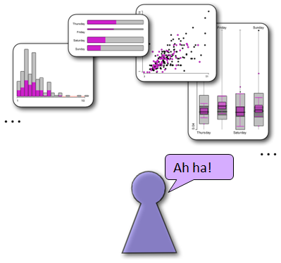
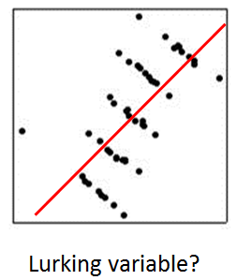
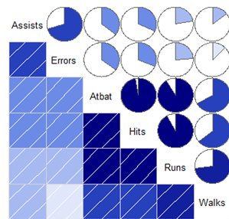
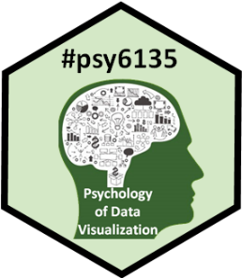
Psychology of Data Visualization: Course Overview
Michael Friendly
Psych 6135
https://friendly.github.io/6135 @datavisFriendly

Slide 2
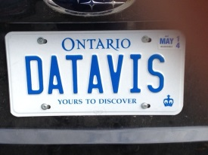
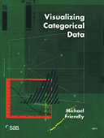
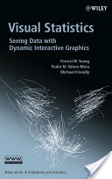
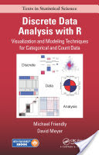
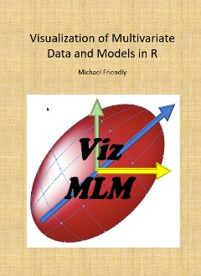
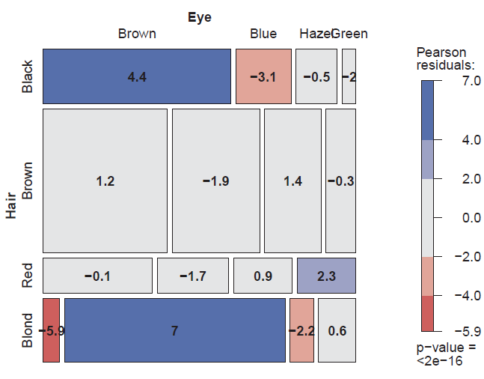
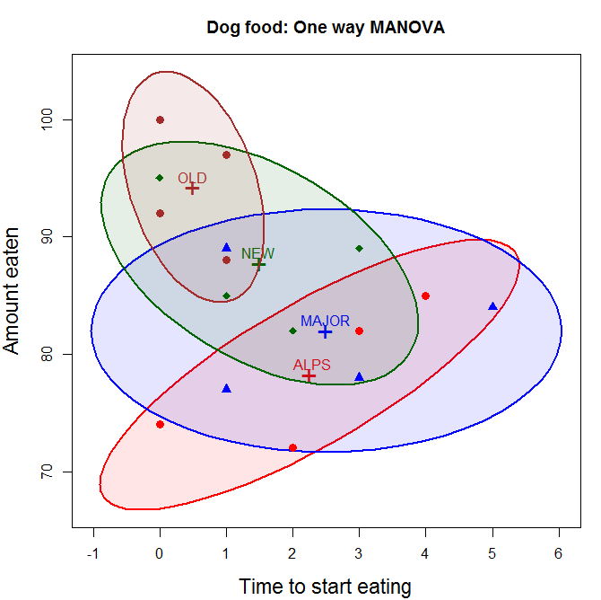
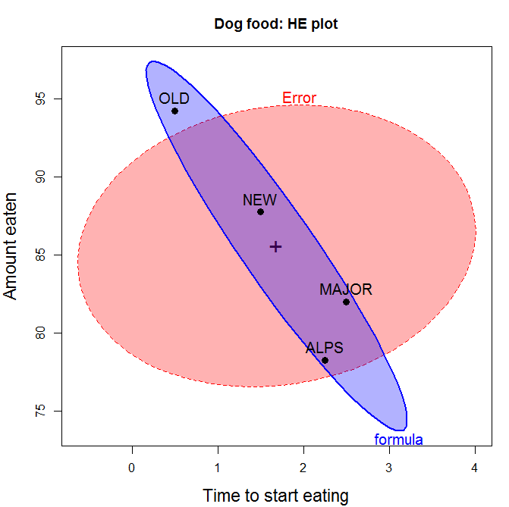
Introducing: me
I wear two hats, both reflected on my license plate:
Statistical graphics developer (categorical & multivariate data analysis)
Yours to discover!
mosaic plots for frequency tables
HE plots for MANOVA

Slide 3
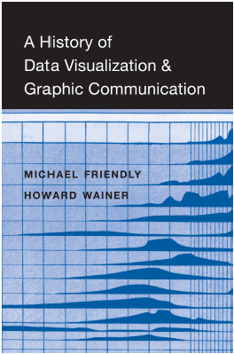
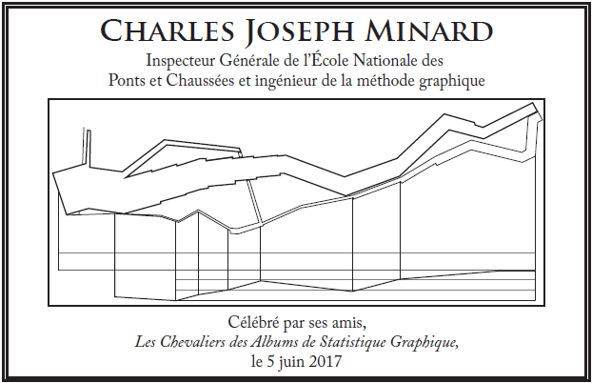
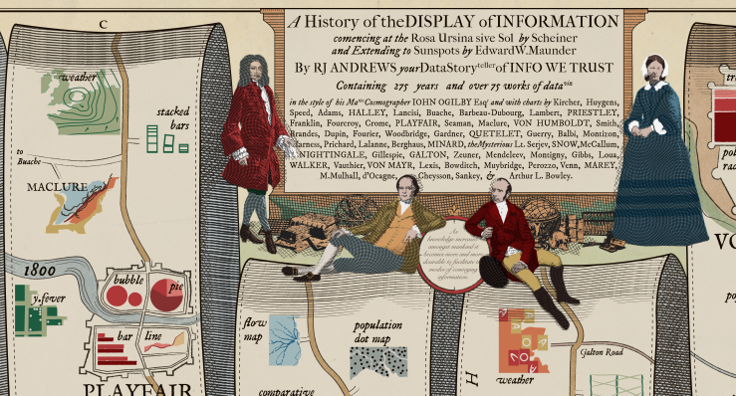
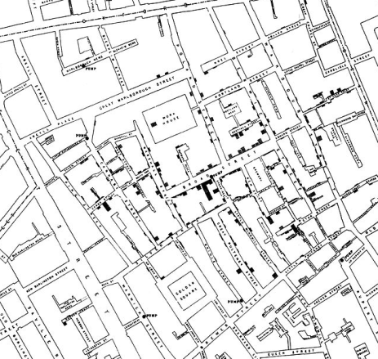
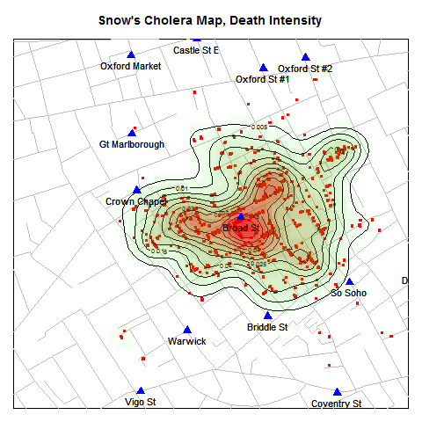
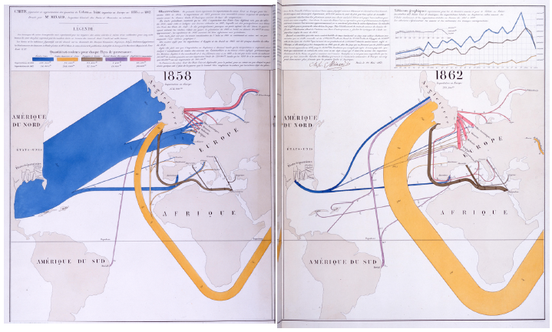
Introducing: me
History of data visualization: Les Chevaliers; Friendly & Wainer (2021)
John Snow’s map of cholera in London, 1854
C. J. Minard: Flow maps of cotton trade
original
modern enhancement
Visual explanation: What happened in the US Civil War?

Slide 4
Course Topics
Varieties of information visualization
Goals of visualization
Survey of graphic forms
History of information visualization
“Those who don’t know history are doomed to plagiarize it”
Psychological models, theories and results
What can people see, understand and remember from data displays?
Perceptual aspects, cognitive aspects
Human factors research
How to tell what works for different tasks?
Software tools for information visualization (mainly R)
ggplot2; tidyverse
Special topics
Visualizing uncertainty; Data journalism
Categorical data; High-D data; Dynamic and interactive methods

Slide 5
Your role
Weekly readings – see the course web site for updates
Discussion – no formal grade, but please contribute
Discussion leader (20%)
Each week 1-2 of you will lead a brief discussion on one of the readings or sub-topics (~ 5-8 min.)
Please sign up on the Google sheet, https://bit.ly/3S6o9pP
Class presentation (40%)
In the last 2 weeks, each person will give a ~ 20 min presentation on a topic of research, application or software related to data visualization
Research proposal (40%)
Prepare a brief research proposal on a data visualization topic

Slide 6
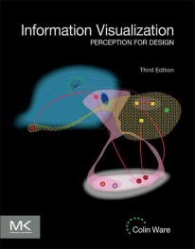
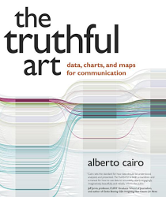
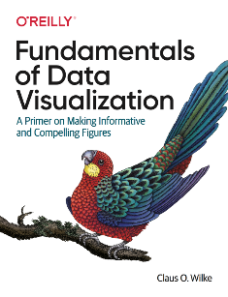
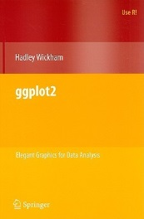
Books & Readings
Colin Ware, Information Visualization, 3rd Ed.
What perceptual science has to say about data visualization, from a bottom-up perspective
Course notes at: http://ccom.unh.edu/vislab/VisCourse/index.html
Alberto Cairo, The Truthful Art
Information graphics from a communication perspective
Blog: http://www.thefunctionalart.com/
Claus Wilke, Fundamentals of Data Visualization
Well thought out, a wide range of topics, good practical advice, lots of examples.
Online version: https://clauswilke.com/dataviz/
Course notes: https://wilkelab.org/SDS375/
Hadley Wickham, ggplot2: Elegant graphics for data analysis, 2nd Ed.
1st Ed: Online, http://ggplot2.org/book/
ggplot2 Quick Reference: http://sape.inf.usi.ch/quick-reference/ggplot2/
Complete ggplot2 documentation: http://docs.ggplot2.org/current/

Slide 7
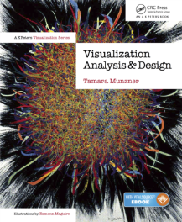
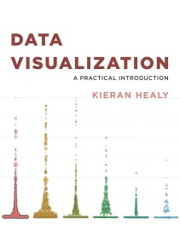
More books I like
Tamara Munzner (2014), Visualization Analysis & Design
An attractive new book combining computer science and design perspectives
Web page: http://www.cs.ubc.ca/~tmm/vadbook/ with lots of illustrations & lectures
Manuel Lima, The Book of Trees: Visualizing branches of knowledge
A visual delight; an entire history of tree-type diagrams
Blog: http://www.visualcomplexity.com/vc/blog/
Keiran Healy, Data Visualization: A Practical Introduction
An accessible primer on how to create effective graphics from data using ggplot2
Online: http://socvis.co

Slide 8
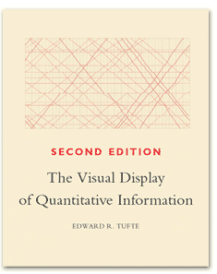
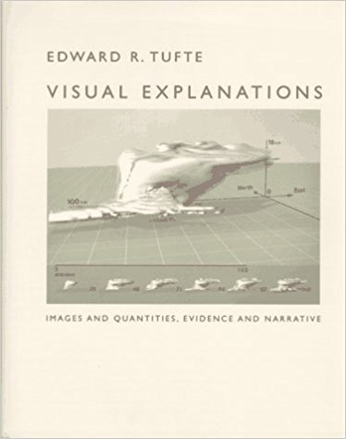
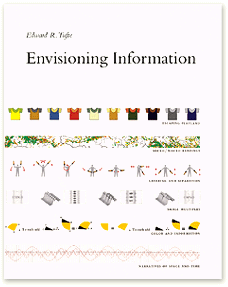
Tufte Stufte
Four books by Edward Tufte largely defined the landscape for data visualization and information design
Concepts introduced:
chart junk,
data-ink ratio,
small multiples,
substance takes precedence over visual design
Web site: https://www.edwardtufte.com

Slide 9
Blogs & Web resources
My web site, http://datavis.ca. Contains the Milestone Project on the history of data vis, Data Visualization gallery, links to books, papers and courses.
Kaiser Fung, http://junkcharts.typepad.com/. Fung discusses a variety of data displays and discusses how they can be improved.
Nathan Yau's blog, http://flowingdata.com. A large number of blog posts illustrating data visualization methods with tutorials on how to do these with R and other software.
http://visiphilia.org/. Statisticians Di Cook and Heike Hofmann from Iowa State University blog about data visualization topics, using R
Manuel Lima’s blog, http://www.visualcomplexity.com/vc/blog/, with hundreds of projects on all types of visualizations

Slide 10
Blogs & Web resources
http://datastori.es/. A podcast on data visualization with Enrico Bertini and Moritz Stefaner; interviews with over 100 graphic designers & developers.
Annual awards celebrate excellence and beauty in data visualizations, infographics, interactives & information art.
https://www.informationisbeautifulawards.com
https://www.r-bloggers.com/. A large collection of posts on R news and tutorials by over 750 R bloggers.
Raymond Andrews, http://infowetrust.com/. A visual storyteller delights with graphic stories from the history of data visualization

Slide 11
Psychology facts: Why visualization?
~90% of information about the environment is received through the eyes.
~50% of our brain neurons are involved in the processing of visual information.
The presence of pictures increases desire to read the text by ~80%.
We remember 10% of what we heard, 20% of what’s read, and 80% of what’s seen!
People perceive 70% of the information if there are no illustrations. Add pictures there — the figure will increase up to 95%.
McLeod, S. A. (2018). Visual perception theory. Simply Psychology. www.simplypsychology.org/perception-theories.html

Slide 12
Data and Stories
Statistical analysis: Data + Story
Conf. presentation: .4*Data + .6*Story ?
Historical analysis: .2*Data + .8*Story ?
Meta-Q: What is the “data” of history?
A one-parameter family?
Wischenschaftliche-Forschung: WF = p * Data + (1-p)*Story
Where are the pictures?
Statistical graphics: Data + Picture + Story
Notes:
Some years ago I started thinking of the goal of statistical analysis as that of telling a credible story about quantitative data, using numbers and words

Slide 13
Data, pictures, models & stories
Goal: Tell a credible story about some real data problem
data
COVID vaccination
Global warming
Housing costs
…
story
Notes:
Some years ago I started thinking of the goal of statistical analysis as that of telling a credible story about quantitative data, using numbers, words and graphs

Slide 14
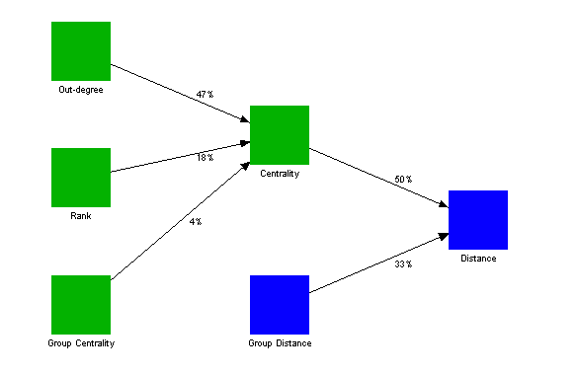
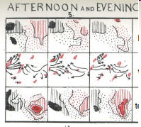
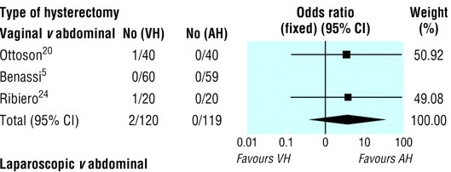
Data, pictures, models & stories
Two paths to enlightenment
model
data
Model-based
visualization
summary
Exploratory
story
Notes:
There are two paths …
A direct path, using exploratory methods, hoping to uncover some interesting facts or truths
An indirect path using statistical models …

Slide 15
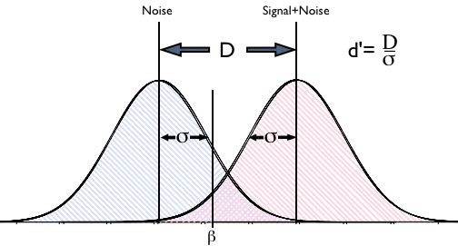
Data, pictures, models & stories
Now, tell the story!
model
data
Model-based
visualization
summary
Exploratory
story
inference

Slide 16
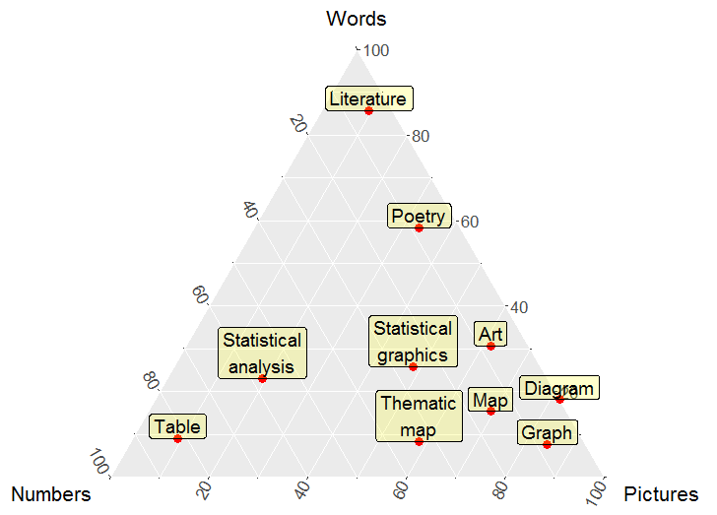
Words, numbers and pictures
Pictures and images in a wider context
Modes of communication, as composed of words (story), numbers (symbols) and pictures (images) in different proportions
e.g.,
Poetry ≈ 60% words + 40% images
Table ≈ 10% words + 80% numbers
+ 10% images
Notes:
Generalizing, we can try to organize different modes of communication in relation to the relative proportions of data, story and pictures entailed in each
In this course, t is useful to think of pictures and images in a wider context.
Throughout history, ideas and phenomena have been expressed in three different forms – words, numbers and pictures.
We can think of different forms of communication in relation to the relative proportions of data, story and pictures entailed in each.

Slide 17
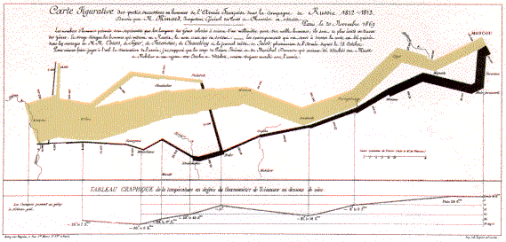
Words, numbers and pictures
Beauty: The 4th dimension
Modes of communication also vary in beauty & aesthetic appeal
Beauty: 4th dimension?
Notes:
There is another dimension: beauty or aesthetic appeal

Slide 18
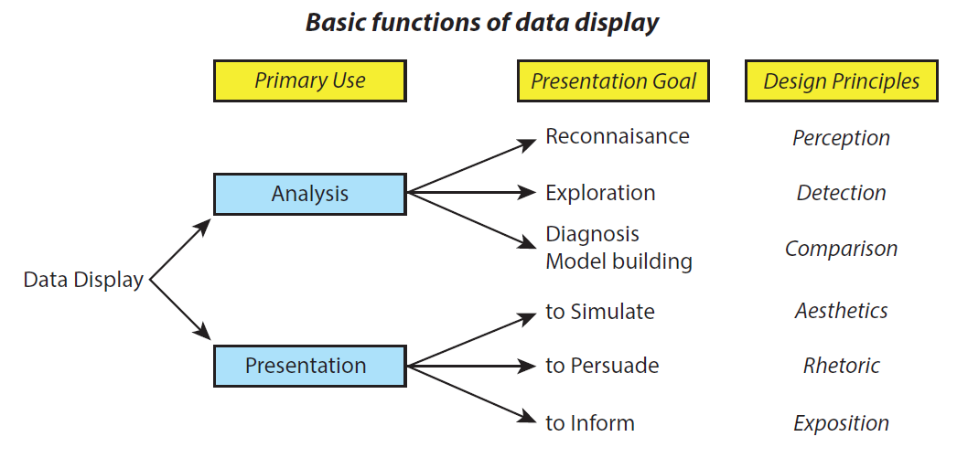
Roles of graphics in communication
Graphs (& tables) are forms of communication:
What is the audience?
What is the message?
Analysis graphs: design to see patterns, trends, aid the process of data description, interpretation
Presentation graphs: design to attract attention, make a point, illustrate a conclusion
Stimulate

Slide 19
Different graphs for different purposes
Wow!
Ah ha!
Goal: the Wow! experience
Single image for a large audience
Tells a clear story!
Goal: the Ah ha! Experience
Many images, for a narrow audience (you!), linked to analysis
Notes:
Let me start with some general remarks about graphs.

Slide 20
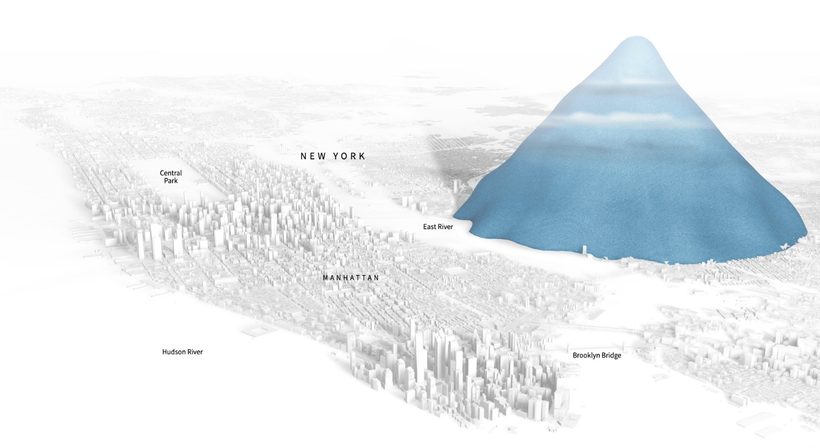
Infographics
The best infographics tell a story, using numbers, but shown visually
Drowning in plastic
Plastic bottles sold in NYC, shown to scale
From: https://graphics.reuters.com/ENVIRONMENT-PLASTIC/0100B275155/index.html

Slide 21
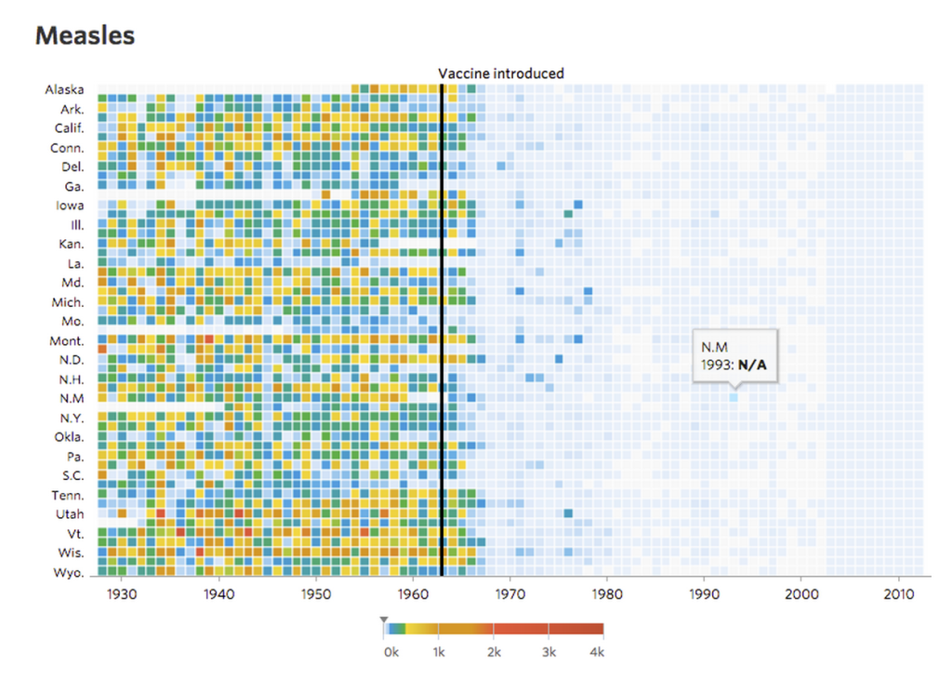
Powerful graphs: Measels and vaccines
Visualizing the impact of health policy interventions
In 2015 Tynan DeBold & Dov Friedman in the Wall Street Journal show the effect of the introduction of vaccination programs in the US states on disease incidence, using color-coded heat maps for a variety of diseases
Before: 17.0 M cases, 1926--1963
After: 1.7 M cases, 1963--2015
Measles was decimated!
The message hits you between the eyes!
Powerful graphs make comparison easy
In 2014, vaccination rates declined and measles re-emerged in those areas
Effective graphs can cure ignorance, but not stupidity.
Source: http://graphics.wsj.com/infectious-diseases-and-vaccines/
Notes:
Complex data can be made understandable with well-designed graphs. Many of the best examples come from data journalists…

Slide 22
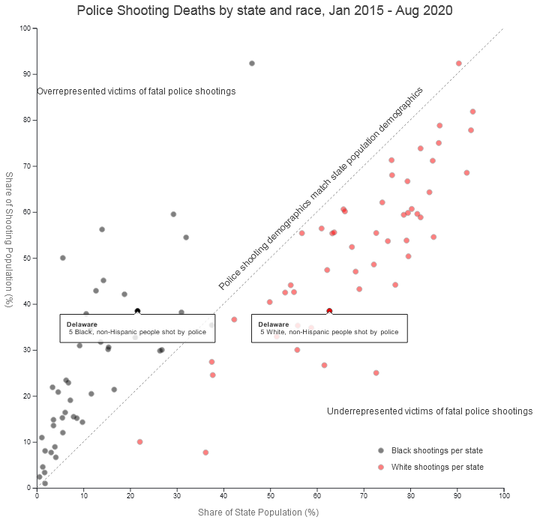
Police shooting deaths
Analysis of Washington Post database on 5500 police shooting deaths for Blacks vs. Whites
Plotting % of shooting vs. % of pop shows a clear & disturbing pattern
Annotations help to tell the story
From: https://medium.com/two-n/visualizing-wapos-police-shooting-dataset-3792593f6be

Slide 23
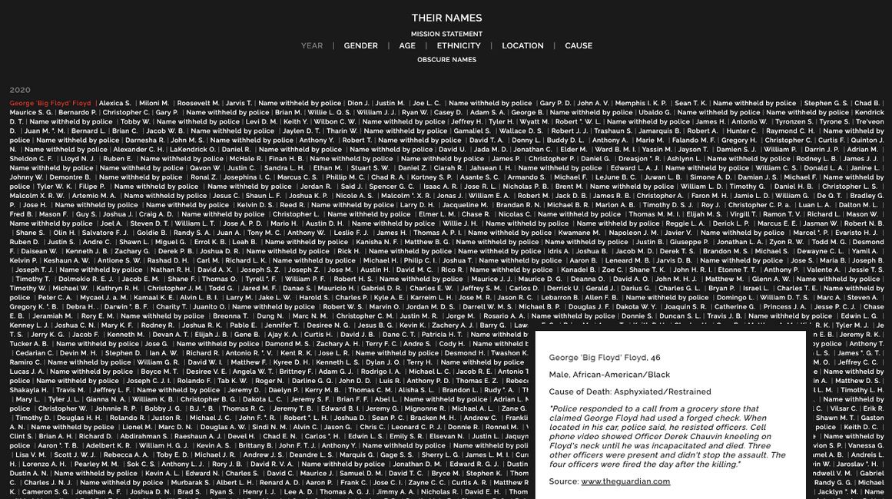
Their names: Interactive graphic
As powerful as Yad Vashem & the Washington D.C. Vietnam memorial, this list of 28,000 US fatal encounters with police commands attention.
Each one is linked to a story or description. Classified by {Gender, Age, Cause}
https://theirnames.org/

Slide 24
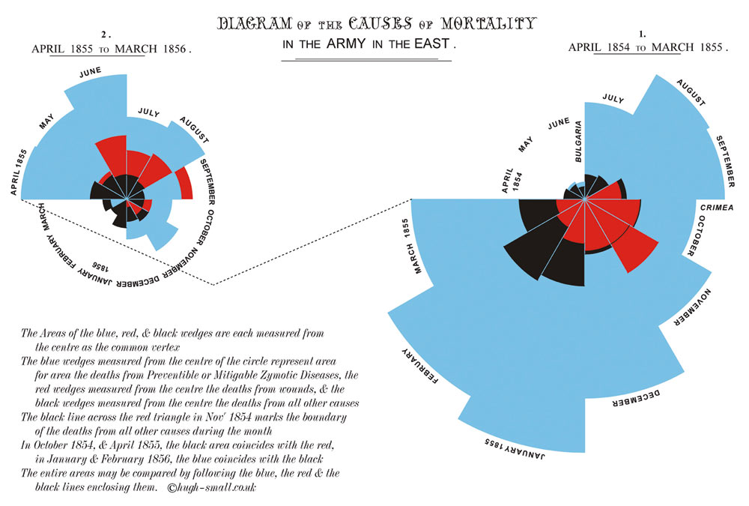
Presentation graph: Nightingale (1857)
After reform
Before reform
preventable
other
wounds
The best graphs pass the Interocular Traumatic Test: the message hits you between the eyes!
Notes:
Florence Nightingale, who founded modern nursing, wanted to convince British Parliament of the urgent need to reform medical treatment of soldiers in the Crimean War. …

Slide 25
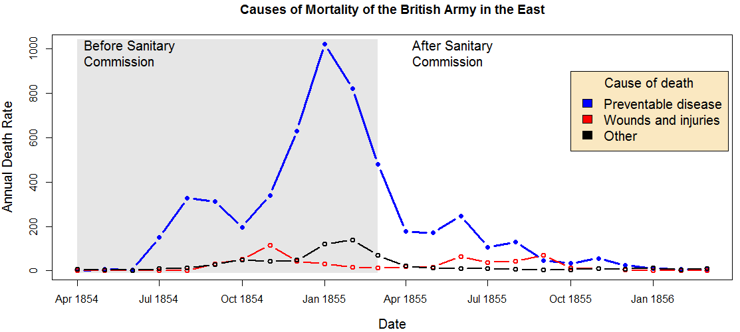
Data graph: Nightingale (1857)
The same, as a data graph, using time-series line plots
Some statisticians might prefer this today, but it doesn’t draw attention or interest as Flo’s original did. It likely would not have roused British Parliament to act!

Slide 26
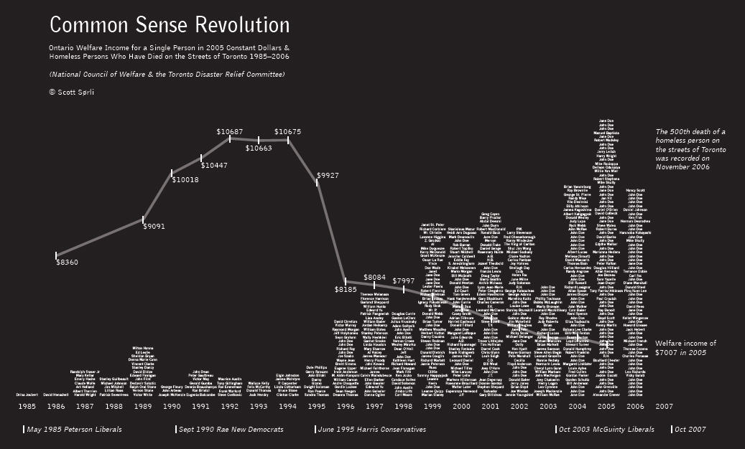
Rhetorical graph: Welfare income and Homeless deaths after the “Common Sense Revolution”
Scott Sorli (2007)
Liberals
NDP
Conservatives (“CSR”)
Liberals
welfare payments
homeless deaths
Notes:
Here is a recent example of a graph designed to make a political statement.
It shows two parallel time series of data from my home in Toronto, Canada:
Average payments to people on welfare, as a line graph
Number of homeless people who died, as a bar graph made up from their names
The goal is to show the effect after a Conservative government was elected in June 1995 with the slogan “Common Sense Revolution.”

Slide 27
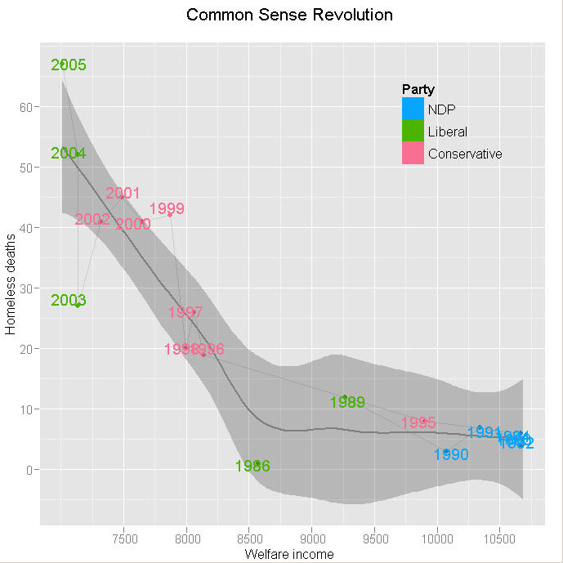
Analysis graph: Deaths vs. Income
Scatterplot of deaths vs. income
Loess smooth + CI band
Labels: year
Color: party in power
The message here is interesting, but it lacks the power and eloquence of the original graph
As well, the relationship of deaths to time & party is lost
Notes:
By contrast, here is an analysis graph of the same data, plotting # of deaths vs. welfare income
It’s a very pretty statistical graph…
… but it serves a very different communication goal. In particular the direct linking of time and political regime with welfare income and deaths is lost, whereas it is explicit in the original graph.

Slide 28
Race & Crime
Toronto Star investigation of racial disparities in treatment by Toronto Police Services
FOI request → ½ M arrests, 1997—2002
Evidence for racial profiling?
Only look at discretionary charges:
Simple marijuana possession
Non-moving auto infractions
Notes:
An application: racial profiling by Toronto police
- Began with FOI request in 1995: two years to get data, cost $800
- looked at differences in treatment in situations where police have discretion
- 5 reporters, two editors, one stats expert, three database specialists, one lawyer

Slide 29
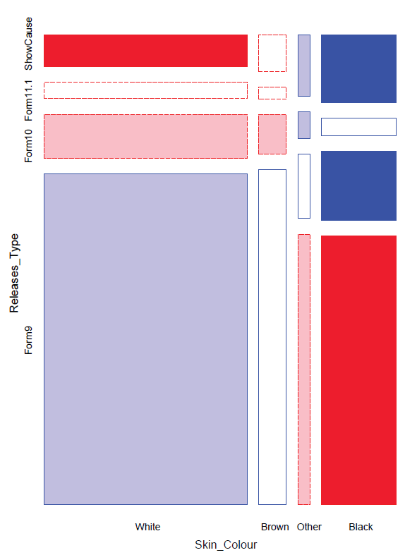
Racial profiling: Analysis graph
Toronto Star (2002) study of police actions on a charge of simple possession of marijuana
release with a summons (Form 9) vs. hold for bail (Show cause)
Evidence for racial bias?
First graph: mosaic display
area ~ frequency
shading: ~ residual
Obs > Expected in blue
Obs < Expected in red

Slide 30
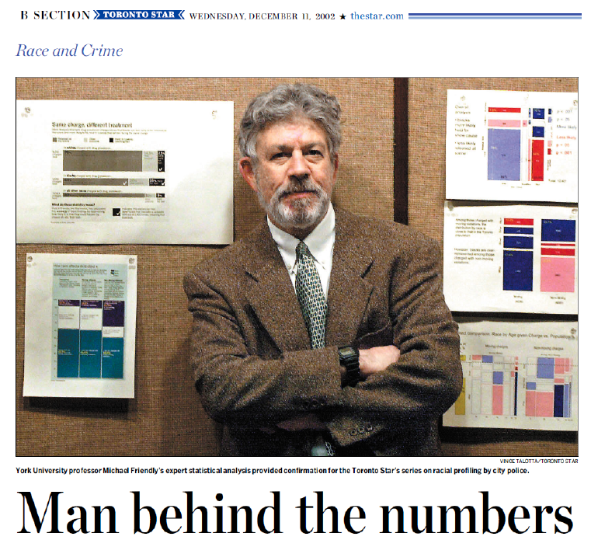
Racial profiling: The process
How to communicate these results most effectively?
What is the message? What features are directly comprehensible to the audience?
Graphic designer’s early attempts
My early attempts

Slide 31
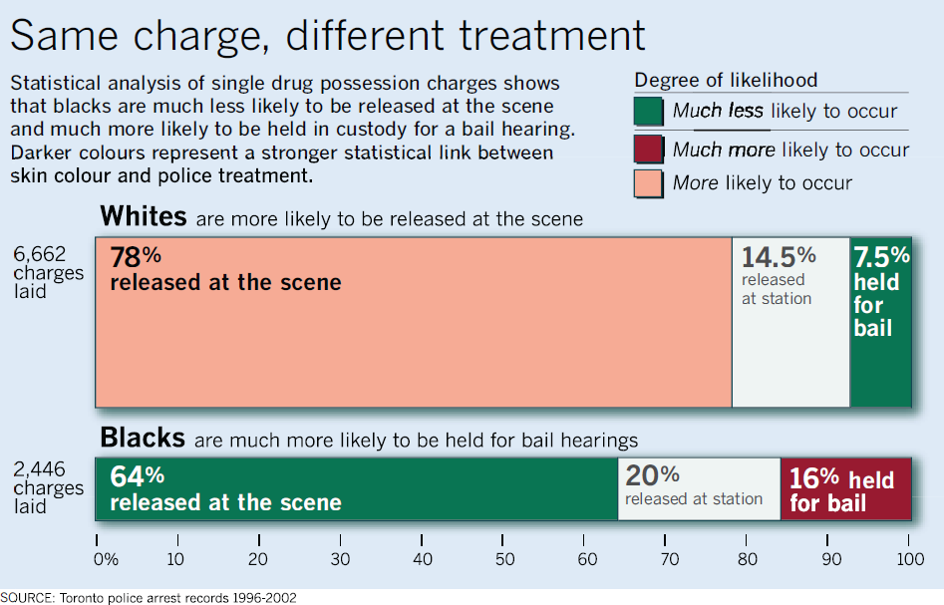
Racial profiling: Presentation graphic
Together, we created this (nearly) self-explaining infographic
Legend gives a layman’s description of shading levels
Title gives the main conclusion
Text description gives details
Bar width ~ charges
Divided by % release
numbers shown in the cells

Slide 32
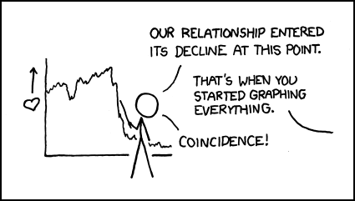
Why plot your data?
Graphs help us to see
patterns, trends, anomalies and other features
not otherwise easily apparent from numerical summaries.
Well, at least I noticed!
Well, at least I noticed!
Source: http://xkcd.com/523/

Slide 33
Why plot your data?
Three data sets with exactly the same bivariate summary statistics:
Same correlations, linear regression lines, etc
Indistinguishable from standard printed output
Totally different interpretations!
Standard data
r=0 but + 2 outliers
Lurking variable?

Slide 34
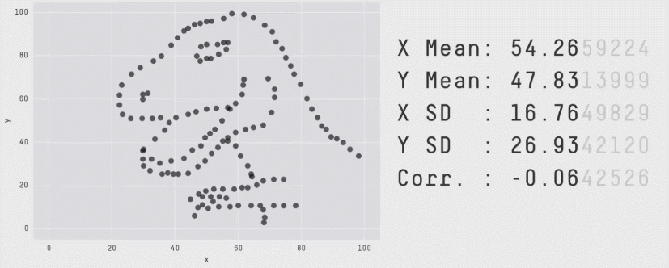
Datasaurus Dozen
As it happens, it is also possible to create any number of datasets with the same means, standard deviations and correlations with nearly any shape you like — even a dinosaur!
Method: Matejka & Fitzmaurice (2017). Same stats, different graphs. Proceedings of the 2017 CHI Conference on Human Factors in Computing Systems. https://doi.org/10.1145/3025453.3025912
Image source: https://youtu.be/It4UA75z_KQ

Slide 35
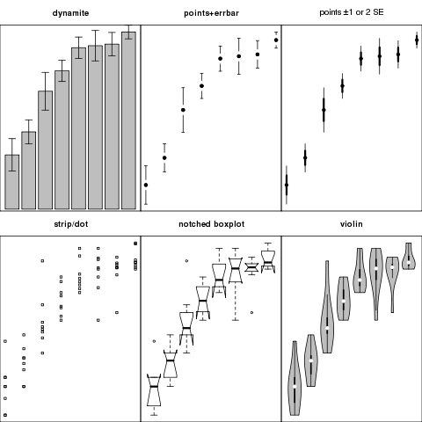
Comparing groups: Analysis vs. Presentation graphs
Six different graphs for comparing groups in a one-way design
which group means differ?
equal variability?
distribution shape?
what do error bars mean?
unusual observations?
Never use dynamite plots
Always explain what error bars mean
Consider tradeoff between summarization & exposure

Slide 36
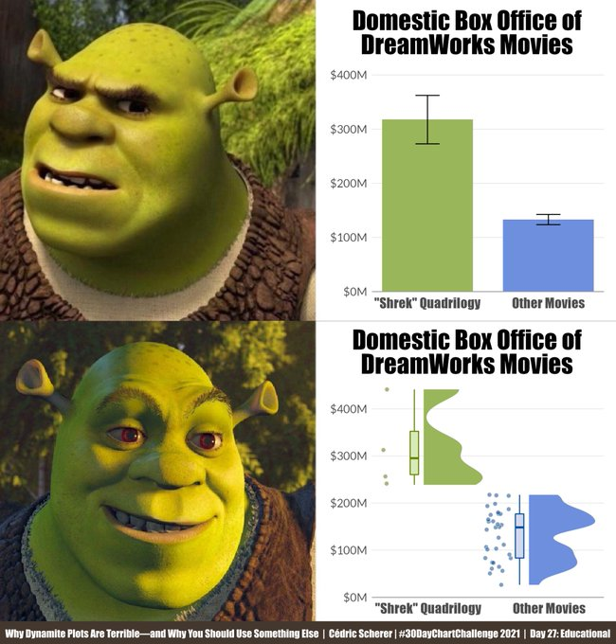
Dynamite plots – barcharts with error bars provide little useful information
Raincloud plots:
Boxplots, violin plots show the important features
Center
Spread
Shape
Dot plots show the data

Slide 37
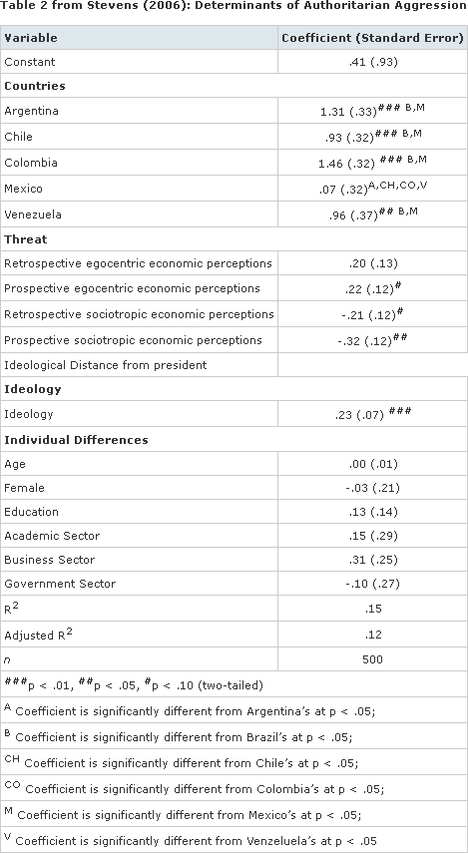
Presentation: Turning tables into graphs
Graphs of model coefficients are often clearer than tables
From: Kastellec & Leoni, 2007. “Using Graphs Instead of Tables in Political Science.” Perspectives on Politics 5 (4): 755–71.
See: The R dotwhisker pkg, https://fsolt.org/dotwhisker/

Slide 38
Semi-graphic tables
Tables can be made more visual by including mini-graphics in some table cells
The original idea– sparklines (Tufte), is now more general
A good solution for the Table 1 problem – description of your sample
Image from: https://discourse.holoviz.org/t/add-sparkline-formatters-to-tabulator/3197

Slide 39
Graphs & Information design
Graphs & info displays should be viewed in relation to communication goals & audience
Some criteria for assessing:
comprehensibility: does it make information as easy to understand as possible?
attention: does the audience take notice?
aesthetics: is it visually appealing?
memorability: will they remember it?
behavior: does it result in some desired action?
From: Ben Jones, To Optimize or to Satisfice in Data Visualization? https://dataremixed.com/2016/01/optimize-or-satisfice-in-dataviz/

Slide 40
Effective data display
Make the data stand out
Fill the data region (axes, ranges)
Use visually distinct symbols (shape, color) for different groups
Avoid chart junk, heavy grid lines that detract from the data
Facilitate comparison
Emphasize the important comparisons visually
Side-by-side easier than in separate panels
“data” vs. a “standard” easier against a horizontal line
Show uncertainty where possible
Effect ordering
For variables and unordered factors, arrange them according to the effects to be seen

Slide 41
Make visual comparisons easy

Slide 42
Make visual comparisons easy
QQ plots assess the degree to which data follows a particular distribution (normal, χ2)
The reference line of equality is usually a 45º line
It is easier to see any departure in relation to a horizontal line at 0

Slide 43
Make comparisons direct
Use points not bars
Connect similar by lines
Same panel rather than different panels
Is there evidence of an interaction here?
???
YES
Published in: Ian Gordon; Sue Finch; Journal of Computational and Graphical Statistics 2015, 24, 1210-1229.
DOI: 10.1080/10618600.2014.989324
Copyright © 2015 American Statistical Association, Institute of Mathematical Statistics, and Interface Foundation of North America

Slide 44
Direct labels vs. legends
Direct labels for points, lines and regions are usually easier and faster than legends
Give the names of the four groups shown in the line graph at left in top-to-bottom order. (Answer: b, d, a, c.)
Source: Franconeri etal. DOI: 10.1177/15291006211051956

Slide 45
Direct labels vs. legends
Direct labels for points, lines and regions are usually easier and faster than legends
Give the names of the four groups shown in the line graph at left in top-to-bottom order. (Answer: b, d, a, c.)
Now do the same for the graphs using color or shape legends
You need to look back and forth between the graph and legend
Source: Franconeri etal. DOI: 10.1177/15291006211051956

Slide 46
Visualizing uncertainty
Standard plots of observed vs. predicted lack a basis for assessment of uncertainty
Confidence envelopes indicate extent of deviation wrt a standard
Identify “noteworthy” observations to track them down
Example: Normal QQ plots used to assess normality of data

Slide 47
Uncertainty: Theory & simulation
In most cases, standard theory allows calculations of uncertainty intervals (confidence bands)
Simulation provides a theory-free alternative
Viewed as an animation gives a better sense of variation from sample to sample

Slide 48
Effect ordering
Information presentation is always ordered
in time or sequence (a talk or written paper)
in space (table or graph)
Constraints of time & space are dominant– can conceal or reveal the important message
Effect ordering for data display
Sort the data by the effects to be seen
Order the data to facilitate the task at hand
lookup – find a value
comparison – which is greater?
detection – find patterns, trends, anomalies
Friendly & Kwan (2003). Effect Ordering for Data Displays. Computational Statistics and Data Analysis, 43, 509–539. DOI: 10.1016/S0167-9473(02)00290-6

Slide 49
Effect order failure: the Challenger disaster
Few events in history provide as compelling illustration of importance of appropriate ordering and display of information
On January 28, 1968, the space shuttle Challenger exploded on take-off.
The cause was later determined to be that rubber O-rings failed due to cold weather
Tables and charts presented to NASA by Thiokol engineers showed data from prior launches ordered by time (launch number), rather than by temperature—the crucial factor.
The engineers’ charts were also remarkable for information obfuscation: “erosion depth” (O-ring damage), “blow-by” (soot on O-rings), …
time

Slide 50
Visual explanation: Physics
NASA appointed members of the Rogers Commission to investigate the cause of the disaster
the noted physicist Richard Feynman discovered the cause: at low temperature, O-rings became brittle and were subject to failure
in his testimony, he demonstrated the effect by plunging a rubber O-ring into a cup of ice water

Slide 51
Visual explanation: Graphics
Subsequent statistical analysis showed the relationship between launch temperature and O-ring failures
As Tufte (1997) notes: the fatal flaw was in the ordering of the data.
The graph shown here is the result of a statistical model fit to the data
The thick line shows the predicted value of failure vs. temperature
The red dotted lines show uncertainty of the predicted values
Challenger launch

Slide 52
Presentation graphic
A presentation version of the previous graph alters the scales and describes the story in text annotations

Slide 53
Graphic displays: Main effect ordering
To see trends, patterns, anomalies: Sort unordered factors by means or medians
Data on barley yields
10 varieties x 6 sites x 2 years
3-way dot plot, sorted by main effect means
Which site has the highest yield?
Which variety is highest on average?
Which site stands out in pattern over year?
Variety

Slide 54
Tabular displays: Main effect ordering
Tables are often presented with rows/cols ordered alphabetically
good for lookup
bad for seeing patterns, trends, anomalies

Slide 55
Tabular displays: Main effect ordering
Better: sort rows/cols by means/medians
Shade cells according to residual from additive model

Slide 56
Tabular displays: Main effect ordering
Yield difference, Δy_{ij} = 1931 – 1932 by Variety & Site
Ordered: by row and column means; shaded: by value (| Δy_{ij} | > {2,3} × σ (Δy_{ij} ) )
What features stand out?

Slide 57
Graphical display: Two-way tables
Tukey two-way plot of average barley yield
If there is no interaction,
y_{ij} = μ + α_{site} + β_{variety}
Site & variety effects sorted automatically
Effects are spaced by fitted values
More variation among sites than varieties
Waseca best, by a wide margin

Slide 58
Multivariate data: correlation ordering
Arrange variables so that:
Similar variables are contiguous
Ordered to show patterns of relations
Arrange observations so that:
Similar variables are contiguous
Ordered to show patterns of relations

Slide 59
Correlation matrices
Baseball data: Batting, fielding and (log) Salary
Nobody wants to see all those decimals
> cor(bb)
Assists Atbat Errors Hits Homer logSal Putouts RBI Runs Walks Years
Assists 1.0000 0.3421 0.70350 0.3040 -0.16160 0.0500 -0.0434 0.0629 0.179 0.1025 -0.0851
Atbat 0.3421 1.0000 0.32558 0.9640 0.55510 0.4149 0.3096 0.7960 0.900 0.6244 0.0127
Errors 0.7035 0.3256 1.00000 0.2799 -0.00974 -0.0208 0.0753 0.1502 0.193 0.0819 -0.1565
Hits 0.3040 0.9640 0.27988 1.0000 0.53063 0.4496 0.2997 0.7885 0.911 0.5873 0.0186
Homer -0.1616 0.5551 -0.00974 0.5306 1.00000 0.3398 0.2509 0.8491 0.631 0.4405 0.1135
logSal 0.0500 0.4149 -0.02080 0.4496 0.33983 1.0000 0.2245 0.4441 0.426 0.4324 0.5374
Putouts -0.0434 0.3096 0.07531 0.2997 0.25093 0.2245 1.0000 0.3121 0.271 0.2809 -0.0200
RBI 0.0629 0.7960 0.15015 0.7885 0.84911 0.4441 0.3121 1.0000 0.779 0.5695 0.1297
Runs 0.1793 0.8998 0.19261 0.9106 0.63108 0.4256 0.2712 0.7787 1.000 0.6970 -0.0120
Walks 0.1025 0.6244 0.08194 0.5873 0.44045 0.4324 0.2809 0.5695 0.697 1.0000 0.1348
Years -0.0851 0.0127 -0.15651 0.0186 0.11349 0.5374 -0.0200 0.1297 -0.012 0.1348 1.0000
If you are going to present the numbers, round a lot
> round(100*cor(bb))
Assists Atbat Errors Hits Homer logSal Putouts RBI Runs Walks Years
Assists 100 34 70 30 -16 5 -4 6 18 10 -9
Atbat 34 100 33 96 56 41 31 80 90 62 1
Errors 70 33 100 28 -1 -2 8 15 19 8 -16
Hits 30 96 28 100 53 45 30 79 91 59 2
Homer -16 56 -1 53 100 34 25 85 63 44 11
logSal 5 41 -2 45 34 100 22 44 43 43 54
Putouts -4 31 8 30 25 22 100 31 27 28 -2
RBI 6 80 15 79 85 44 31 100 78 57 13
Runs 18 90 19 91 63 43 27 78 100 70 -1
Walks 10 62 8 59 44 43 28 57 70 100 13
Years -9 1 -16 2 11 54 -2 13 -1 13 100

Slide 60
Correlation ordering: corrgrams
Rendering: a correlation value can be displayed in different ways, for different tasks
Correlation ordering:
A PCA finds weighted sums of variable to maximize variance accounted for
Angles between vectors reflect the correlations
→ Arrange variables in the order of their angles
Friendly (2002), Corrgrams: Exploratory displays for correlation matrices, American Statistician.

Slide 61
Baseball data
This is a corrgram display of the correlations among the baseball statistics, with the variables ordered alphabetically

Slide 62
Baseball data
The same display, with the variables sorted according to the angles between vectors in the PCA
Not that dramatic, but it isolates the positive & negative correlations

Slide 63
Good
Evil

Slide 64
Good/excellent graphs
Like good writing, good graphical displays of data communicate ideas with:
clarity,
precision, and
efficiency– avoids graphic clutter
Even better: excellent graphs make the message obvious
What makes a good graph?
Integrity (quality of information)
Story (interesting, meaningful)
Goal (usefulness)
Visual form (beauty)

Slide 66
Bad/evil graphs
Like poor writing, bad graphical displays:
distort or obscure the data,
make it harder to understand or compare, or
thwart the communicative effect the graph should convey.
Even worse: evil graphs distort, or mislead.

Slide 67
Bad graphs are easy in Excel
Friends don’t let friends use Excel for data visualization or statistics
How many things are wrong with this graph?

Slide 68
Pie charts are easy to abuse
What’s wrong with these pictures?
1 π = 193%
1 π = 178%
Why do graphic designers so often get this wrong?

Slide 69
Pie chart merriment
On the other hand, pie charts are a great source of merriment for people interested in graphics
But: how much π have I eaten?
What perceptual ideas make this a great joke and lesson?
Once you see the pyramid, it’s hard to see the pie.

Slide 70
But, can be used to great effect
This graphic uses pie charts to show the transport of different kinds of goods to the ports of Paris and the principal maritime ports
size of each pie reflects total
sectors reflect relative %
location places them in geo context
Émile Cheysson, Mouvement de la Navigation Dans le Port de Paris et les Principaux Ports Francais en 1883. Album de Statistique Graphique, 1885, plate 17. https://bit.ly/47DwnKU

Slide 71
3D pie charts are usually evil
What was the intent of the designer of this graphic?
Which category led to the greatest total deaths?
What was the proportion of deaths due to strokes?
Did more people die from strokes vs. accidents?

Slide 72
Simple re-design makes it clearer

Slide 73
Or, try to use direct labels
Other causes
Heart disease
??
Cancer
Accidents
Stroke
Chronic resp. disease
As a rule of thumb, pie charts max out at ~ 5-7 sectors

Slide 74
Double Y-axis: Really evil graphs
After pie charts, double Y-axis graphs have caused more trouble than almost any other
OMG, autism has been increasing directly with sales of organic food!
BAN ORGANIC FOOD!

Slide 75
But, can be used to great effect
William Playfair invented the pie chart, line chart and bar chart.
In this figure, he shows 3 parallel time series over a 250-year period, 1560--1810
weekly wages of a good mechanic
price of wheat
reigning monarch
Goal: show that workers were better off most recently (1810) than in the past.
Is this what you see?
wheat
wages

Slide 76
Or, another graph would have been better
A modern re-vision plots the ratio of price of wheat to wages directly
Makes Playfair’s point more directly, but less beautifully

Slide 77
Even more evil: No scales, no data
Rep. Jason Chaffetz, R-Utah, sparred with Planned Parenthood president Cecile Richards during a high-profile hearing on Sept. 29, 2015 and presented this graph.
"In pink, that's the reduction in the breast exams, and the red is the increase in the abortions. That's what's going on in your organization.“
Created by an anti-abortion group it is a deliberate attempt to mislead.
Can you see why?
See: http://www.politifact.com/truth-o-meter/statements/2015/oct/01/jason-chaffetz/chart-shown-planned-parenthood-hearing-misleading-/

Slide 78
Corrected graph
This graph shows the actual data from the Planned Parenthood reports used by Americans United for Life
The number of abortions was relatively steady.
Some services like pap smears, dropped due to changing medical standards about who should be screened and how often.
What improvements can be made to this graph?
Fix formatting of axis labels
Choose better colors
Use direct labels

Slide 79
Corrected graph, in context
Showing a wider range of PP activities puts these data in context
PP activities were far higher for contraception and STD testing

Slide 80
Evil Bars
You can say anything you want if you don’t show a scale for the vertical axis
Q: Do people judge the difference in heights or the ratio of heights?
A: It depends on the question
You can greatly distort the perception of difference or ratio by truncating the Y axis.
35%
39.6%
Y-axis truncation is/was the default in Excel!

Slide 81
Evil bars: A source of merriment?

Slide 82
More evil: 3D bars
CBC found it irresistible to make 3D bars to show the 2015 election projection.
Why do you think the smallest 5 bars are all the same height?

Slide 83
How to make a confusing bar chart
Why did they make this a bar chart?
What re-design would avoid the confusion?
https://twitter.com/TheEditorDiary/status/1742939764003893567/photo/1

Slide 84
Graphical Excellence: Tables
A study by Abigail Friendly (2017) wanted to show the use of benefits afforded to Toronto developers for their contributions of different types over time
Color background scale from light to dark highlights the largest values
Most frequent benefits appear at the top
Can see overall trends and anomalies
What happened in 2014-2016?
Source: Friendly, A. R. (2017). Land Value Capture and Social Benefits: Toronto and São Paulo Compared. IMFG Papers on Municipal Finance and Governance, No 33, University of Toronto, https://munkschool.utoronto.ca/imfg/

Slide 85
Graphical failure
This graph reports the results of a survey by Sherman Kent for the CIA with the question:
What [probability/number] would you assign to the phrase "[phrase]”
The goal was to contribute to an understanding of how intelligence analysts use these terms
Why can this be considered a graphical failure?
Grid lines obscure the data
What do the grey bars mean?
https://www.cia.gov/library/center-for-the-study-of-intelligence/csi-publications/books-and-monographs/psychology-of-intelligence-analysis/fig18.gif/image.gif

Slide 86
Graphical excellence
This graph shows the same data, as both dotplots & boxplots
We can see a lot more:
“about even” has very low variability
the bottom 3 categories are listed out of order
the extreme outliers stand out
skewness is – for high probability, + for low probability
Technical notes:
software: ggplot2
design: faint grid lines
color: points use transparent color & jittering; outliers also shown in black
From: https://github.com/zonination/perceptions

Slide 87
Graphical excellence
This graph uses “ridgeline” plots to show the same data
Each one is a small version of a density plot showing a smoothed version of the distribution
Stacking them in this way allows center, variability, shape and other features to be readily compared.
Color & transparency are used effectively

Slide 88
Chart junk or effective info vis?
Charts can be offensive and/or effective
What is the message?
Who is the audience?
NB: Info designers now consider the term “chart junk” itself offensive

Slide 89
Chart junk or effective info vis?
Suzana Herculano-Houzel has a new method for determining counts of cortical neurons across different species. How to present this effectively?
Goal: compare mammal species brain size and cortical neuron count
Neuron count is shown both as numbers and bars
Claim: Human brain is ~ linear of primate brains
What do you think?
How could this be made better?
From: Herculano-Houzel, “The human brain in numbers: a linearly scaled-up primate brain ” https://www.frontiersin.org/articles/10.3389/neuro.09.031.2009/full

Slide 90
As a scatterplot?
A scatterplot makes clear how humans differ from other species
Using scaled images as point symbols also conveys brain size
Primates are distinguished from non-primates by text color
This is arguably a more effective display.
What do you think?
Human
African Bush Elephant

Slide 91
As a scatterplot – log scale
Perhaps even better is to make the plot using log scales for both axes
The relationship is now easier to see, but only approx. linear
The argument for neurons ~ brain weight needs more work.
African Bush Elephant

Slide 92
Why graphs matter: Climate change
In the movie, An Inconvenient Truth (2006), Al Gore used the now-famous “hockey stick” graph to show that human activities had greatly increased the degree of global warming over the recent past
The goal was to raise public awareness and call for action to curb environmental effects: CO₂ emissions as the main agent.
Movie: https://www.youtube.com/watch?v=8ZUoYGAI5i0; http://www.imdb.com/title/tt0497116/

Slide 93
Climate change: Original graph
Sir John Houghton presents the original Northern Hemisphere hockey stick graph to the Intergovernmental Panel on Climate Change (IPCC) in 2005.
It is based on an analysis by Mann, Bradley & Hughes (1990), with a smoothed curve and uncertainty intervals.

Slide 94
Climate change: data sources
The MBH (1999) paper had used a wide variety of data sources. They were combined using a novel statistical technique, the first eigenvector-based climate field reconstruction (CFR).
Climate scientists understood this; the sceptics did not.
TOO MUCH INFO??
See: https://en.wikipedia.org/wiki/Hockey_stick_controversy for details

Slide 95
Countering climate change
Taking a longer view, and adding a lot of extraneous historical details, climate sceptics were easily able to mount alternative explanations:
Solar radiation & volcanoes
How to mislead:
Show no temp. scale
Draw smoothed curve
Suggest that all is due to “swings” in temp.
Compress recent history into the end of the time scale

Slide 96
Time scale
Perhaps one fault with the original graphs was trying to show noisy data, from many sources, over too wide a time span.
What could you do to make this graph even more convincing?
De-emphasize the annual data
Add an overall smooth curve

Slide 97
Climate change: Infographic
A politically-incorrect graphic shows very clearly the effect of global warming on panty size
Source: http://www.politically-incorrect-humor.com/2010/03/positive-proof-of-global-warming

Slide 98
Climate change: other explanations
This infographic attempts to relate global warming to the decrease in pirates
Aside from the substance, how many things are wrong about this graphic?
Simple explanation:
Lack of pirates causes
global warming!
Conclusion:
To stop global warming, become a pirate!
Source: http://www.forbes.com/sites/erikaandersen/2012/03/23/true-fact-the-lack-of-pirates-is-causing-global-warming

Slide 99
Climate change: animation
This NASA video by Ed Hawkins shows monthly global temperature anomalies, 1890-2021 as an increasing spiral whose color reflects temperature.
Video: https://www.youtube.com/watch?v=jWoCXLuTIkI
See also: https://www.climate-lab-book.ac.uk/spirals/

Slide 100
Circle graphs
What features makes this graph effective?

Slide 101
Animation
Shifting Distribution of Land Temperature Anomalies, 1951-2020
https://svs.gsfc.nasa.gov/4891

Slide 102
Animation -> Ridgeline plot
A ridgeline plot (stacking traces) turns the animation into a static graph
https://svs.gsfc.nasa.gov/4891

Slide 103
Novel graphic ideas
Change from time series plots to a bivariate plot –
temp anomaly vs. precipitation
Include season and year as point labels.
What do you think?

Slide 104
Some graphic rules
Bars
Don’t cut off their feet
Don’t add dynamite fuses
Pies
Generally, best preserved for dessert
Well used for part-whole relations with a small number of categories
Better used as a graphic form in larger displays
Axes
Avoid double Y-axes
Don’t truncate without considerable thought
3D
Avoid for useless “glitz”

Slide 105
Summary
Graphs as a form of communication
Data (numbers), words, images → Stories
Goal: tell a credible story
Analysis graphs vs. presentation graphs
Know your audience
Some principles of effective data display
Make the data stand out
Facilitate comparisons
Effect ordering
Direct labeling
Target info to your message
Avoid doing evil

