Slide 1
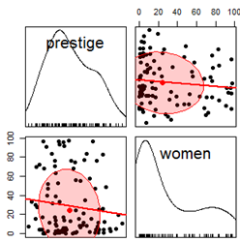
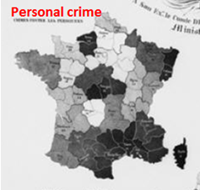
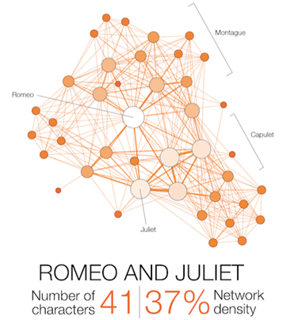
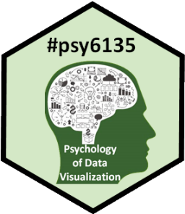
Varieties of information visualization
Michael Friendly
Psych 6135
https://friendly.github.io/6135 @datvisFriendly

Slide 2
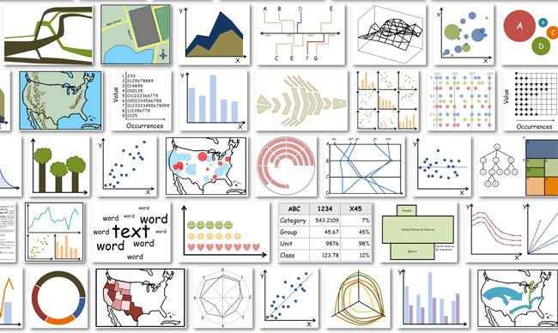
So many types
There are so many kinds of charts, diagrams, graphs, maps
What are their features?
What tasks are they good for? – Accuracy or speed of judgment? Memorability?

Slide 3
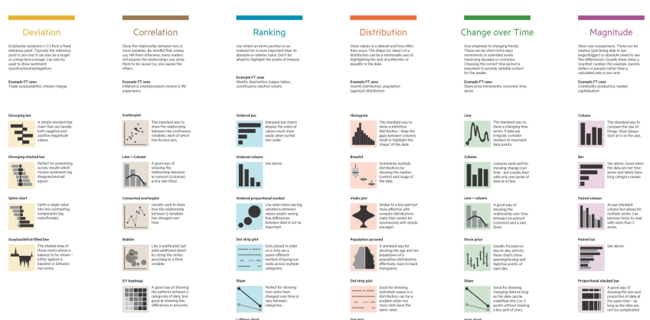
How to classify ???
For purposes of “What kind of graph should I use?” usually most useful to think: “What do I want to show?”
Financial Times, Chart Doctor, https://github.com/ft-interactive/chart-doctor

Slide 4
Topics, by graph type: Content & form
Statistical data graphs
1D: dotplot, boxplot, violin plot
1.5D: time-series plot, density plot, bar chart, pie chart
2D: scatterplot, ridgeline plot
3D: contour plot, 3D scatterplot, surface plot
Thematic maps
Choropleth map
Anamorphic map
Flow maps
Network & tree visualization
Animation & interactive graphics
Notes:
But theories of graphic often use a classification by graphical types based on content & form

Slide 5
Data graphs
0-d
•
Fig credit: Di Cook @visnut
1 D
1.5 D
2 D
3 D
n D ?
Data graphs can be roughly ordered by the number of variables, data dimensions shown in a given graph

Slide 6
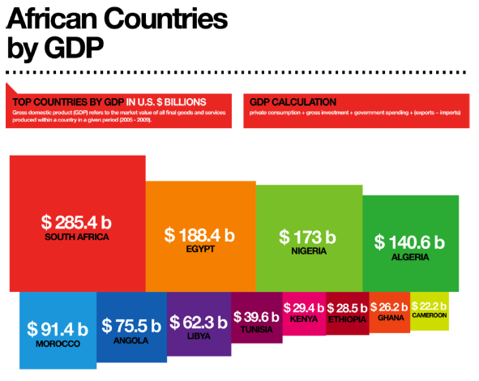
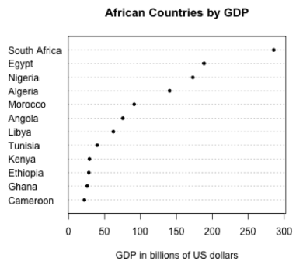
1D: Infographic vs. Data graphic
The same data can be shown in different forms, for different purposes
One might argue that this infographic has greater impact in showing the relative size of GDP
One might argue that this statistical graph makes comparisons easier

Slide 7
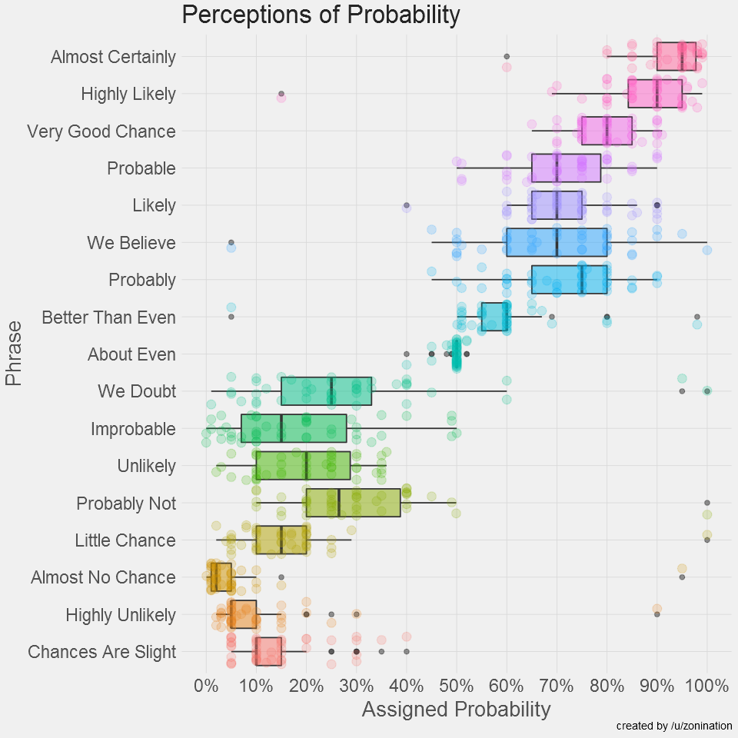
1.5D: Dotplots & boxplots
What number do you give to a probability phrase?
Boxplots summarize the important characteristics of a univariate data distribution:
center (median)
spread (IQR)
shape (symmetric? skewed?)
outliers?
25%
M
75%
outliers
IQR
This example overlays the boxplot with a jittered dotplot, so we can also see the individual observations
This visualization made the longlist for the 2015 Kantar Information is beautiful award. Data & R code: https://github.com/zonination/perceptions

Slide 8
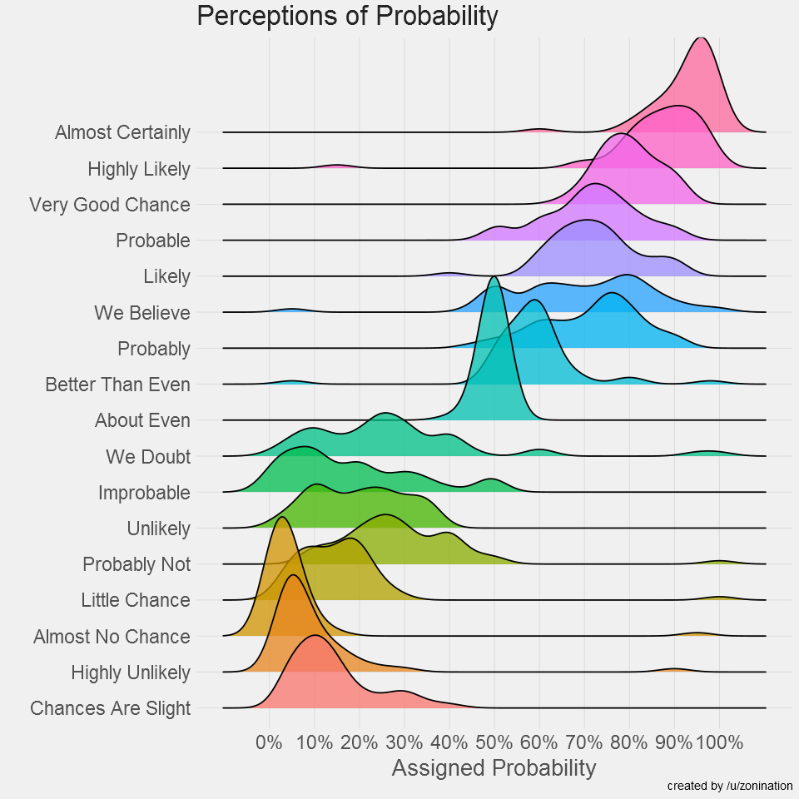
1.5D: Density ridgeline plots
Another possible 1D display is a density estimate– a statistically smoothed histogram.
For comparing a set of them, a ridgeline plot stacks them vertically to create the impression of a mountain range.
As in the boxplot version, this uses:
a progressive scale of colors
transparent colors to handle overlap
Q: What features stand out here?
Software note: These figures are drawn with R, using ggplot2 and the ggridges package. See: https://cran.r-project.org/web/packages/ggridges/vignettes/introduction.html

Slide 9
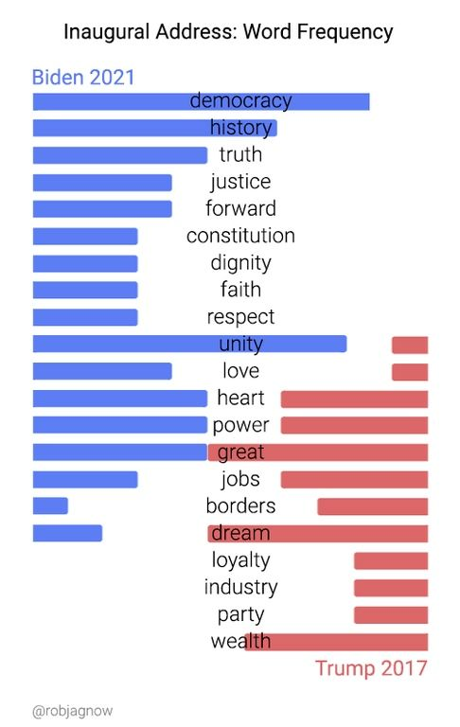
1.5D: Text bar charts
Text can be analyzed as data also, most often in frequency counts.
This chart uses a novel design to compare the most frequent words by Biden (2021) & Trump 2017) in their inaugural addresses.
The contrast is striking!
democracy, unity vs. great, dream
From: https://www.reddit.com/r/dataisbeautiful/comments/l7k0f0/us_inauguration_address_word_frequency_biden_vs/

Slide 10
Bar chart variations
Bar charts are often used to make comparisons between two series
But your eyes must move around to compare
An alternative is a dumbbell chart--- dot plot w/ connecting lines---making comparisons direct.
Effect ordering: Countries have also been sorted to show increase / decrease
Which countries gained the most from 1960 – 2000?
From: https://medium.com/@amorimfranchi/an-easier-to-interpret-alternative-to-paired-barplots-in-r-490d4472e8cd

Slide 11
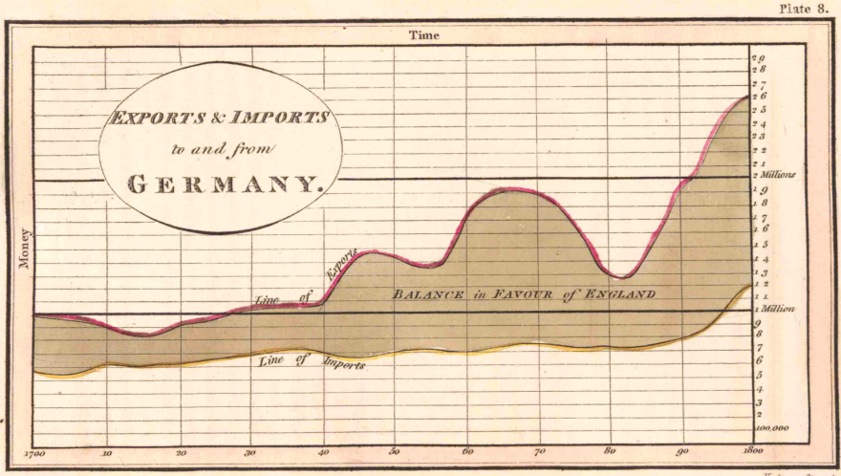
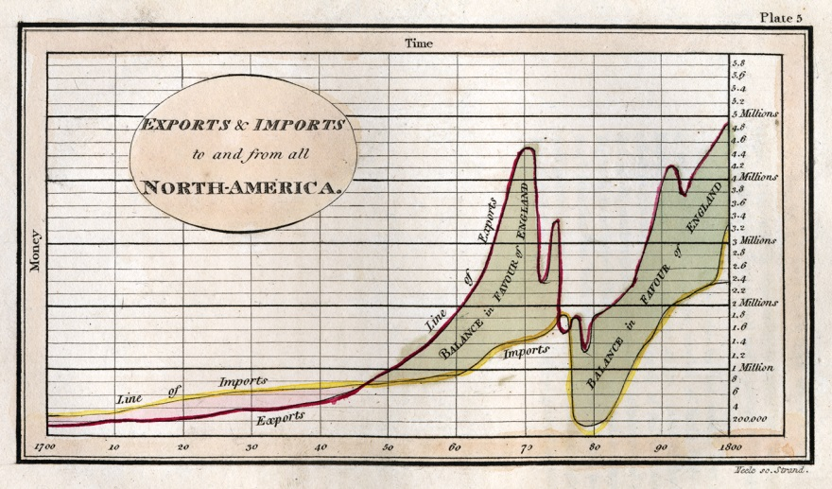
1.5D: Time series line graphs
William Playfair (1786), The Commercial and Political Atlas, invented the time series line graph as a way to show data on England’s trade with other countries
One curve for imports, one for exports
The balance of trade could be seen as the difference between the curves
Trade with Germany was consistently in favor of England
With North America, the balance changed back and forth over time
exports
imports
Economic ‘history’ could now be visualized and explained

Slide 12
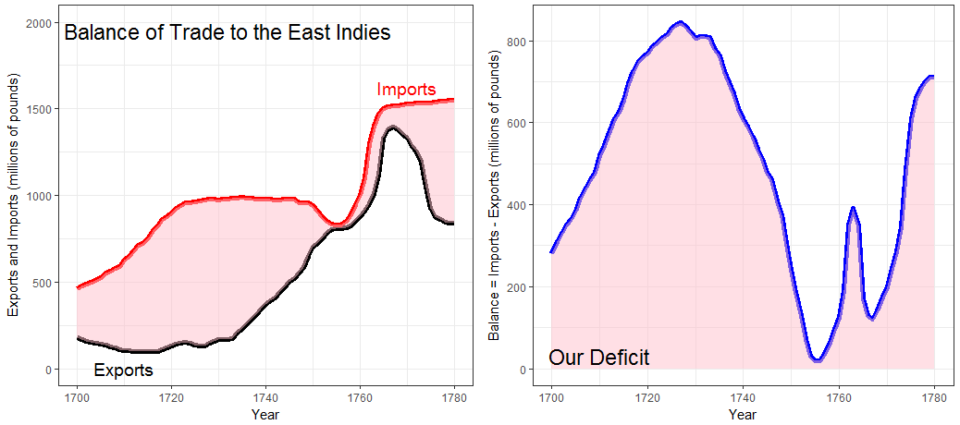
Psychology: Distances between curves
What Playfair didn’t know is that judgments of distance between curves are biased
We tend to see the perpendicular distance rather than the vertical distance
Plotting balance of trade directly
where did this spike come from?

Slide 13
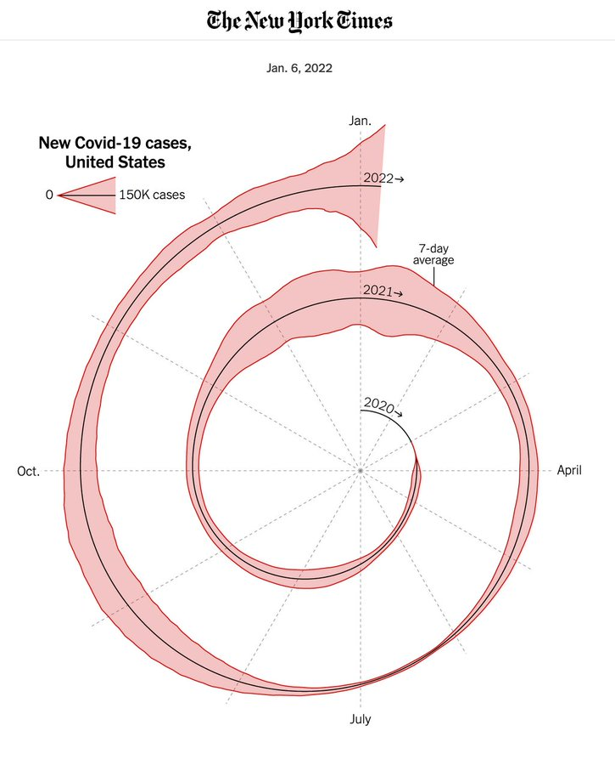
1.5D COVID spiral graph
This graph shows a 1.5D time series of COVID-19 cases over the entire span of the pandemic
It is wrapped into a spiral to compare months over years.
Does this work for you, or is it too weird?
Is it the “tapeworm of doom”?
Hey – wait
Isn’t this just a time-series in polar coordinates?
See commentary: https://www.youtube.com/watch?v=YWOWF9Vi4Mw

Slide 14
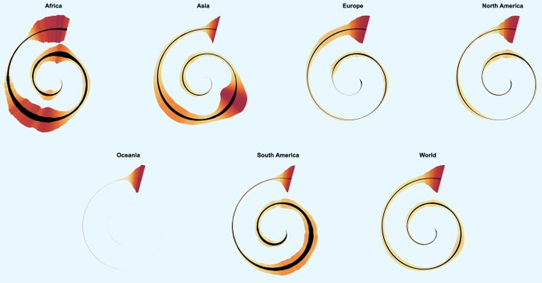
Multi-sprials
Multiple spirals: Allow comparison of the patterns for different geographic units
Overlaid time-series probably would not work here
How could this be improved?
Color: smoothed new Covid-19 cases
Black: Deaths (10x scale)
https://twitter.com/h_i_g_s_c_h/status/1483195230404947968

Slide 15
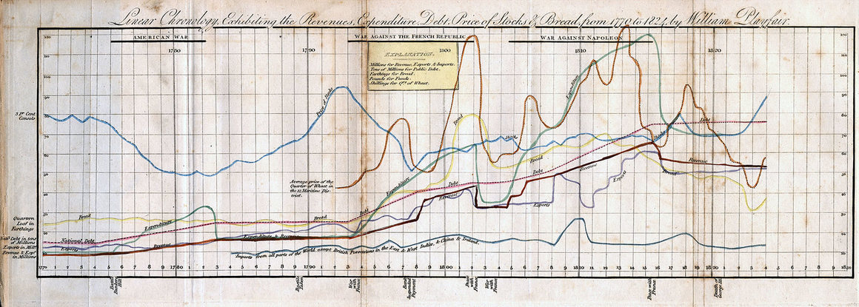
Multiple time series graphs
Things get messy when there are many series to be compared
To be fair, this was designed as timeline of history– a visual story of economics (prices, wages, imports, exports, debt)
History shown as a strip-chart recording (e.g., EKG)
It was Playfair’s last graph.
Perhaps the earliest example of visual storytelling
Playfair, W. (1824) Chronology of Public Events and Remarkable Occurrences.

Slide 16
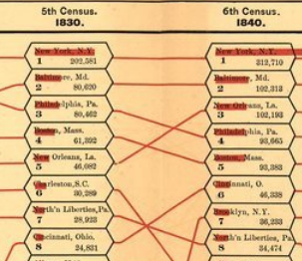
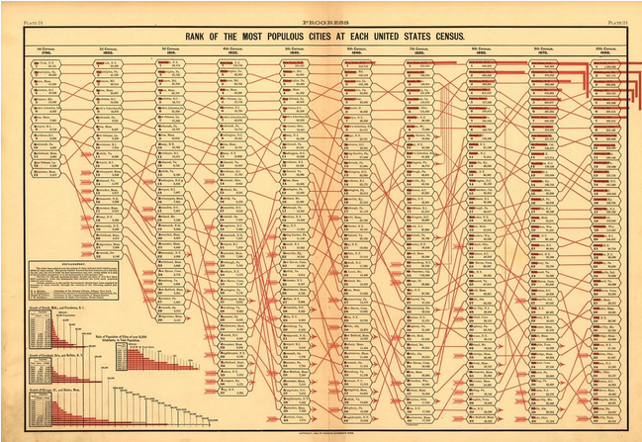
Parallel ranked list charts
Another solution for multiple time series is to chart the ranks of observations and connect them with lines to show changes in relative position.
Slopes of lines reflect change in rank
Red bars try to show the numbers
Ranks of populations of US cities across census years
From: Statistical Atlas of the United States (1880)

Slide 17
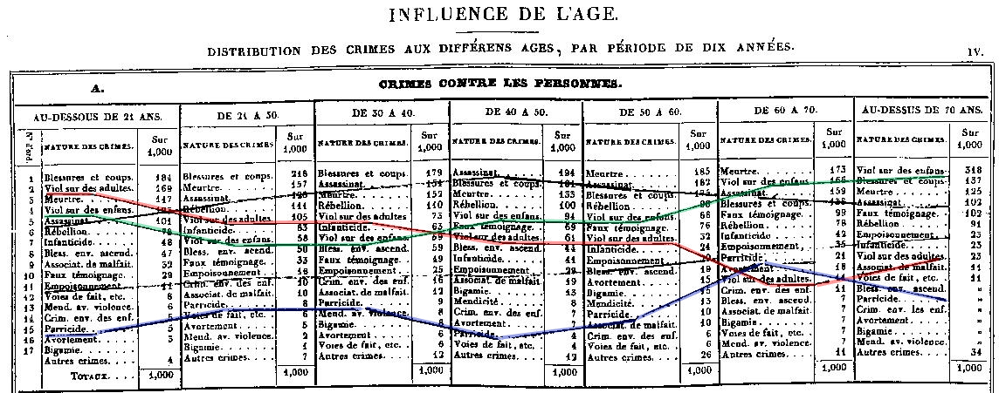
Propensity of crimes across age
André-Michel Guerry (1833), rank order of crimes at different ages
sexual assault against adults decreases with age
sexual assault against children increases with age
parricide relatively low until 60-70
Friendly, (2007). “A.-M. Guerry’s Moral Statistics of France: Challenges for Multivariable Spatial Analysis,” Statistical Science, vol. 22, no. 3. https://www.datavis.ca/papers/guerry-STS241.pdf

Slide 18
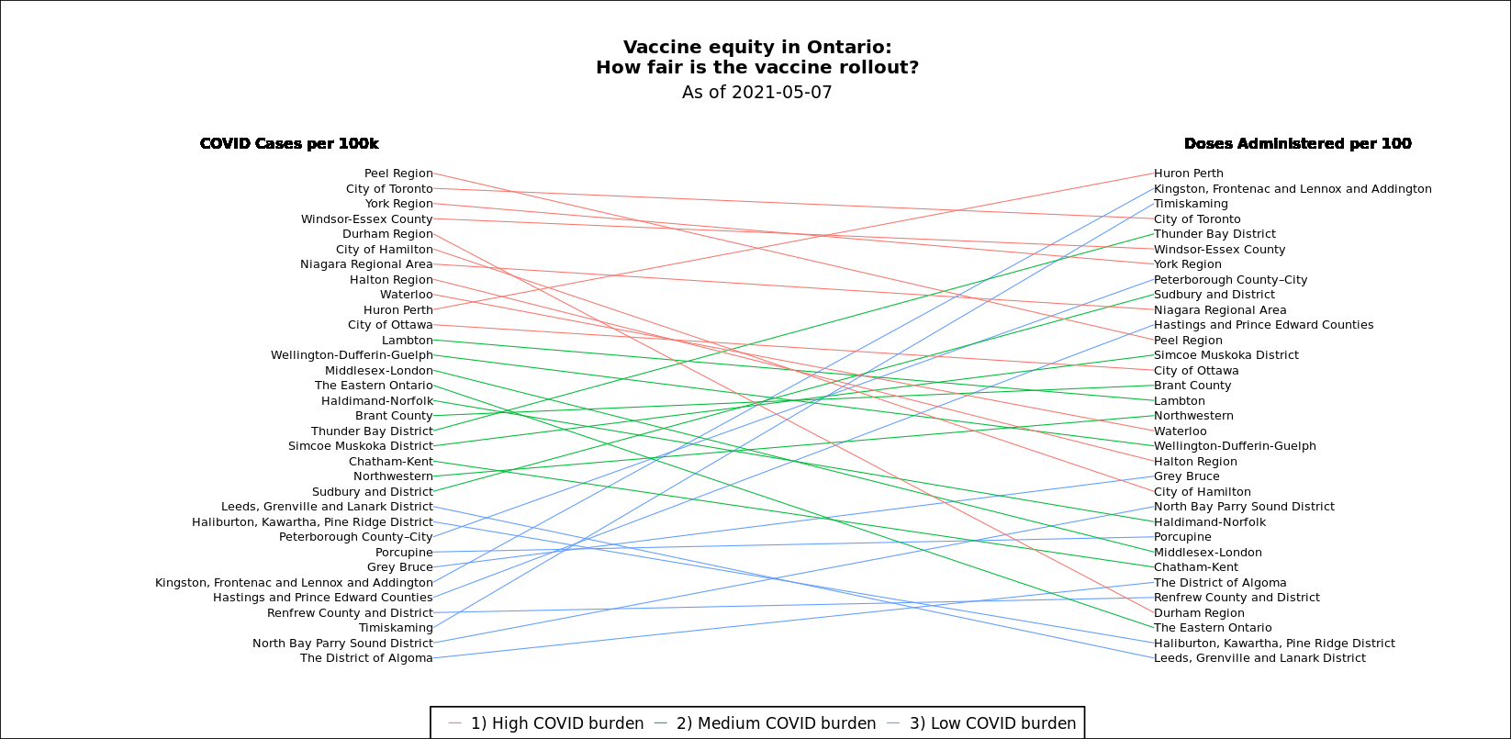
Slope graph of COVID: Cases vs. Doses
Vaccine equity → all lines should be ≈ flat
Which health regions stand out?
How could this graph be better?
cases
doses
bad
good
Graphic by Matthew Dubins, @MDubins

Slide 19
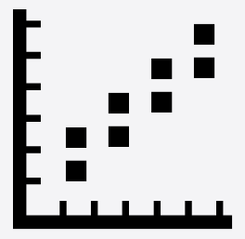
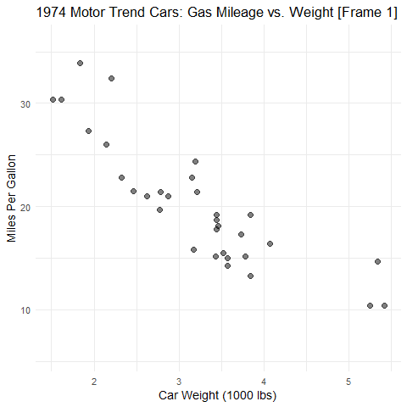
2D: Scatterplots
Goals: Want to see--
Overall pattern:
direction
form
strength
Deviations from pattern:
residuals
outliers
Annotations can help:
regression line
confidence band
smoothed curve (nonlinear?)
residuals

Slide 20
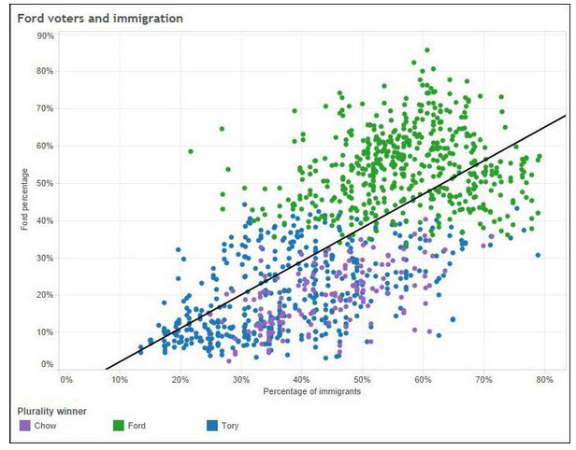
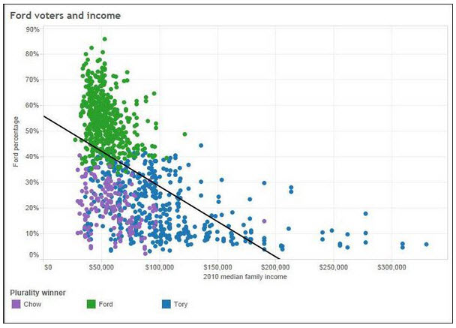
2D: Scatterplots: Ford Nation
Who voted for Rob Ford in the 2014 Toronto mayoral election?
Ford percentage
% immigrants
income
These simple scatterplots by data journalist Patrick Cain use simple enhancements:
Color, for candidate (Chow, Ford, Tory)
Overall regression line
Source: https://globalnews.ca/news/1652571/ford-nation-2014-15-things-demographics-tell-us-about-toronto-voters/

Slide 21
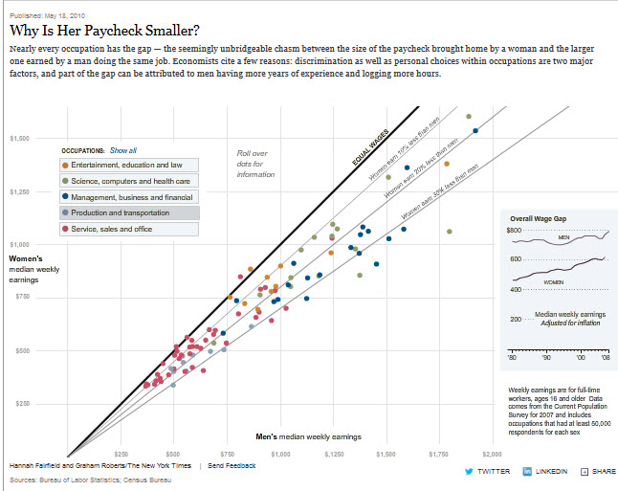
Scatterplots: Wage gap
How to compare salaries of men & women in different occupations?
The NYT chose to plot median salaries for women against those for men, in different occupational groups
The 45º line represents wage parity
Other lines show 10, 20, 30% less for women
How else to show this?
Alberto Cairo, The Truthful Art, Fig 9.19, from:
http://www.nytimes.com/interactive/2009/03/01/business/20090301_WageGap.html

Slide 22
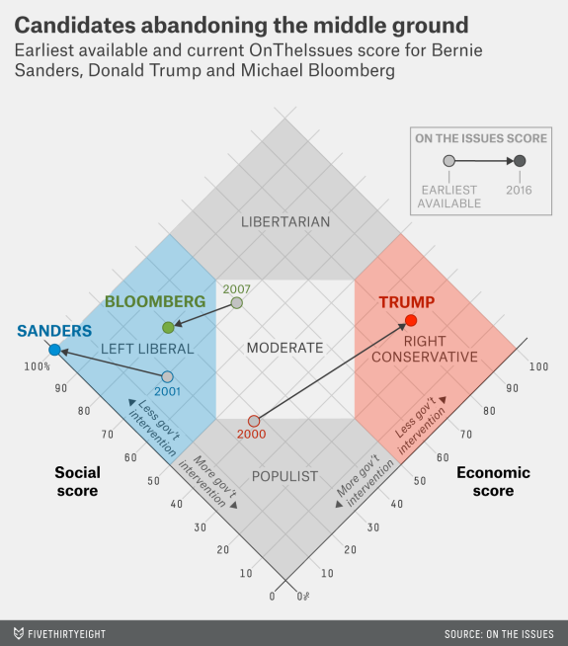
Scatterplots: InfoVis
This graph, from fivethirtyeight.com was designed to show how some presidential candidates had shifted positions before the 2016 election.
The axes are a score on social and economic policy, but they rotate the axes by 45º to create zones related to political thought.
This info graphic is eye-catching and self-explanatory:
colored/labeled zones
interpretive labels on axes
arrows showing movement to extremes

Slide 23
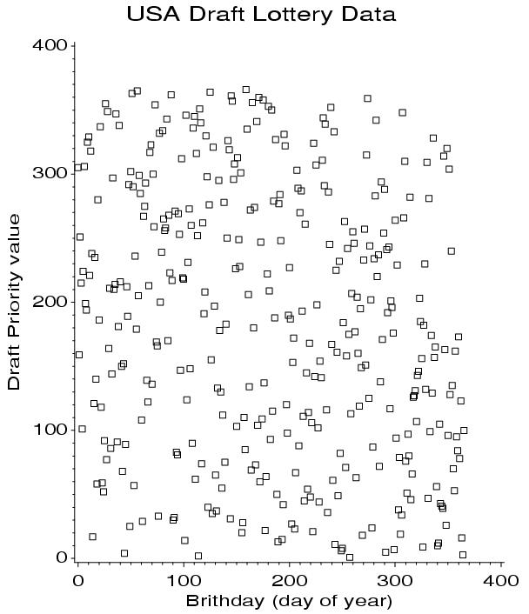
Scatterplots: Annotations enhance perception
Data from the US draft lottery, 1970
Birth dates were drawn at random to assign a “draft priority value” (1=bad)
Can you see any pattern or trend?
This is an example of data with a weak signal and a lot of noise
Less likely to be drafted
Me (May 7):
127 → priority = 35
More likely to be drafted

Slide 24
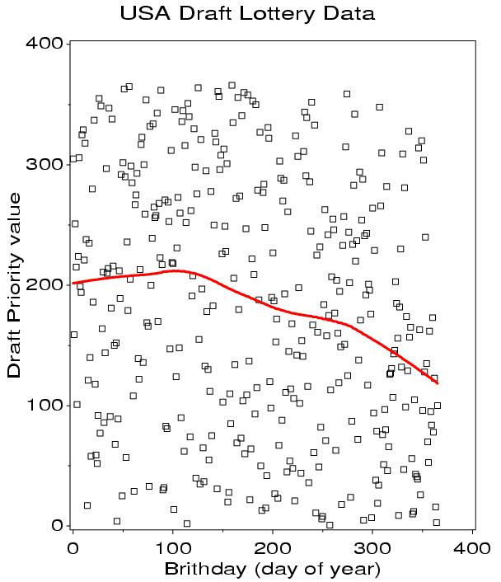
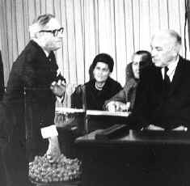
Scatterplots: Smoothing enhances perception
Drawing a smooth curve shows a systematic decrease toward the end of the year.
The smooth curve is fit by loess, a form of non-parametric regression.
Visual explanation:

Slide 25
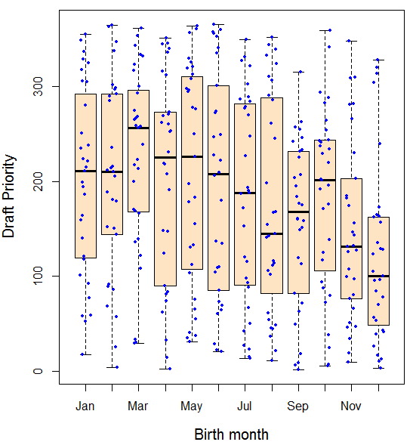
Smoothing by grouping and summarization
Another form of smoothing is to
make one variable discrete &
show a graphical summary – here a boxplot
The decrease in later months becomes apparent
Perception: the boxplots form the foreground; the jittered points show the data

Slide 26
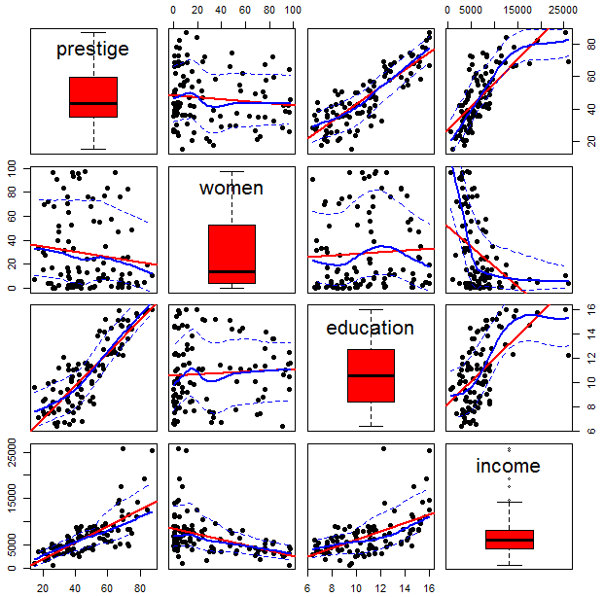
Scatterplot matrices
A scatterplot matrix shows the bivariate relation between all pairs of variables.
Seeing these all together is more useful than a collection of separate plots.
Q: How does occupational prestige depend on %women, education and income?
The individual plots are enhanced with linear regression lines and non-parametric smooths to show non-linearity
This figure uses scatterplotMatrix() in the car package. There are many options.

Slide 27
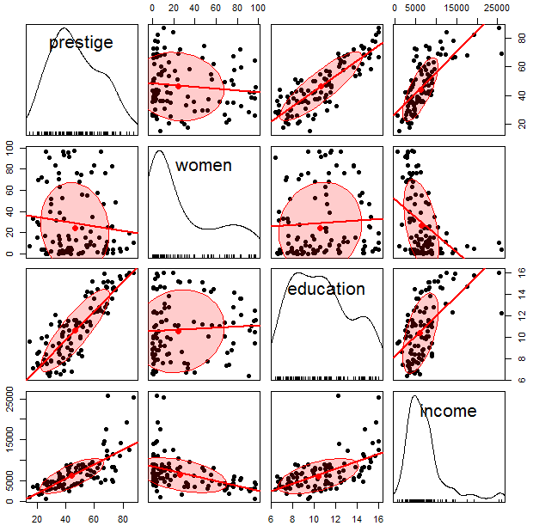
Scatterplot matrices
Essential idea: You can choose different methods to render the diagonal & off-diagonal panels
Density plots are often more useful for showing the shapes of distributions
prestige: ~ symmetric
women: bimodal
income: highly skewed
A data ellipse gives a visual summary of the direction and strength of the relationship
Again, graphical annotation aids interpretation.

Slide 28
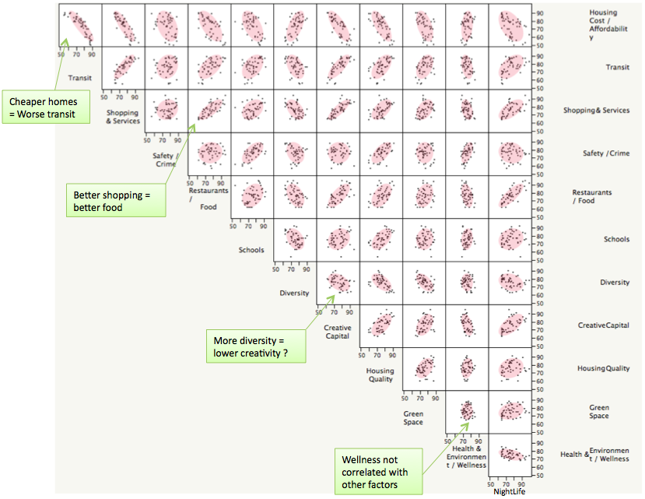
Larger data sets
Scatterplot matrices hold up reasonably well with a larger number of variables
Where to live in NYC?
This SPM shows 12 variables on ~ 60 neighborhoods
The data ellipses provide a visual summary
I call this visual thinning – reducing details in a larger picture
In an interactive display we can zoom in/out
From: http://junkcharts.typepad.com/junk_charts/2010/06/the-scatterplot-matrix-a-great-tool.html

Slide 29
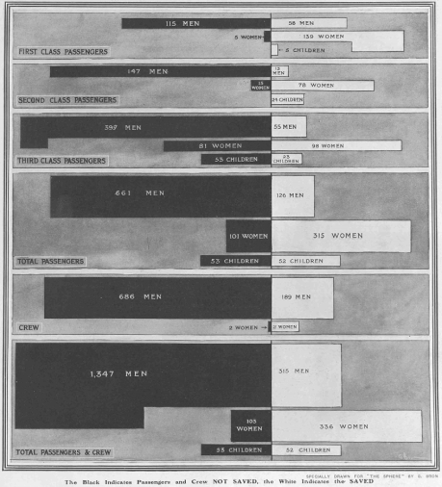
Categorical data
died
survived
This remarkable chart shows survival on the Titanic, by Class for passengers and Gender and Age.
It was drawn by G. Bron, a graphic artist, and published in The Sphere, one month after the Titanic sank.
It uses back-to-back bar charts, with area ∼ frequency
1st
2nd
3rd
crew
See our web page: http://datavis.ca/papers/titanic/

Slide 30
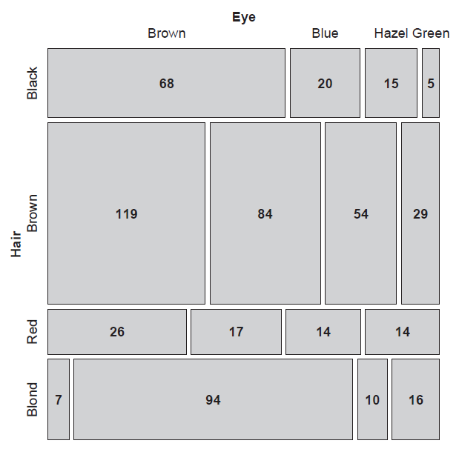
Categorical data: Mosaic plots
Similar to a grouped bar chart
Shows a frequency table with tiles, area ~ frequency
> data(HairEyeColor)
> HEC <- margin.table(HairEyeColor, 1:2)
> HEC
Eye
Hair Brown Blue Hazel Green
Black 68 20 15 5
Brown 119 84 54 29
Red 26 17 14 14
Blond 7 94 10 16
> chisq.test(HEC)
Pearson's Chi-squared test
data: HEC
X-squared = 140, df = 9, p-value <2e-16
How to understand the association between hair color and eye color?

Slide 31
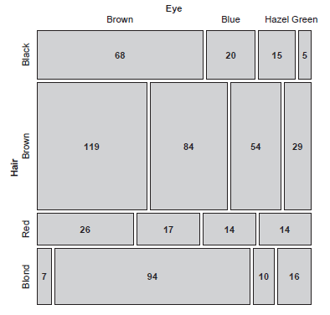
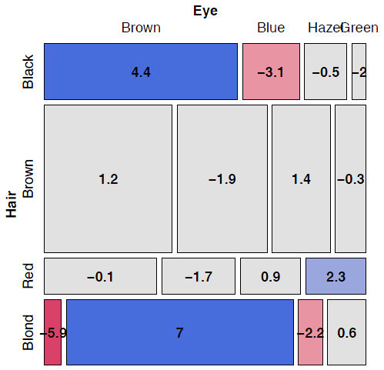
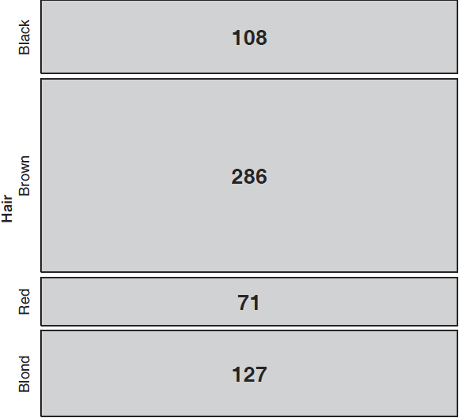
Mosaic plots
Area proportional display of frequencies in n-way table
Shaded according to deviation (residual) from independence
Divide unit square ~ V1 marginal frequencies
Subdivide each ~ V2|V1 conditional frequencies
Shade ~ residual (d_{ij})
positive: O > E
negative: O < E

Slide 32
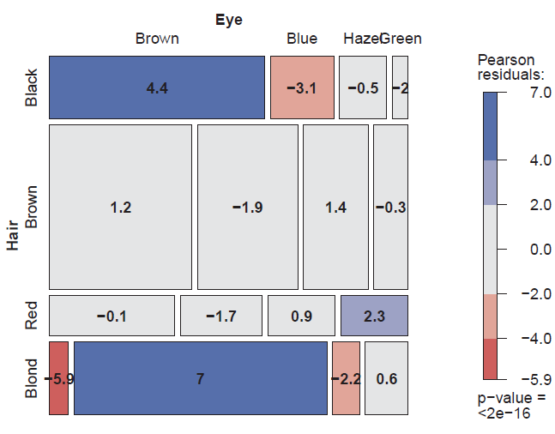
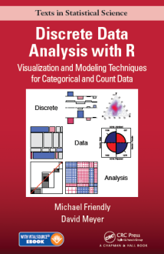
Mosaic plots
Shade each tile in relation to the contribution to the Pearson χ² statistic
> round(residuals(chisq.test(HEC)),2)
Eye
Hair Brown Blue Hazel Green
Black 4.40 -3.07 -0.48 -1.95
Brown 1.23 -1.95 1.35 -0.35
Red -0.07 -1.73 0.85 2.28
Blond -5.85 7.05 -2.23 0.61
Mosaic plots extend readily to 3-way + tables
They are intimately connected with loglinear models
See: Friendly & Meyer (2016), Discrete Data Analysis with R, http://ddar.datavis.ca/

Slide 33
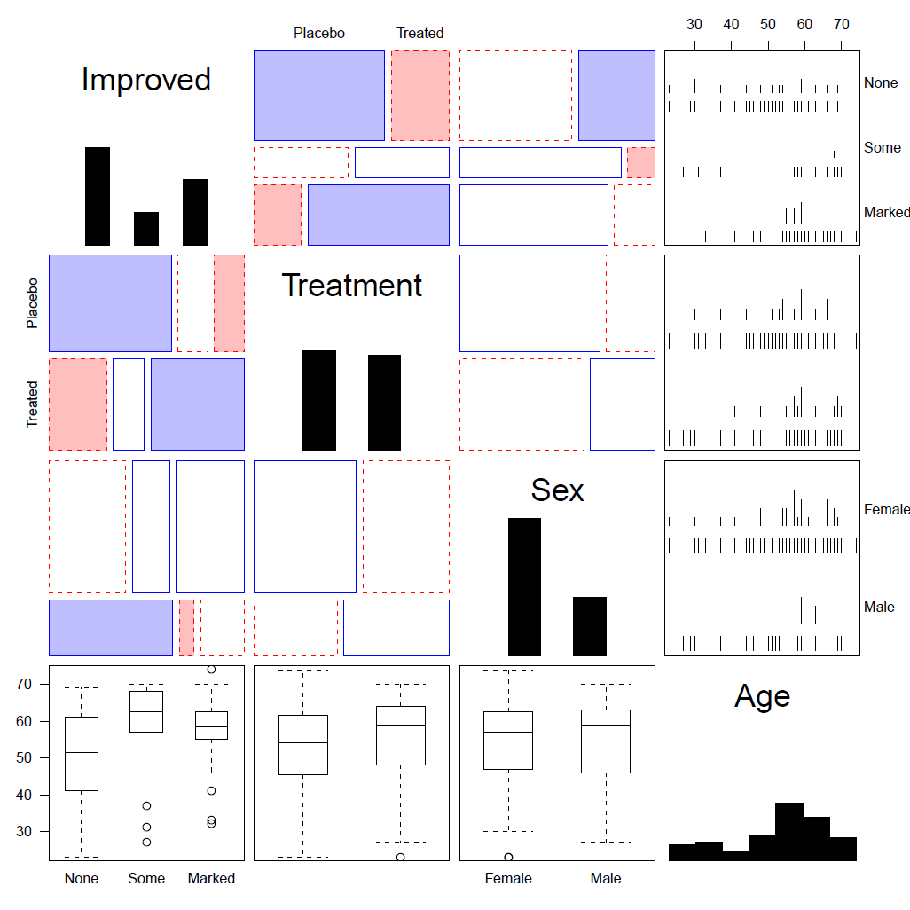
Generalized pairs plots
Generalized pairs plots from the gpairs package handle both categorical (C) and quantitative (Q) variables in sensible ways
x | y | plot
Q | Q | scatterplot
C | Q | boxplot
Q | C | barcode
C | C | mosaic
library(gpairs)
data(Arthritis)
gpairs(Arthritis[, c(5, 2:5)], …)

Slide 34
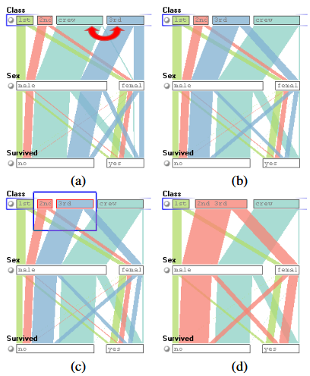
Parallel Sets
Titanic data: Who survived?
Parallel sets use parallel coordinate axes to show the relations among categorical variables.
The frequencies of one variable (Class) are sub-divided according to the joint frequencies in the next (Sex) and shown by the width of the connecting line.
The ParSets application is interactive:
categories can be reordered (a, b)
categories can be grouped (c, d)
From: Kosera et al. (2006), https://kosara.net/papers/2006/Kosara_TVCG_2006.pdf

Slide 35
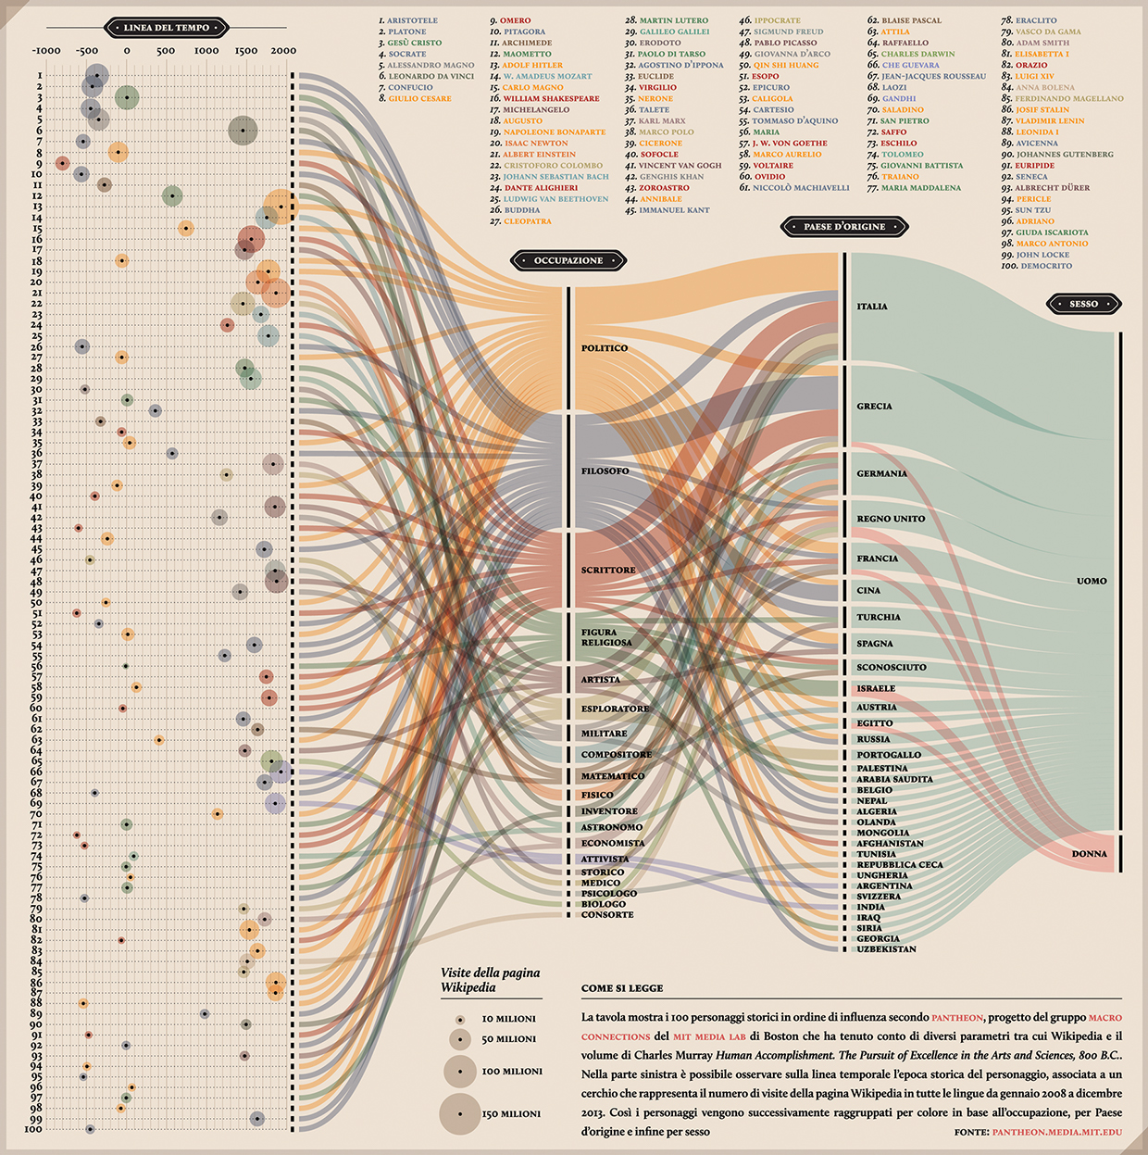
Sankey diagram
Pantheon, by Valerio Pellegrini
Visualizing the 100 most influential figures in History (Wikipedia visits)
Columns show occupation, country of origin and gender
Flow lines link individuals to the column variables, width ~ influence

Slide 36
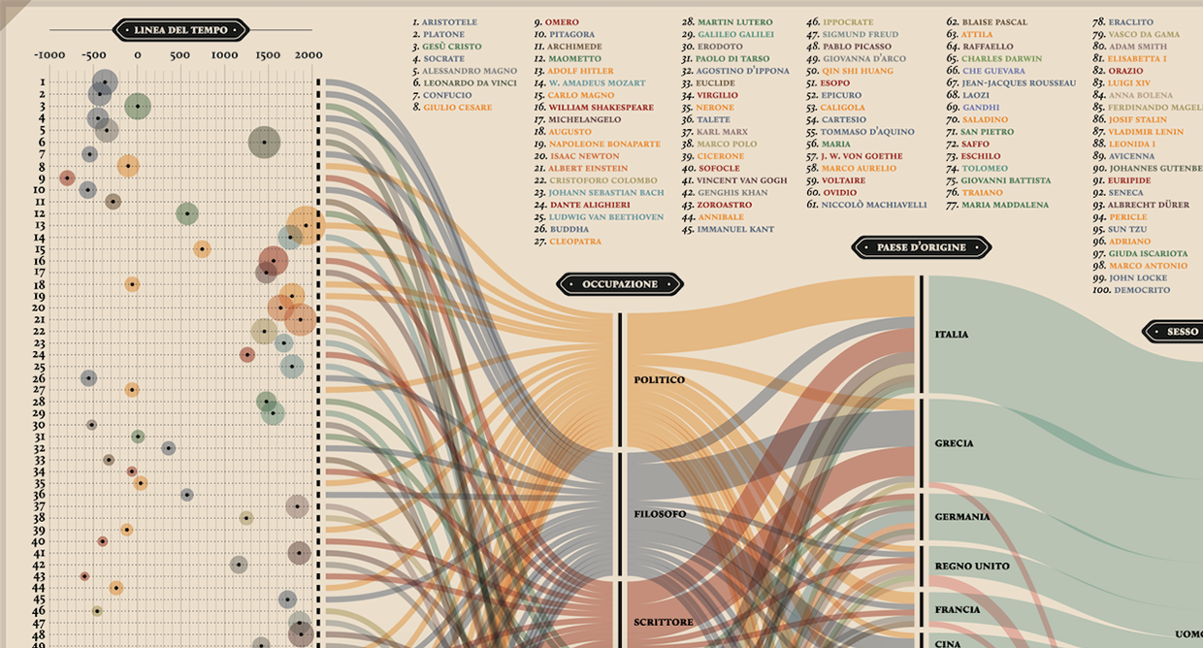
Sankey diagram
Multiple dimensions of the most influential people in history
From: http://visualoop.com/blog/83382/pantheon-by-valerio-pellegrini

Slide 37
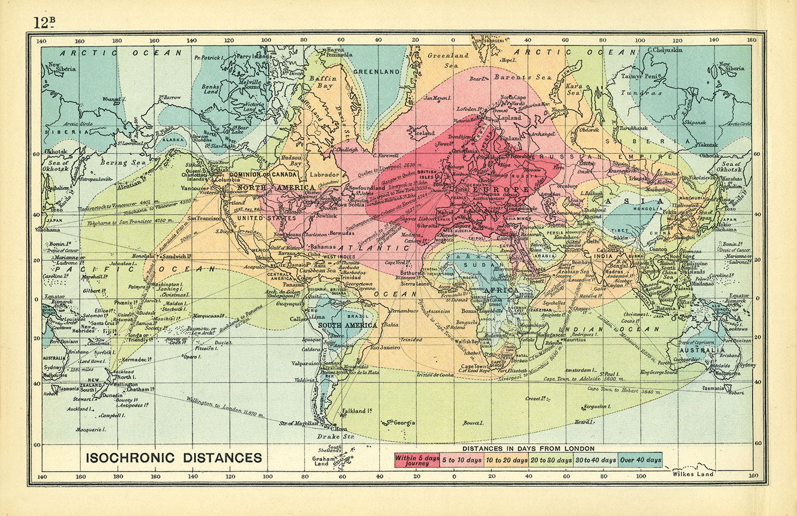
3D: Iso-contour maps
Early attempts to show 3D data used contours of equal value on a map
The data was actually very thin; the contours the result of imaginative smoothing
Francis Galton, Isochronic chart of travel time, 1881

Slide 38
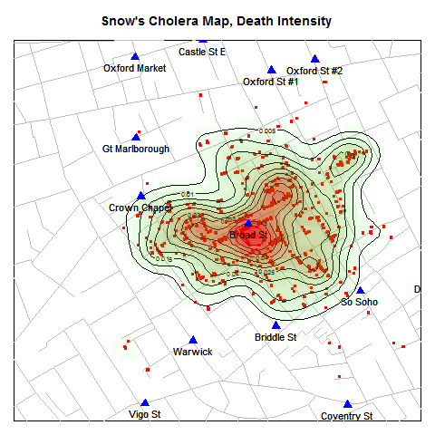
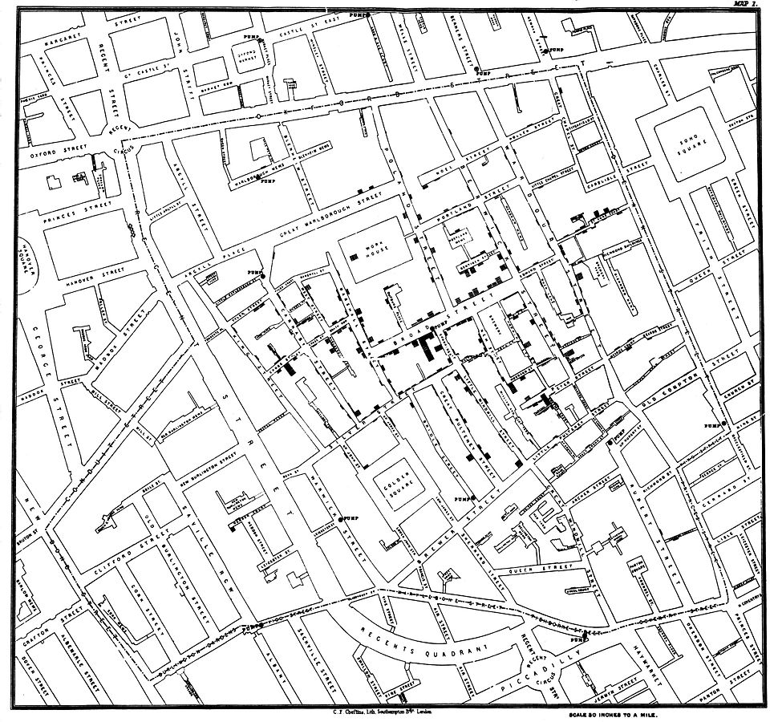
3D: Bivariate density estimation
John Snow’s map of cholera deaths in London, 1854
Modern statistical techniques can compute contours of constant density
Broad St. pump
Data: HistData package for R

Slide 39
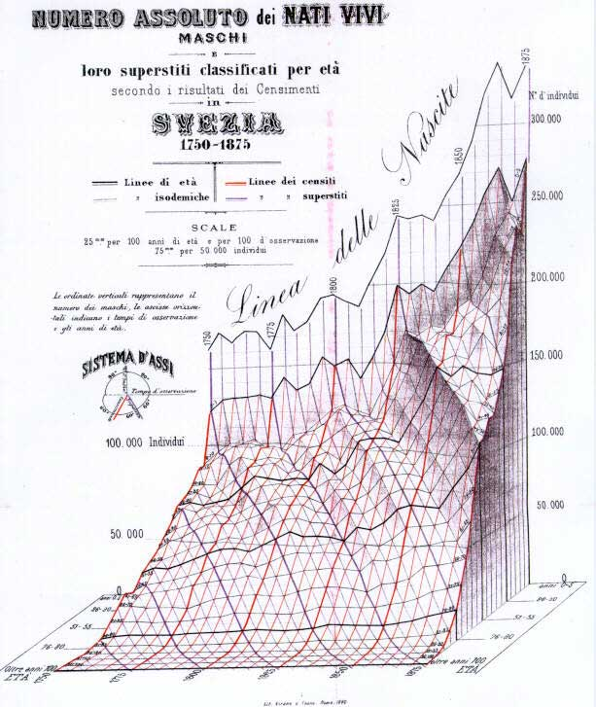
3D: population pyramid
Italian demographer Luigi Perozzo (1880) developed the first true 3D diagram showing the population of Sweden over years and age groups as a 3D surface
Census counts for a given year are shown by the red lines
Survival of a given age are shown by black lines
Cohorts are shown by diagonal lines down & to the right
These 3 variables are primary in demography.
A mystery here: what caused the decline at the upper right?
census
cohort
age
1750
year
1875

Slide 40
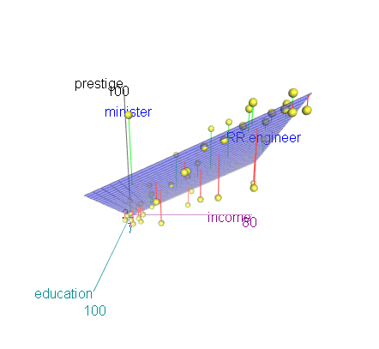
3D: scatterplot & regression surface
How does occupational prestige depend on income & education?
This plot shows the data and a fitted multiple regression surface, connecting the points to the regression plane
It is hard to see in a static view, but easier when the plot is rotated dynamically
This plot is produced in R, using the car and rgl packages
data("Duncan", package="car")
scatter3d(prestige ~ income + education, data=Duncan, id.n=2)
movie3d(spin3d(c(0,1,0), rpm=6), duration=6, movie="duncan-reg3d")

Slide 41
Dashboards
Dashboards provide multiple images of different aspects, often linked interactively

Slide 42
Exercise
What is this SUNBURST chart trying to show?
How many dimensions of data?
What do the colors mean?

Slide 43
Thematic (statistical) maps
Image from: David Rumsey Map Collection, https://www.davidrumsey.com/

Slide 44
Thematic maps & Spatial visualization
Thematic maps use a wide variety of techniques to display quantitative or qualitative variables on the geographic framework of a map
Once the domain of cartographers, these ideas are now being developed as an area of geospatial visualization and geospatial statistical methods
From: Slocum et al., Thematic cartography and geographical visualization, Fig 4.3
------ # dimensions -------

Slide 45
Thematic maps: Types
Basic types of thematic maps
Most are direct mappings of numbers to visual variables
Choropleth maps shade by geographic unit
Isopleth maps use contours of equal value
From: Slocum et al., Thematic cartography and geographical visualization, Fig 4.9

Slide 46
Thematic maps: Theory
Alan MacEachern (1979) classifies point, line and area symbols on thematic maps according to whether they depict quantitative or qualitative phenomena, in the physical or cultural domain.
This is a coarse classification.
Theories, ideas, and methods have advanced considerably since this time.
MacEachern, A. (1979). The Evolution Of Thematic Cartography / A Research Methodology and Historical Review, The Canadian Cartographer 16(1) June 1979, p. 17-33

Slide 47
Choropleth maps
Balbi & Guerry (1829)
First thematic maps of crime data
First comparative maps (“small multiples”)
→Crime against persons inversely related to crime against property
→Education: France obscure & France éclairée
→N. of France highest in education & also property crime
This was the beginning of modern criminology & social science --- relations among social variables made visible
See: Friendly, M. (2022). The life and works of André-Michel Guerry, revisited. Sociological Spectrum, 42, 233–259

Slide 48
Anamorphic maps
Anamorph: Deforming a spatial size or shape to show a quantitative variable
Émile Cheysson used this to show the decrease in travel time from Paris to anywhere in France over 200 years
Album de Statistique Graphique, 1888, plate 8

Slide 49
What’s wrong with choropleth maps?
Choropleth maps are misleading because size (area) of units dominates perception.
This is particularly true for maps of the US & Canada. Not so for France (why?)
Montana looks bigger than Washington
Note use of labels for small NE states
fivethirtyeight.com election predictions, Oct. 13, 2017

Slide 50
Cartogram (tilegrams)
A tilegram uses hexagonal tiles to make area proportional to a given variable
Here, the size of each state is made ~ number of electoral college votes
Now, it is easy to see the impact of states
Take-away: Area doesn’t vote; People do!
fivethirtyeight.com election predictions, Oct. 13, 2017

Slide 51
Mosaic cartograms
US map provides a spatial framework for showing the distribution of categorical data
Each tile is positioned as in a schematic US map

Slide 52
Geo-faceting
More general idea:
A grid of (x, y) locations defines geographic units
Each grid cell can be composed of any kind of plot conceivable with ggplot2
From: https://cran.r-project.org/web/packages/geofacet/vignettes/geofacet.html

Slide 53
Worldmapper: The world in cartograms
How to visualize social, economic, disease, … data for geographic units?
worldmapper.org : cartograms: area ~ variable of interest (700+ maps)
Notes:
Choropleth maps are often difficult to decode because area of states is confounded with the measure of intensity to be shown.

Slide 54
Worldmapper: Carbon emissions
This map animation shows the growth in CO2 emissions globally: the map keeps growing in size from 1970 - 2016
also shows the changing shares of countries contributing to the increase in emissions
https://worldmapper.org/map-animation-co2-emissions/
Notes:
These pages are well-designed according to data vis principles – high impact overview graphic accompanied by interpretive details and explanation.

Slide 55
Worldmapper: Cholera deaths
Deaths from cholera in 2004. Territory size ~ proportion of worldwide deaths
http://www.worldmapper.org/display.php?selected=232

Slide 56
Bivariate maps
Vaccination rates and COVID hospitalizations
How to show relation between two variables on a map?
Bivariate maps combine two colors with degrees of saturation
Claim:
Regions with more vaccinations have fewer hospitalizations
Can you see this?
https://www.washingtonpost.com/health/2021/09/23/covid-vaccination-hospitalization-map/

Slide 57
Scatterplot to the rescue
This lovely scatterplot shows:
Yes, inverse relation ✓
NB: Classing of color
Whoa: non-linear trend?
But:
Shouldn’t the axes be reversed?
Geography is ignored

Slide 58
Contour maps
Contour maps ignore region boundaries and estimate constant contours of a phenomenon over geographical space. This is a form of geo-smoothing.
From: https://medium.com/two-n/an-alternative-to-choropleth-contour-density-maps-in-d3-js-93e1fdbdc4e

Slide 59
Spatial visualization: Analysis + maps
Linguistics: Food dialect maps– visualizing how people speak
soda vs. pop?
In the Cambridge Online Survey of World Englishes, Bert Vaux and Marius L. Jøhndal surveyed 11,500 people to study the ways people use English words.
NC State Univ. student Joshua Katz turned the US data into shaded kernel density maps.
Take the survey: http://www.tekstlab.uio.no/cambridge_survey
Programming in R: http://blog.revolutionanalytics.com/2013/06/r-and-language.html

Slide 60
Spatial visualization: Analysis + maps
Linguistics: Food dialect maps– visualizing how people speak
crawfish, crawfish, crawdad?
A k-nearest neighbor kernel density estimate over (x,y) locations gives a smoothed & interpretable display of the choice probabilities.
Regional differences are quite apparent.
The use of color combines discrete categories with intensity to give a meaningful display

Slide 61
Flow maps
Flow maps show movement or change in a geographic framework
The master work is this image by Charles-Joseph Minard (1869)
Marey (1878): “defies the pen of the historian in its brutal eloquence”
Tufte (1983): “the best statistical graphic ever produced”
Notes:
My next topic starts with the famous graph by Charles Joseph Minard depicting the fate of Napoleon’s Grand Armee in the disastrous 1812 campaign on Moscow.
Do I need to describe it?
It shows the strength of Napoleon’s army, starting nearly half a million strong at the Polish border …

Slide 62
Effect of US civil war on cotton trade
Before
After
Note the deformation of the map to accommodate the data
Notes:
Another set of before-after diagrams to explain the effect of the US civil war on trade in cotton illustrate my theme of visual explanation.
The visual message here is immediate: most imports of cotton from the southern US disappeared, and some were replaced from India and Egypt.

Slide 63
The Great Migration
In a graphic tribute to C.-J. Minard and W. E. B. Du Bois, RJ Andrews & Howard Wainer tell the story of the migration of blacks from the southern US after freedom from slavery.
Migration
Lynchings
Andrews, R. J. & Wainer, H. The Great Migration: A Graphics Novel Featuring the Contributions of W. E. B. Du Bois and C. J. Minard. Significance, 2017, 14, 14-19. See also: http://infowetrust.com/picturing-the-great-migration/ for the story of this graphic

Slide 64
Network visualization
Once the domain of mathematicians & computer scientists, graph theory and network visualization turn out to have surprising & interesting applications.
Animated demo by Martin Granjean showing transport of passengers from/to world airports.
It illustrates the difference between geography & force-directed layout to focus on volume & connections
From: http://www.martingrandjean.ch/connected-world-air-traffic-network/
See more: https://flowingdata.com/2016/05/31/air-transportation-network/

Slide 65
Network visualization: Transport maps
How do I get from Chigwell to Charing Cross?
How much will it cost?
This route map shows the connections and fare zones
The first one was designed by Henry Beck in 1931.
The modern version is zoomable and available on your phone.
See: https://tfl.gov.uk/maps/track

Slide 66
Network visualization: Shakespeare tragedies
A new form of literary criticism?
Martin Grandjean looked at the structure of Shakespeare tragedies through character interactions.
Each circle (node) represents a character, and an edge represents two characters who appeared in the same scene.
The structural characteristics of the graphs have meaningful interpretations.
From: https://flowingdata.com/2015/12/30/shakespeare-tragedies-as-network-graphs/

Slide 67
Semantic memory: Cognitive structure
Various tasks can be used to assess the relations among words/concepts in our semantic memory
The data can be used to calculate measures of similarity, and be shown in network or other diagrams
Verbal fluency task: Say/write all the names of [animals, countries, …] you can in 1 minute.
Similarity ratings: For each pair, indicate how similar they are
From: Wulff et al. (2018), Structural differences in the semantic networks of younger and older adults, https://www.nature.com/articles/s41598-022-11698-4

Slide 68
Semantic memory: Cognitive structure
Fluency
Similarity
Do younger and older adults differ on measures calculated from their network diagrams?
<k> : Average “degree” # of connections
C : average local clustering
L : average path length in network
Δ() : young – old difference
IMHO, this graph tries to do too much.
The fluency data is most important to their argument.
ΔL & Δ <k> show consistent differences between young & old

Slide 69
Love, Actually: Interactive app
Interactions among characters in Love, Actually
Data:
Interactive Shiny app: https://dgrtwo.shinyapps.io/love-actually-network/

Slide 70
WikiLeaks Iraq war logs
Johnathan Stray & Julian Burgess analyzed > 11,000 documents for SIGACT (“significant action”) reports from the 2006 Iraqi civil war made available by WikiLeaks.
Each report is a dot. Each dot is labelled by the three most “characteristic” words in that report.
Documents that are “similar” have edges drawn between them, width ~ similarity
The graph-drawing algorithm placed similar nodes together
From: http://jonathanstray.com/a-full-text-visualization-of-the-iraq-war-logs

Slide 71
WikiLeaks Iraq war logs
Certain themes became clear, and could be studied in rich detail
The underlying methods use “term frequency–inverse document frequency” measures of text-mining.
Murder cluster. All contain the word “corpse”
Torture-abduction cluster
http://jonathanstray.com/wp-content/uploads/2010/12/Murders.png
http://jonathanstray.com/wp-content/uploads/2010/12/Torture-abduction.png

Slide 72
Twitter network of R users
Perry Stephenson explores the connections among the top 50 R users on Twitter
The rtweet package provides access to Twitter info
library(rtweet)
followers <- get_followers(“datavisFriendly"))
From: https://perrystephenson.me/2018/09/29/the-r-twitter-network/

Slide 73
Twitter circles Who do I most often interact with?
Three rings to show my twitter world
One ring to rule them all:
@datavisFriendly
Other rings: #datavis, #maps, #rstats, #psy6135
Generated by http://chirpty.com

Slide 74
Tree-based Visualization
Branching patterns
History as a tree
Treemaps
Ramon Llull, 1298, Tree of Philosophy of Love
Showing aspects of love between God and the faithful Catalan
Notes:
Image:

Slide 75
Tree diagrams
Trees are natural, organic visual metaphors for branching processes and space-filling designs.
Ramon Llull’s tree of science, showing roots and branches of knowledge
Charles Darwin’s first visual sketch of the evolution of species

Slide 76
History as a Tree:
Geschictesbaum Europa (2003)
The entire history of Europe in one diagram
space-filling design: resolution ~ time²
natural metaphors for roots, branches
Image: David Rumsey map collection, https://bit.ly/3GYZ2iw
Notes:
Personal note: I was given a poster of this at a conference in ~ 2012, but a high-res image was never online. I sent my original to David Rumsey and he added it to his collection.

Slide 77
History as a Tree
Branches for countries & domains of thought
Leaves for all the details
linear horizontal scale → area ~ time²

Slide 78
Treemaps
Where has my hard disk space gone?
Treemaps display hierarchical data as a set of nested rectangles.
Each node (leaf) has an area ~ size (file space)
The construction makes efficient use of space
Nesting shows relative size at multiple levels:
folder -> subfolder -> …
See: https://www.cs.umd.edu/hcil/treemap-history/

Slide 79
Treemaps
Treemaps display hierarchical data as a set of nested rectangles.
Each node (leaf) has an area ~ size (CO₂)
The construction makes efficient use of space
Nesting shows relative size at multiple levels: continent -> country
No limit to the depth of the branches

Slide 80
Treemaps: Google Newsmap
They turn out to be useful in a wide range of applications
Google NewsMap shows top news stories with
Size ~ popularity
Color: domain– world news, sports, national, …
Shades: recency
Interactivity: Hover, click to show details
See: https://newsmap.ijmacd.com/. This uses https://github.com/ijmacd/newsmap-js

Slide 81
Radial trees: Visual Thesaurus
The Visual Thesaurus, from Thinkmap was the first application to make word meanings visual and interactive.
They used a radial layout to show the various related senses of given focus word.
This application was incisive in promoting ideas of interaction with tree-based data: query, zoom, tool-tips, …
This fig from Manuel Lima, The Book of Trees, p. 127

Slide 82
Voroni treemaps
Le nouveau camembert?
A voroni diagram subdivides space into polygons.
As a treemap, this is done recursively in hierarchical categories.
The circular form makes it an easy replacement for a lowly π chart,
Image from: https://community.tableau.com/s/question/0D54T00000C6fMDSAZ/voronoi-diagram-and-other-charts

Slide 83
Animation & Interactive Graphics
Origins: Visualizing motion
Animated graphics
Dynamically updated graphics
Linking views
Interactive application development frameworks

Slide 84
A wager about a horse in motion
In the late 1800s, a popular quasi-scientific question was: Does a horse, in a trot, cantor or gallop ever have all four feet off the ground?
This came to be called the Hypothesis of Unsupported Transit
Eadweard Muybridge solved the problem by automating multiple photographs

Slide 85
É.-J. Marey: A science of visualizing motion
Physiology: How to make internal physiological processes subject to visual analysis?
Invented many graphic recording devices (heart rate, blood pressure, muscle contraction, etc.)
“Every kind of observation can be expressed by graphs”
Marey’s sphygmograph, recording a visual trace of arterial blood pressure
Notes:
Meanwhile, across the pond Etienne-Jules Marey was about to take dynamic graphic recording to a higher level.

Slide 86
Animation: Chronophotography
Marey pioneered the study of human and animal motion photographically
The photographic gun, allowing recording of 12 frames/sec. at intervals of 1/720 of a second

Slide 87
Animated graphics
Animated graphics, like movies are just a series of frames strung together in a sequence
The data for this animation come from human figures in motion-capture suits dancing the Charleston.
The Carnegie-Mellon Graphics Lab maintains a Motion Capture Database, http://mocap.cs.cmu.edu/
From: http://blog.revolutionanalytics.com/2017/08/3-d-animations-with-r.html

Slide 88
Animated line graph
To show the evolution of time series over time, you can use an animation line graph
The Data Visualization Catalog shows page views of its top 10 charts
Graphs like this can be done using the gganimate package

Slide 89
Bar chart races
Data that changes over time can often be shown in a simpler animated graphic
This example of a bar chart race shows the strengths & weaknesses of this approach.

Slide 90
Statistical animations
Statistical concepts can often be illustrated in a dynamic plot of some process.
This example illustrates the idea of least squares fitting of a regression line.
As the slope of the line is varied, the right panel shows the residual sum of squares.
This plot was done using the animate package in R.

Slide 91
Animated graphics
Hans Rosling captivated audiences with dynamic graphics showing changes over time in world health data
Video: Hans Rosling, “The best stats you’ve ever seen,” https://www.ted.com/talks/hans_rosling_shows_the_best_stats_you_ve_ever_seen

Slide 92
Animation & Interactivity
The Gapminder “moving bubble chart” was the vehicle.
Choose (x, y) variables
Choose bubble size variable
Animate this over time
Liberating the X axis from time opened new vistas for data exploration
Software made this available as a general tool
Notes:
Fast-forward to today: animation and interactive control can now routinely add additional dimensions

Slide 93
Animation: Interpolated views
Animation can also be used to show the difference between two views, using interpolated transitions: Current = α view₁ + (1- α) view₂
This image showed Rep vs. Dem votes in the 2016 US election, contrasting shading by area vs. shading by population.
Land doesn’t vote; people do
https://www.fastcompany.com/90572489/u-s-election-maps-are-wildly-misleading-so-this-designer-fixed-them

Slide 94
Linking animated views
This example links a dendrogram to a grand tour and map of the USArrests data to visualize a classification in 5 dimensions
The grand tour animates a series of 2D projections of the 5D data
The image is recorded as a GIF
From: Carson Sievert, https://plotly-book.cpsievert.me/linking-animated-views.html

Slide 95
Interactive application frameworks
selectors
inputs
shiny for R makes it easy to create interactive applications
https://walkerke.shinyapps.io/neighborhood_diversity/

Slide 96
shiny gallery
There is now a large collection of shiny applications, https://shiny.rstudio.com/gallery/
These integrate other interactive web software: d3, Leaflet, Google Charts, …

Slide 97
Summary
The topics here were largely about data graphs, for analysis & presentation. Mainly not Info-graphics
Quantitative data: different forms for 1D, 1.5D, 2D, 3+D data
Categorical data: often best shown as areas ~ frequency (bar plots, mosaic plots)
Thematic maps: visualizing spatially varying data
Raw data with different visual encodings
Spatial statistical models provide some smoothings
Networks/trees: visualizing connections
Animation: show changes over time or space
Interaction: allow the viewer to explore the data

