Slide 1
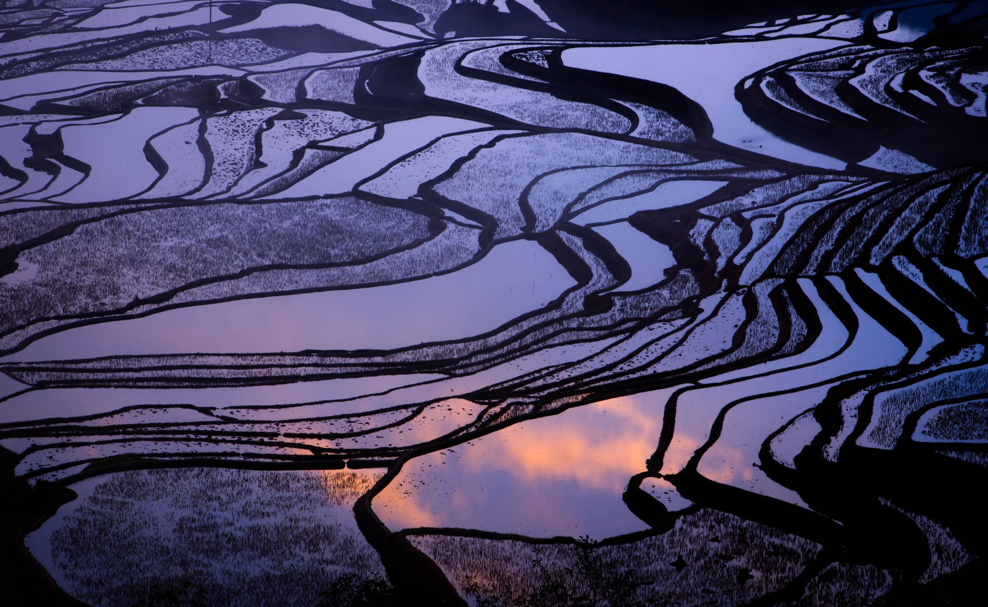
Mapping Uncertainty For Climate and Temperature Data
Stephanie Bell
Psyc 6135

Slide 2
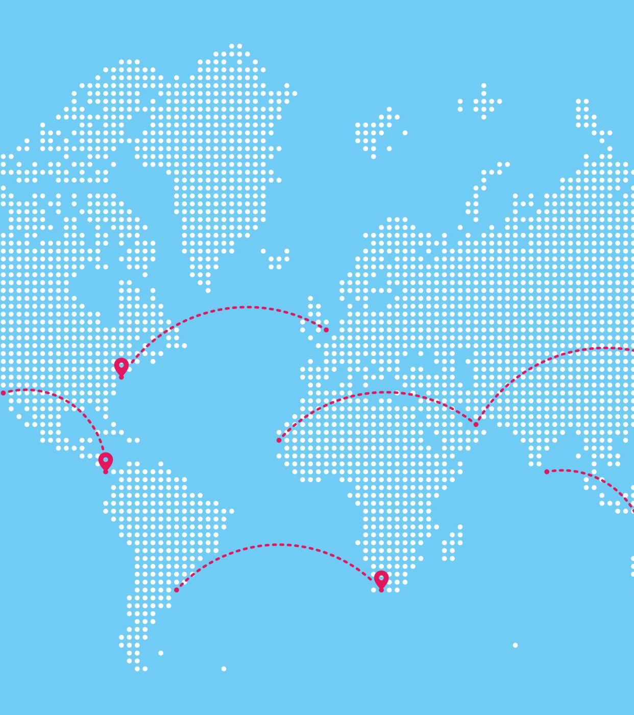
Why map uncertainty?
Maps are often taken as scientifically authentic regardless of data quality
Maps and estimates serve as the basis for decision-making in a number of areas
Temperature and climate data uncertainty may be incorrectly assumed by readers
Notes:
Edwards and Nelson (2001) write that well-drawn and precise maps are often taken as scientifically authentic, regardless of the quality or certainty of the data they represent. However, these maps are often based on imprecise and uncertain data surrounding topics such as bird migration patterns, land stability, natural hazards, etc. as well as temperature and precipitation forecasts, storm warnings, and predicted climate change.
These kinds of predictions are the basis for a lot of individual, organizational, and political decision-making, so it is important to represent the certainty of the data to provide the most complete picture possible. Yet, the execution of this is still a topic of major discussion within the cartographic community.
For temperature and climate data, in particular, people typically assume some kind of error is present, but in the absence of explicit information, users form estimates based on their own expectations, leaving room for a lot of misinterpretations and user error.

Slide 3
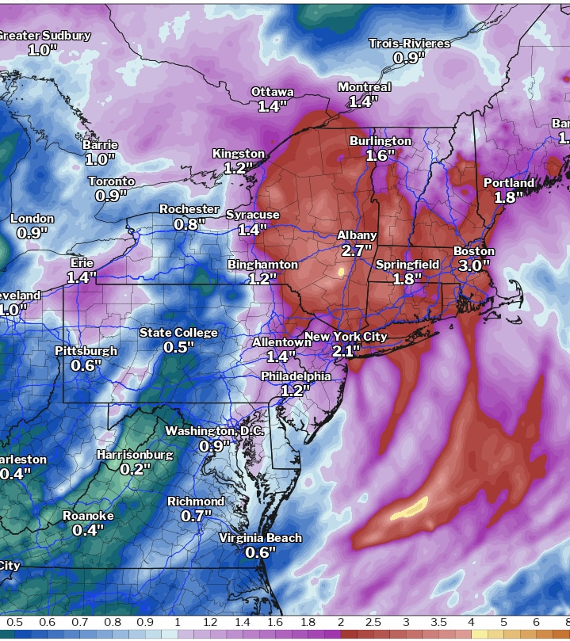
How can we present uncertainty information?
Graphs
Footnotes, captions and legends
Numerical values such as ranges or percentages
Maps: adjacent or coincident/seamless information
Notes:
While in psychology, we can typically graph uncertainty using error bars, standard error and confidence intervals, or plot styles like violin plots, geodata and cartography provide a unique challenge.
But, it turns out there are several solutions, though I would like to note before I go into these that there have only been a few studies investigating the performance of different methods of certainty communication, so no real conclusions about which method is best can be confidently drawn.
Of course, we can graph temperature or climate change data. However, it might be desirable to see these data in their respective locations to visualize geographical patterns and for logistical reasons such as city planning, commutes and travel, etc. Maps may be preferable for a number of reasons.
For many maps, the solution has been to include uncertainty as a footnote or caption, or as a note attached to the legend. For example, a note in the legend that says “Totals derived from data collected in and around [x] area are most certain. Data certainty decreases as distance from [x] increases.” Or the legend or caption may include confidence intervals for different areas, but unless you are mapping a small region or have an interactive map, this could be quite cumbersome.
Uncertainty may also be presented as numerical values such as ranges or percentages. For weather maps, this can take the form of ranges of possible temperatures or possibility of precipitation, also known as POP. These values can be misinterpreted quite easily. For example, I have seen several popular Tiktoks and posts regarding the meaning of POP, claiming that in fact it means the amount of area which will be affected by rain. This is a common interpretation of POP, but it is incorrect. In fact, POP does refer to the chances that there will be precipitation during a given time period. So perhaps numerical values aren’t the complete answer either.
In fact, a 2017 systematic review by Kinkeldey and colleagues concluded that visual representations of uncertainty are advantageous over numerical or written depictions. In fact, including numerical information separately but in conjunction with maps can lead to decreased performance in user interpretations.
Uncertainty can also be included in the map design itself, not just through numeric values or legends and captions, and this can be done in a few different ways. Maps may be presented as adjacent or coincident.

Slide 4
Adjacent maps
Notes:
Adjacent maps like the one shown here generally present the data or projections in one map and uncertainty information in a second map beside or below. As you can see, the second map is identical in area and highlights the same regions but is monochromatic and displays levels of certainty instead of projected estimates.
Note that there are only 4 levels of uncertainty. Kinkeldey and colleagues (2017) recommended that authors find a reasonable number of bins to describe certainty information that can convey enough information without overwhelming users.
This style has several advantages in that it is particularly clear and easy to interpret, as well as being logistically easier to create. It has also been found to yield quite accurate interpretations among non-expert users.
However, the adjacent map is not very good at displaying bivariate relationships and linking certainty information directly with estimates. Research has suggested that this method requires more time and mental effort for users than if the information were presented together.
As such, some cartographers prefer to use a coincident map, instead, which features both projections and certainty in a single map. This can be particularly challenging, as both the variable and certainty levels must be interpretable individually as well as in combination.

Slide 5
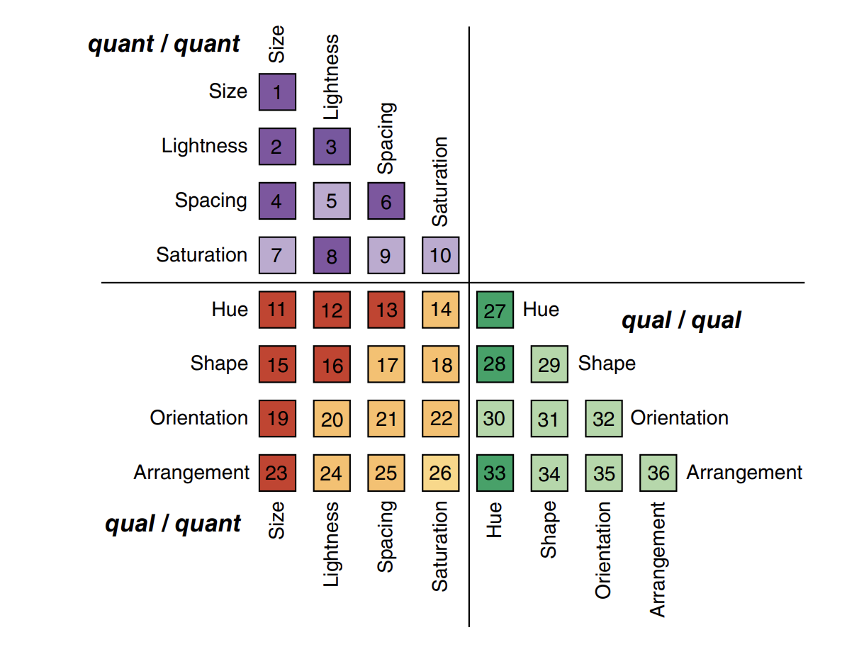
Coincident Map Features
Notes:
There are multiple ways of showing uncertainty on a coincident map. Here, I have a few visuals from Retchless and Brewer (2015) showing different methods of formatting a display in a bivariate map. The grid is divided into three sections based on data type and features 8 different customizable mapping characteristics.
Features include size, lightness, spacing, saturation, hue, shape, orientation, and arrangement. This creates a possible 36 different combinations for a bivariate map or, in this case, a temperature/climate map which includes uncertainty as another layer.
A lot of these methods are similar to bivariate tools we’ve previously discussed previously in this course. Pairing these features together are also not the only options. Some cartographers may using multiple combinations, or opt to try something like pixilating uncertain areas or create a bivariate choropleth map using two dimensions of colour, etc.

Slide 6
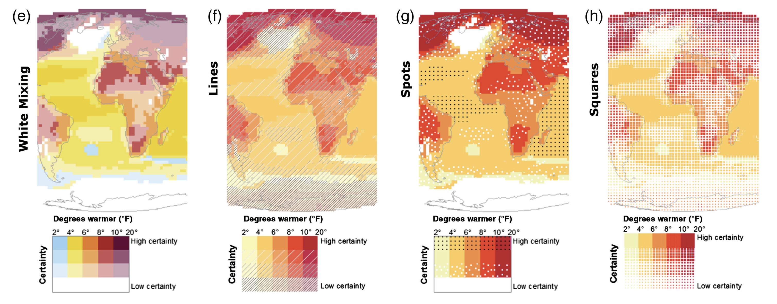
Notes:
Temperature and climate information are most often depicted using different colours or hues. Uncertainty can then be mapped on top of these using one of the other characteristics – most often patterns and lightness or saturation.
A few examples are shown here from Retchless and Brewer’s study of effective uncertainty mapping, based on several styles proposed by other authors and cartographers. This is not even close to an exhaustive list but is intended to give a brief look at different coincident map setups.
Lightness, seen here in (e), can be used such that a white overlay can be placed over the map to reduce the vividness of the colour beneath based on the level of certainty in that data. In this case, low certainty data would be faded to white while high-certainty data would be depicted in a more vibrant colour.
A similar method, not shown here, is to reduce the saturation as data becomes less certain, fading to black rather than white.
This design is also quite similar to an approach called seamless integration, where the data and uncertainty are rendered together and data/certainty ranges can be presented more continuously. An example of this would have data points with high certainty are shown as vibrant colourful dots fading out to white where data is much less certain. A few maps I saw using this approach kind of looked like funfetti cakes where the sprinkles are the data points and the cake itself is the area of lower certainty.
Personally, I think a cool feature of coincident mapping is that it allows us to obscure uncertain areas by fading or covering them so that it is immediately apparent that certainty is low and final conclusions should not be drawn based on that data. This type of presentation almost forces readers to interpret predictions and certainty information as one and can deter readers from making unfounded conclusions.
Patterns and pattern sizing may be incorporated, such as in maps (f) through (h) here. Patterns are generally recommended if the goal of the map is to easily distinguish between the prediction and certainty levels while simultaneously interpreting both.
Of the designs included in their study, Retchless and Brewer found the dots pattern here in (g) demonstrated the highest literacy and user preference significantly above the other two designs. In fact, both squares and lines were also scored below the white overlay, indicating that the style of pattern is also an important consideration for the intended audience.
Ultimately, aside from readability, the goal of the map and the degree to which uncertainty should be easily separable from estimates should determine what designs to choose.
And, although I haven’t tried it out myself, I saw a talk while doing my research for this presentation about a recently-developed R package called vizumap that allows the creation of maps with uncertainty. So if you’re ever interested in creating one of your own, you can check that out. Here’s a link to Vizumap if you’re interested in checking it out for yourself: https://github.com/lydialucchesi/Vizumap OR https://rdrr.io/github/pkuhnert/Vizumap/ (you may need to copy/paste – I can’t seem to hyperlink in a comment).

Slide 7
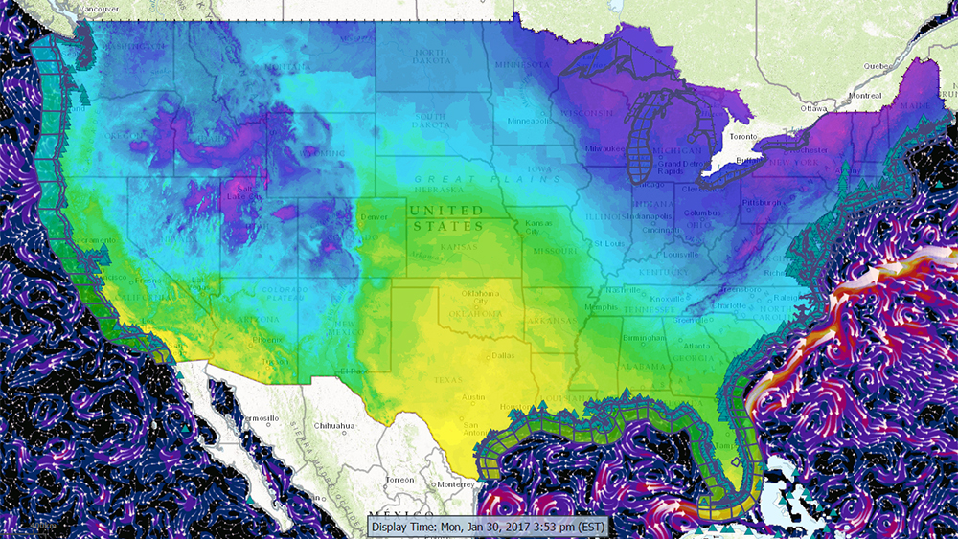
“A map may be like a person who talks clearly and convincingly on a subject of which his knowledge is imperfect.”
– Wright (1942)

Slide 8
references
Ash, K.D., Schumann, R.L., & Bowser, G.C. (2013). Tornado warning trade-offs: Evaluating choices for visually communicating risk. Weather, Climate, and Society, 6, 104-118. doi: 10.1175/WCAS-D-13-00021.1
Edwards, L.D. & Nelson, E.S. (2001). Visualizing data certainty: A case study using graduated circle maps. Cartographic Perspectives, 38, 19-36.
Kinkeldey, C., MacEachren, A.M., Riveiro, M., & Schiewe, J. (2017). Evaluating the effect of visually represented geodata uncertainty on decision-making: Systematic review, lessons learned, and recommendations. Cartography and Geographic Information Science, 44(1), 1-21. doi: 10.1080/15230406.2015.1089792
Morss, R.E., Lazo, J.K., & Demuth, J.L. (2010). Examining the use of weather forecasts in decision scenarios: Results from a US survey with implications for uncertainty communication. Meterorological Applications, 17, 149-162. doi: 10.1002/met.196
Retchless, D.P. & Brewer, C.A. (2016). Guidance for representing uncertainty on global temperature change maps. International Journal of Climatology, 36, 1143-1159. doi: 10.1002/joc.4408
Schneider, M. (2019, Sept. 11). NEDTalks: Visualizing Uncertainty. [Video]. YouTube. https://youtu.be/u7aTak8xhP4
Statistical Society of Australia. (2020, June 14). MIGHTY MAPS: Showcasing estimate uncertainty - Susanna Cramb & Lydia Lucchesi. [Video]. YouTube. https://youtu.be/Fytjxc3PCNU
Notes:
The speech about Vizumap is in the final reference, and starts about halfway through the video.

