Slide 1
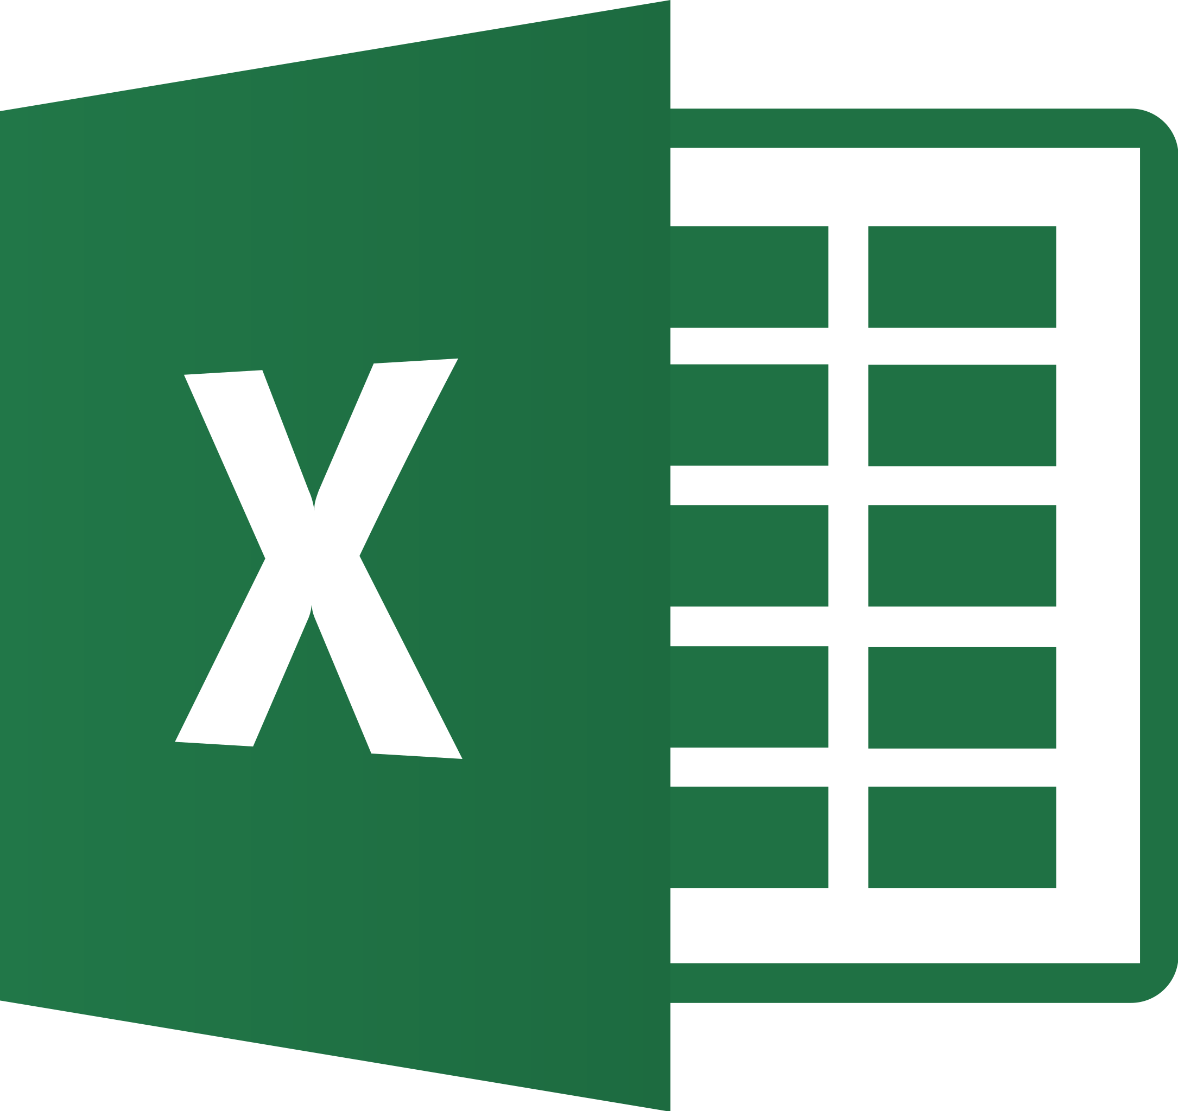
Duel of the Defaults
Graphical Defaults in point-and-click vs. code-based softwares
&
&
Gabriel Crone
Jean-Marc Moke

Slide 2
Agenda
Introduction
Point-and- click: Excel & jamovi
Syntax-based: Base R & GGplot2
Summary & Discussion
Presentation Title

Slide 3
Introduction
Software often dictates how easy plots are to make, and how they look!
2 Software Types:
Point-and-click- easy to learn, not as customizable
Syntax/code-based- Far more customizable, but harder to learn
Q: Which software’s defaults are generally better for data viz purposes? Does it depend?
[POTENTIAL GABE SLIDE]

Slide 4
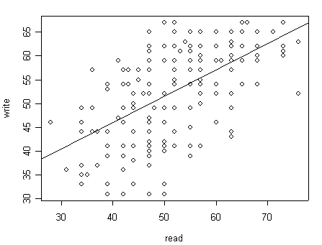
Guiding Example
We’ll explore the defaults with a guiding example:
Data- mtcars
Plot- Line plot with fitted regression line:
X-axis = Weight (wt)
Y-axis = Miles per gallon (mpg)
Plots created with bare minimum defaults
Image source:
Cars- https://www.imdb.com/title/tt0317219/
Graph Sample- https://stats.oarc.ucla.edu/r/faq/how-can-i-do-a-scatterplot-with-regression-line-or-any-other-lines/

Slide 5
Graphics from point-and-click software: Introduction
Point-and-click softwares have many custom defaults for users to design graphics quickly and easily
Far more intuitive to learn and run, but far more limited in scope and customizability
e.g., Excel, jamovi, SPSS, JASP, Tableau, PowerBI, etc…

Slide 6
Point-and-click software Examples:
Excel & jamovi
Excel
jamovi
3rd most popular statistical software taught in Canadian intro stats! (Davidson et al., 2019)
Simple to use, but susceptible to developing chartjunk (e.g., many options for [pointless!] 3D plots), and difficult to create elegant plots (Su, 2008)
jamovi is like SPSS (popular point-and-click software), except it’s open-source & free!
Downside: Almost no customizability
Upside: analysis is reproducible! (via .omj file format)

Slide 7
How to make plots:
Excel:
Import data
Select columns for wt and
Insert (ribbon) → Scatter → Scatter (basic one)
Click the plot → Chart Design (ribbon) → Add Chart Element → Trendline → Linear
jamovi:
Import data
Go to analysis → Exploratory Analysis → Scatterplot
Drag variables into “X” and “Y” columns
Select “Linear” underneath “Regression Line”

Slide 8
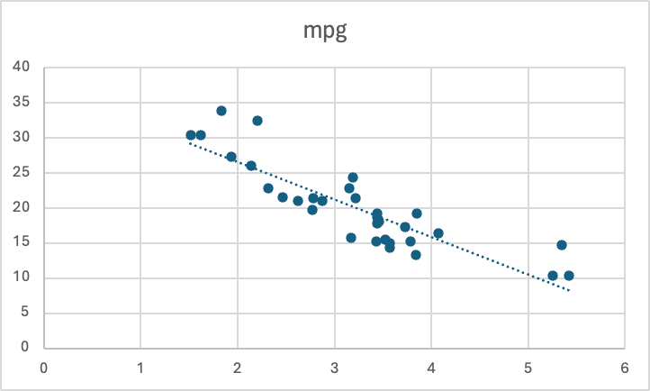
Excel’s Plot

Slide 9
Excel’s Plot
Default title is the y-axis, which is uninformative
Trendline is difficult to see :/
Color & size of points are nice
Gridlines are okay, but not as subtle as they should be
No axis labels! Need to specify 🙁
Size of axis labels are decent, but could be larger
Many customizable themes 😎

Slide 10
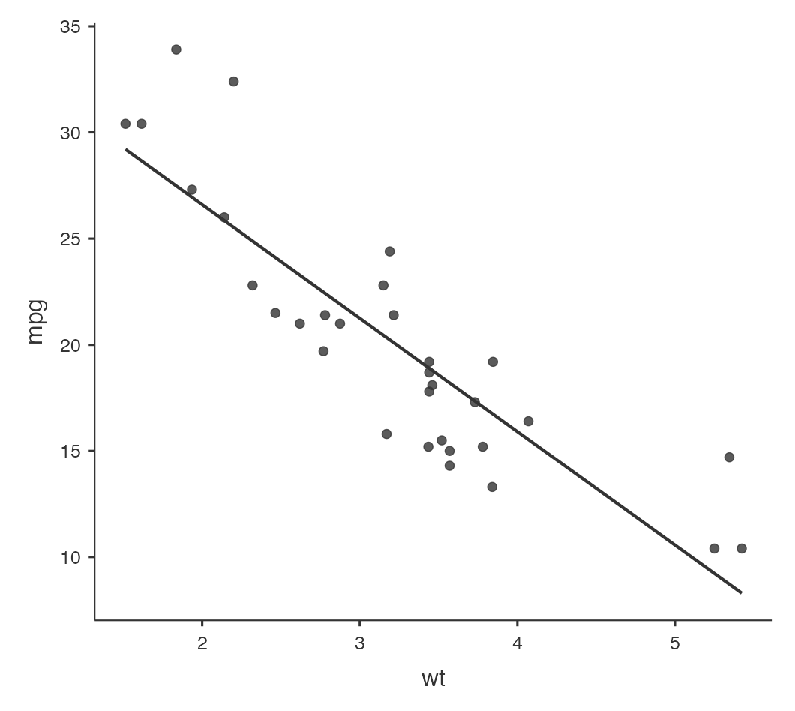
jamovi Scatterplot

Slide 11
jamovi Scatterplot
Text is a bit small
No title :/
Has a nice, minimalistic design (no gridlines is good!)
Cannot customize theme; must use default! 😱
Variable names are somewhat informative. Only changeable by renaming cols.
Regression line is clearly visible

Slide 12
Point-and-click: Summary
While great for beginners (or people wanting to get plots “in a hurry”), point-and-click softwares are highly limited in their customizability
Excel is more customizable than jamovi, but jamovi is free whereas Excel can be costly
No matter what software one chooses, the user is ultimately limited to the plotting choices of the software designer! (Works well if choices are good, not so much otherwise…)

Slide 13
Syntax-based Graphs: Introduction
Usually created with syntax-directed editors
Python, SQL, R, JavaScript, and Scala
Allow for a high degree of customizability
Better suited for big data visualization
Caution: high margin of error for newbies.

Slide 14
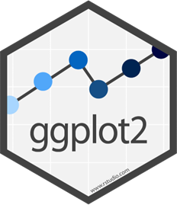
Syntax-based Examples
Base R
ggplot2
Comes embedded in the R statistical software.
Uses "ink-on-paper", programming approach.
Requires passing new arguments.
Static, does not allow for extensive customization.
Uses visual approach.
Wilkinson's grammar of graphics (GoG).
Components added using "and" (+).
Built in data management;
Does not require manual manipulation.

Slide 15
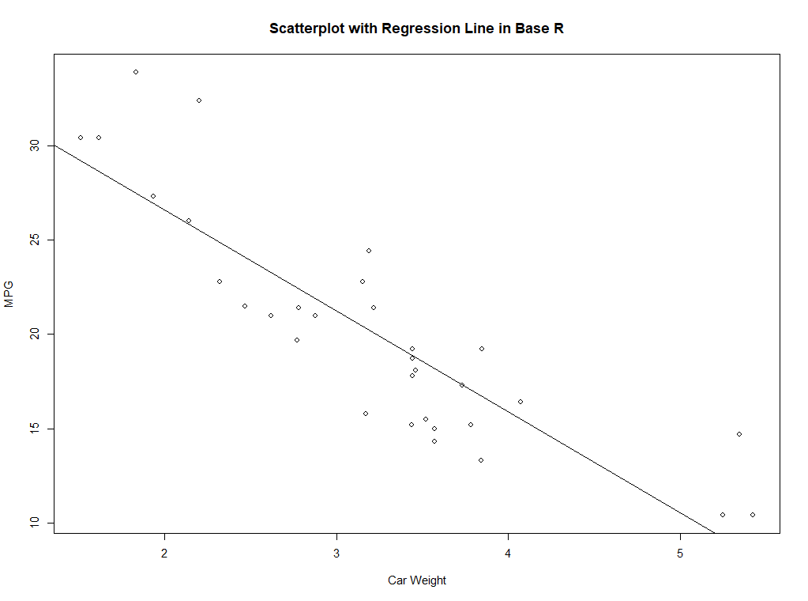
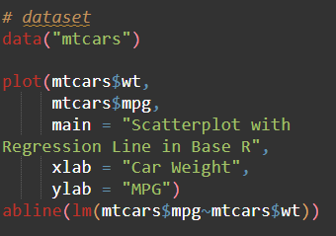
In R: Base R & ggplot2
Base R:
Default theme has limited customizability.
Clunky and inefficient.
Separate arguments for new components.
Can get messy if new to base R.
Additions are time-Consuming.

Slide 16
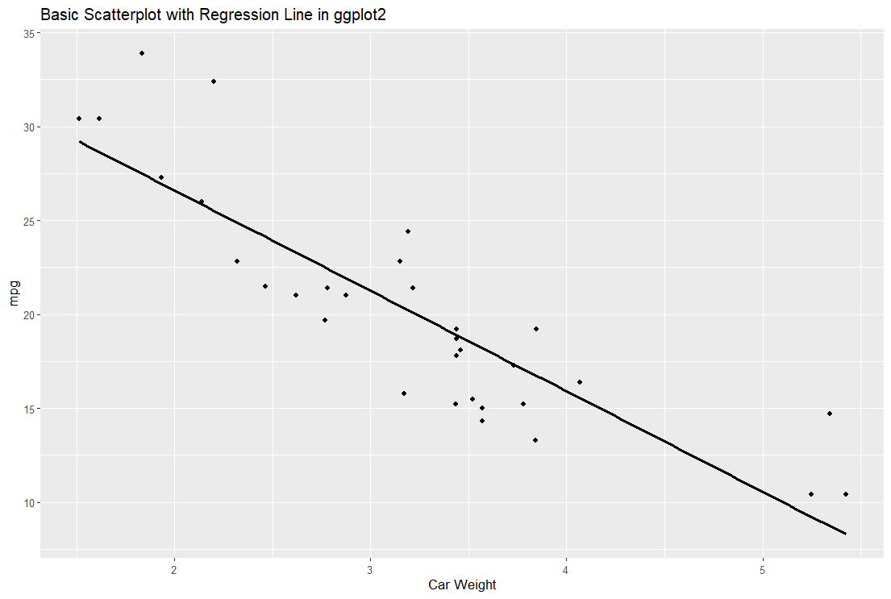
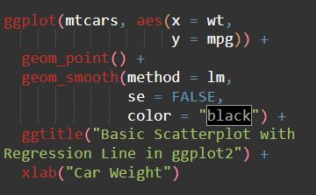
In R: Base R & ggplot2
ggplot2:
New components added using “+” operator.
Efficient coding pattern.
Flexible to the user.
Default theme highly customizable.

Slide 17
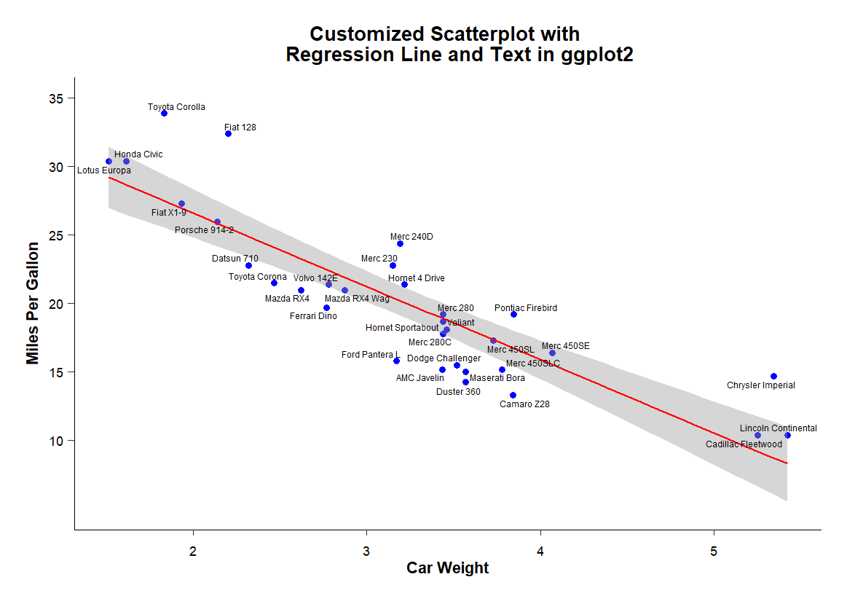
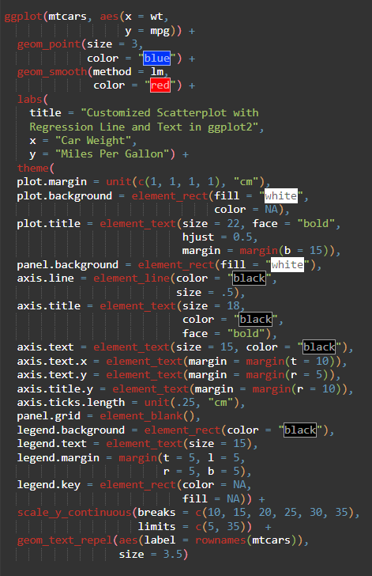
In R: Base R & ggplot2
ggplot:
Default theme highly customizable.
Can be complicated for newbies.
Can handle many types of visuals.

Slide 19
Syntax-based graphs: Summary
Flexible, reproducible, scalable, and consistent.
Improve the scientific process.
Enhance communication of research insights.
More intuitive and customizable than point-and-click.
R and the ggplot2 package take advantage of these benefits.
Many alternatives (e.g., matplotlib in Python, Scala, D3.js in JavaScript, etc.)
“Point-and-click tools for data visualization are popular, but they are neither reproducible nor scalable.”
- Aaron Williams comparing syntax-based and PAC tools, Data@Urban

Slide 20
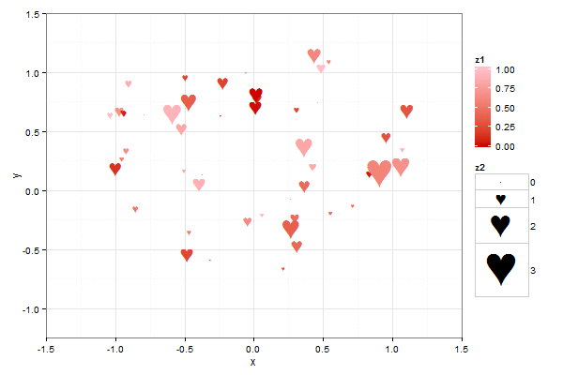
Moral of the Story
Use ggplot2! (Or other code-based software!)
Source: https://www.summitllc.us/blog/show-your-valentine-how-much-you-care-create-a-statistical-graph

Slide 21
Discussion Questions
What are your favorite defaults shown today? Why?
How might a different audience respond to this presentation? (e.g., Graphic designer vs. lay public?)
Which graphic software do you personally use and why? (Doesn’t have to be anything shown today!)
.

Slide 22
References
Davidson, H., Jabbari, Y., Patton, H., O’Hagan, F., Peters, K., & Cribbie, R. (2019). Statistical software use in Canadian university courses: Current trends and future directions. Teaching of Psychology, 46(3), 246–250. https://doi.org/10.1177/0098628319853940
Ginsberg, C. (2024). Programming Languages for Data Analysts. Noble Desktop. https://www.nobledesktop.com/classes-near-me/blog/top-programming-languages-for-data-analysts.
Li, Z., & Fan, Y. (2022). Base R vs. ggplot2 visualization. EDAV Fall 2021 Tues/Thurs Community Contributions. https://jtr13.github.io/cc21fall2/base-r-vs.-ggplot2-visualization.html.
Minas, M. (2006). Syntax definition with graphs. Electronic Notes in Theoretical Computer Science , 148, 19-40. doi:10.1016/j.entcs.2005.12.011.
Su, Y. (2008). It’s easy to produce chartjunk using Microsoft Excel 2007 but hard to make good graphs. Computational Statistics & Data Analysis, 52(10), 4594–4601. https://doi.org/10.1016/j.csda.2008.03.007.
Williams, A. (2018). Why The Urban Institute Visualizes Data with ggplot2. Medium. https://urban-institute.medium.com/why-the-urban-institute-visualizes-data-with-ggplot2-46d8cfc7ee67.

Slide 23
Thank you!
Gabriel Crone
Jean-Marc Moke

