Slide 1
Data Journalism in the Digital Era
Discussion by: Michelle Blumberg and Natasha Baptist-Mohseni
PSYC 6135: The Psychology of Data Visualization
March 28, 2024

Slide 2
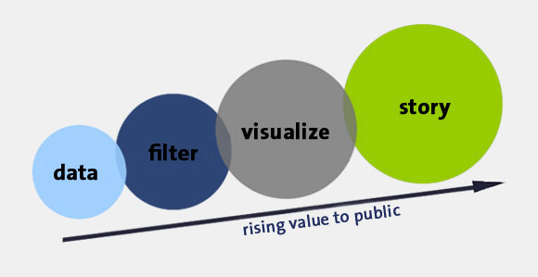
What is Data Journalism?
Data journalism or data-driven journalism (DDJ):
Journalism based on filtering and analyzing data to create or elevate a news story
Works to increase the role of numerical data in the communication of information
Data journalism is interdisciplinary and requires expertise from various fields:
Journalism
Computer Science
Statistics
Data Visualization

Slide 3
Why is DDJ important?
Data-driven stories…
Match the increasing demand for long-form journalism
Summarize important content in a meaningful and memorable way
In recent years, some of the most urgent and compelling stories have been data-driven.
2016: Panama Papers vs global capitals flows & tax avoidance
2019: satellite data & human causes for Amazon Forest fires

Slide 4
Where do non-data driven journalists stand in the current digital era?
Beyond the most popular, well-funded newsrooms in the world, data journalists are usually working on their own..
So, where does that leave us…
What if you don’t have the budget of the New York Times?
Or the developer chops to create data visualisation web apps?
Well, there’s good news!
Journalist roles available today are more accessible and powerful than ever before
… and there’s even better news:
There are plenty of beautiful, long-form feature stories created and made accessible by other data journalists
The best part: a background in data science or a robust data team of external experts is not always necessary!

Slide 5
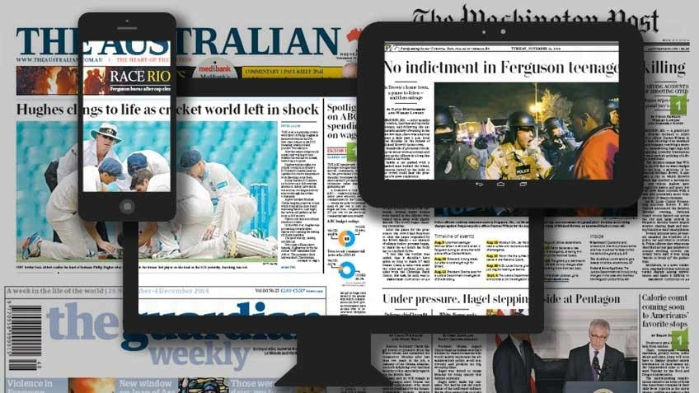
Data Journalism in 2023
What we can learn from 2023’s outstanding examples of data journalism?

Slide 6
The Green Divide: How Wealth Buys Shade in a Warming World
By: Kate Newton (Data Journalist based in New Zealand)
Notes:
[Link: https://interactives.stuff.co.nz/2022/03/urban-heat-island-tree-cover/]

Slide 7
Detroit Segregation Wall Still Stands, a Stark Reminder of Racial Divisions
By: Erin Einhorn, NBC News, and Olivia Lewis, BridgeDetroit
Notes:
[Link: https://www.nbcnews.com/specials/detroit-segregation-wall/]

Slide 8
Pros?
PROS TO DATA JOURNALISM
Outlines significance of the information being reported
Can increase accessibility and understanding of information
Similarly, we live in a time where we access resources and information via technology
May encourage critical thinking in an era of easy access to online information

Slide 9
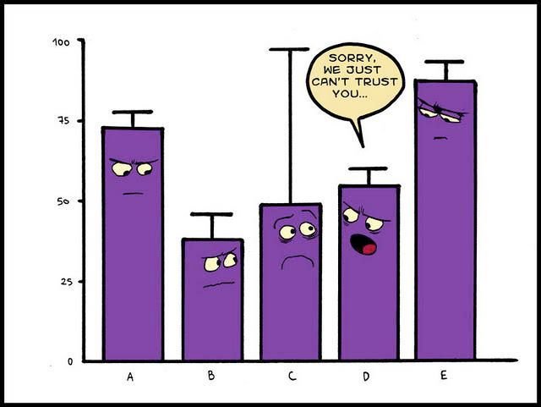
Cons?
CONS TO DATA JOURNALISM
Can be misleading or biased
Risk of domination of graphics vs. content, or overloading with content → message becomes illegible and/or lost in translation
Key: optimal balance between content and graphics

Slide 10
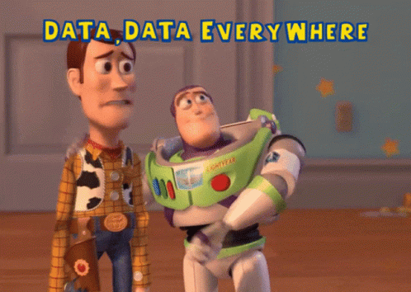
Conclusions
Numbers and data can be an invaluable way of interpreting and communicating big, important stories…
But they can also be invaluable for smaller, more personal ones.
Your daily inspiration:
He inspired [me] to realize there was a “different way of doing journalism… and you didn’t have to be a mathematician… you just have to be a storyteller”.
Pamela Duncan

