Slide 1
Data Visualization in Neuroscience
Using Principal Component Analysis (PCA) to visualize structural connectivity

Slide 2
Table of contents
01
02
03
04
Structural Connectivity
Neuroimaging
Principal Component Analysis
Implication
References

Slide 3
01
Structural Connectivity Neuroimaging

Slide 4
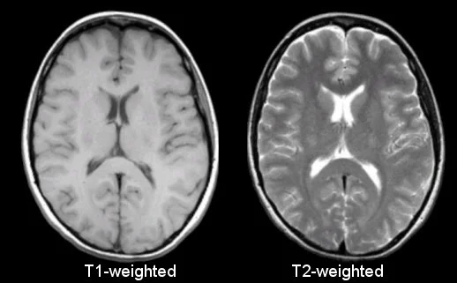
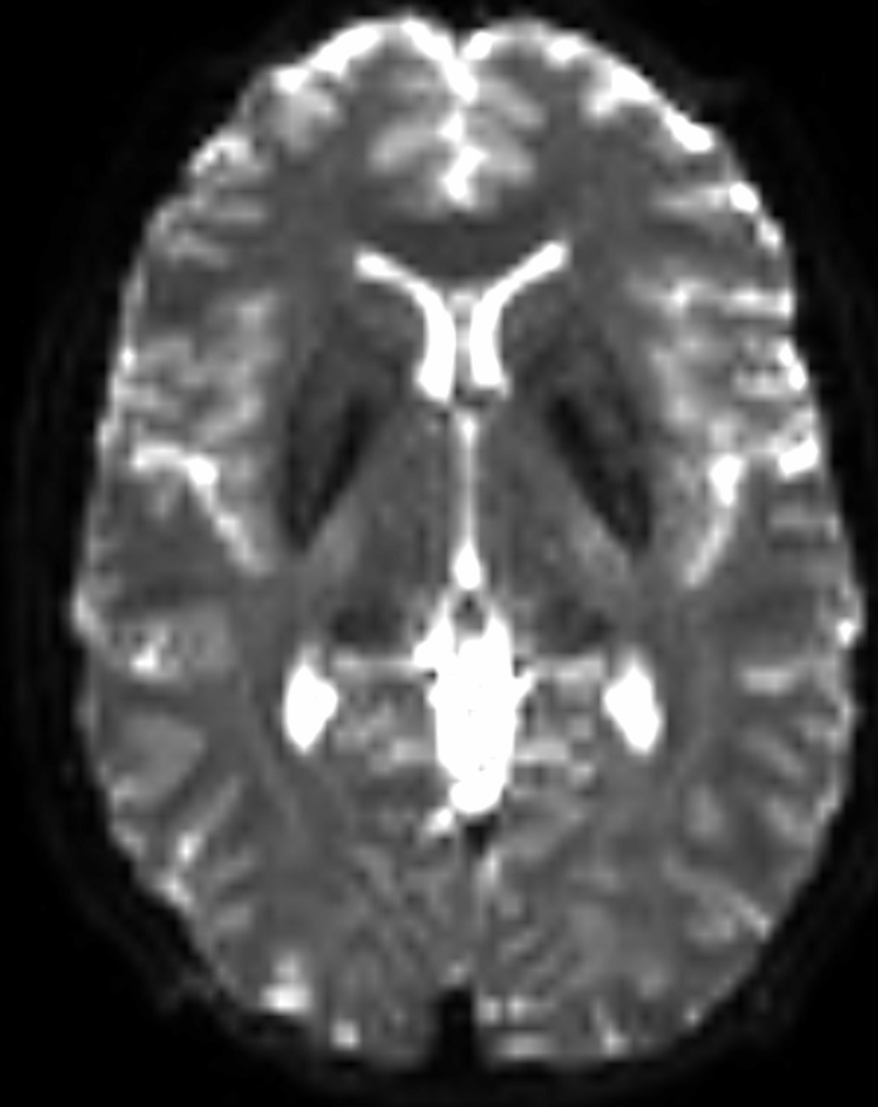
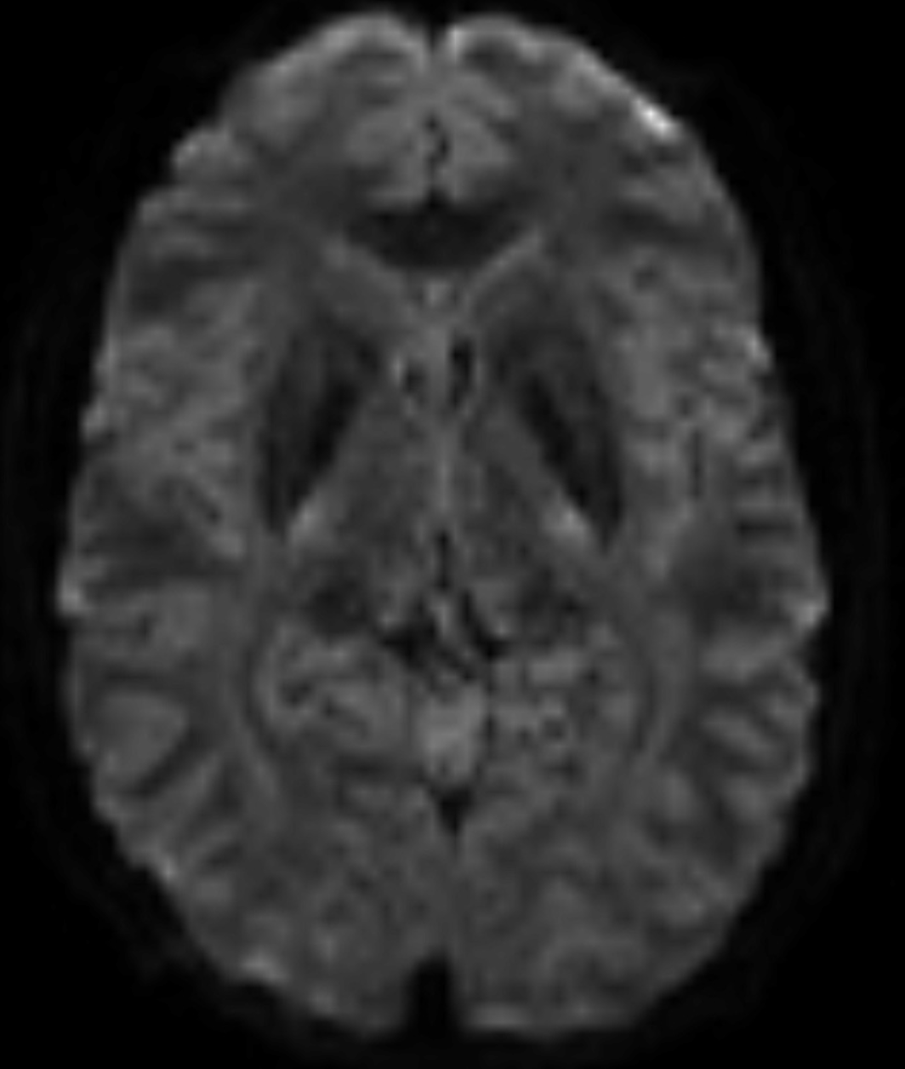
T1 & T2
DWI & DTI
Strong contrast between
tissue types
Excellent spatial resolution
4-D scan, focus on the change across time
Most emphasis on white matter
Notes:
Structural Neuroimaging vs Structural Connectivity Neuroimaging
Focuses on structural differences, gray/white matter volume, tissue integrity
Focuses on white matter specifically, how water moves in a time interval
In this pres, we will focus on structural connectivity neuroimaging

Slide 5
DWI & DTI
Diffusion Weighted Imaging (DWI)
Water Diffusion across time
Detect difference in diffusion
Signal attenuation = more diffusion
GM
GM
CSF
CSF
WM
WM
t = 0
t = 1000 ms
Notes:
Diffusion Weighted Imaging
It visualized water diffusion across time, signal attenuation if the water moves a lot
On the right, same subject, captured at different time points
CSF appears very dark, water is always moving, no signal
WM becomes darker, restricted water diffusion
GM doesn’t change in brightness, very much restriction

Slide 6
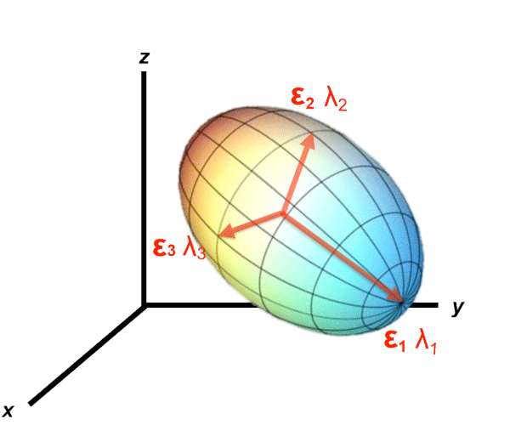
DWI & DTI
Diffusion Weighted Imaging (DWI)
Water Diffusion across time
Detect difference in diffusion
Signal attenuation = more diffusion
Diffusion Tensor Imaging (DTI)
Also use water diffusion
Establish a Tensor within each voxel
Metrics
Axial Diffusivity (AD, λ₁)
Radial Diffusivity (RD, (λ₂+λ₃)/2)
Mean Diffusivity (MD, (λ₁+λ₂+λ₃)/3)
Fractional Anisotropy (FA)
Notes:
Diffusion Tensor imaging
Establish a tensor within each voxel of the brain, hence the name. The tensor is ellipsoid for ease of visualization
Metrics:
Axial diffusivity: water diffusion along the main axis
Radial diffusivity: water diffusion along 2 radial axes
Mean Diffusivity: mean water diffusion
Fractional Anisotropy: Measures how much anisotropy there is in the tensor, describes the overall shape.

Slide 7
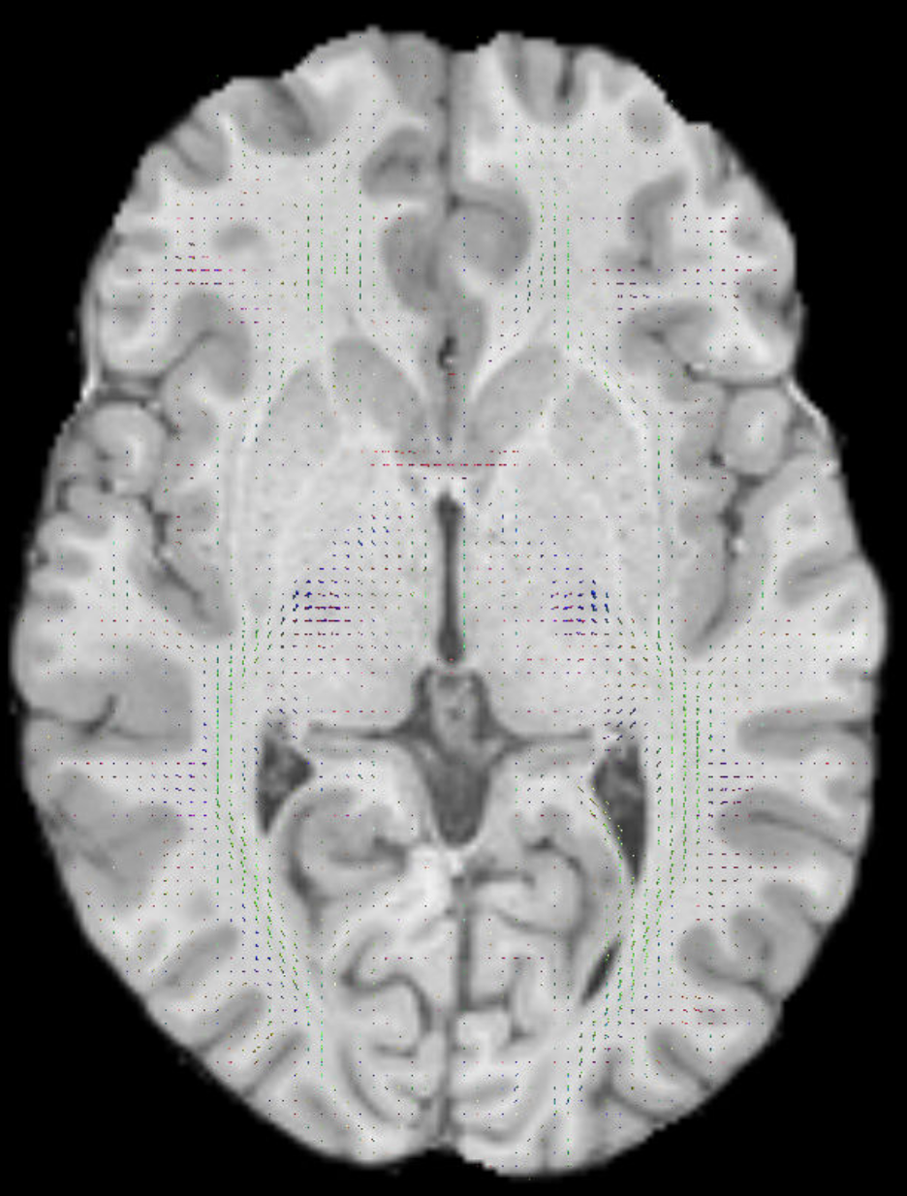
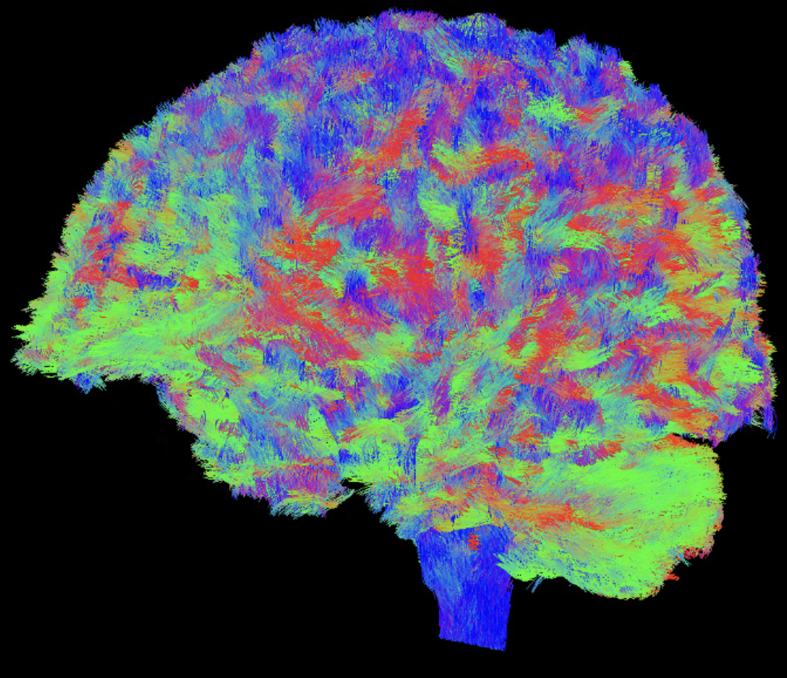
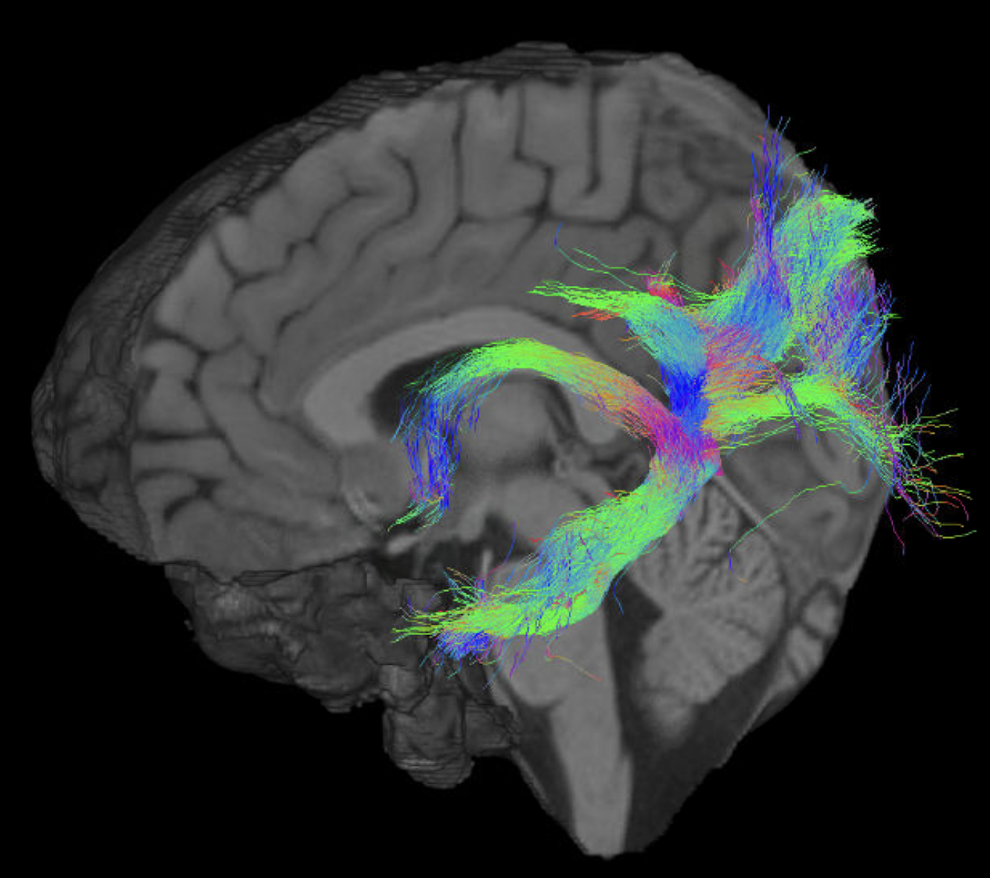
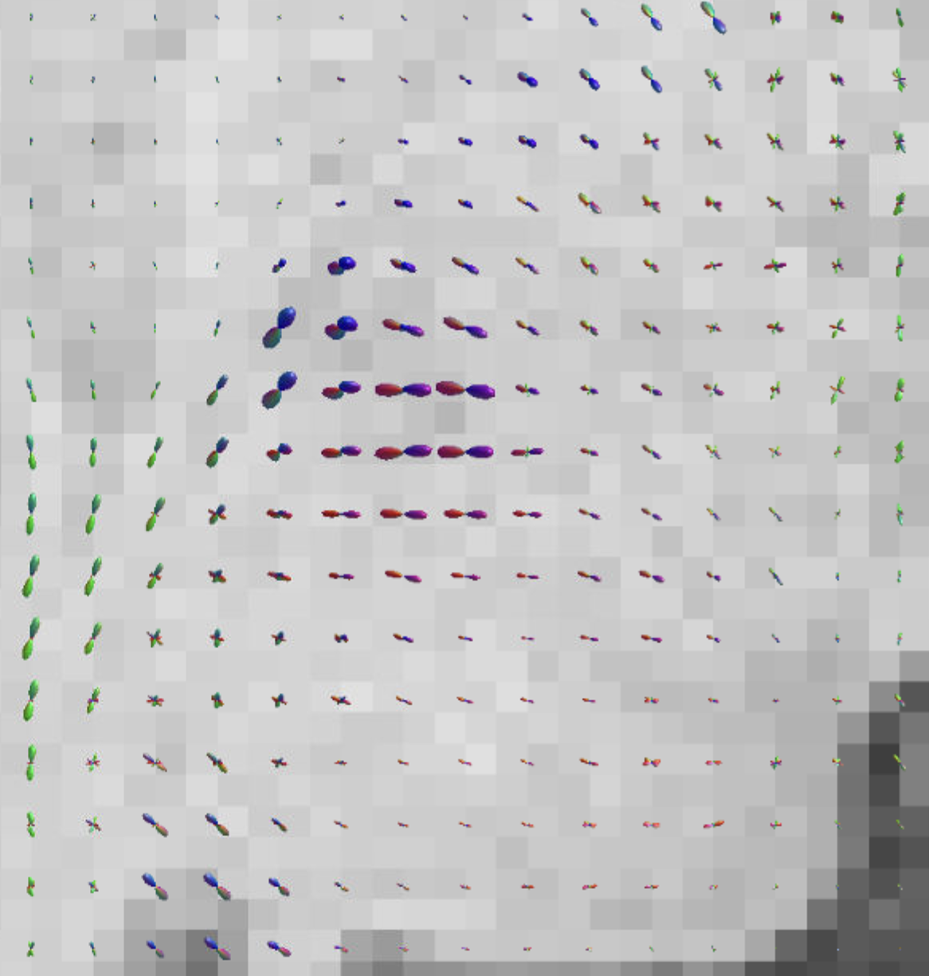
DWI & DTI
Diffusion Weighted Imaging (DWI)
Water Diffusion across time
Detect difference in diffusion
Signal attenuation = more diffusion
Diffusion Tensor Imaging (DTI)
Also use water diffusion
Establish a Tensor within each voxel
Metrics
Axial Diffusivity (AD)
Radial Diffusivity (RD)
Mean Diffusivity (MD)
Fractional Diffusivity (FA)
Notes:
As you can see a tensor is established for each voxel, there in different shape, not ellipsoid. Constrained spherical deconvolution-based (CSD) tensor, advantage in crossing fibers
We can fit streamlines with the tensor to estimate fiber orientation to yield a whole-brain tractogram
We can then modify streamlines to suit our needs

Slide 8
Using only FA for structural connectivity
Comprehensive
FA Increase
FA Decrease
FA DOES NOT TELL
THE WHOLE STORY!
Integrates all 3 directions
Overall shape of Tensor
Easy Interpretation
Brain Tumour
(Dimou et al., 2013)
Hydrocephalus
(Hattingen et al., 2010)
Mild Traumatic Brain Injury
(Wilde et al., 2008)
Increased “kissing fiber” in professional dancers
(Giacosa et al., 2016)
Notes:
Current studies has been using FA as a proxy for SC, mainly for it describes the overall shape of the tensor and it’s easy in interpretation.
But FA increase/decrease does not repersent SC very well. In brain tumours, hydrocephalus (too much CSF in ventricles) or TBI, the WM tracks were not as “good” but FA significantly increases in these cases.
Similliarly, When people develop more fiber variation and more crossing WM fibers, common found in expert dancers, there FA decreases.
All of these tells us, FA does not tell the whole story for SC. We need all four metrics to collectively represent of SC
So what do we think of?

Slide 9
02
Principal Component Analysis
Notes:
We think of dimension reduction, principal component analysis specifically.

Slide 10
Principal Component Analysis
PCA
Challenge
Per
subject
Success
Component Loadings
One single metric is not comprehensive enough
Difficult interpretation using multiple metrics
Identifies the most apparent “trend” in data
tract-specific
Dimension Reduction
Provide interpretable metric for the whole tract in each participant
Ease for correlation with functional/behavioural metrics
Notes:
The challenge is that the single metric is not comprehensive enough, and the interpretation could be difficult if we incorporate multiple raw metrics
By using PCA, we could convert the raw metrics to organized trend to represent a single white matter track - we will see this in the upcoming slides
We could also use the component loadings with raw metrics to generate participant-specific overall metric
Now the SC can be represented holistically, the correlation with functional/behavioural metrics is also easy

Slide 11
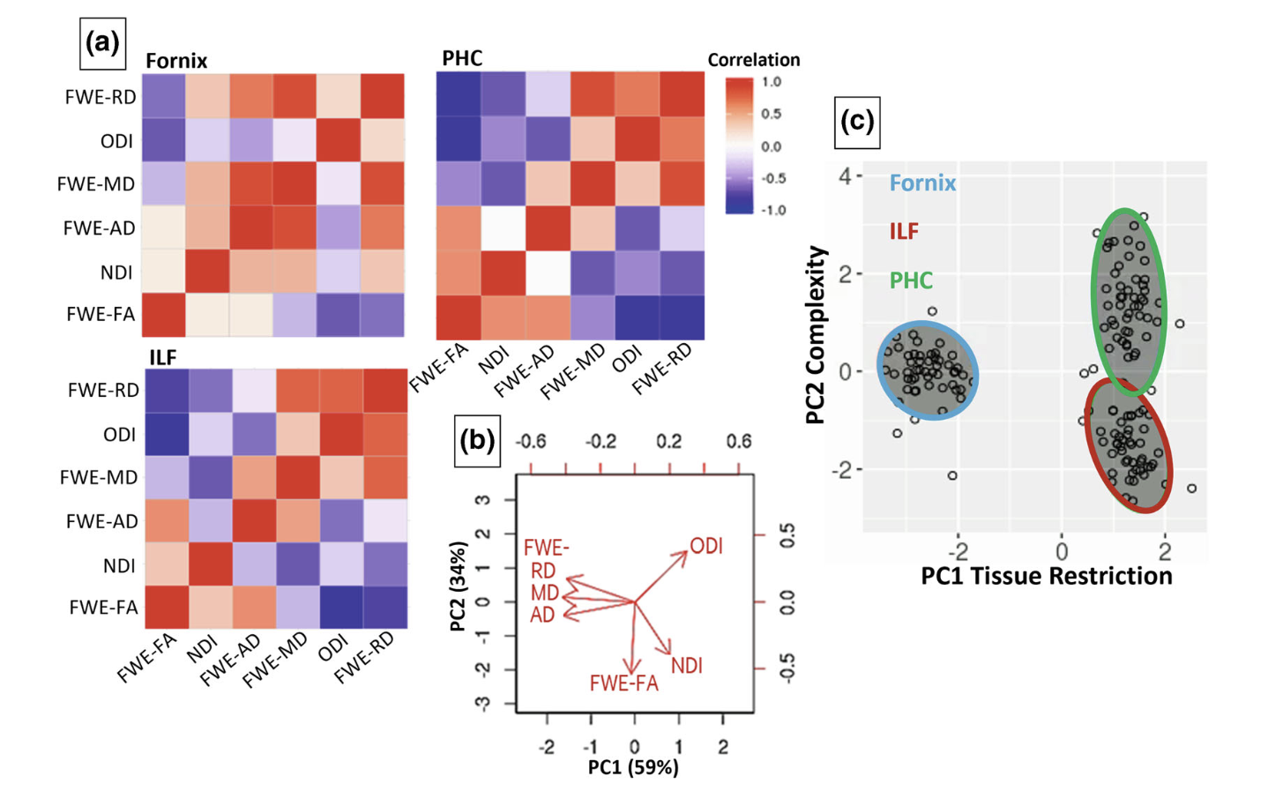
Outcomes from PCA
ODI - Orientation Dispersion Index
NDI - Neurite Density Index
(Read et al., 2023)
Notes:
This is recent paper employing PCA to represent structural connectivity.
The metrics are pretty inter-related, so PCA also addresses the inter-relationship that our predictors have
ODI-How much axon dispersion is in that voxel
NDI-how much axon is packed in that voxel
Looking panel B, the relative loadings that the variables have, they interpreted the PC1 as tissue restriction, since diffusivity all loaded negatively and PC2 as tissue complex. Basically a metric for how much complexity a white matter tract have.
Through clustering analysis, they were able to spot 3 WM tract: the white matter tract fornix, inferior longitudinal fasiculus, and parahippocampal cingulum. Which made the interpretation really simple, as we will see in the next slide.

Slide 12
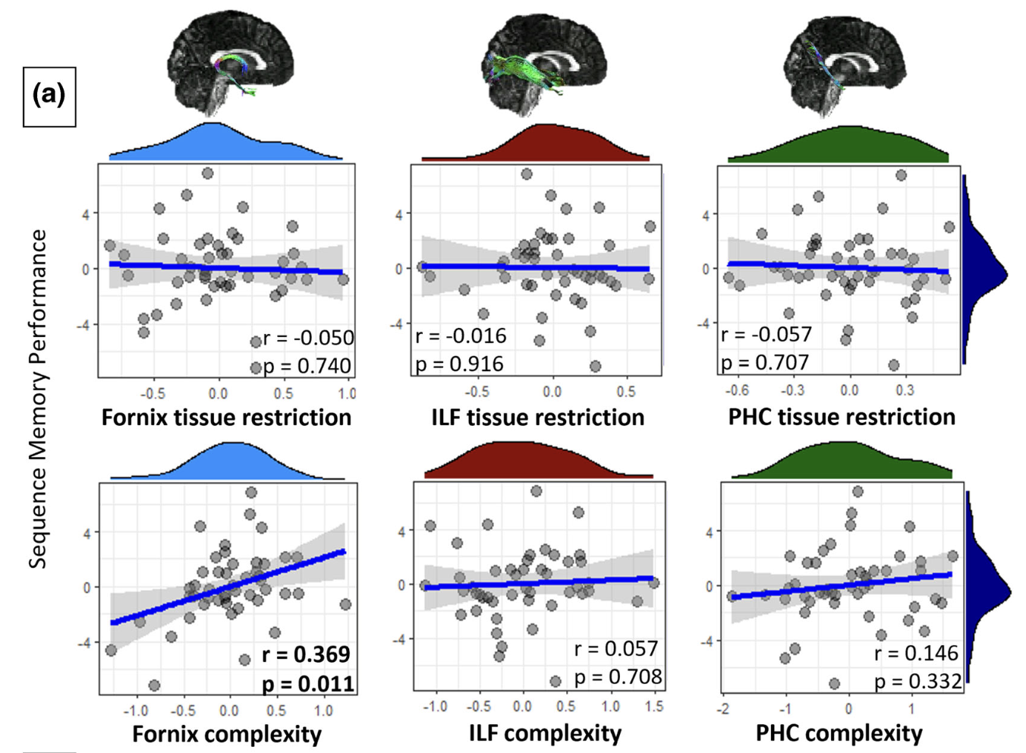
Analyses with PCA components
“Aha! Fornix complexity is positively correlated with Sequence Memory Performance!”
(Read et al., 2023)
Notes:
With this linear correlation, we can immediately visualize that fornix complexity is positively correlated with sequence memory performance!

Slide 13
03
Implication
Notes:
But how did this PCA method improved my project?

Slide 14
My current project
Goal
Experimental procedure
Examine how structural connectivity individual difference can contribute to functional connectivity and episodic memory
Participant encoded 2 different movies in the scanner and asked to free-recall them in random delay orders (immediate vs. 2-day delay)
Metrics
Previous findings
AD, RD, MD, FA in fornix and cingulum
FC between hippocampus (HC) & Posterior Medial Network (PMN)
Number of central detail recalled
FC between HC & PMN at event offset is crucial for that event to be remembered
Fornix & Cingulum are at anatomical proximity for these regions
Notes:
Functional connectivity - co-fluctuation in activity happening between two brain regions
Central detail - if you remove this detail, the event will change in content

Slide 15
Simple SC & Memory correlation
NULL CORRELATION?
Notes:
We have AD and FA on this graph because of lack of space. But there’s no correlation at all between any of the structural connectivity metric with recall performance.

Slide 16
PCA with Current Data
Fornix AD
Fornix RD
Fornix FA
Right Cingulum AD
Right Cingulum RD
*MD is excluded in all tracts because it’s an derived metric from AD & RD and causes too much autocorrelation
Right Cingulum FA
Left Cingulum AD
Left Cingulum RD
Left Cingulum FA
Fornix FA
Fornix RD
Fornix AD
Left Cingulum FA
Left Cingulum RD
Left Cingulum AD
Right Cingulum FA
Right Cingulum RD
Right Cingulum AD

Slide 17
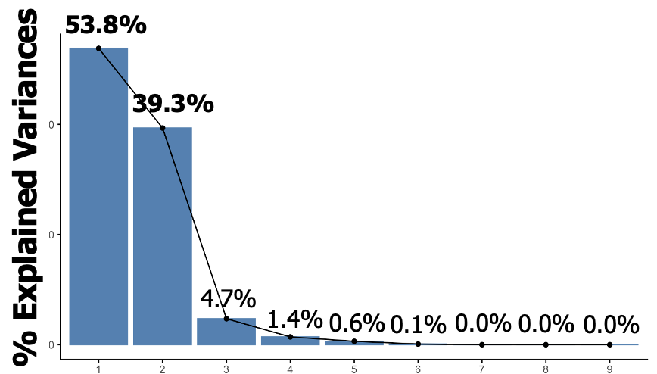
PCA with Current Data

Slide 18
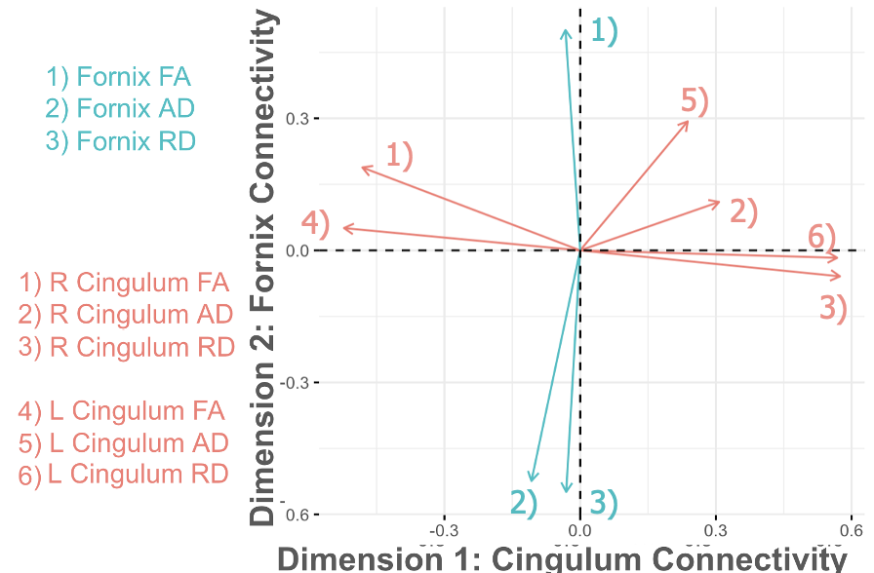
PCA with Current Data
We can easily interpret Dimension 1 as Cingulum SC (negative is better) and Dimension 2 as Fornix SC (positive is better)!

Slide 19
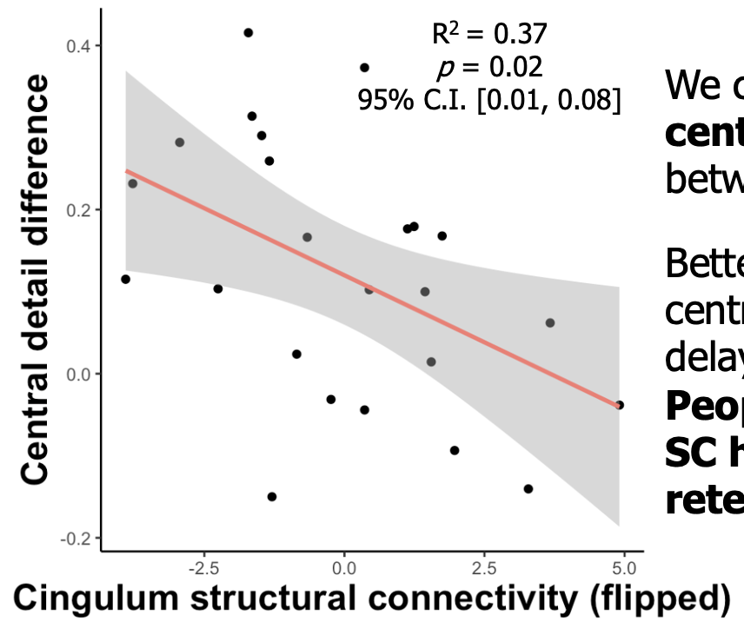
SC & Memory Correlation
We calculated the percent of central detail reduction between 0-day and 2-day delay.
Better cingulum SC predicts less central detail forgotten across delay conditions.
People with better cingulum SC have better central detail retention ability.

Slide 20
Implications and Limitations
More SC Metrics
Small sample size
Other SC metrics (like ODI and NDI) can be incorporated into the PCA
24 University-level students
Lack demographic variability
Metric or subject level
Interpretation?
Read et al. (2023) used cluster analysis to identify 3 different tracts
We used the principal components to identify 2 main SCs (L & R cingulum are in the same dimension)
What happens when the PCs/cluster analysis does not reveal clear tract interpretation?

Slide 21
Thanks!
Frontal lobe
Motor function area
Wernicke’s area
Occipital lobe
Do you have any questions?
marcus.meng@mail.utoronto.ca
mengxz@yorku.ca
Please keep this slide for attribution

Slide 22
References
Dimou, S., Battisti, R. A., Hermens, D. F., & Lagopoulos, J. (2013). A systematic review of functional magnetic resonance imaging and diffusion tensor imaging modalities used in presurgical planning of brain tumour resection. Neurosurgical Review, 36(2), 205–214. https://doi.org/10.1007/s10143-012-0436-8
Giacosa, C., Karpati, F. J., Foster, N. E. V., Penhune, V. B., & Hyde, K. L. (2016). Dance and music training have different effects on white matter diffusivity in sensorimotor pathways. NeuroImage, 135, 273–286. https://doi.org/10.1016/j.neuroimage.2016.04.048
Hattingen, E., Jurcoane, A., Melber, J., Blasel, S., Zanella, F. E., Neumann-Haefelin, T., & Singer, O. C. (2010). Diffusion Tensor Imaging in Patients With Adult Chronic Idiopathic Hydrocephalus. Neurosurgery, 66(5), 917–924. https://doi.org/10.1227/01.NEU.0000367801.35654.EC
Read, M., Umla‐Runge, K., Lawrence, A. D., Costigan, A. G., Hsieh, L., Chamberland, M., Ranganath, C., & Graham, K. S. (2023). A role for the fornix in temporal sequence memory. European Journal of Neuroscience, 57(7), 1141–1160. https://doi.org/10.1111/ejn.15940
Wilde, E. A., McCauley, S. R., Hunter, J. V., Bigler, E. D., Chu, Z., Wang, Z. J., Hanten, G. R., Troyanskaya, M., Yallampalli, R., Li, X., Chia, J., & Levin, H. S. (2008). Diffusion tensor imaging of acute mild traumatic brain injury in adolescents. Neurology, 70(12), 948–955. https://doi.org/10.1212/01.wnl.0000305961.68029.54

