Slide 1
Visualizing weather through history
Iroshini Gunasekera
Jan 23rd, 2025
Psyc 6135

Slide 2
What is a weather map?
A graphical representation that displays weather conditions across a specific geographical area.
What is a weather map used for?
A tool to easily visualize understandable information about the weather to make effective decisions.

Slide 3
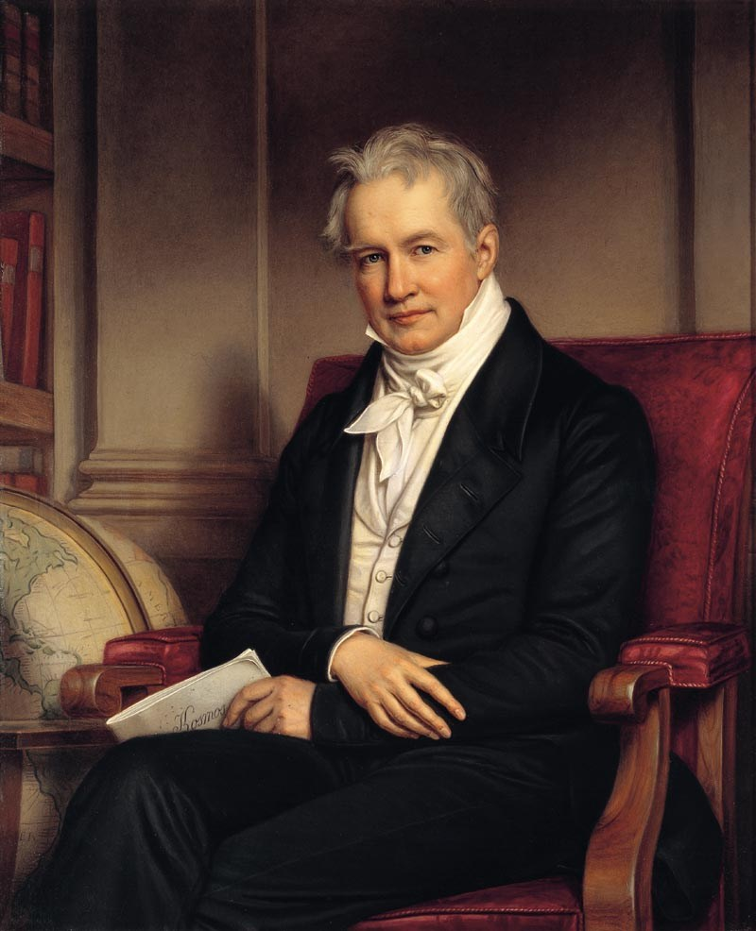
Alexander von Humboldt
“Father of temperature mapping”
A global map of average temperature – first climate global analysis in 1816.
Later published in 1830 by Woodbridge.
Wikipedia Contributors. (2019, April 18). Alexander von Humboldt. Wikipedia; Wikimedia Foundation. https://en.wikipedia.org/wiki/Alexander_von_Humboldt

Slide 4
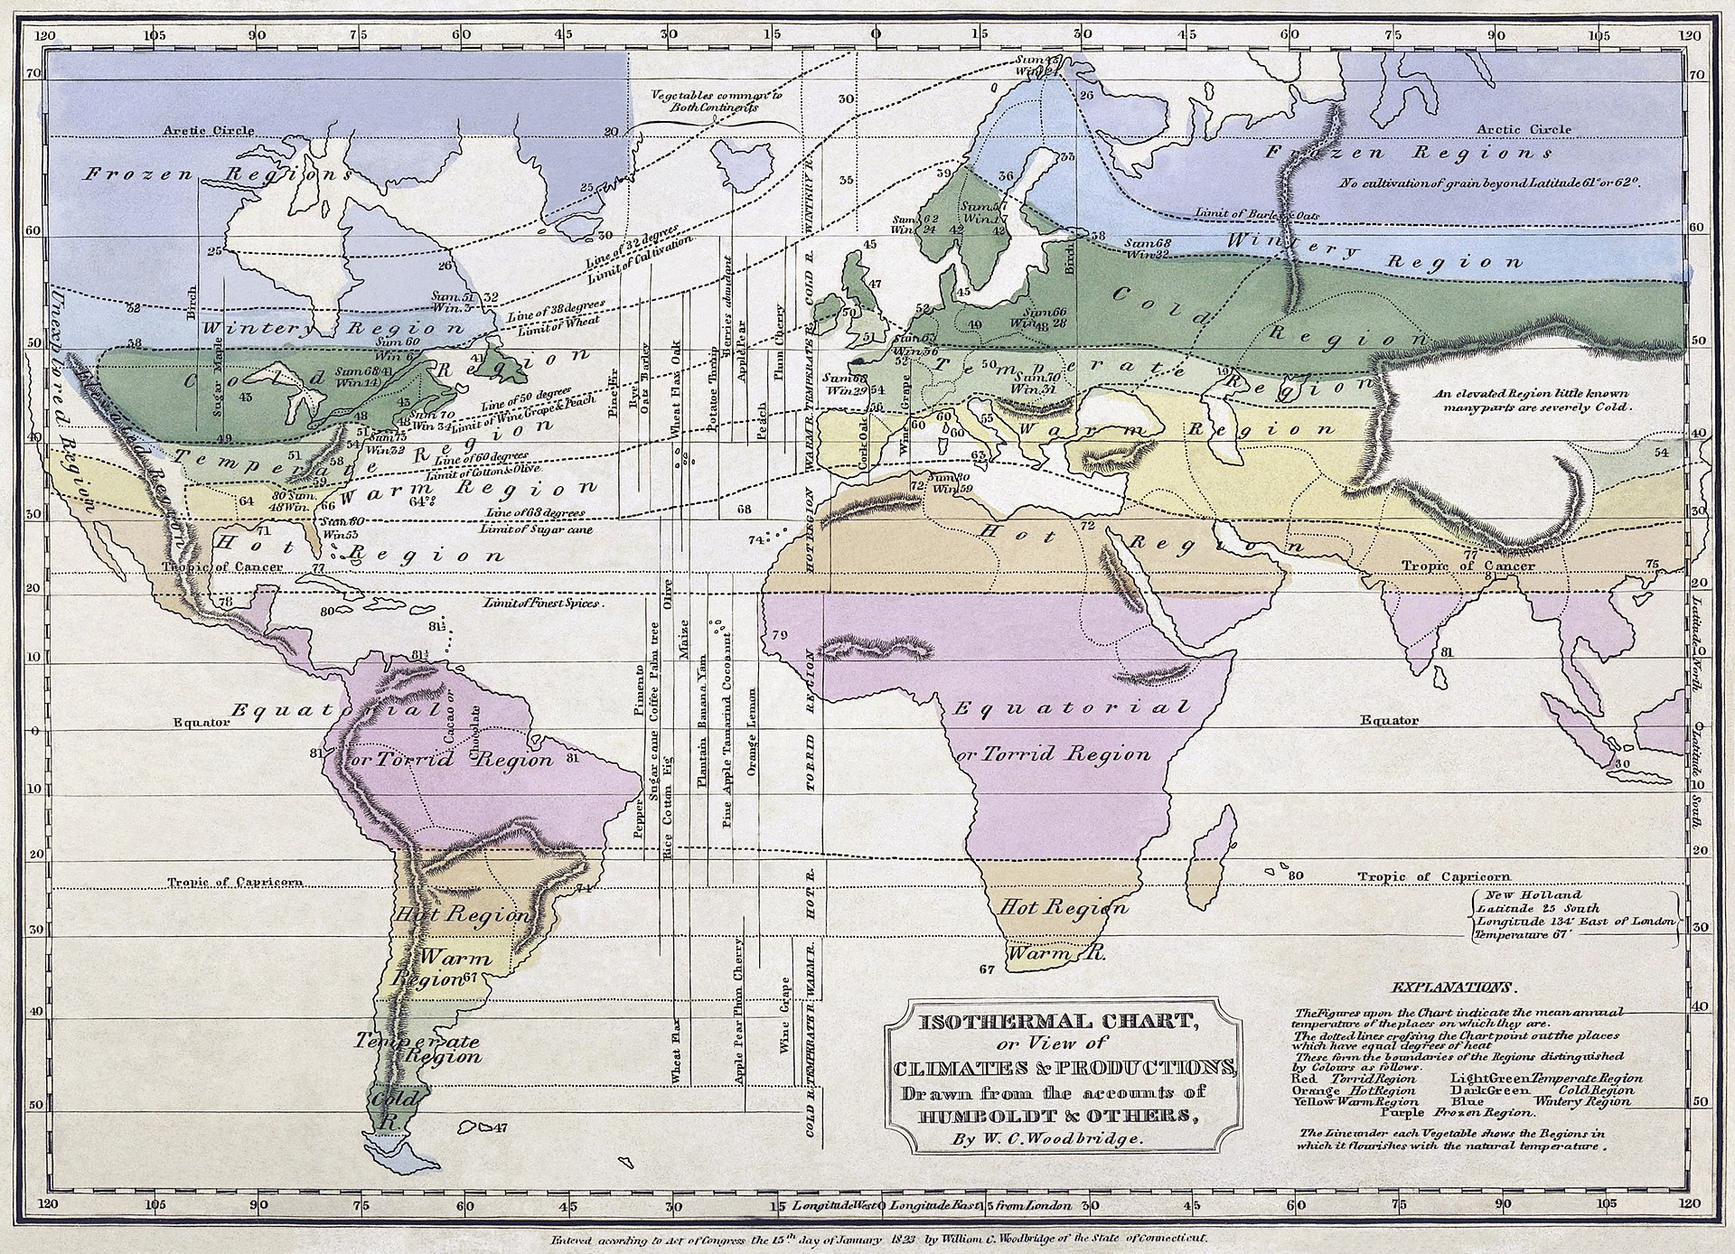
Wikipedia Contributors. (2019, April 18). Alexander von Humboldt. Wikipedia; Wikimedia Foundation. https://en.wikipedia.org/wiki/Alexander_von_Humboldt

Slide 5
Sir Francis Galton – the first meteorologist.
Cousin to Charles Darwin (!)
Polymath
Invented the weather map.
‌Wikipedia Contributors. (2019, May 8). Francis Galton. Wikipedia; Wikimedia Foundation. https://en.wikipedia.org/wiki/Francis_Galton

Slide 6
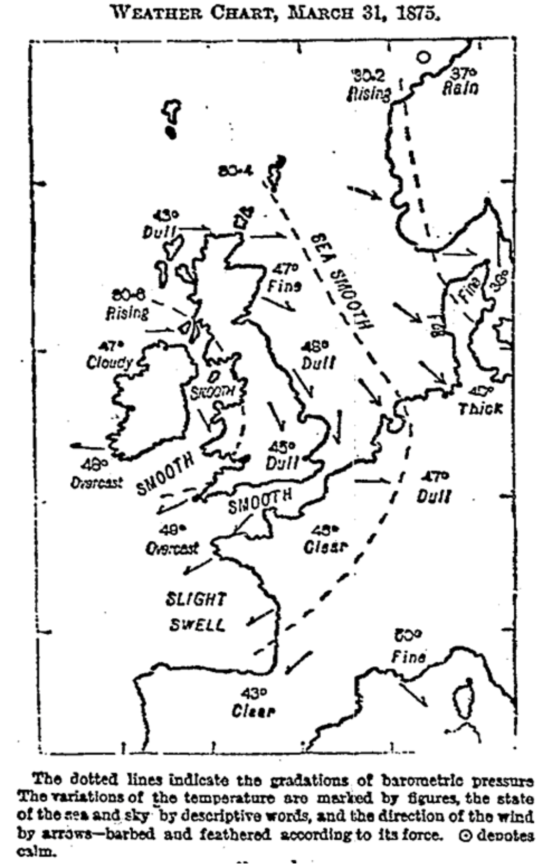
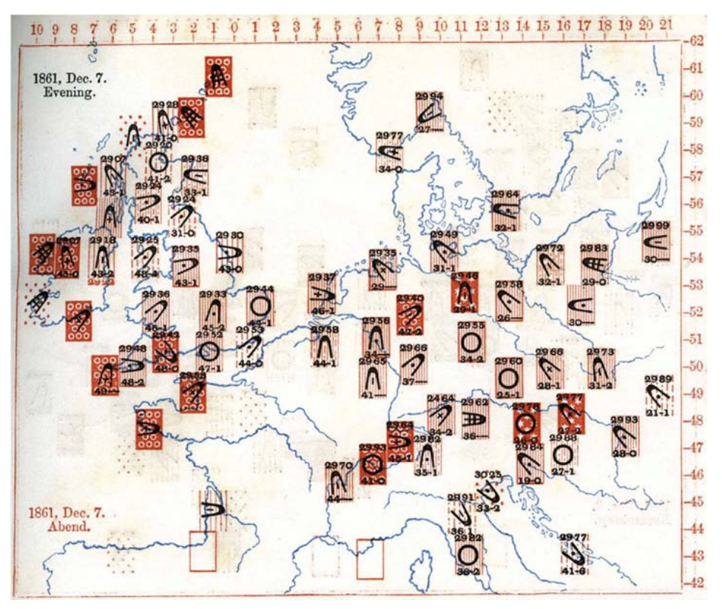
Francis Galton: Meteorologist. (n.d.). Galton.org. https://galton.org/meteorologist.html

Slide 7
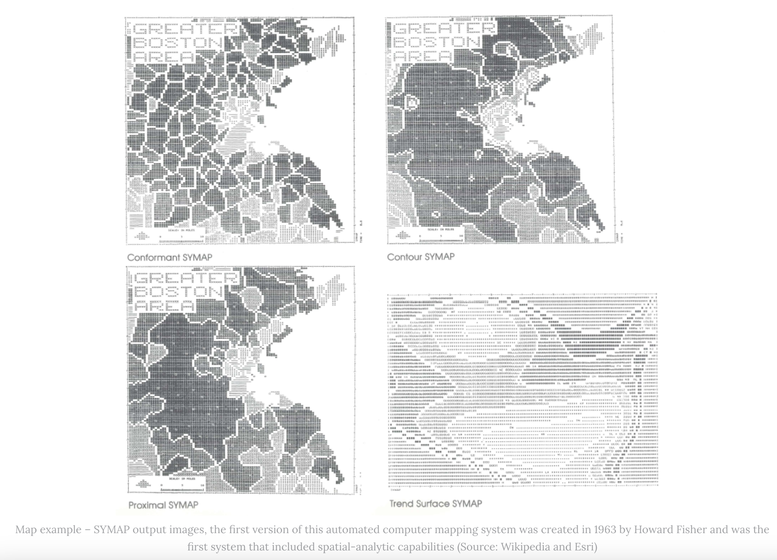
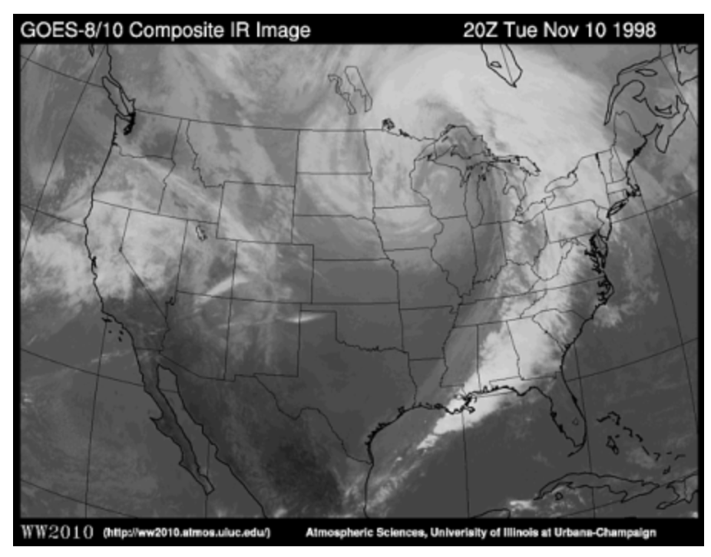
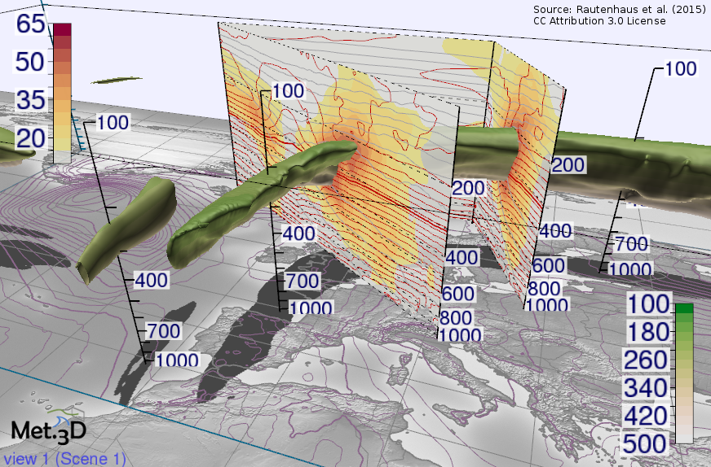
CLEVER°FRANKE, & CLEVER°FRANKE. (2024, April 3). The Evolution and Future of Interactive Data Visualization (Part 1), Nightingale. Nightingale. https://nightingaledvs.com/the-evolution-and-future-of-interactive-data-visualization-part-1/
Infrared Satellite Images: estimating temperature. (2025). Uiuc.edu. http://ww2010.atmos.uiuc.edu/%28Gh%29/wwhlpr/infrared_sat.rxml?hret=/indexlist.rxml
https://met3d.wavestoweather.de/met-3d.html
https://www.youtube.com/watch?v=K75YFndkAZY

Slide 8
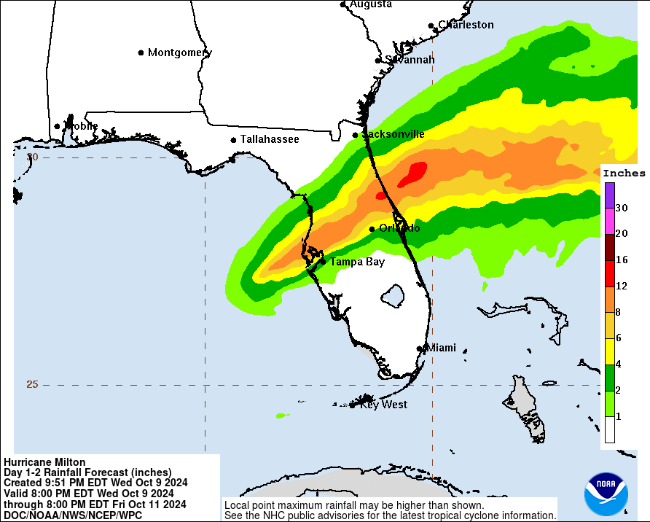
Why are good weather maps important?
Help predict future weather conditions.
Help people stay SAFE and make informed choices by offering a visual representation of potential weather risks and changes.
https://www.boston.com/weather/weather/2024/10/08/hurricane-milton-maps-path-timing-wind-speeds-storm-surge-rainfall/

Slide 9
Extra content
https://climate.nasa.gov/interactives/climate-time-machine/?intent=021
https://nightingaledvs.com/the-evolution-and-future-of-interactive-data-visualization-part-1/

Slide 10
References
CLEVER°FRANKE, & CLEVER°FRANKE. (2024, April 3). The Evolution and Future of Interactive Data Visualization (Part 1), Nightingale. Nightingale. https://nightingaledvs.com/the-evolution-and-future-of-interactive-data-visualization-part-1/
Francis Galton: Meteorologist. (n.d.). Galton.org. https://galton.org/meteorologist.html
Wikipedia Contributors. (2019, April 18). Alexander von Humboldt. Wikipedia; Wikimedia Foundation. https://en.wikipedia.org/wiki/Alexander_von_Humboldt
‌Wikipedia Contributors. (2019, May 8). Francis Galton. Wikipedia; Wikimedia Foundation. https://en.wikipedia.org/wiki/Francis_Galton
Infrared Satellite Images: estimating temperature. (2025). Uiuc.edu. http://ww2010.atmos.uiuc.edu/%28Gh%29/wwhlpr/infrared_sat.rxml?hret=/indexlist.rxml
‌
‌
‌

