Slide 1
Human Factors: Eliciting emotional reactions within data visualizations
Nisha Vashi
PSYC 6135
Mini-Presentation
February 6, 2025

Slide 2
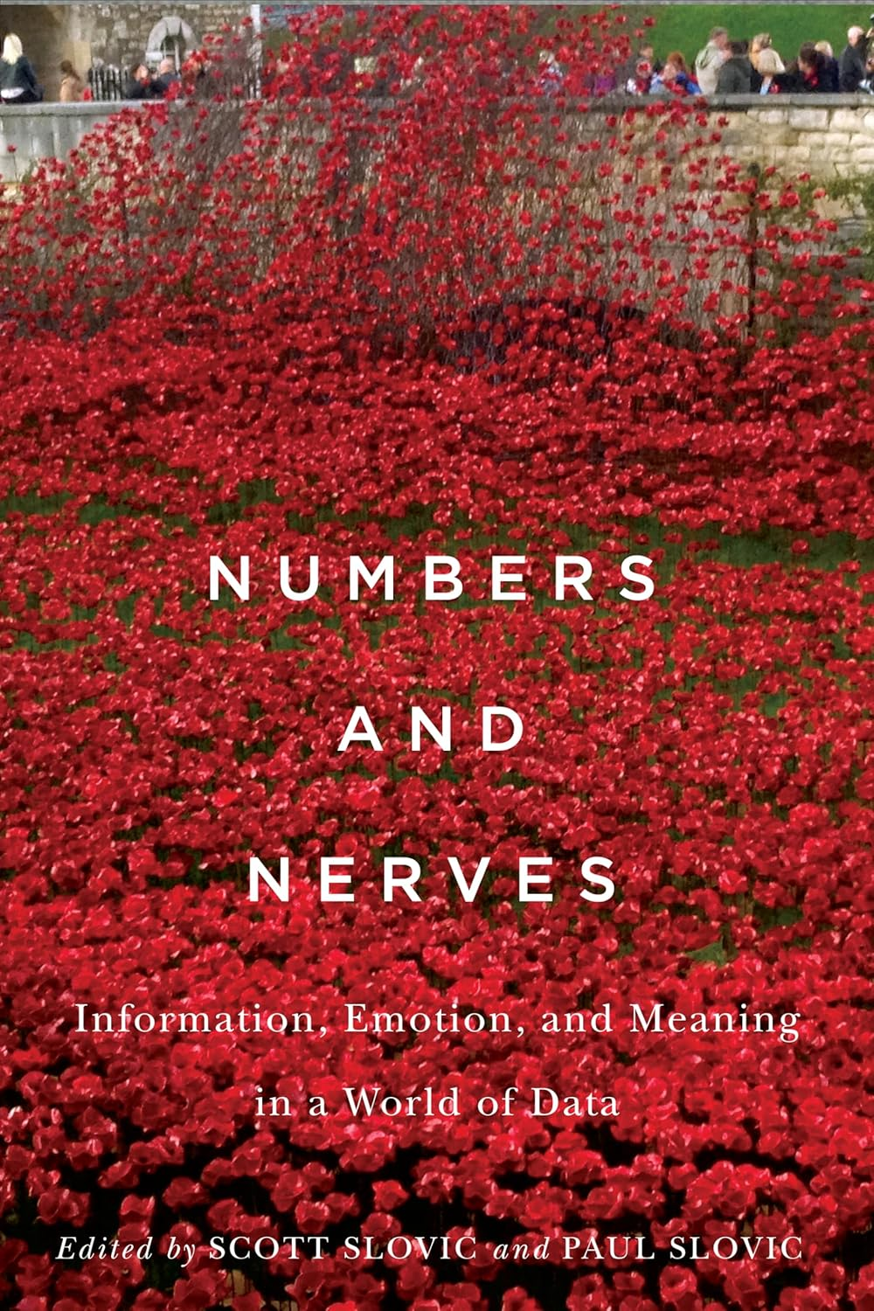
Do we really look at the numbers?
Scott & Paul Slovic (2015) – Numbers and Nerves: Information, Emotion, and Meaning in a World of Data
“Statistical Numbing” → Our incapacity to wrap our head around numbers and the lack of empathy elicited by them

Slide 3
Study: Garretón et al. (2024)
Notes:
Conducted a user study and compared the effects which data visualizations and illustrations have on changing attitude towards a presented topic.
Explored the effects on readers’ attitudes along three: persuasion, emotion, and information retention.
By comparing different versions of the same article, they observed how attitudes differ based on the visual stimuli present, and how they are perceived when combined.
Results indicated that the narrative using only data visualization elicits a stronger emotional impact than illustration-only visual support, as well as a significant change
in the initial attitude about the topic.

Slide 4
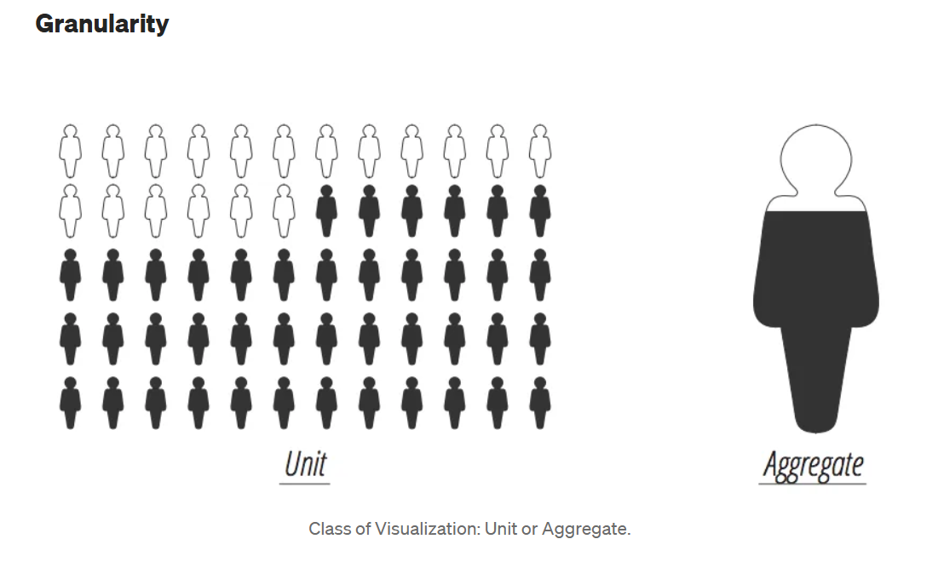
Technique #1: Anthropographics
Notes:
Data can be visualized at different levels of granularity
One basic decision a designer can make is to visualize every single data items with a dot or an icon or to abstract away from the units by calculating an aggregate measure of some sort.
One basic intuition here is that when data represent people, especially people involved in some kind of human tragedy, it is useful (more respectful even) to represent them in single units to emphasize the idea that behind each single dot there is a human life.
A similar argument has been espoused by a popular essay by Jake Harris titled “Connecting with the Dots”, in which Jake argued that “from a distance, it’s easy to forget the dots are people” and that it’s very important for visualization to keep this issue in mind when creating data visualizations.

Slide 5
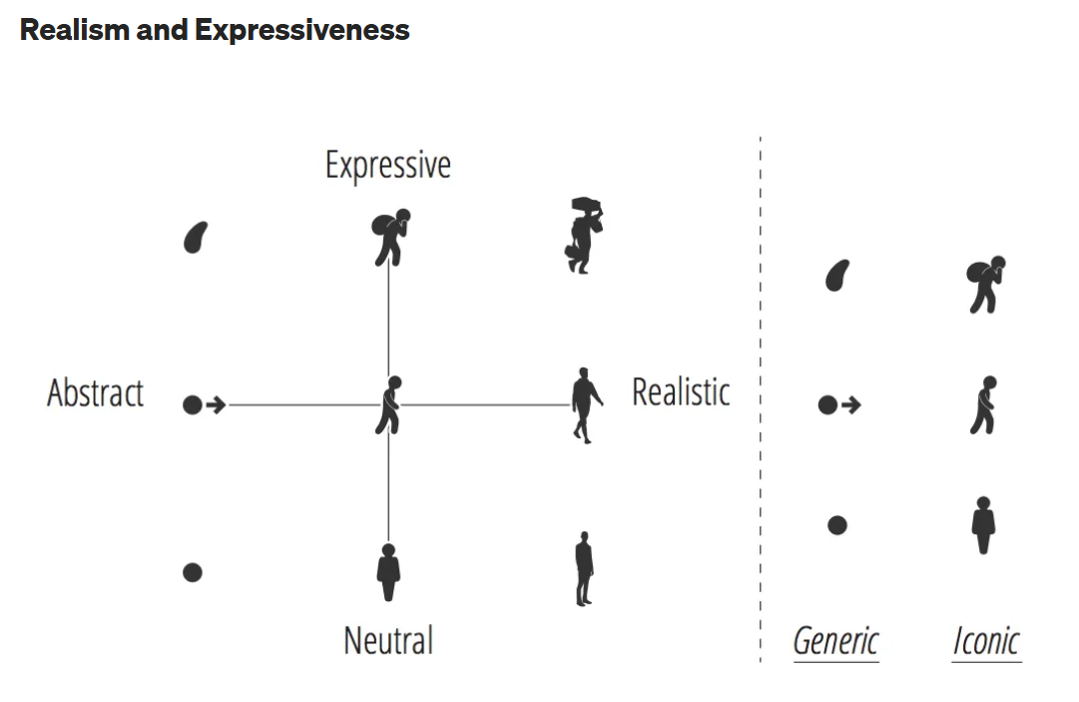
Notes:
A second aspect to take into consideration is how realistic a given icon to represent a human is.
The icon can have different levels of realism (a dot vs. a human figure) and expressiveness (an icon showing a migrant with a bag on his head)
Again, the basic intuition here is that more expressive and realistic depictions should elicit more empathy in the reader.

Slide 6
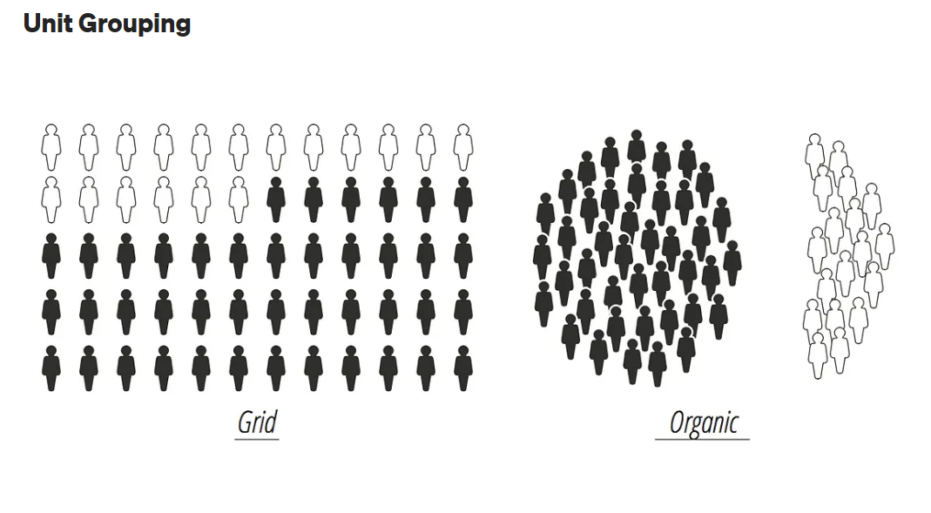
Notes:
Finally, the units can be organized in a rigid grid or in a more organic fashion
Rigid grids are less realistic, whereas more organic structures like the one of the right are more evocative of the kind of gatherings humans would create in reality and as such they may be an additional instrument to connect the dots to their human dimension.

Slide 7
Study: Boy et al. (2017)
Used human rights visualizations based on poverty, displacement, access to water, and education
Looked at the effect of these various conditions on empathic concern, personal distress, and prosocial behaviour
What they found:
Anthropographics (using units and more evocative graphics) did not lead to more empathy than standard graphics
Removing the graphics and changing stories (e.g., education, water) did not change the level of empathy
Removing the text reduced the level of empathy, but did not lead to a difference between the type of visualization used (e.g., anthropographics vs. pie charts)
Notes:
- Used anthropographics vs. pie charts

Slide 8
Technique #2: Use of Colour
Notes:
Use of colour in general can activate our attentional cues, and specific colours can also be used to elicit emotions
What do you notice here?

Slide 9
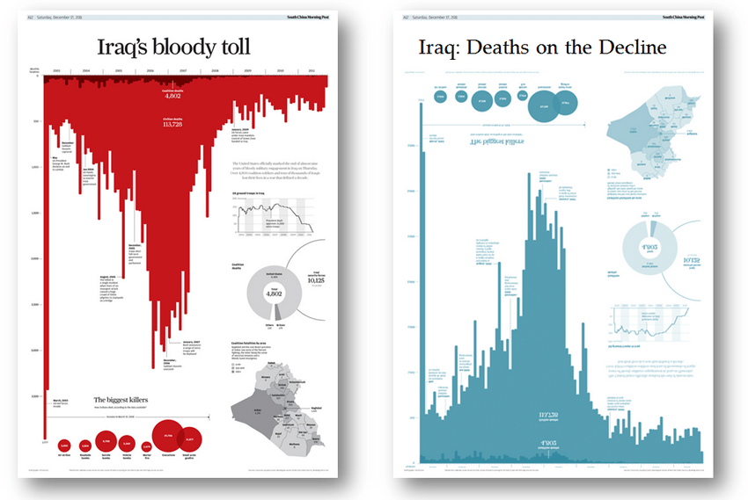
Notes:
Shows number of deaths in Iraq from 2003 to 2011
Dark red shows number of soldier deaths, light red shows civilian deaths
Smaller text shows key events, circles show causes of death (e.g., air strikes vs. gunfire), fatalities by area
Other graph reversed and in a different colour shows same data, but this time depicts Iraq deaths being on the decline

Slide 10
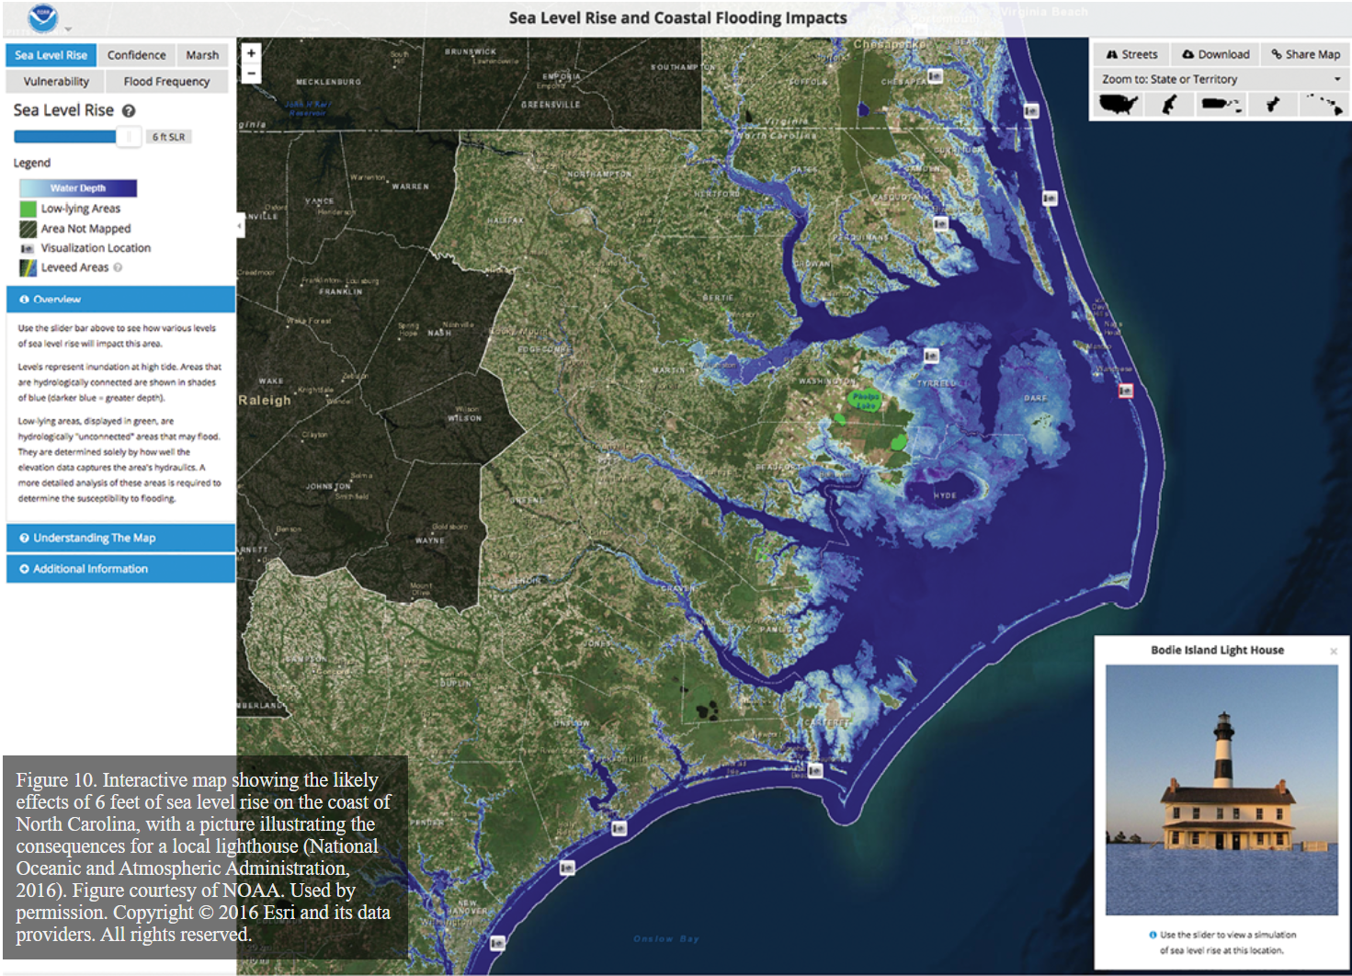
Notes:
Interactive map showing the likely effects of 6 feet of sea level rise on the coast of North Carolina, with a picture illustrating the consequences for a local lighthouse
Blue makes it look like water is seeping in
Varying degrees of blue show the water depth
Using a real picture within the visualization helps to connect to a real experience and elicit emotions

Slide 11
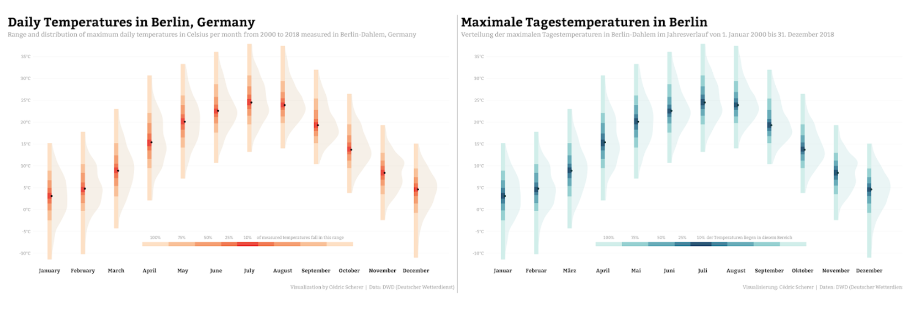
Variation in daily temperatures in Berlin, in English and German with two different color palettes.
Notes:
Cedric Scherer
Range and distribution of maximum daily temperatures in Celsius per month from 2000 to 2018 in Berlin, Germany
Without any intention, the two variations of the visualization triggered different emotional reactions
While the red chart likely leads you to think “Wow, Berlin summers are quite hot,” the blue version may push you to think of summers as rainy and rather cold.

Slide 12
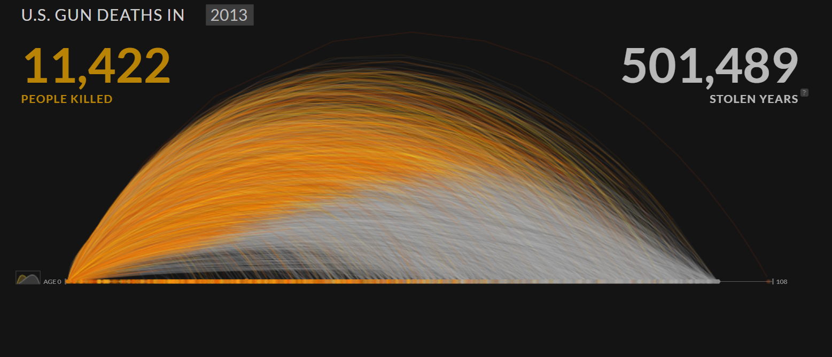
Technique #3: Interactivity
U.S. Gun Deaths
Notes:
Number of US gun deaths in 2013, and the projected number of years they may have lived until
Potential lifespan of victims was determined by using US mortality data from WHO (age and cause of death predictions are based on likelihood of deaths at different ages)
Can also explore by gender, age group, region, etc.
U.S. Gun Deaths

Slide 13
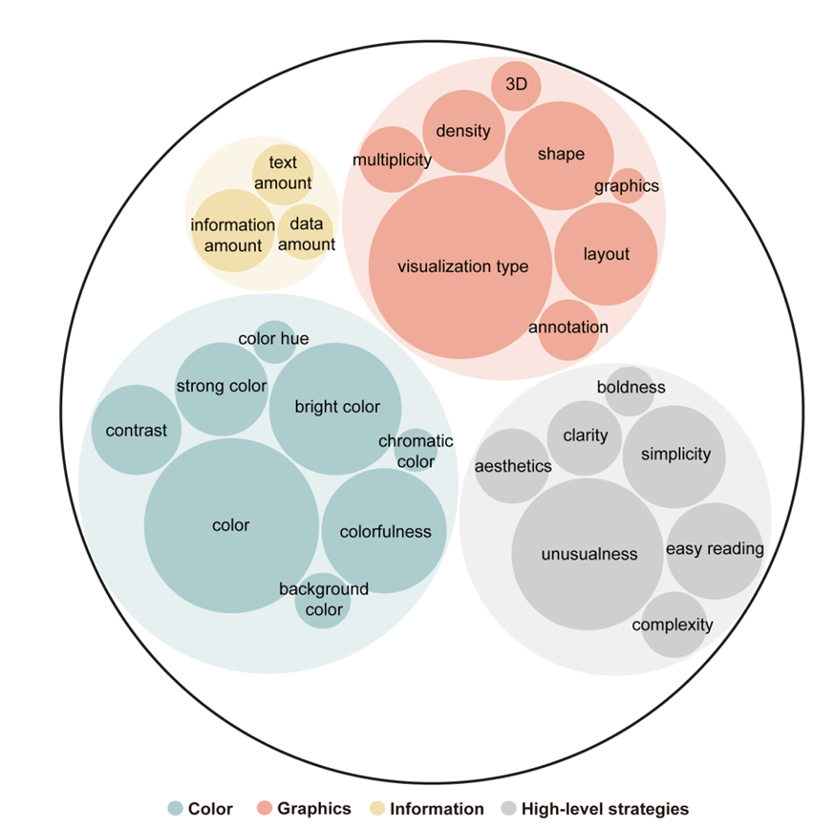
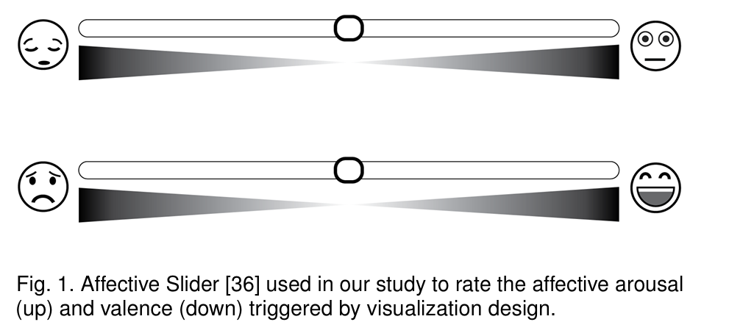
Study: Lan et al. (2022)
Notes:
Collected a corpus of 265 data visualizations and conducted a crowdsourcing study with 184 participants during which the participants were asked to rate the affective arousal elicited by data visualization design (all texts were blurred to exclude the influence of semantics) and provide their reasons
Used a sliding scale to indicate their affective arousal using smiley faces (intensity of the effect) and valence (positive or negative affect)
Based on the collected data, first, they identified a set of arousal-related design features by analyzing user comments qualitatively

Slide 14
References
Boy, J., Pandey, A. V., Emerson, J., Satterthwaite, M. L., Nov, O., & Bertini, E. (2017). Showing people behind data: Does anthropomorphizing visualizations elicit more empathy for human rights data? NYU School of Law, Public Law Research Paper No. 17-02.
Garreton, M., Morini, F., Celhay, P., Dork, M., & Parra, D. (2023). Attitudinal effects of data visualizations and illustrations in data stories. IEEE Transactions on Visualization and Computer Graphics. 1-16. https://doi.org/10.1109/TVCG.2023.3248319
Lan, X., Yanqiu, W., & Chen, Q. (2022). The chart excites Me! Exploring how data visualization design influences affective arousal. https://doi.org/10.48550/arXiv.2211.03296
https://guns.periscopic.com/?year=2013
https://www.stc.org/techcomm/2016/05/11/the-re-emergence-of-emotional-appeals-in-interactive-data-visualization/
https://www.cedricscherer.com/2021/06/08/colors-and-emotions-in-data-visualization/

