Slide 1
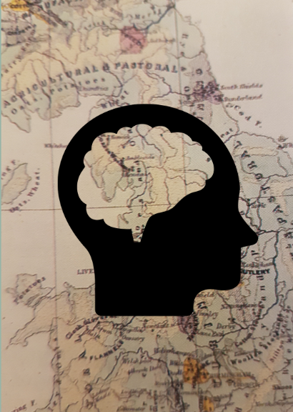
From Thematic Maps to Brain Maps
Camille Proszanski
(From Robinson, A.H., 1982)

Slide 2
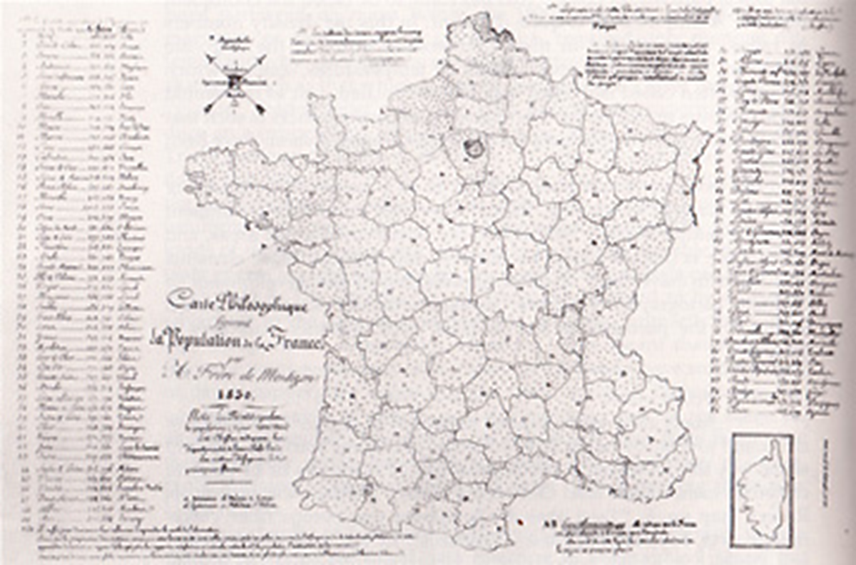
First Population Dot Map
Created in 1830 by
Armand Joseph Frère de Montizon
Each dot represents 10,000 people
(From Robinson, A.H., 1982)

Slide 3
Shading Dot Map
Physikalischer Atlas (1848) by Heinrich Berghaus
Closer dots indicate denser population
(From Robinson, A.H., 1982)

Slide 4
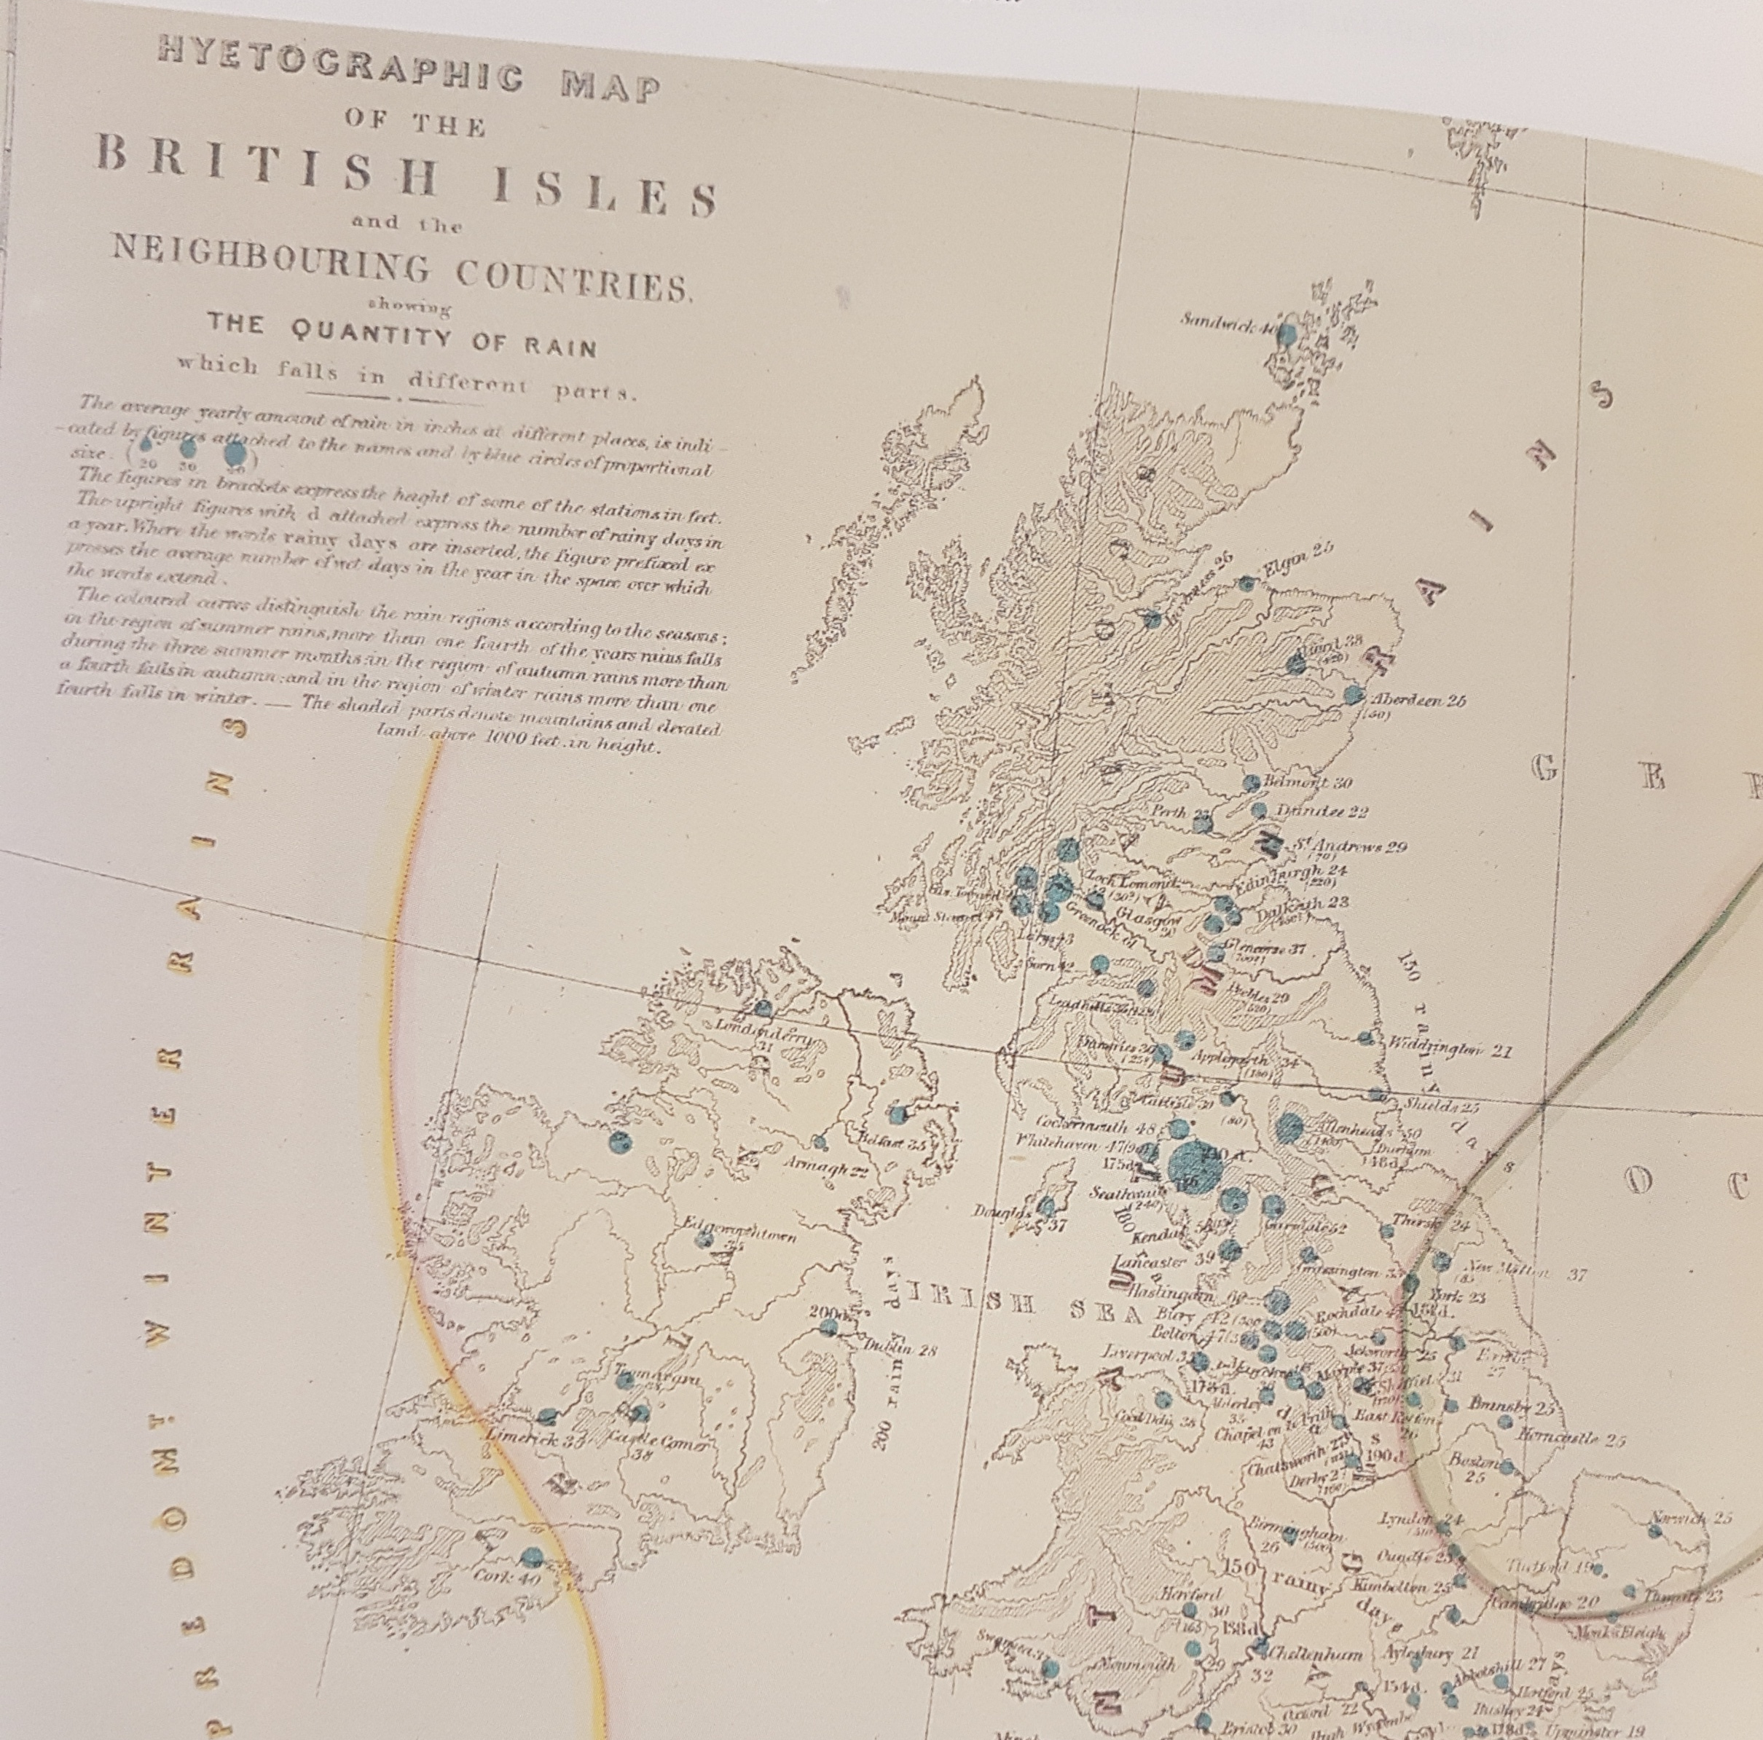
Dot Maps Take Off
Maps Illustrative of the Physical, Political and Historical Geography of the British Empire (1851)
Petermanns Mitteilungen (1857)
(From Robinson, A.H., 1982)

Slide 5
Dot Brain Maps
First psychology textbooks:
The Principles of Psychology (1890) - William James
Principles of Physiological Psychology (1904 & 1910)
- Wilhelm Wundt, Translated by Edward Titchener
Die functions-localisation auf der grosshirnrinde anthierexperimenten und klinischenfdllen nachgewiesen
by Luigi Luciani and Giuseppe Seppilli
Translated by M. O. Fraenkel (1886)

Slide 6
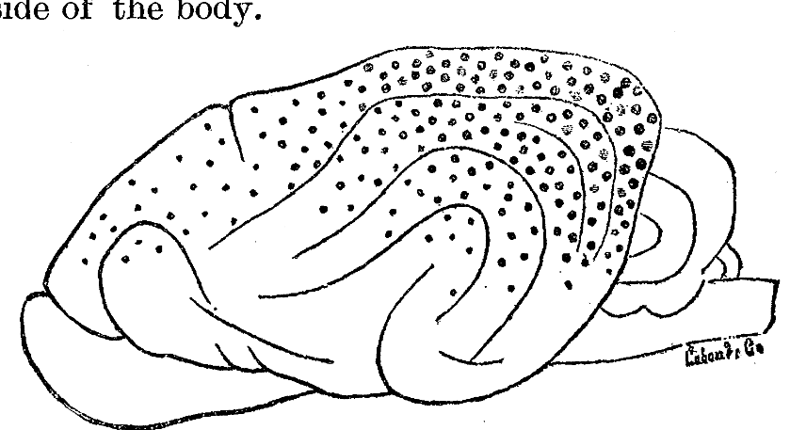
Dot Brain Map of Visual Function
Size of the dots
Spacing of the dots
Texture of the dots
(Luciani, L., 1886 in Jastrow, J., 1886)

Slide 7
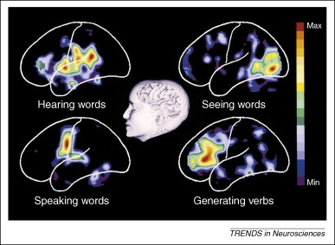
PET Brain Activation Map
(Petersen et al., 1988 in Raichle, 2008)

Slide 8
fMRI Brain Activation Map

Slide 9
References
James, W. (1890). The principles of psychology. H. Holt and company. https://psychclassics.yorku.ca/James/Principles/prin2.htm
Jastrow, J. (1886). Localization of Function in the Cortex of the Brain. Science (American Association for the Advancement of Science), 8(195), 398–399. https://doi.org/10.1126/science.ns-8.195s.398
Palsky, G. (1984). La naissance de la démocartographie. Analyse historique et sémiologique. Espace populations sociétés, 2(2), 25‑34. https://doi.org/10.3406/espos.1984.956
Raichle, M. E. (2009). A brief history of human brain mapping. Trends in Neurosciences (Regular Ed.), 32(2), 118–126. https://doi.org/10.1016/j.tins.2008.11.001
Robinson, A. H. (1982). Early thematic mapping in the history of cartography. University of Chicago Press.
Wundt, W. M., & Titchener, E. B. (1904). Principles of physiological psychology. S. Sonnenschein & Co., Lim. https://archive.org/details/b21504520/page/194/mode/2up
Wundt, W. M., & Titchener, E. B. (1910). Principles of physiological psychology. S. Sonnenschein & co., Lim. https://books.scholarsportal.info/uri/ebooks/ebooks0/apa/2011-02-09/1/200905699

