Slide 1
Graph design and interpretation:
Cultural considerations &
Health Risk Communication
Ashley
Sami
Notes:
5 min each

Slide 2
Context of our presentation
Given the idea of standardization of graph design, how are graphs standard as well as not so standard?
How are graphs designed to consider the influence of culture on interpretation?
How are graphs designed to effectively communicate medical/health risk?
Notes:
Graphs are a cultural construction
Surveys are a cultural construction
Standardization broadly speaking – there are attempts at standardization at different levels, e.g., bertin, standardization of graph elements– but also attempts at standardization in specific contexts, e.g., standards for communication of health risk info – we'll be referring more to the latter, how graphs are adapted in certain contexts – culture, and communication of health risk.

Slide 3
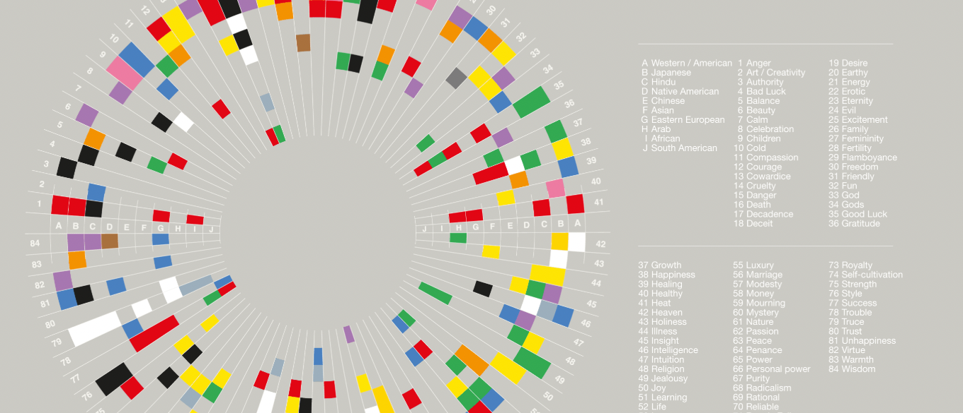
Colour Interpretation Across Cultures
https://informationisbeautiful.net/visualizations/colours-in-cultures/
Notes:
This is a classic graph that represents how colours are reperesented across culture – I had to show this one first because I was fascinated by the fact that a visualiation trying to help others understand the importants of visual factors – like colours, was quite a difficult visual to interpret

Slide 4
Colour Interpretation Across Cultures
Colors represent different things, in different cultures

Slide 5
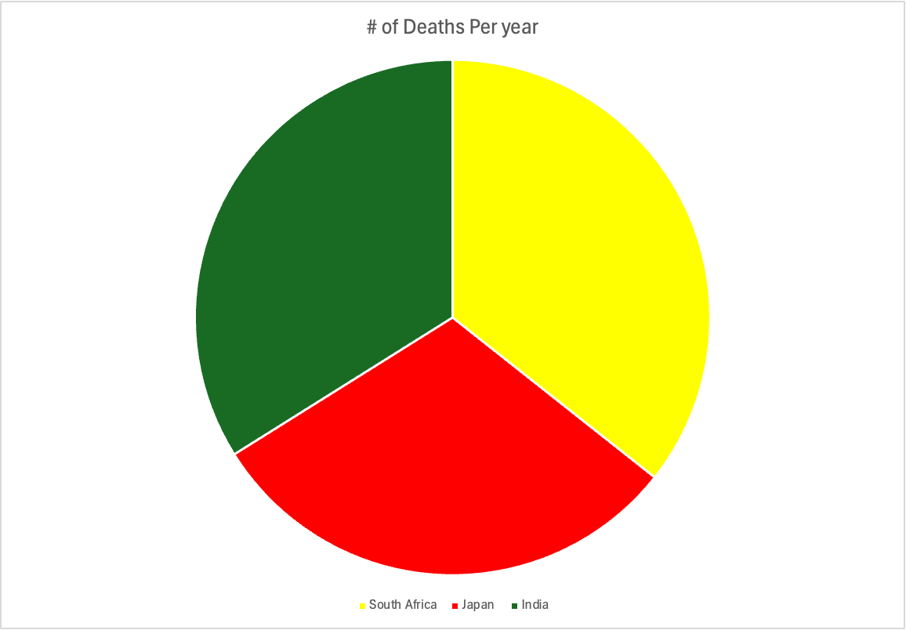
Notes:
Graphs are a cultural construction
Surveys are a cultural construction

Slide 6
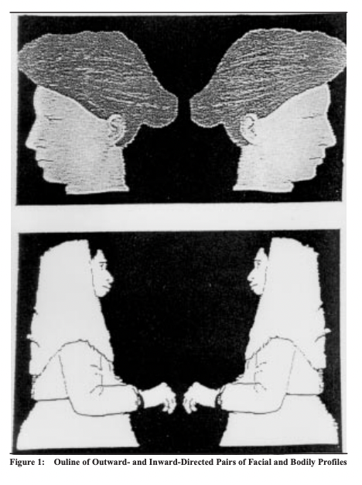
Reading Direction
Left and right profiles of human faces and bodies were presented via video
Participants were asked to indicate the profile they considered more beautiful
Individuals who read and write from left to right preferred profiles that turned left
Individuals who read and write from left to right preferred those that turned left
Preference depends on the direction of scanning
Nachson et al., 1999

Slide 7
Reading Direction
Göbel, 2015

Slide 8
Right-to-Left Timeline
[2000] —— [1950] —— [1900] —— [1850] —— [1800]
Left-to-Right Timeline
[1800] —— [1850] —— [1900] —— [1950] —— [2000]

Slide 9
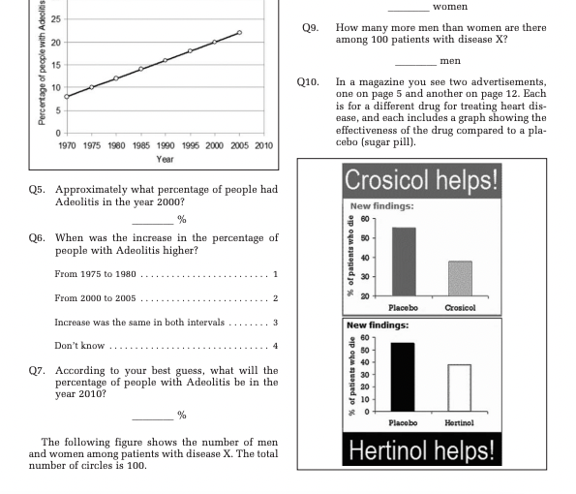
Graph Literacy Scale
Galesic & Garcia-Retamero, 2011

Slide 10
Graph Literacy Scale
Administered to German and US populations
Part of the "Helping People with Low Numeracy Understand Medical Information"
Presented information about the risk of stroke and heart attack
Galesic & Garcia-Retamero, 2011

Slide 11
Graph Literacy Scale Findings

Slide 12
Communicating medical/health risk via graphs
Notes:
Literature = big
Briefly talk about example from research. In these examples, I'll be placing some emphasis on how graph design might be tailored to children or to people of older age or to numeracy level.
-------------------------------

Slide 13
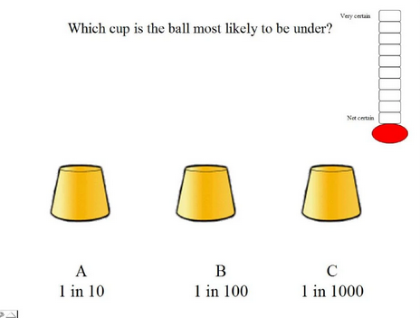
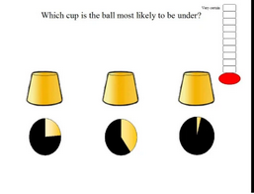
Communicating probability risk to children (Ulph, Townsend, & Glazebrook, 2009)
N = 106
7-11 years old
Trial variations:
Verbal label
%
1 in X
1:X
*Pie charts*
Notes:
This study is about communication of risk to children – the authors say the application of this study is to communicate probabilistic information about newborn screening and carrier results - Although maybe not the best face validity because they're using a cup and ball trial vs actually communicating that health information.
In this study, the participants were children age 7-11 years old. In a single trial, 3 cups are presented and below each cup is some indication of the probability that a ball will be under the cup. The child is asked to select the cup which is most likely to contain the ball.
There were 5 kinds of trials: verbal label (e.g., rarely, sometimes), %, 1 in x, 1:x, pie charts.
Regarding the scale on the right side of the image, the children were asked to rate their certainty of their choice.
Two main take-aways for the results. First, children were more significantly accurate with their responses in the pie chart trials in comparison to the rest of the trials, and that children were significantly more certain of their responses with pie charts compared to the other formats. Second, older age was associated with better performance on all formats except percentages, an implication in this specific study context is that we have to be sensitive to the age group of the observer.
----------------------------------
Methods: A probabilistic task based on the cup game was used to measure which of five different formats was
associated with greatest understanding in children aged 7–11 years old (n = 106). Formats used were verbal labels
(e.g. rarely, sometimes), percentages, proportion-word (e.g. 1 in X), proportion-notation (e.g. 1:X) and pie charts.
There was also an additional mixed format condition. In each trial a picture was presented of three cups, each
with a different probability depicted beneath it, and the child was asked to select which cup was most likely to
contain the ball. Three trials were presented per format. Children also rated how certain they were that they had
answered correctly.

Slide 14
Graphs and medical decision-making (Hawley et al., 2008)
N = 2412
Mean age: 49 years old, range: 18-90
Half of participants were categorized as low numeracy
Randomized to 1 of 6 graph formats
Presenting treatment risk & benefit information
Outcome: Verbatim knowledge, gist knowledge, treatment decision, trustworthiness of format
Notes:
This study is about medical decision making. It involves a wide age range of participants 18-90 years old. Half of participants were categorized as low numeracy.
Participants are brought into a hypothetical medical decision-making scenario – they're randomized to 1 of 6 different graph presentations of treatment risk and benefit information. The participant then makes a treatment decision (hypothetically) and answers questions to assess understanding of the graph in terms of verbatim knowledge and gist knowledge. I realized when searching the literature that these 2 constructs come up in many health risk visualization studies – so it's common. Verbatim knowledge: the ability to correctly read numbers from graphs. Gist knowledge: the ability to identify the essential point of the information presented
----------------------------------------------------------------------------------------------------------
An online hypothetical medical decision making scenario. Participants were randomized to
view treatment risk and benefit information in one of the six graphg formats and they answer questions based on understanding in terms of verbatim knowledge and gist knowledge which I noticed are often studied constructs in the literature on communication of health risks.
Age groups: < 40, 40-59, >59 years old

Slide 15
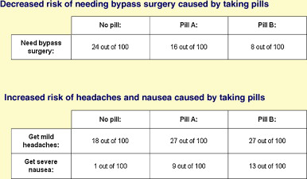
Table

Slide 16
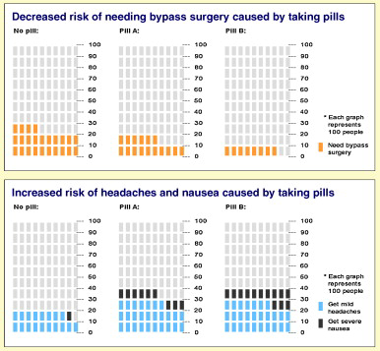
2. Pictograph

Slide 17
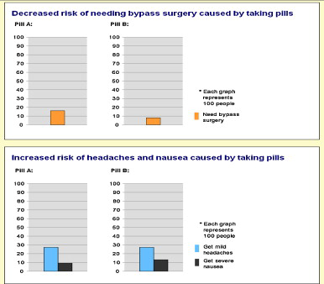
3. Bar graph
Notes:
Note: no 'no pill' graph – I don’t know why
-----------------

Slide 18
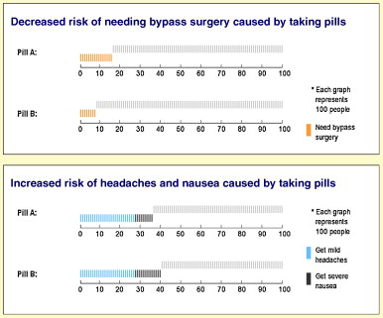
4. Sparkplug

Slide 19
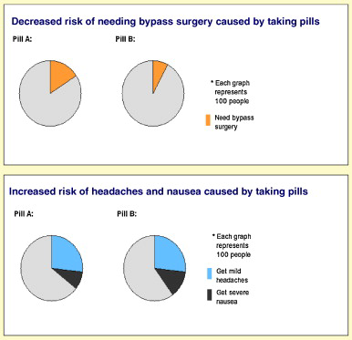
5. Pie chart

Slide 20
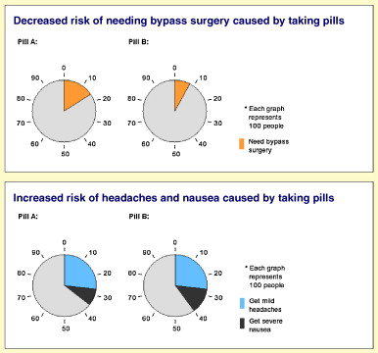
6. "Clock" graph – modified pie graph

Slide 21
Selected results (Hawley et al., 2008)
Tables
Adequate verbatim knowledge, but lower likelihood of adequate gist knowledge vs. other formats
Pictograph
Adequate understanding, especially for low numeracy individuals
Recommendations
If goal is to impart general knowledge about which treatment better or worse, perhaps pie graph
If goal for patients to understand specific numeric risk or benefit, perhaps table
"Pictographs are the best format for communicating probabilistic information to patients in shared decision making environments, particularly among lower numeracy individuals."
Notes:
Verbatim and gist knowledge scores were significantly associated with choosing a medically superior treatment choice
Tables: higher likelihood of adequate verbatim knowledge vs. other formats (p < 0.001) but lower likelihood of having adequate gist knowledge (p < 0.05)
Perceived as well trusted
Pie graph: perceived as least trustworthy
Pictograph:
Adequate understanding, especially for low numeracy individuals
Trusted by high and low numeracy individuals
Recommendations
If goal is to impart general knowledge about which treatment better or worse, perhaps pie graph
If goal for patients to understand specific numeric risk or benefit, perhaps table
"Pictographs are the best format for communicating probabilistic information to patients in shared decision making environments, particularly among lower numeracy individuals."

Slide 22
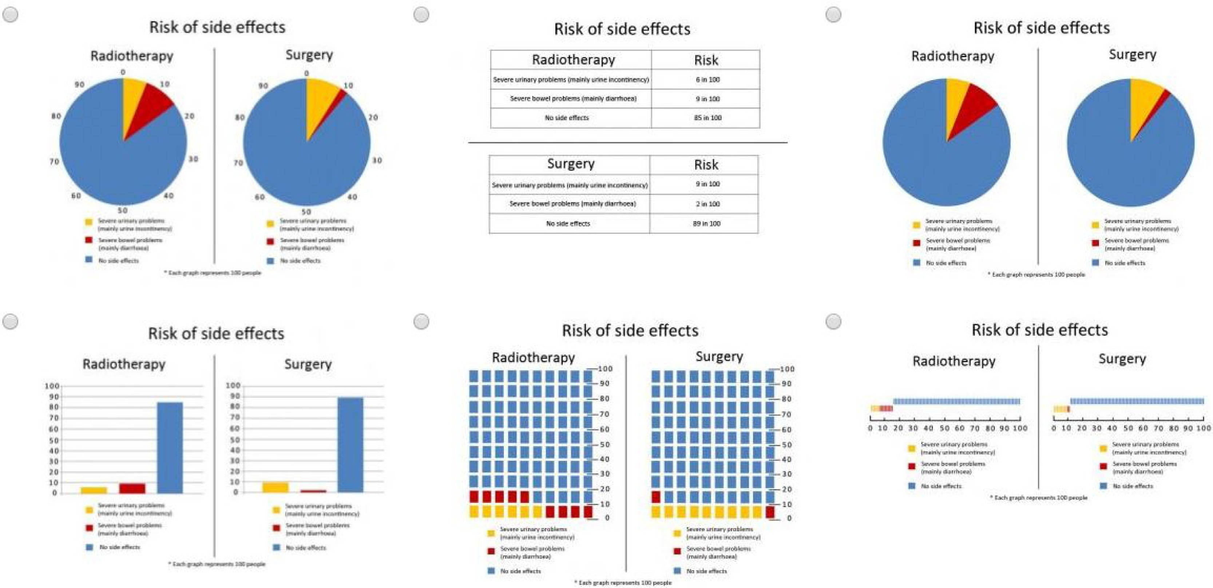
Health risk communication and age (van Weert et al., 2021)
Notes:
446 participants
Groups: < 65, >= 65 years old
Hypothetical situation in this study: You're diagnosed with cancer and asked to consider risks of radiotherapy and surgery. Answer questions about verbatim and gist.
Clock, pie, bars, sparkplugs, tables, and pictographs

Slide 23
Selected results (van Weert et al., 2021)
Notes:
446 participants
Groups: < 65, >= 65 years old
Clock, bars, sparkplugs, tables, pies, and pictographs
Most participants preferred clock, pie or bar chart.
Higher health literacy and graph literacy were associated with higher gist knowledge.
Conclusion: Although not the preferred format, tables are best understood by older adults.
Recommendation:
Cognitive illustrations, i.e., illustrations that visually represent text to facilitate comprehension and learning of information
Using affective-visual cues, and affecting the observer's emotion and satisfaction of taking in the graph

Slide 24
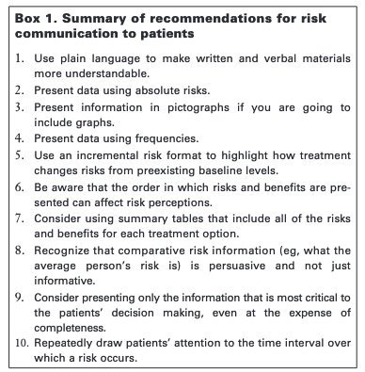
Recommendations for graphic communication of risk (Lipkus & Hollands, 1999)
Recommendations for graphic communication of risk (Fagerlin et al., 2011)
Avoid areas or volumes to depict quantities
Consider the task, e.g., Carswell (1992) taxonomy
Point reading
Local comparisons
Global comparisons
Synthesis
Minimize number of mental operations
Data-ink ratio
Use of multiple graphs
Highlight differences
Use distinctive legends
Be consistent
Audience
Small probabilities as a frequency vs. as decimal
Notes:
n point reading, the observer judges the value of a
single graphical element (e.g., what is the value of risk expressed
in a histogram?). In local comparisons, the observer compares
two graphical elements (e.g., which person, A or B, has a higher
risk of getting breast cancer?).
For global comparisons, compares quantities derived from other quantities shown
in the graph (e.g., is person A’s risk for breast cancer less than
that of B’s over two time periods?).
For synthesis judgments, the
observer needs to consider all data points to make a general,
integrative judgment (e.g., is person A’s risk of breast cancer
increasing or decreasing over time?).

Slide 25
References
Carswell CM. Choosing specifiers: an evaluation of the basic tasks model of graphical perception. Human Factors 1992;34:535–54
Fagerlin A, Zikmund-Fisher BJ, Ubel PA. Helping patients decide: ten steps to better risk communication. Journal of the National Cancer Institute. 2011 Oct 5;103(19):1436-43.
Galesic, M., & Garcia-Retamero, R. (2011). Graph literacy: a cross-cultural comparison. Medical decision making : an international journal of the Society for Medical Decision Making, 31(3), 444–457. https://doi.org/10.1177/0272989X10373805
Göbel S. M. (2015). Up or down? Reading direction influences vertical counting direction in the horizontal plane - a cross-cultural comparison. Frontiers in psychology, 6, 228. https://doi.org/10.3389/fpsyg.2015.00228
Hawley ST, Zikmund-Fisher B, Ubel P, Jancovic A, Lucas T, Fagerlin A. The impact of the format of graphical presentation on health-related knowledge and treatment choices. Patient Education and Counseling. 2008;73(3):448-55.
Lipkus IM, Hollands JG. The visual communication of risk. JNCI monographs. 1999 Jan 1;1999(25):149-63.
Nachson, I., Argaman, E., & Luria, A. (1999). Effects of Directional Habits and Handedness on Aesthetic Preference for Left and Right Profiles. Journal of Cross-Cultural Psychology, 30(1), 106-114. https://doi.org/10.1177/0022022199030001006
Schapira MM, Nattinger AB, McAuliffe TL. The influence of graphic format on breast cancer risk communication. Journal of health communication. 2006 Jul 1;11(6):569-82.
Ulph F, Townsend E, Glazebrook C. How should risk be communicated to children: a cross-sectional study comparing different formats of probability information. BMC Medical Informatics and Decision Making. 2009;9:1-5.
van Weert JC, Alblas MC, van Dijk L, Jansen J. Preference for and understanding of graphs presenting health risk information. The role of age, health literacy, numeracy and graph literacy. Patient Education and Counseling. 2021 Jan 1;104(1):109-17.

