Slide 1
Qualitative Data Visualization of Lived Experience
Sami

Slide 2
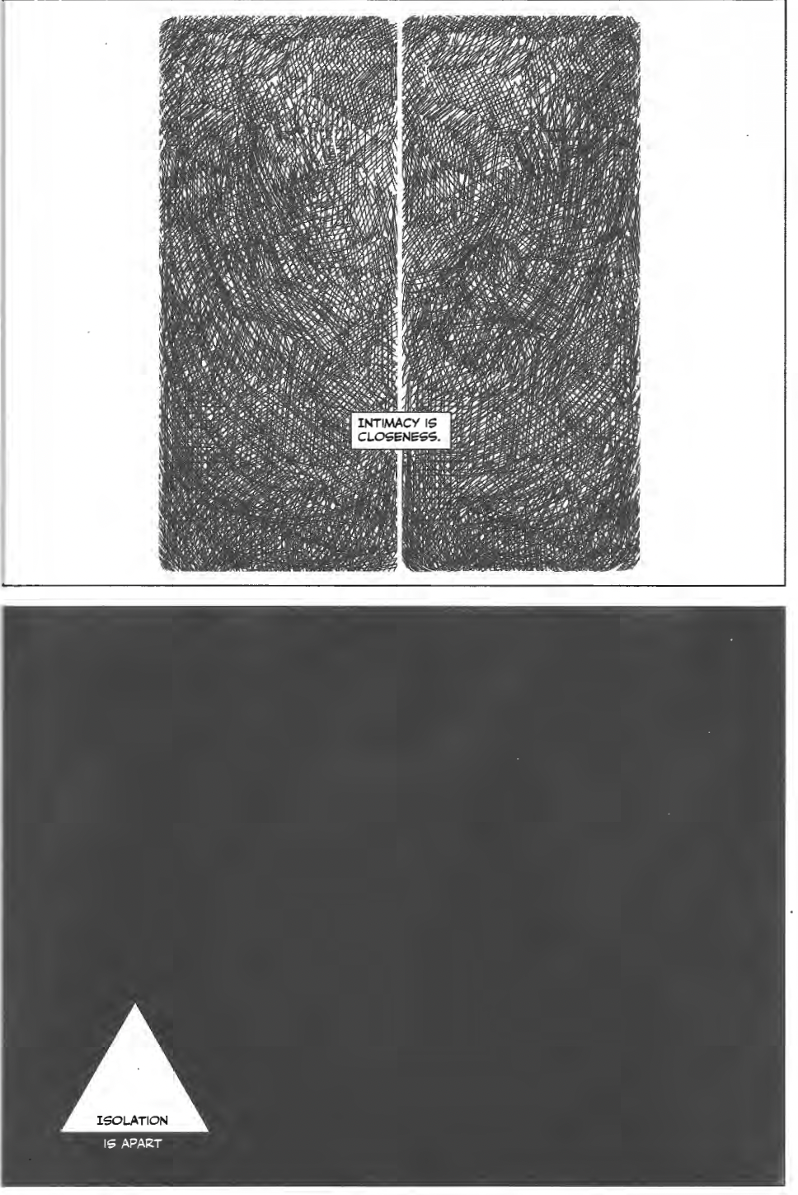
Order
1. Context
2. Mainstream
3. Peripheral
4. Conclusion
Sousanis 2015

Slide 3
1. Context

Slide 4
Data distinctions
Quantitative:
“… the kind of data that is in the form of discrete units that can be counted, categorized or analysed via mathematical means.”
E.g.,
Frequency counts
Survey scale data
Demographic data
Sensor data
Qualitative:
“… typically descriptive and can be read or analysed via interpretation.”
E.g.,
Text
Sound
Image
Video, etc.
Davila & Hall 2022

Slide 5
Mixed-methods integration
Integrating qualitative and quantitative data into a unified study
at different research stages:
Collection
Analysis
Visualization
Discussion*
Tashakkori & Creswell, 2007; Bartholomew et al., 2018
Bateson 1979

Slide 6
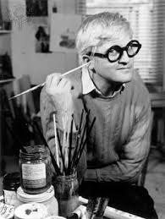
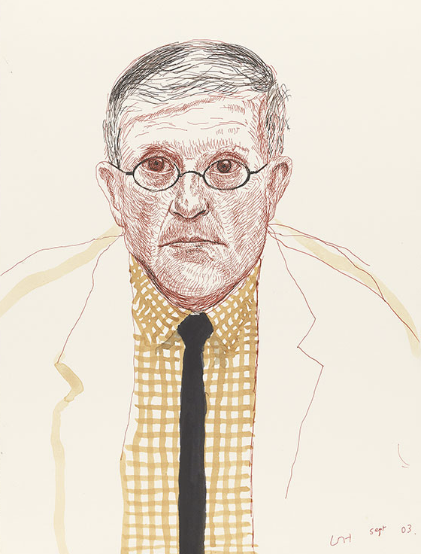
Qualitative stance
Metaphor: portraiture (Dixson, 2005)
Qualitative descriptive – Interpretive description
Active reflexivity
Sandelowski, 2000; Marecek, 2003

Slide 7
2. Mainstream

Slide 8
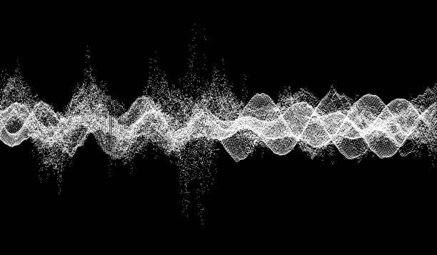
Commonplace
Collection
Surveys
Ecological momentary assessment
Diary
Group methods
Filming
Interview
Analysis
Thematic analysis
Results write-up
Narrative discussion
Visual displays (Verdinelli & Scagnoli, 2013)
Audio, Video, Text
Processing
Text

Slide 9
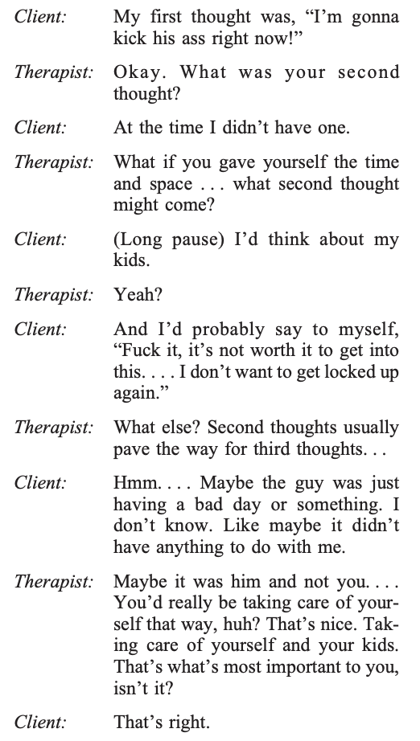
Typical transcript
Roffman 2004

Slide 10
Visualizing results and analysis

Slide 11
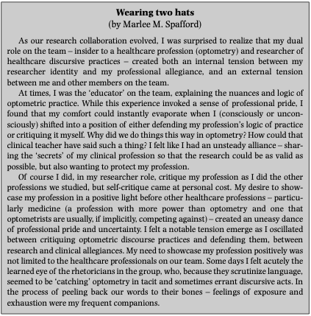
Boxed display
Lingard 2007

Slide 12
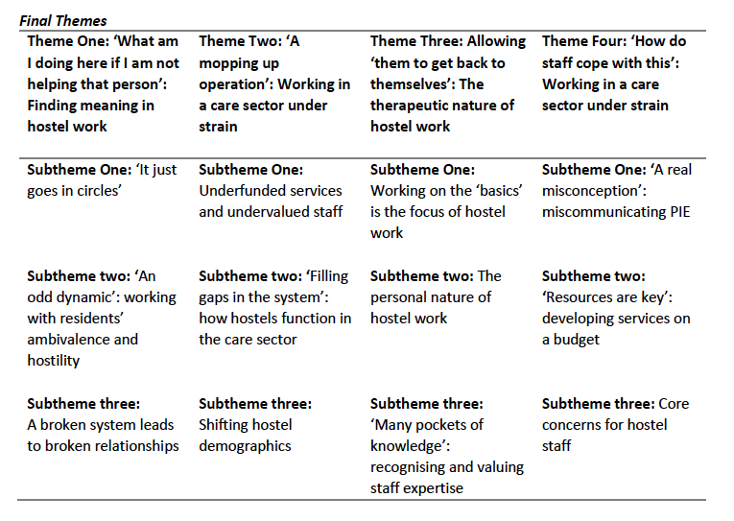
Matrix or table
Aspinall 2023

Slide 13
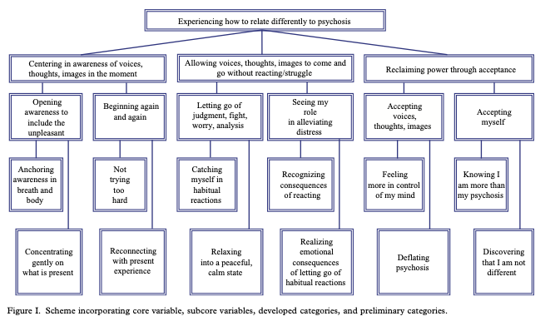
Taxonomy
Abba et al., 2008

Slide 14
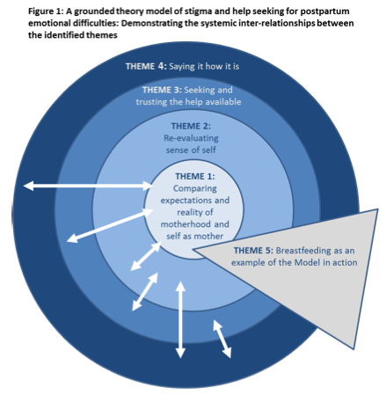
Taxonomy
Smallwood 2017

Slide 15
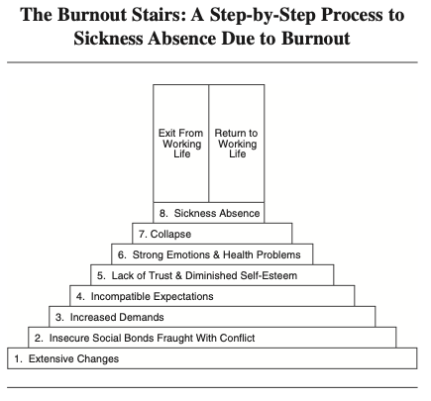
Ladder or step-by-step process
Eriksson et al.,
2008

Slide 16
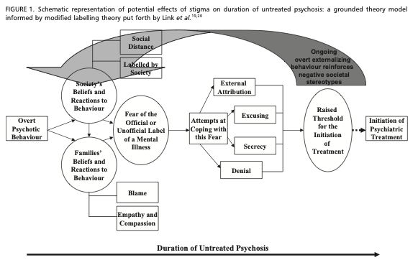
Flow chart
Franz et al., 2010

Slide 17
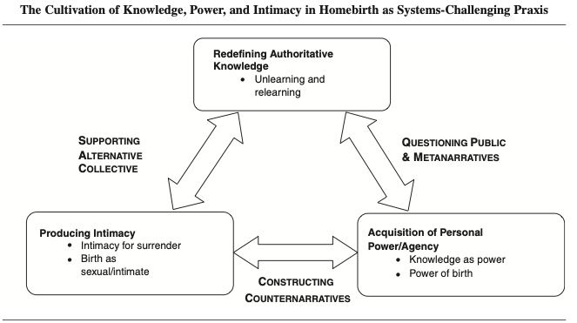
Network
Cheyney 2008

Slide 18
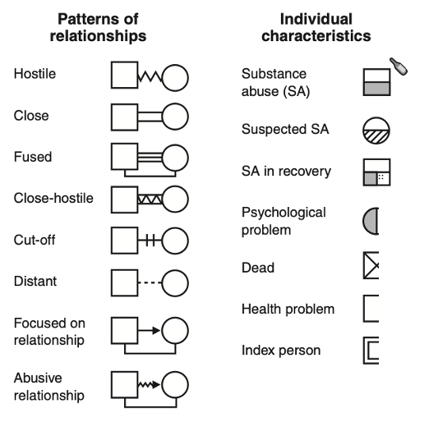
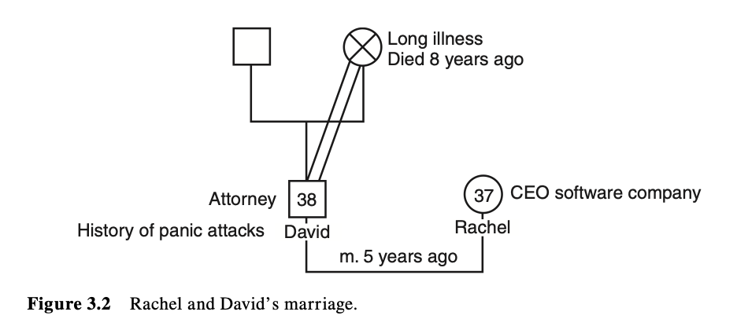
Shellenberger 2006

Slide 19
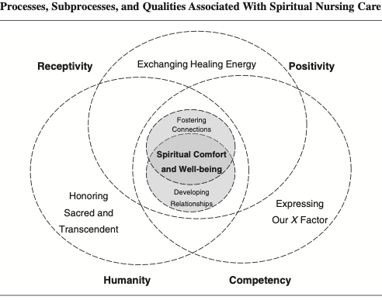
Venn diagram
Carr 2008

Slide 20
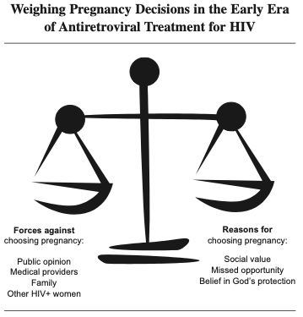
Metaphorical visual display
Barnes & Murphy 2009

Slide 21
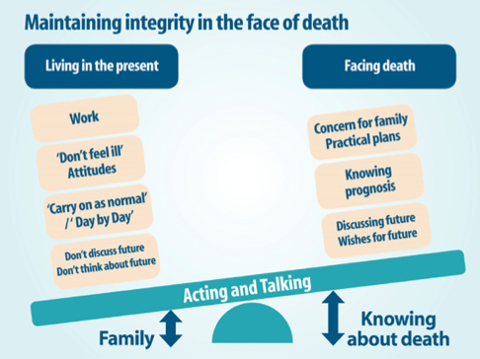
Metaphorical visual display
Horne et al. 2012

Slide 22
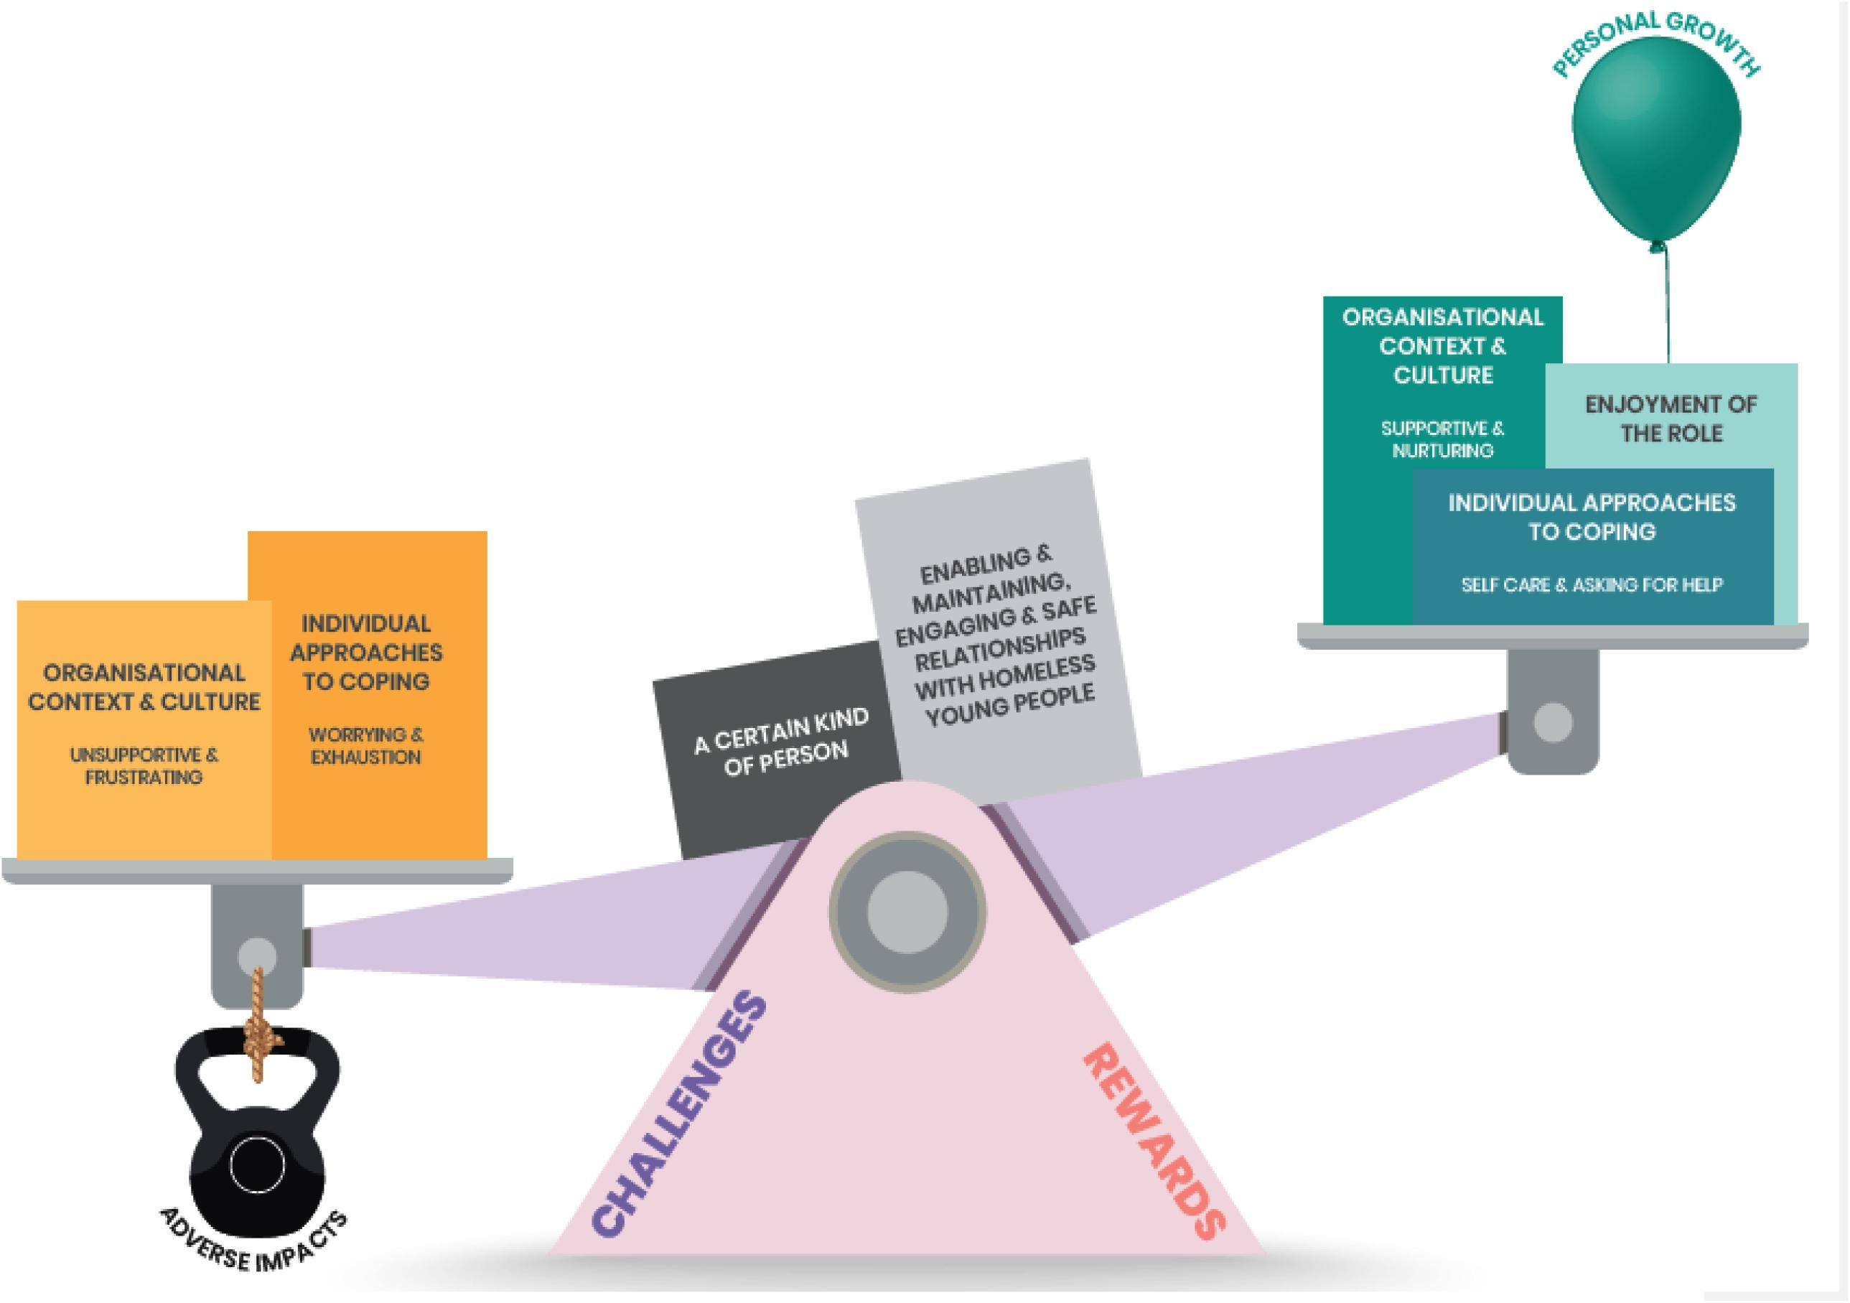
Metaphorical visual display
Peters et al., 2021

Slide 23
3. Peripheral

Slide 24
Broadening transcription

Slide 25
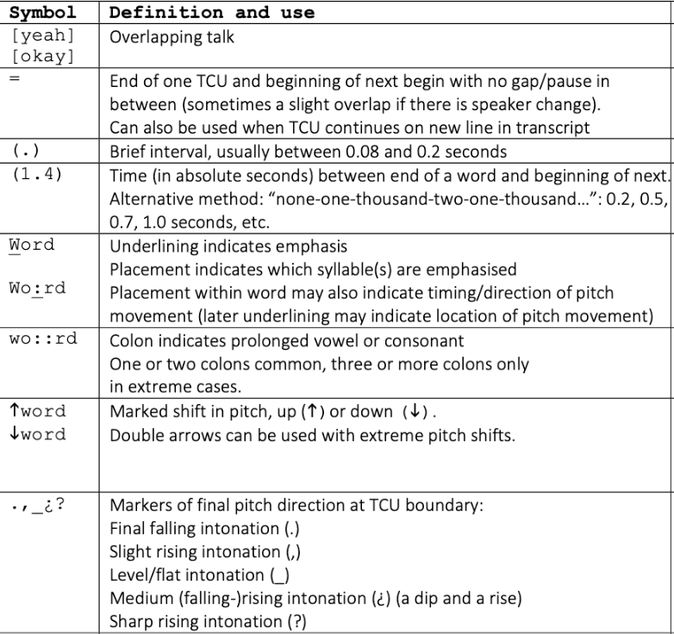
Jeffersonian transcript
https://universitytranscriptions.co.uk/jefferson-transcription-system-a-guide-to-the-symbols/

Slide 26
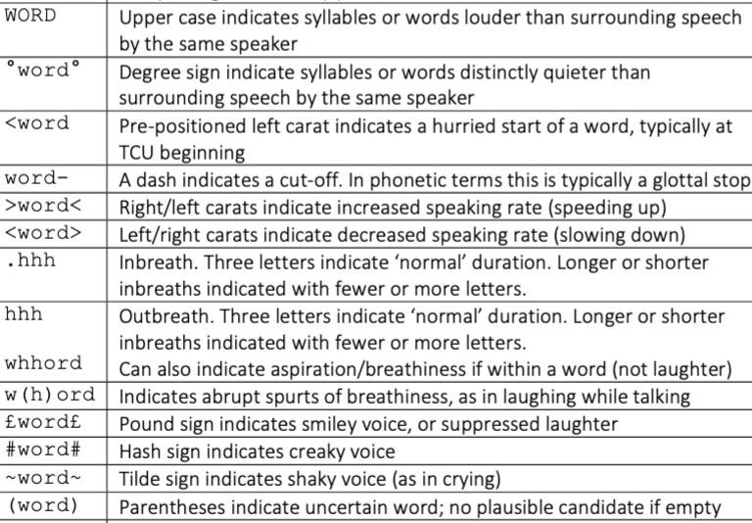
Jeffersonian
Transcript
https://universitytranscriptions.co.uk/jefferson-transcription-system-a-guide-to-the-symbols/

Slide 27
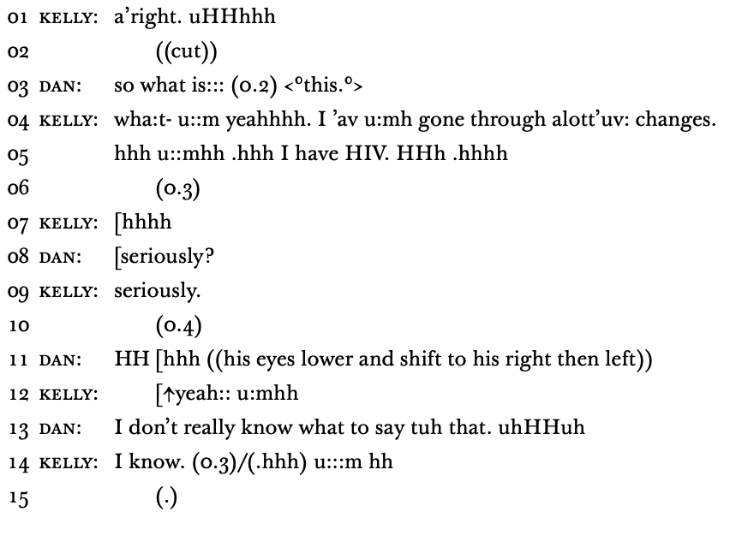
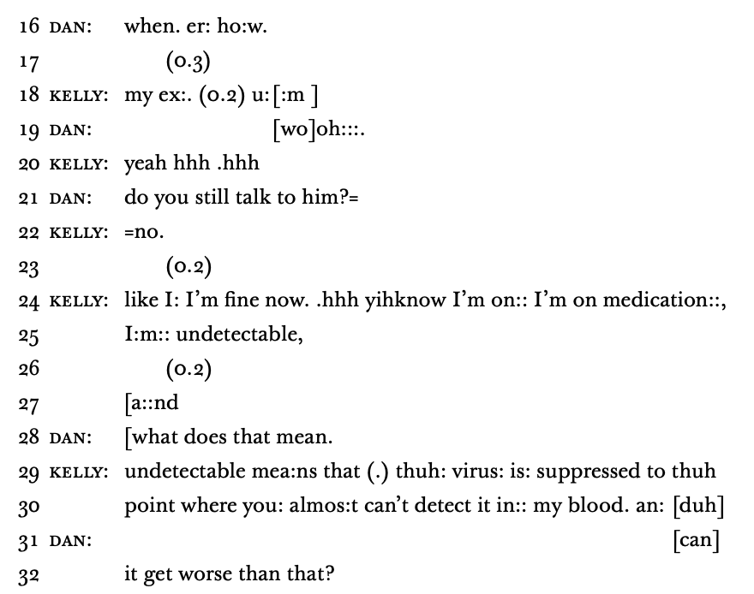
Jeffersonian transcript
Aguinaldo 2019

Slide 28
Broadening data collection and analysis

Slide 29
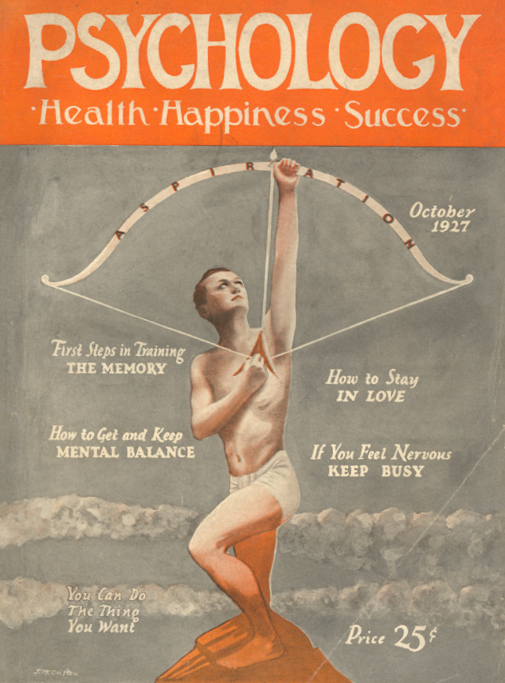
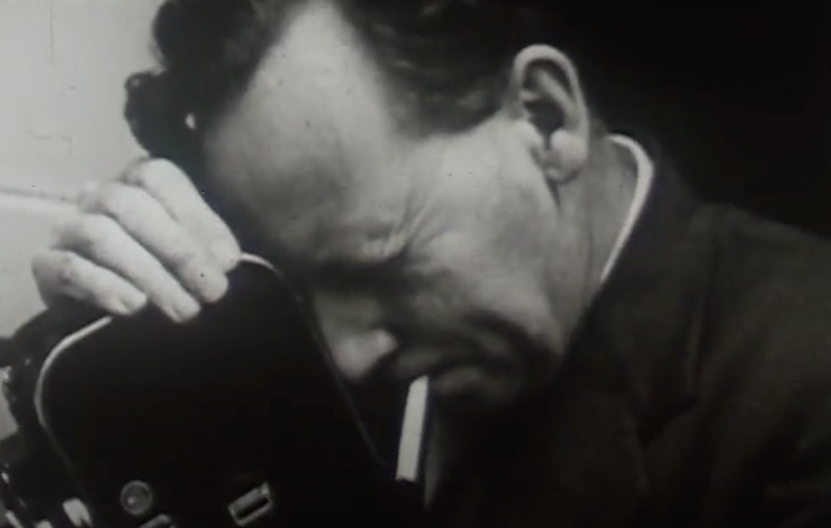
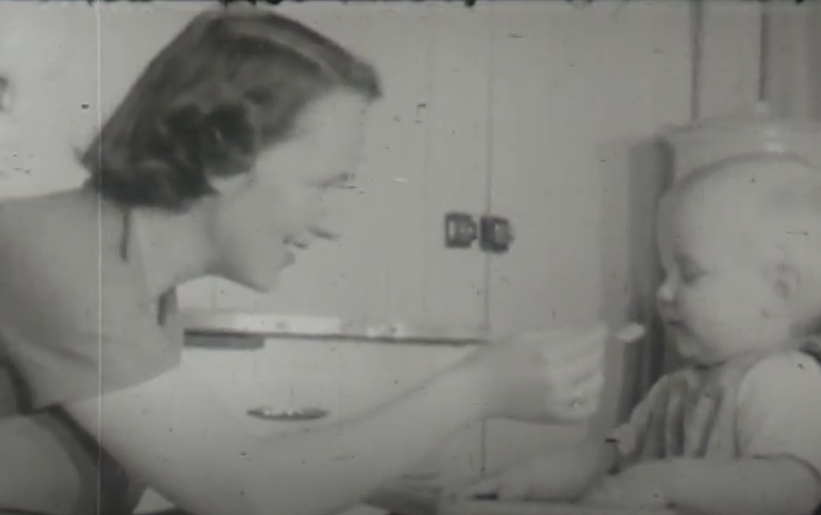
Historical & archival work
https://archive.org/details/0904_Communication_and_Interaction_in_Three_Families_01_00_07_25
https://centerhistorypsychology.wordpress.com/2023/07/19/america-is-suffering-from-an-outbreak-of-psychology/

Slide 30
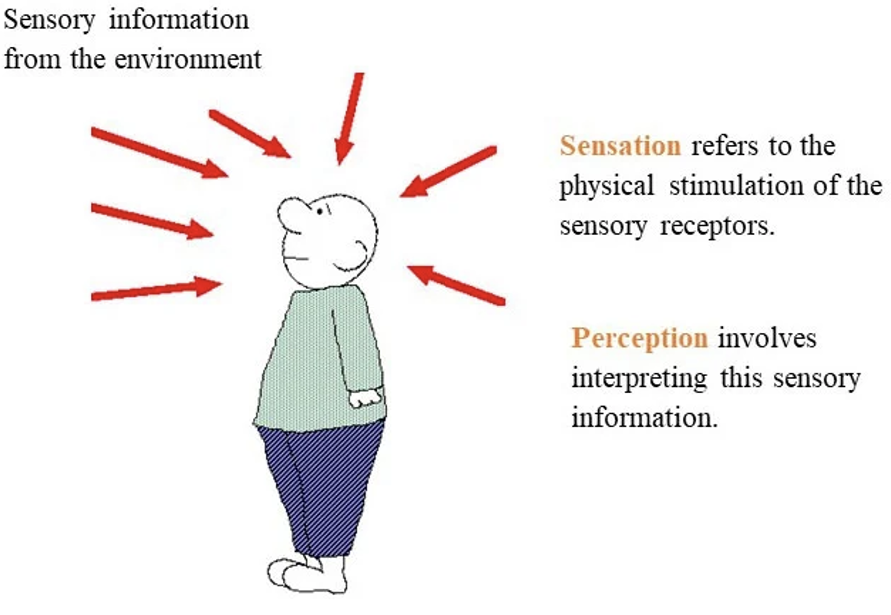
Fieldwork
E.g., participant-observer in community, ethnographic field notes, journals, diaries
https://www.simplypsychology.org/perception-theories.html

Slide 31
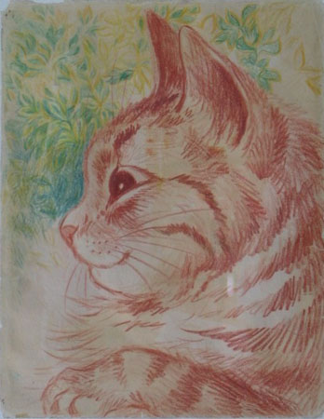
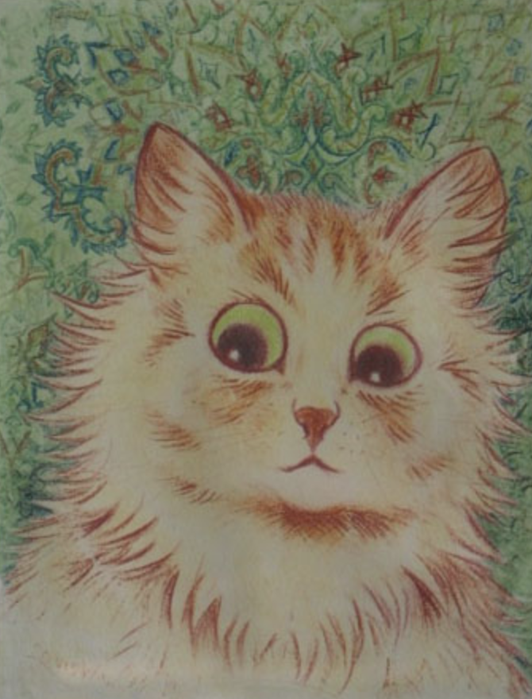
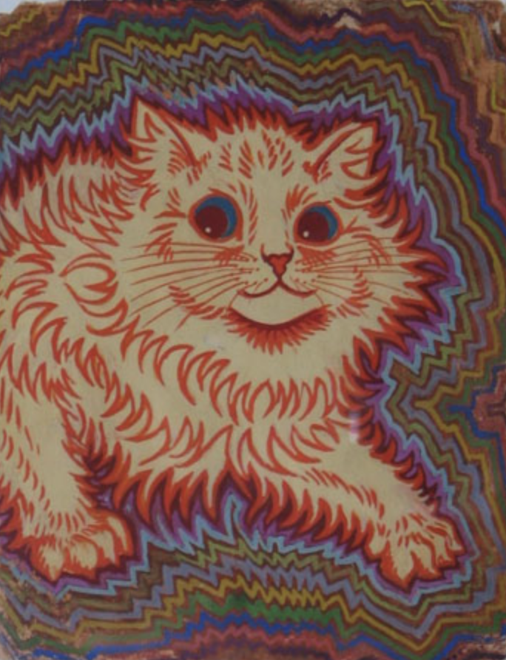
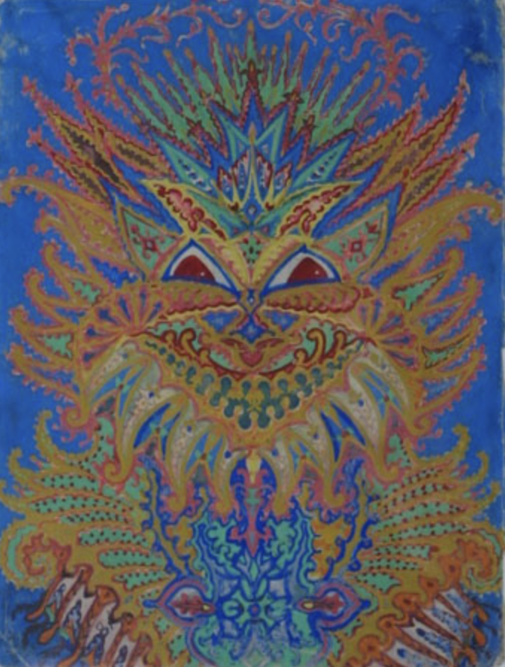
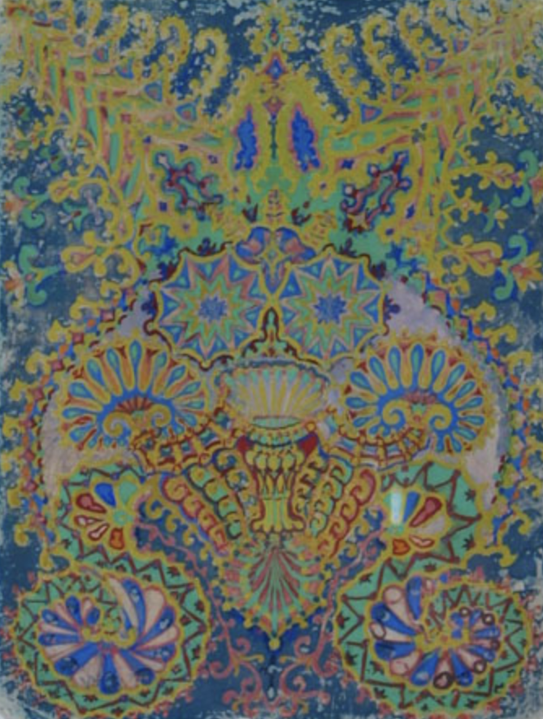
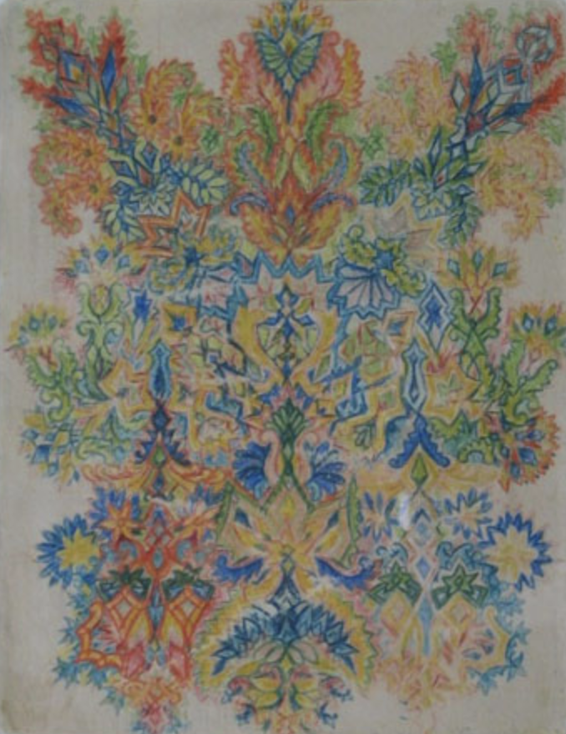
Arts-based
research
Examples:
Poetry
Drawing / painting
Music-making
Dance
Filmmaking
Theatre
https://www.wikiart.org/en/louis-wain

Slide 32
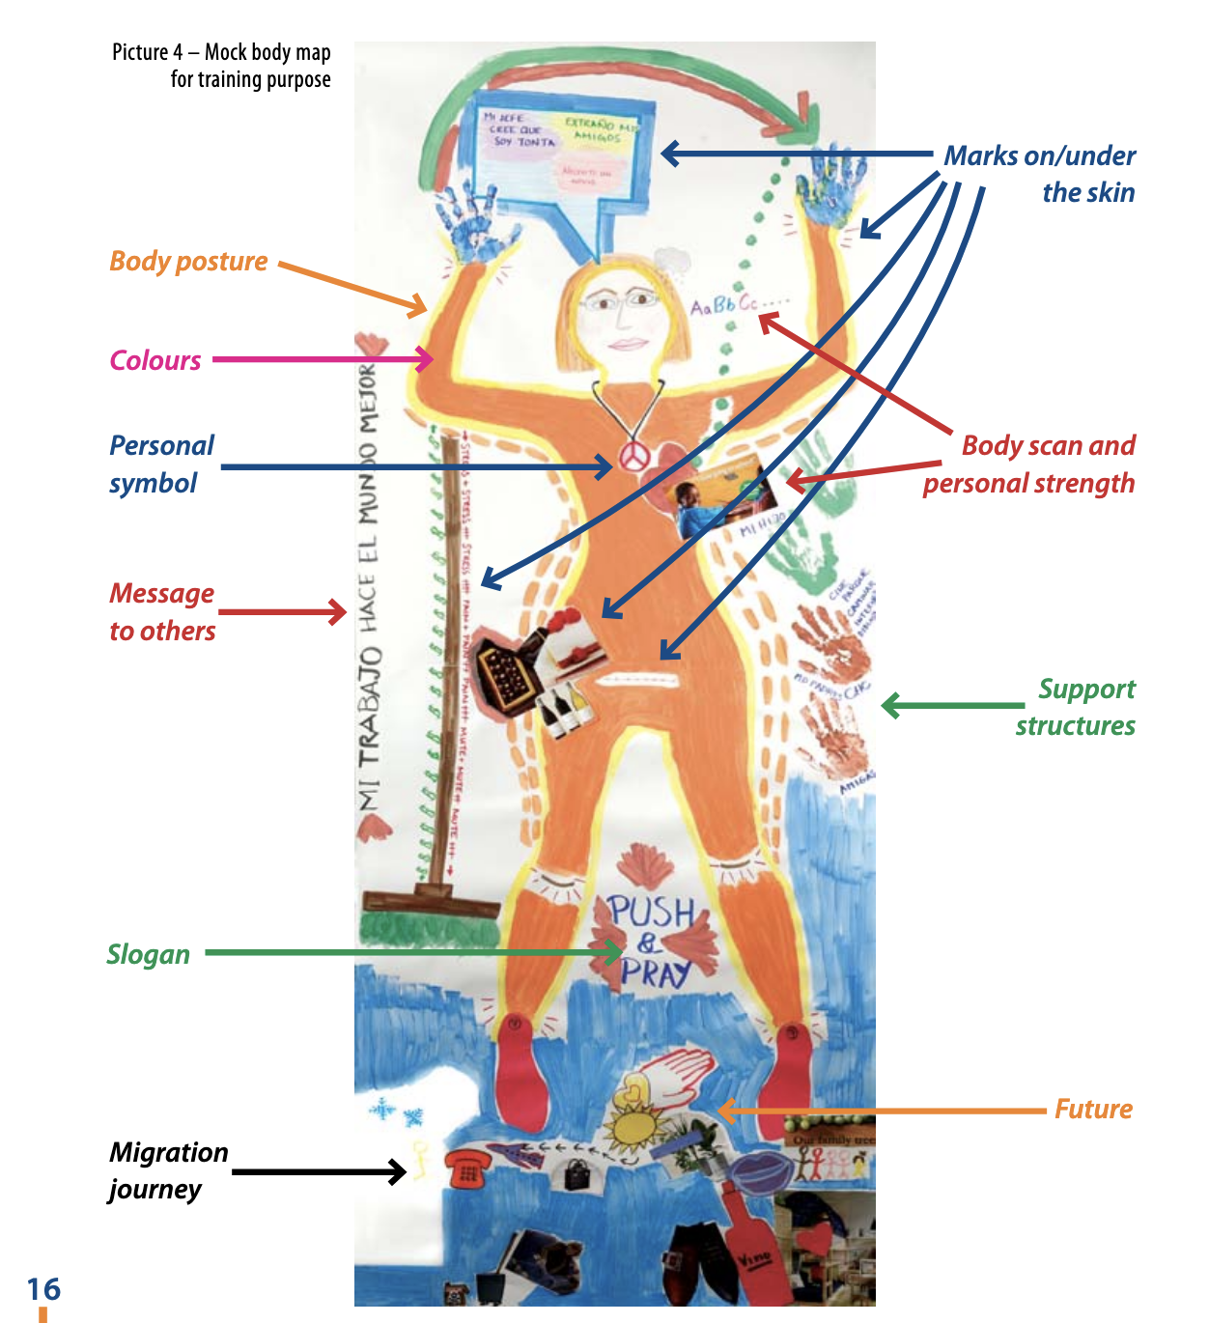
Body mapping
1. Interview
2. Body mapping session facilitated by exercises
https://www.migrationhealth.ca/sites/default/files/Body-map_storytelling_as_reseach_LQ.pdf

Slide 33
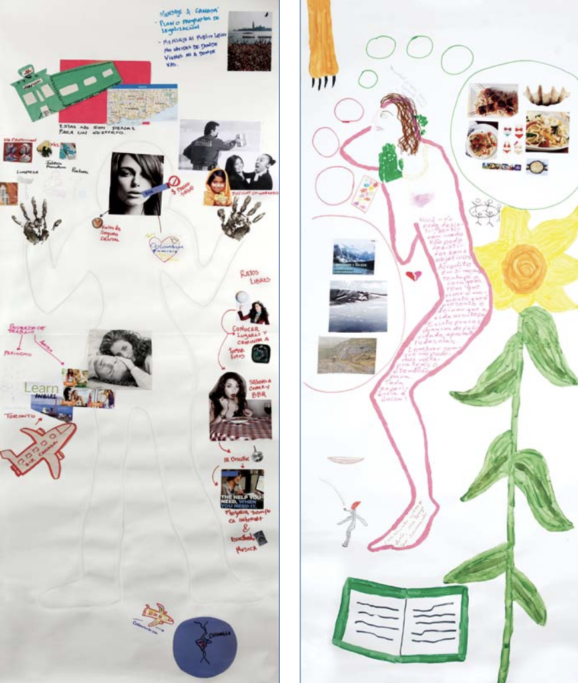
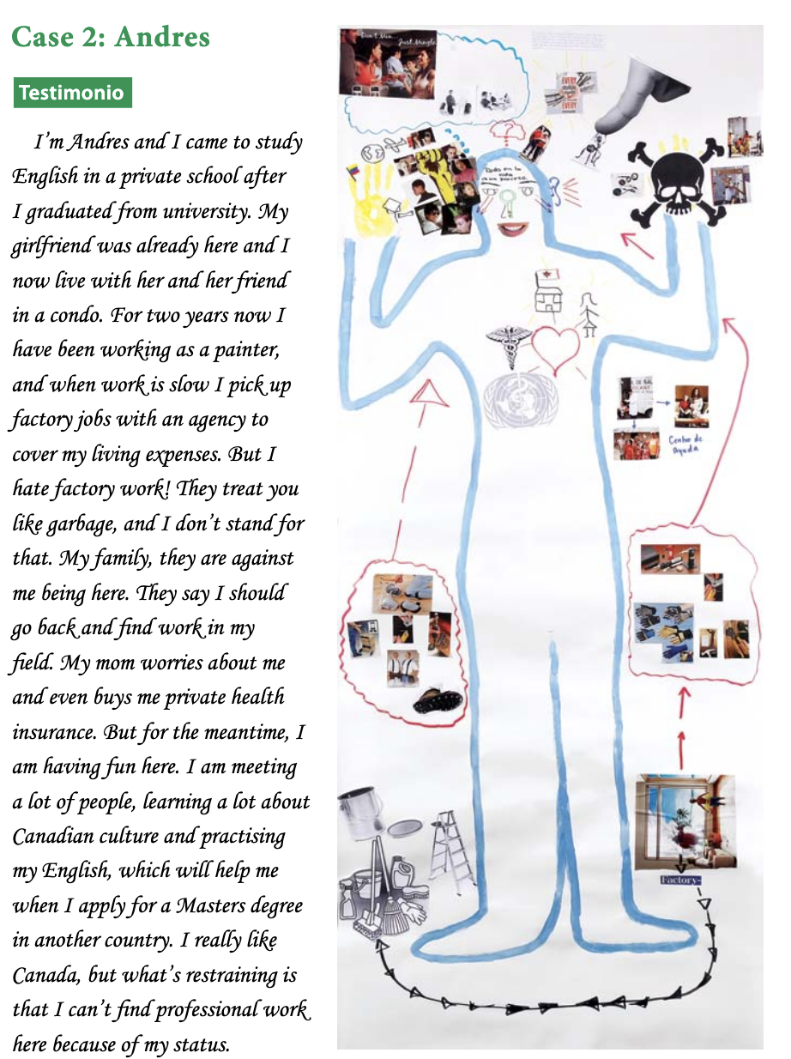
https://www.migrationhealth.ca/sites/default/files/Body-map_storytelling_as_reseach_LQ.pdf

Slide 34
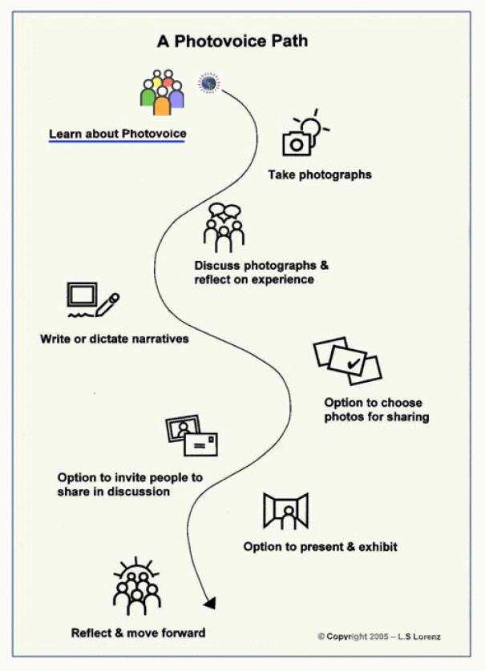
Photovoice
Sutton-Brown 2014

Slide 35
https://www.cambridgepublichealth.org/wp-content/uploads/2023/06/PhotoVoice-Digital-Presentation.pptx.pdf

Slide 36
Through her eyes: Photovoice as a research method for women with mental health challenges living in supportive housing
Esposito 2023

Slide 37
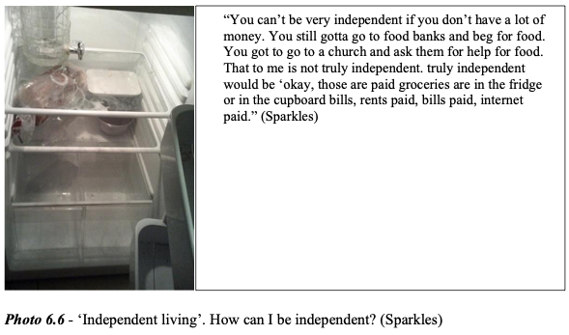
Esposito 2023

Slide 38
Esposito 2023

Slide 39
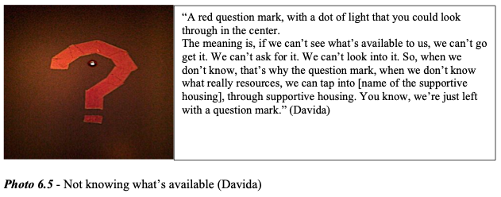
Esposito 2023

Slide 40
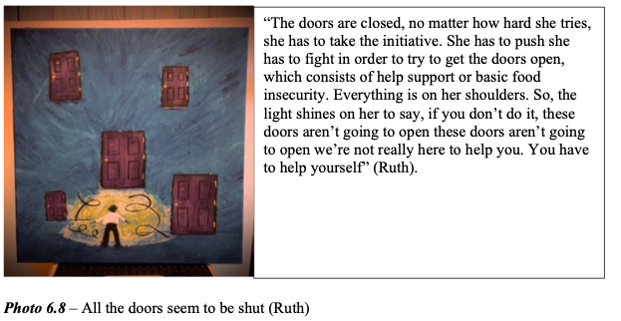
Esposito 2023

Slide 41
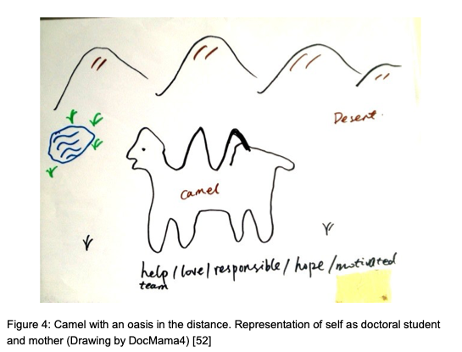
Interviewing linked to drawing
CohenMiller 2018

Slide 42
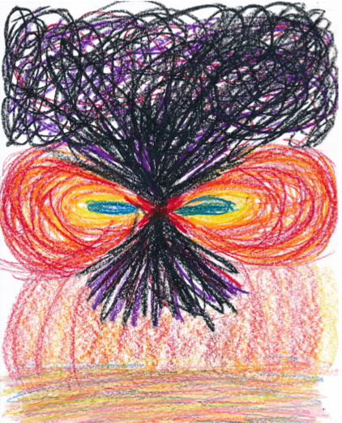
Dance
“Phenomenology of artistic practice”
“… aims at an exploration of the lived experience of performative movement.”
Participants asked to:
Express through performative movement their experiences of why dance is important for them
Express this experience of dance in a poem and a picture
Interview
Krantz 2014, 2016

Slide 43
Arts-based phenomenology (Gupta, 2024a)
Painting (e.g., Gupta, 2024b)
Collect participant’s written descriptions of reclaiming erotic power
Hermeneutic data interpretation
Express the thematic findings for each pt as symbolic imagery via folk paintings
Showcase to public online and via in-person art exhibitions
https://desieros.com

Slide 44
Arts-based phenomenology: cinematic
Select a sociocultural phenomenon for consciousness-raising
Collect participants’ anecdotes of lived experience
Code and thematize the data
Translate data into cinematic language
Produce the film
Gupta 2019, 2020

Slide 45
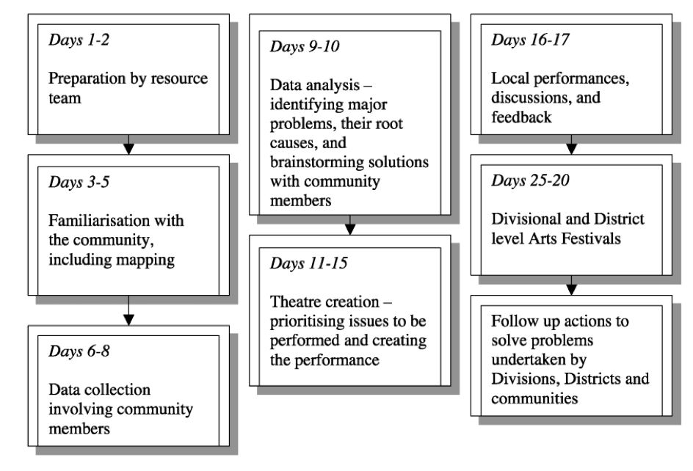
Theatre
Bagamoyo College of Arts et al. 2002

Slide 46
4. Conclusion

Slide 47
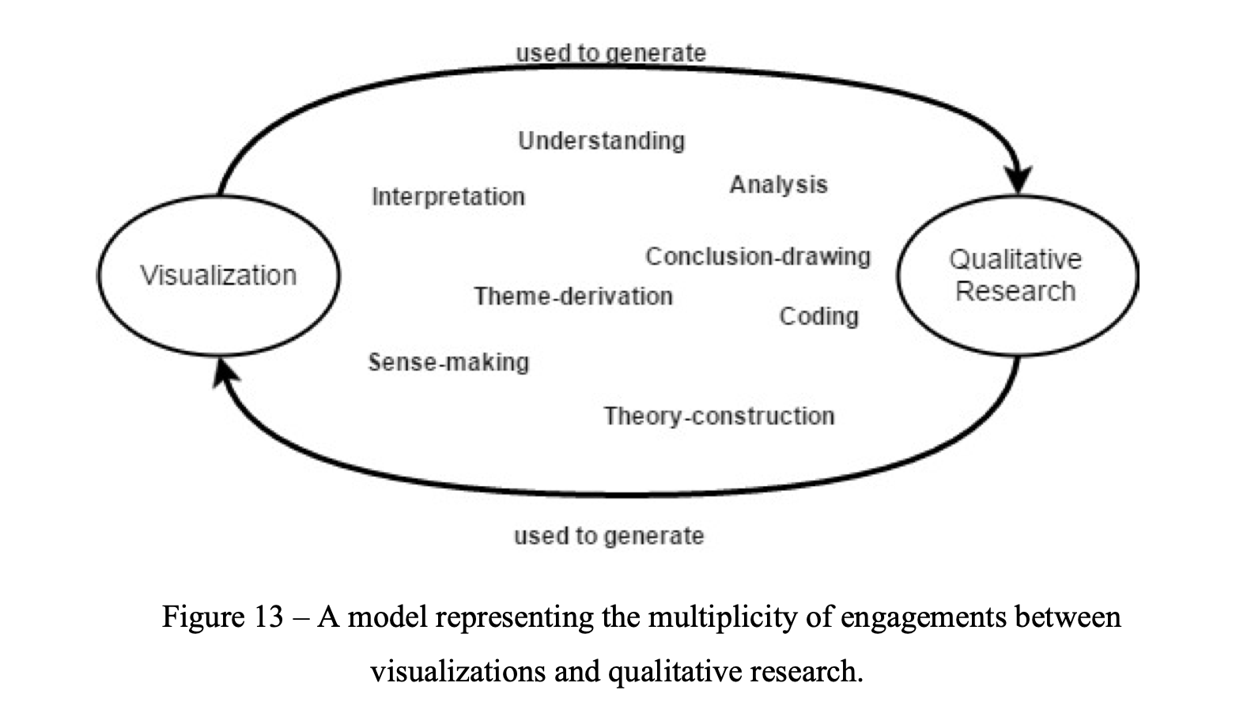
AlSughayer 2017

Slide 48
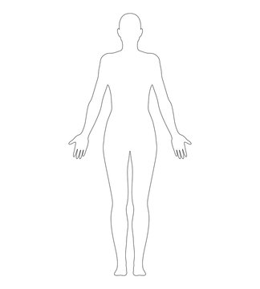
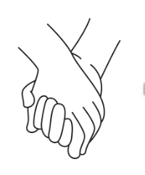
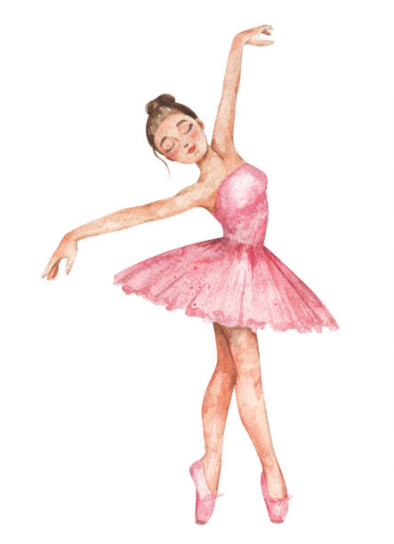
Dialogue
Consider various visual methodologies to approach a phenomenon
De-centering scriptocentrism
No observer-independent visualizations
Interpretation
Imagination
The words we say are part of the moving body
Participants as co-researchers
Re-think standard visualizations
Bring visualizations to life
Do justice to participants’ voices/narratives and corporeality as they lend to understanding the phenomenon
Culture, spirituality, religion
Aesthetic reactions
Visualizations for social advocacy and justice
Emotion at the heart of qualitative research

Slide 49
Thank you for your ears

Slide 50
References
Abba N, Chadwick P, Stevenson C. Responding mindfully to distressing psychosis: A grounded theory analysis. Psychotherapy Research. 2008;18(1):77-87.
Aguinaldo JP. The Interactional Organization of HIV-Positive Disclosures. Thinking Differently about HIV/AIDS: Contributions from Critical Social Science. 2019:134.
AlSughayer F. Within context: Exploring visualization and qualitative research (Doctoral dissertation). 2017.
Aspinall P. 'You're there to support someone regardless': a thematic analysis of staff experiences of working in homeless hostels (Doctoral dissertation, University of the West of England). 2023.
Bagamoyo College of Arts BC, Centre TT, Mabala R, Allen KB. Participatory action research on HIV/AIDS through a popular theatre approach in Tanzania. Evaluation and Program Planning. 2002;25(4):333-9.
Barnes DB, Murphy S. Reproductive decisions for women with HIV: Motherhood's role in envisioning a future. Qualitative Health Research. 2009;19(4):481-91.
Bartholomew TT, Lockard AJ. Mixed methods in psychotherapy research: A review of method (ology) integration in psychotherapy science. Journal of Clinical Psychology. 2018;74(10):1687-709.
Bateson G. Mind and nature: a necessary unity. New York: Dutton; 1979.
Carr T. Mapping the processes and qualities of spiritual nursing care. Qualitative Health Research. 2008;18(5):686-700.
Cheyney MJ. Homebirth as systems-challenging praxis: knowledge, power, and intimacy in the birthplace. Qual Health Research 2008; 18 (2): 254-67.
CohenMiller AS. Visual arts as a tool for phenomenology. InForum Qualitative Sozialforschung/Forum: Qualitative Social Research 2018 (Vol. 19, No. 1, p. 22). DEU.
Dixson AD. Extending the metaphor: Notions of jazz in portraiture. Qualitative Inquiry. 2005;11(1):106-37.
Eriksson UB, Starrin B, Janson S. Long-term sickness absence due to burnout: absentees' experiences. Qualitative Health Research. 2008;18(5):620-32.
Esposito A. Through Her Eyes: Photovoice as a Research Method for Women with Mental Health Challenges Living in Supportive Housing (Doctoral dissertation). 2023.
Franz L, Carter T, Leiner AS, Bergner E, Thompson NJ, Compton MT. Stigma and treatment delay in first‐episode psychosis: a grounded theory study. Early Intervention in Psychiatry. 2010;4(1):47-56.
Gupta N. The Phenomenological Film Collective: Introducing a cinematic‐phenomenological research method for social advocacy filmmaking. Social and Personality Psychology Compass. 2019;13(4):e12445.
Gupta N. Illuminating the trauma of the LGBTQ closet: A cinematic-phenomenological study and film about existential rights. Qualitative Research in Psychology. 2020;19(3):632-57.

Slide 51
References
Gupta N, Zieske C. Arts-based phenomenological research: Theory and praxis. Qualitative Psychology. 2024a;11(1):95.
Gupta N. DESI EROS: Reclaiming South Asian erotic power through arts-based phenomenology and Hindu epistemology. Qualitative Psychology. 2024b;11(1):127.
Hall PA, Dávila P. Critical Visualization: Rethinking the Representation of Data. Bloomsbury Publishing; 2022.
Horne G, Seymour J, Payne S. Maintaining integrity in the face of death: a grounded theory to explain the perspectives of people affected by lung cancer about the expression of wishes for end of life care. International Journal of Nursing Studies. 2012;49(6):718-26.
Krantz G. Using the phenomenology of artistic practice to explore and compare teaching. Research in Comparative and International Education. 2016;11(4):406-21.
Krantz G. Students' experiences of dance: a hermeneutic phenomenological study (Doctoral dissertation, University of Plymouth). 2014.
Lingard L, Schryer CF, Spafford MM, Campbell SL. Negotiating the politics of identity in an interdisciplinary research team. Qualitative Research. 2007;7(4):501-19.
Marecek J. Dancing through minefields: Toward a qualitative stance in psychology. In: Camic PM, Rhodes JE, Yardley L, editors. Qualitative Research in Psychology: Expanding Perspectives in Methodology and Design. Washington, DC: American Psychological Association; 2003. p. 49–69.
Peters LM, Samuel VM, Hobson CW. Shining a light on the experiences of staff working with young homeless people: A grounded theory study. Children and Youth Services Review. 2021;121:105843.
Roffman AE. Is anger a thing-to-be-managed?. Psychotherapy: Theory, Research, Practice, Training. 2004;41(2):161.
Smallwood S. Understanding the role of stigma in women’s help-seeking behaviours for postpartum emotional difficulties: a grounded theory study (Doctoral dissertation, London Metropolitan University). 2017.
Sandelowski M. Whatever happened to qualitative description?. Research in Nursing & Health. 2000;23(4):334-40.
Shellenberger S. Use of the Genogram with Families for Assessment and Treatment. Handbook of EMDR and family therapy processes. 2007:76-94.
Sousanis N. Unflattening. Harvard University Press; 2015.
Sutton-Brown CA. Photovoice: A methodological guide. Photography and culture. 2014;7(2):169-85.
Tashakkori A, Creswell JW. Exploring the nature of research questions in mixed methods research. Journal of Mixed Methods Research. 2007;1(3):207-11.
Verdinelli S, Scagnoli NI. Data display in qualitative research. International Journal of Qualitative Methods. 2013;12(1):359-81.

