Slide 1
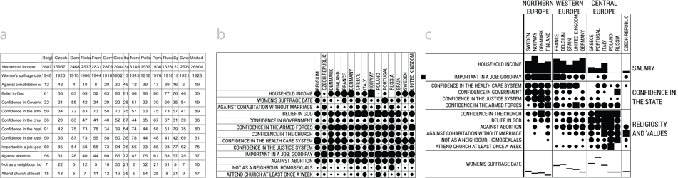
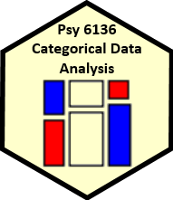

Categorical Data Analysis Course overview
Michael Friendly
Psych 6136
http://friendly.github.io/psy6136
@datavisFriendly || #psy6136

Slide 2
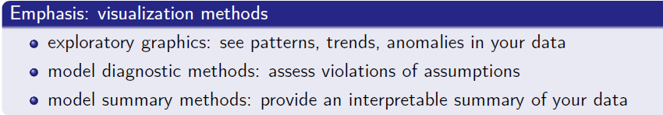
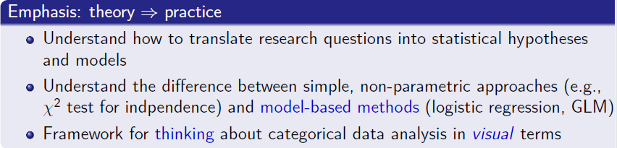
Course goals
This course is designed as a broad, applied introduction to the statistical analysis of categorical data, with an emphasis on:

Slide 3
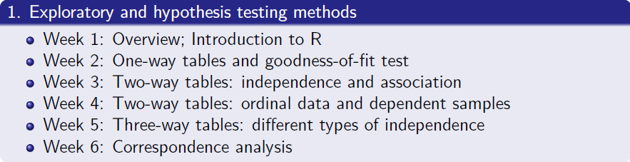
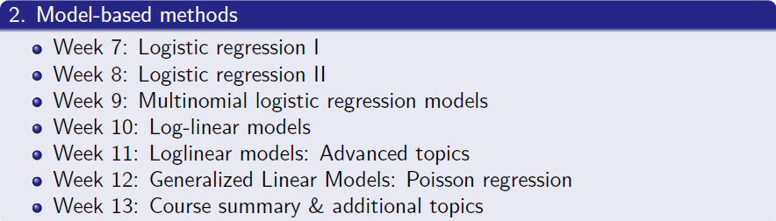
Course outline

Slide 4
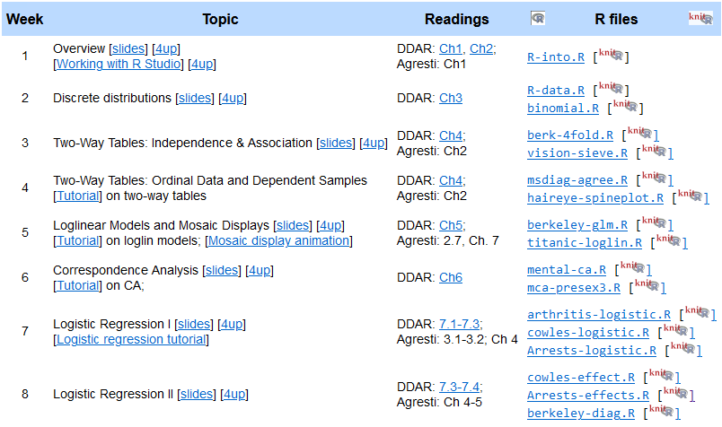
The schedule page provides links to slides, tutorials, readings & R scripts
. . .

Slide 5
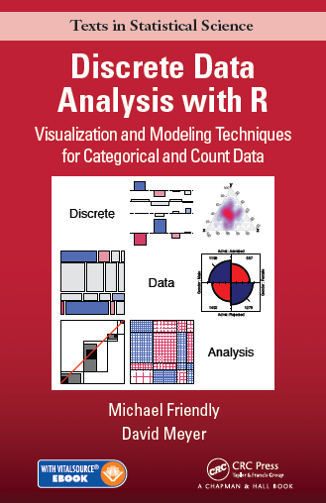
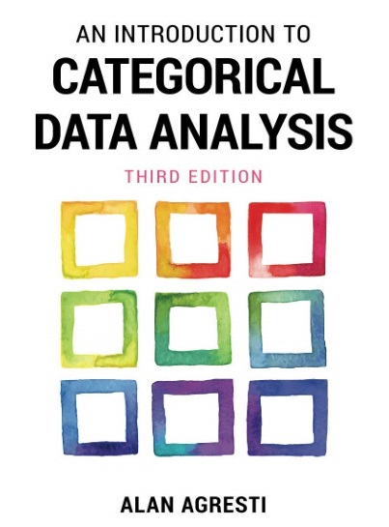
Textbooks
Main texts
Friendly & Meyer (2016). Discrete Data Analysis with R: Visualizing & Modeling Techniques for Categorical & Count Data
30% discount on Routledge web site (code: ADC22)
Draft chapters linked in Schedule
DDAR web site: https://ddar.datavis.ca
Agresti (2007). An Introduction to Categorical Data Analysis, 3rd E. Wiley & Sons.
eBook available: https://bit.ly/3Wzqv0n
Or, via York Bookstore

Slide 6
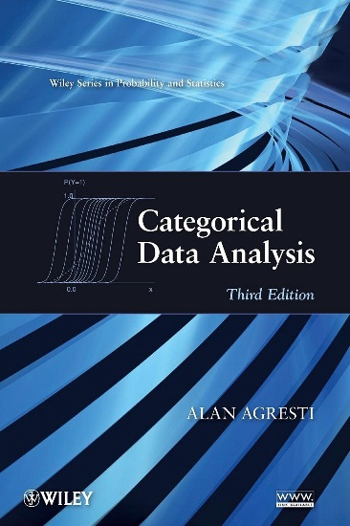
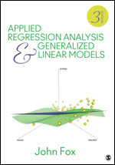
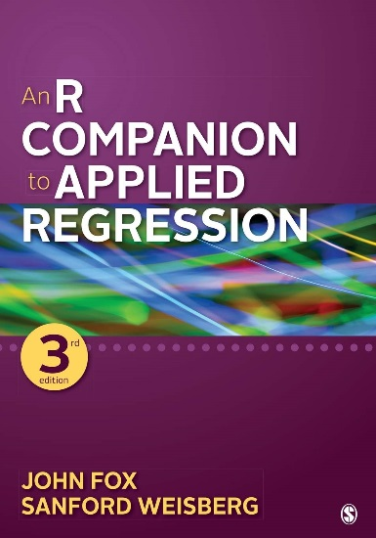
Textbooks
Supplementary readings
Agresti (2013). Categorical Data Analysis, 3rd ed. [More mathematical, but the current Bible of CDA]
PDF available: https://bityl.co/FG9c
Fox (2016). Applied Regression Analysis and Generalized Linear Models, 3rd ed. Particularly: Part IV on Generalized Linear Models
Fox & Weisberg (2018). An R Companion to Applied Regression. Also, web site for the book.

Slide 7
Expectations & grading
I expect you will read chapters in DDAR & Agresti Intro each week
See Topic Schedule on course web site
R exercises & tutorials: Please work on these
R Assignments : Ungraded, but please submit them when assigned
Class discussion: Help make classes participatory
Evaluation: (tentative: subject to change)
(2 x 30%) Two take-home projects: Analysis & research report, based on assignment problems or your own data
(40%)
Assignment portfolio: best work, enhanced
Research report on journal article(s) of theory / application of CDA
In-class presentation (~15 min) on application of general interest

Slide 8


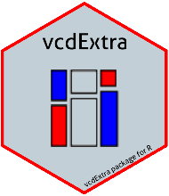


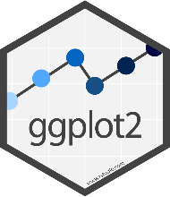
The R you need
R, version >=3.6 [R 4.5 is current]
Download from https://cran.r-project.org/
RStudio IDE, highly recommended
https://www.rstudio.com/products/rstudio/
R packages:
vcd
vcdExtra
car
effects
ggplot2
...
R script to install packages: https://friendly.github.io/psy6136/R/install-vcd-pkgs.R

Slide 9
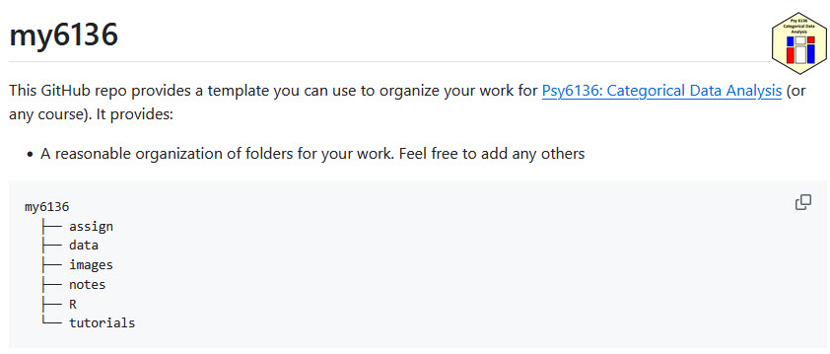
Make life easier: my6136
I created a template for an R Studio project you can use to organize your work in the course: https://github.com/friendly/my6136
Download the zip file, or
Rstudio: New Proj -> Vers cont -> GitHub: https://github.com/friendly/my6136.git

Slide 10
Categorical data analysis: History
Categorical data analysis is a relatively recent arrival
1888 – Galton introduces the concept of correlation
1908 – Student's t-distribution for the mean of small samples
1931 – L. L. Thrustone: Multiple factor analysis
1935 – R. A. Fisher's Design of Experiments – ANOVA
. . . (time passes)
1972 – Nelder & Wedderburn develop the central ideas of generalized linear models (logistic & poison regression)
1973 – J-P. Benzecri: Correspondence analysis (analysis des donnés)
1974 – Bishop , Fienberg, Holland introduce the loglinear model for discrete data, ANOVA for log(Freq)
1984 – Leo Goodman enhanced loglinear models for complex data: RC models, mobility tables, panel data, …

Slide 11
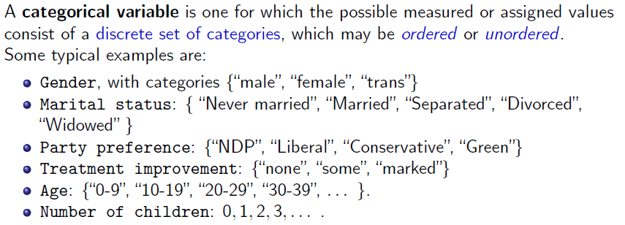
What is categorical data?
Questions:
Which of these are ordered (ordinal)?
Which could be treated as numeric? How?
Which have missing categories, sometimes ignored, or treated as “Other”

Slide 12
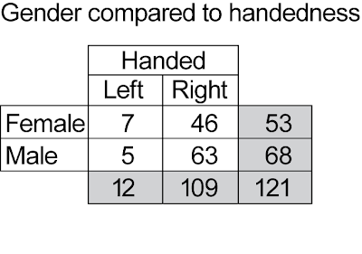
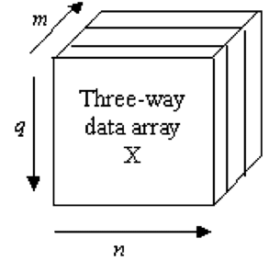
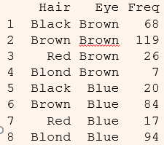
Categorical data: Structures
Categorical (frequency) data appears in various forms
Tables: often the result of table() or xtabs()
1-way
2-way – 2 × 2, r × c
3-way
Matrices: matrix(), with row & col names
Arrays: array(), with dimnames()
Data frames
Case form (individual observations)
Frequency form
margins

Slide 13
1-way tables
Unordered factors
Black Brown Red Blond
n 108 286 71 127
% 0.18 0.48 0.12 0.21
Hair color of 592 students
BQ Cons Green Liberal NDP
n 104 392 126 404 174
% 0.087 0.33 0.1 0.34 0.14
Voting intentions in Harris-Decima poll, 8/21/08
Questions:
Are all hair colors equally likely?
Aside from Brown hair, are others equally likely?
Is there a diff in voting intentions for Liberal vs. Conservative

Slide 14
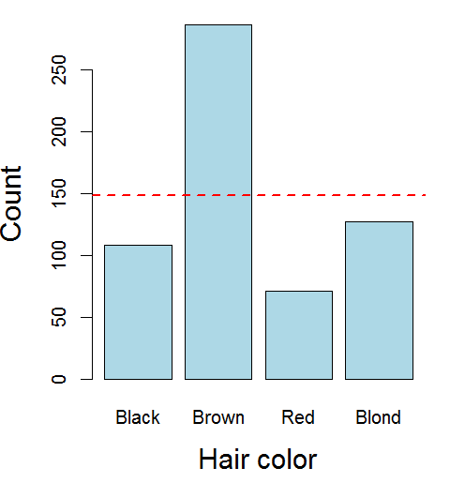
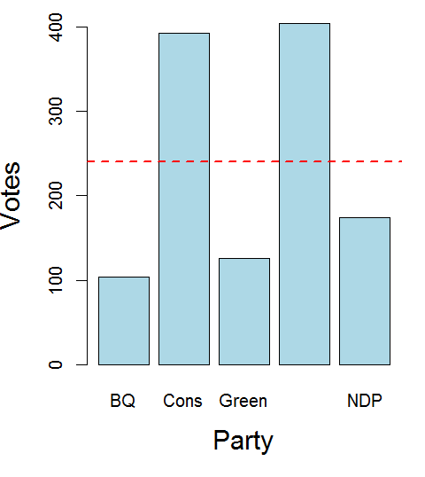
1-way tables
Even here, simple graphs are more informative than tables
But these don’t really answer the questions. Why?

Slide 15
1-way tables
Ordered, quantitative factors
Number of sons in Saxony families with 12 children
> data(Saxony, package="vcd")
> Saxony
nMales
0 1 2 3 4 5 6 7 8 9 10 11 12
3 24 104 286 670 1033 1343 1112 829 478 181 45 7
Questions:
What is the form of this distribution?
Is it useful to think of this as a binomial distribution?
If so, is Pr(male) = 0.5 reasonable to describe the data?
How could families have > 10 children?

Slide 16
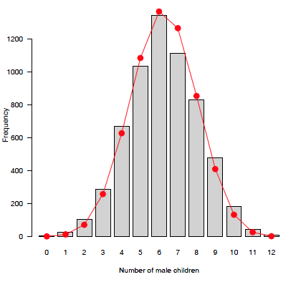
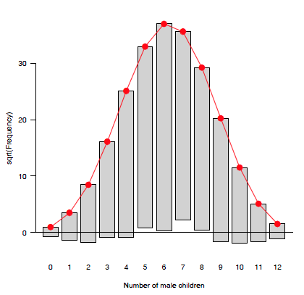
1-way tables: graphs
For a particular distribution in mind:
Plot the data together with the fitted frequencies
Better still: hanging rootogram: freq on sqrt scale; hang bars from fitted values

Slide 17
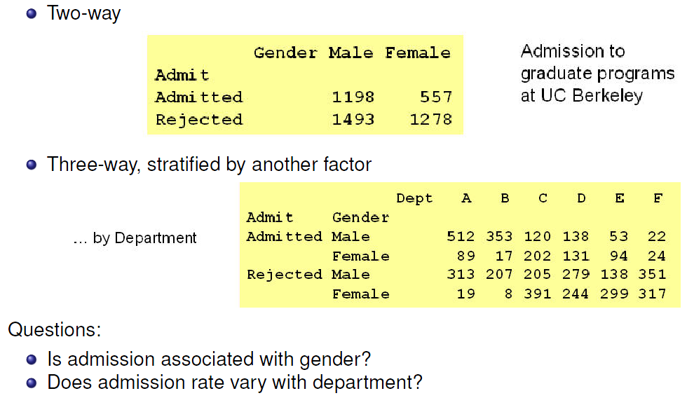
2-way tables: 2 × 2 × …

Slide 18
Larger tables: r × c × …
> margin.table(HairEyeColor, 1:2)
Eye
Hair Brown Blue Hazel Green
Black 68 20 15 5
Brown 119 84 54 29
Red 26 17 14 14
Blond 7 94 10 16
2-way
Actually, this is a 2-way margin of a 3-way table
> ftable(Eye ~ Sex + Hair, data=HairEyeColor)
Eye Brown Blue Hazel Green
Sex Hair
Male Black 32 11 10 3
Brown 53 50 25 15
Red 10 10 7 7
Blond 3 30 5 8
Female Black 36 9 5 2
Brown 66 34 29 14
Red 16 7 7 7
Blond 4 64 5 8
3-way (& higher) can be “flattened” for a more convenient display
formula notation:
row vars ~ col vars

Slide 19
Larger tables
Carcinogenic effects of a fungicide in two strains of mice, a 2 x 2 x 2 x 2 table
> data(Fungicide, package = "vcdExtra")
> str(Fungicide)
num [1:2, 1:2, 1:2, 1:2] 5 4 74 12 3 2 84 14 10 4 ...
- attr(*, "dimnames")=List of 4
..$ group : chr [1:2] "Control" "Treated"
..$ outcome: chr [1:2] "Tumor" "NoTumor"
..$ sex : chr [1:2] "M" "F"
..$ strain : chr [1:2] "1" "2"
Use str() to see the structure of an R object
> ftable(sex + strain ~ outcome + group, data=Fungicide)
sex M F
strain 1 2 1 2
outcome group
Tumor Control 5 10 3 3
Treated 4 4 2 1
NoTumor Control 74 80 84 79
Treated 12 14 14 14
Use ftable() to see it as a flat frequency table
Main Q:
Is there an association between tumor outcome and group?
Does this vary by sex and strain?

Slide 20
Table form
Table form is convenient for display, but information is implicit
a table has dimensions, dim() and dimnames()
the “observations” are the cells in the tables
the “variables” are the dimensions of the table (factors)
the cell value is the count or frequency
> dim(haireye)
[1] 4 4
> dimnames(haireye)
$Hair
[1] "Black" "Brown" "Red" "Blond"
$Eye
[1] "Brown" "Blue" "Hazel" "Green"
> names(dimnames(haireye)) # factor names
[1] "Hair" "Eye"
> prod(dim(haireye)) # of cells
[1] 16
> sum(haireye) # total count
[1] 592

Slide 21
Datasets: frequency form
Another common format is a dataset in frequency form
> as.data.frame(haireye)
Hair Eye Freq
1 Black Brown 68
2 Brown Brown 119
3 Red Brown 26
4 Blond Brown 7
5 Black Blue 20
6 Brown Blue 84
7 Red Blue 17
8 Blond Blue 94
9 Black Hazel 15
10 Brown Hazel 54
11 Red Hazel 14
12 Blond Hazel 10
13 Black Green 5
14 Brown Green 29
15 Red Green 14
16 Blond Green 16
Create: as.data.frame(table)
One row for each cell
Columns: factors + Freq or count
Questions:
What are the dimensions of the table?
What is the total frequency?

Slide 22
Datasets: case form
Raw data often arrives in case form
> expand.dft(as.data.frame(haireye)) |>
as_tibble() |>
mutate(age = round( runif( n =
sum(haireye), min=17, max=29)))
# A tibble: 592 x 3
Hair Eye age
<chr> <chr> <dbl>
1 Black Brown 19
2 Black Brown 19
3 Black Brown 27
4 Black Brown 23
5 Black Brown 19
6 Black Brown 29
7 Black Brown 25
8 Black Brown 29
9 Black Brown 17
10 Black Brown 23
# ... with 582 more rows
One obs. per case
# rows = sum of counts
vcdExtra::expand.dft() expands to frequency form
case form is required if there are continuous variables
case form is tidy
not all CDA functions play well with tibbles

Slide 23
Converting data forms
R functions for CDA sometimes accept only tables (matrices), or data frames, in either case for frequency form.
You may have to convert your data from one form to another
From this ↓ | To this ↓ | To this ↓ | To this ↓
 | Case form | Freq form | Table form
Case form | --- | Z <- xtabs(~ A+ B) as.data.frame(Z) | table(A, B)
Freq form | expand.dft(X) | --- | xtabs(Freq ~ A + B)
Table form | expand.dft(X) | as.data.frame(X) | ---

Slide 24
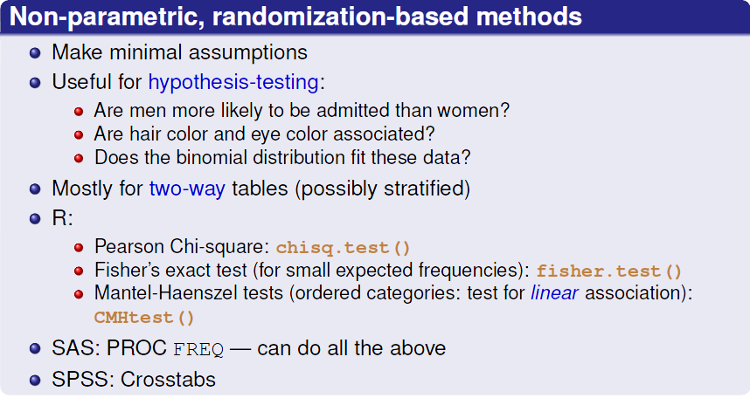
Categorical data analysis: Methods
Methods for categorical data analysis fall into two main categories

Slide 25
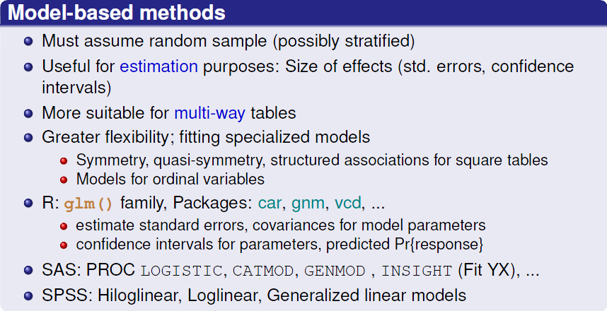
Categorical data analysis: Methods

Slide 26
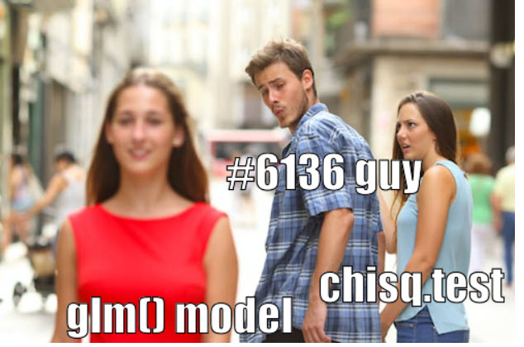
Categorical data analysis: Methods
The non-parametric methods are great for a first date.
Model-based approaches make better lifetime partners

Slide 27
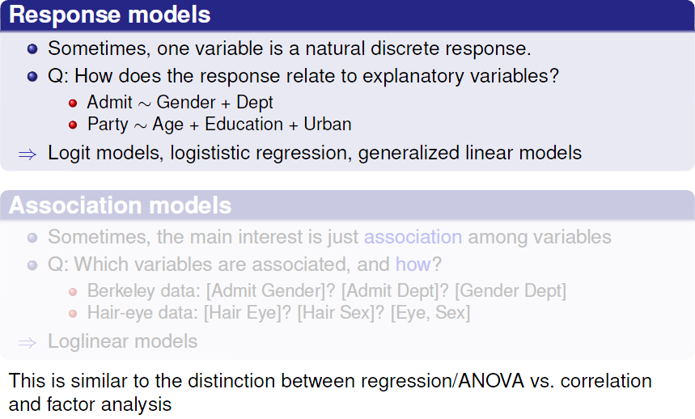
Models: Response vs. Association

Slide 28
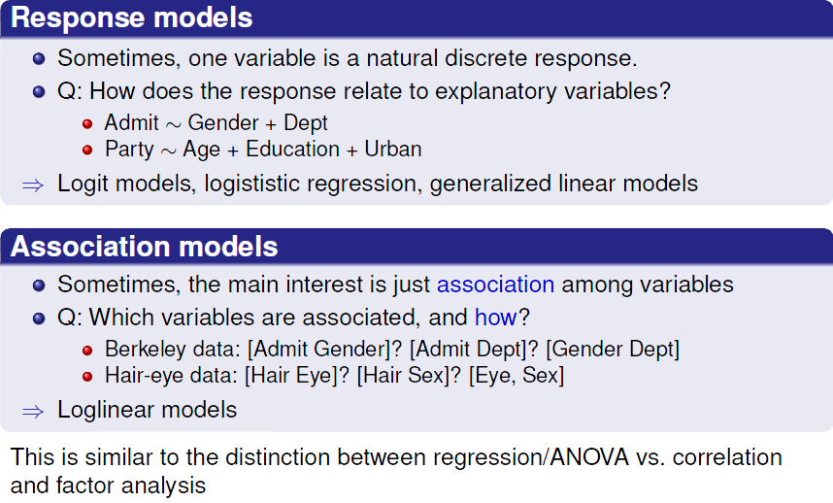
Models: Response vs. Association

Slide 29
Response models
Analysis methods for categorical outcome (response) variables have close parallels with those for quantitative outcomes
 | Quantitative outcome | Categorical outcome
Continuous predictor | Regression: lm(y ~ x1 + x2) | Logistic regression: glm() Loglinear model: loglm() Ordered: prop. odds model: polr()
Categorical predictor | ANOVA: lm(y ~ A + B) Ordered: polynomial contrasts | χ² tests: chisq.test() Ordered: CMH tests, CMHtest() Loglinear model: loglm()
Both | ANCOVA: lm(y ~ A + B + X) | Logistic regression: glm() Loglinear model: loglm()
All use similar model formulas:
lm(y ~ A) # one way ANOVA
lm(y ~ A*B) # two way: A + B + A:B
lm(y ~ X + A) # one-way ANCOVA
lm(y ~ (A+B+C)^2) # 3-way ANOVA: A, B, C, A:B, A:C, B:C

Slide 30
Response models
For quantitative outcomes, lm() for everything, formula notation
lm(y ~ A) # one way ANOVA
lm(y ~ A*B) # two way: A + B + A:B
lm(y ~ X + A) # one-way ANCOVA
lm(y ~ (A+B+C)^2) # 3-way ANOVA: A, B, C, A:B, A:C, B:C
For categorical outcomes, different modeling functions for different outcome types
glm(binary ~ X + A, family=“binomial”) # logistic regression
glm(Freq ~ X + A, family=“poisson”) # poisson regression
MASS::polr(multicat ~ X + A) # ordinal regression
nnet::multinom(multicat ~ X + A) # multinomial regression
loglin(table, margins) # loglinear model
MASS::loglm(Freq ~ .) # loglinear model, . = A+B+C+ …
MASS::loglm(Freq ~ .^2) # + all two-way associations

Slide 31
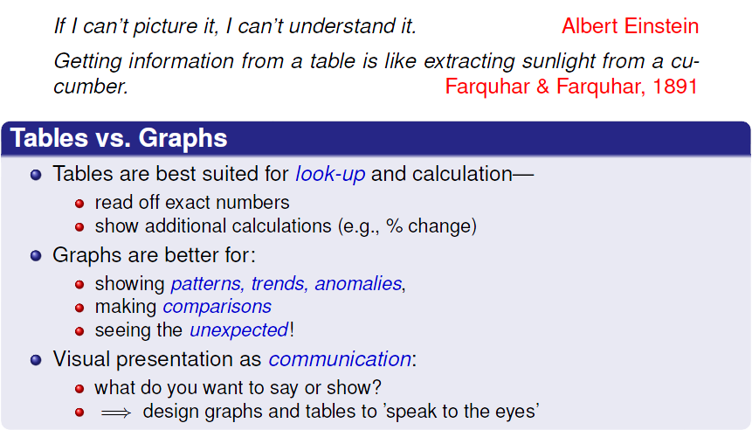
Data display: Tables vs. Graphs

Slide 32
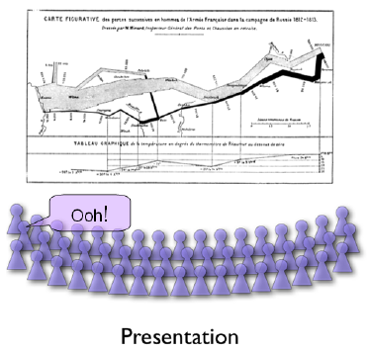
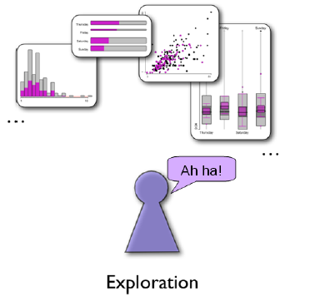
Graphical methods: Communication goals
Different graphs for different audiences
Presentation: A carefully crafted graph to appeal to a wide audience
Exploration, analysis: Possibly many related graphs, different perspectives, narrow audience (often: just you!)

Slide 33
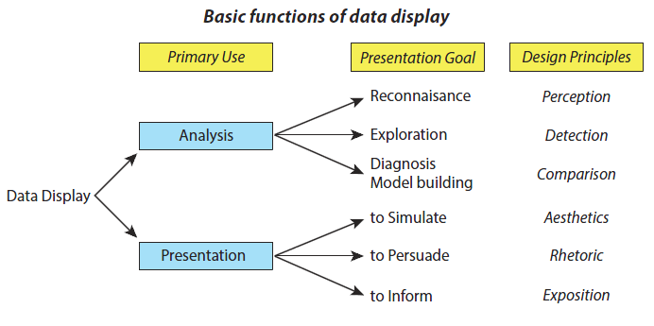
Graphical methods: Presentation goals
Different presentation goals appeal to different design principles
Think: What do I want to communicate? For what purpose?

Slide 34
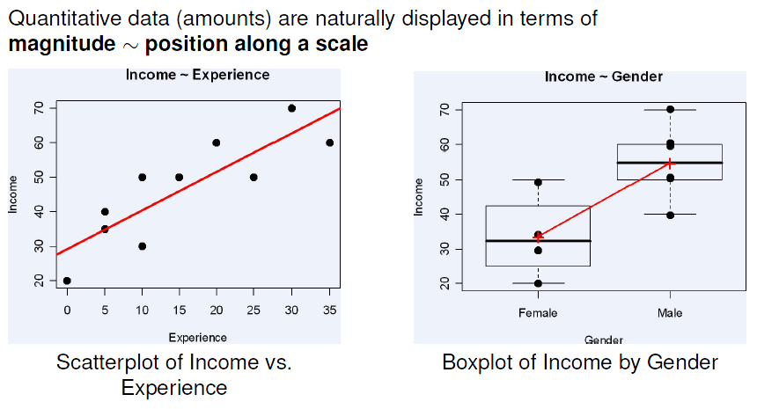
Graphical methods: Quantitative data

Slide 35
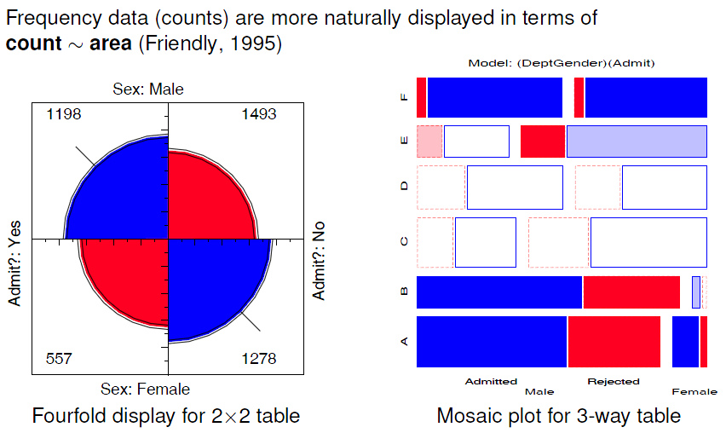
Graphical methods: Categorical data
Friendly, M. (1995). Conceptual and visual models for categorical data. American Statistician, 49: 153-160.

Slide 36
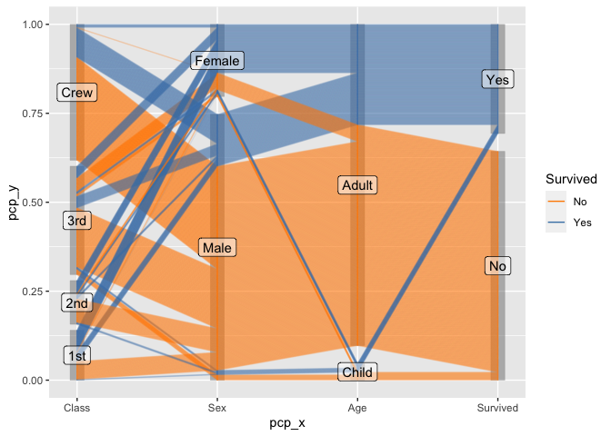
Categorical data: Parallel coordinates plot
Parallel coordinates plots show multiple variables, each along its’ own || axis
The categorical version uses the width of the band to show frequency
Survival on the Titanic, classified by:
Class,
Sex,
Age,
Survived
Band width ~ Freq
This plot was produced using the ggpcp package

Slide 37
Effective data display
Make the data stand out
Fill the data region (axes, ranges)
Use visually distinct symbols (shape, color) for different groups
Avoid chart junk, heavy grid lines that detract from the data
Facilitate comparison
Emphasize the important comparisons visually
Side-by-side easier than in separate panels
“data” vs. a “standard” easier against a horizontal line
Show uncertainty where possible
Effect ordering
For variables and unordered factors, arrange them according to the effects to be seen

Slide 38
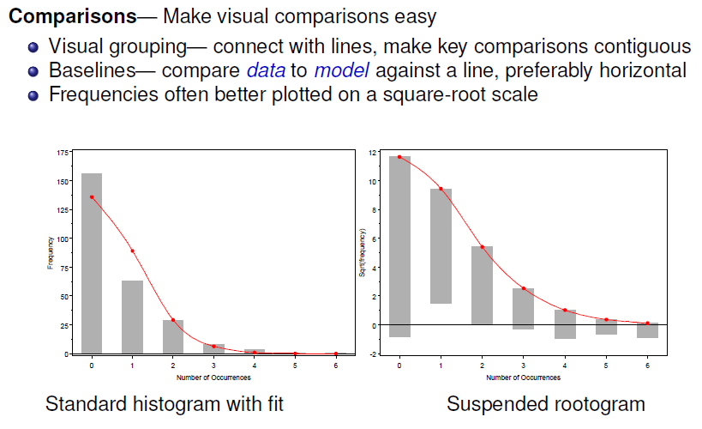
Facilitate comparison

Slide 39
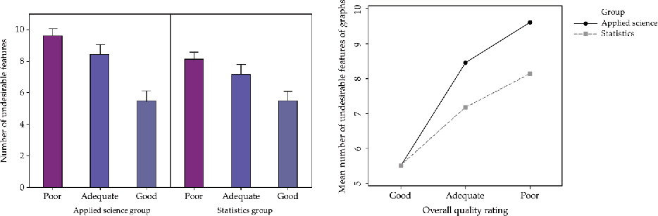
Make comparisons direct
Use points not bars (and don’t dynamite them with ineffective error bars!)
Connect similar circumstances to be compared by lines
Same panel comparisons easier than different panels
Q: Is there evidence of an interaction here?
???
YES
Published in: Ian Gordon; Sue Finch; Journal of Computational and Graphical Statistics 2015, 24, 1210-1229.
DOI: 10.1080/10618600.2014.989324
Copyright © 2015 American Statistical Association, Institute of Mathematical Statistics, and Interface Foundation of North America

Slide 40
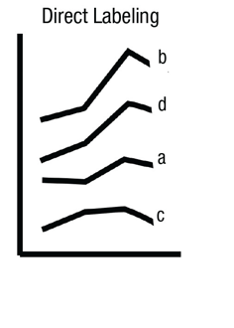
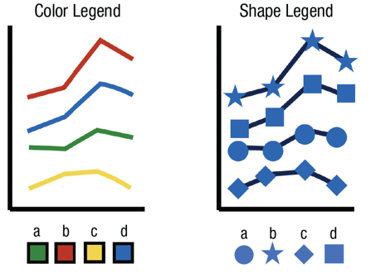
Direct labels vs. legends
Direct labels for points, lines and regions are usually easier and faster than legends
Give the names of the four groups shown in the line graph at left in top-to-bottom order. (Answer: b, d, a, c.)
Now do so for the graphs using color or shape legends
You need to look back and forth between the graph and legend
Source: Franconeri etal. DOI:10.1177/15291006211051956

Slide 41
Effect ordering
Information presentation is always ordered
in time or sequence (a talk or written paper)
in space (table or graph)
Constraints of time & space are dominant– can conceal or reveal the important message
Effect ordering for data display
Sort the data by the effects to be seen
Order the data to facilitate the task at hand
lookup – find a value
comparison – which is greater?
detection – find patterns, trends, anomalies

Slide 42
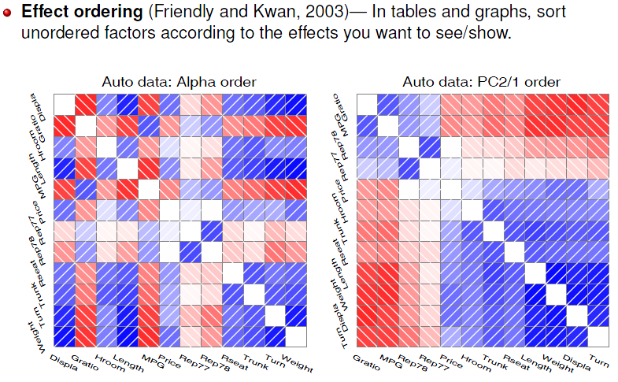
Effect Ordering: Correlations
Friendly & Kwan (2003). Corrgrams: Exploratory displays for correlation matrices. American Statistician, 54(4): 316-324.

Slide 43
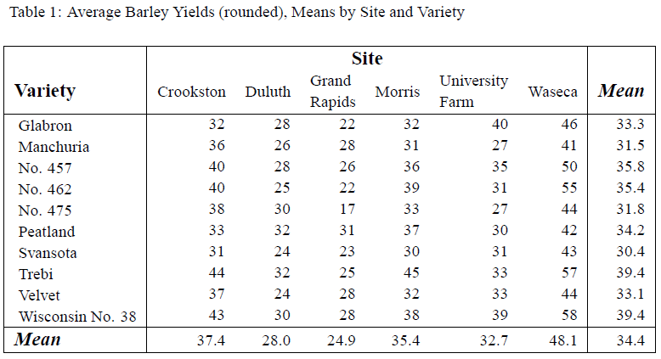
Tabular displays: Main effect ordering
Tables are often presented with rows/cols ordered alphabetically
good for lookup
bad for seeing patterns, trends, anomalies

Slide 44
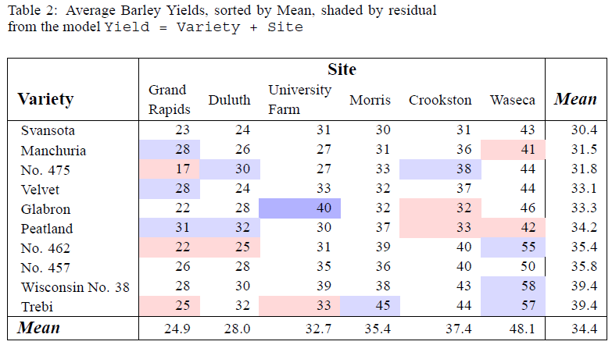
Tabular displays: Main effect ordering
Better: sort rows/cols by means/medians
Shade cells according to residual from additive model

Slide 45
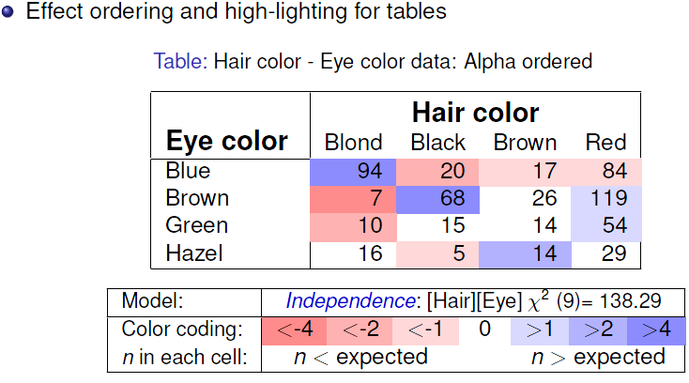
Effect ordering: Frequency tables
There is an association, but it is hard to see the general pattern

Slide 46
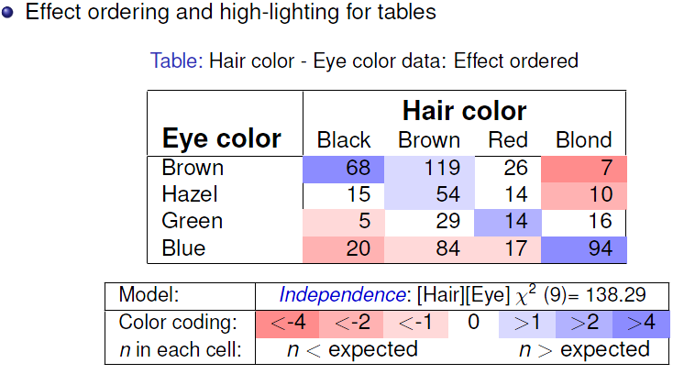
Effect ordering: Frequency tables
The pattern is clearer when the eye colors are permuted: light hair goes with light eyes & vice-versa

Slide 47
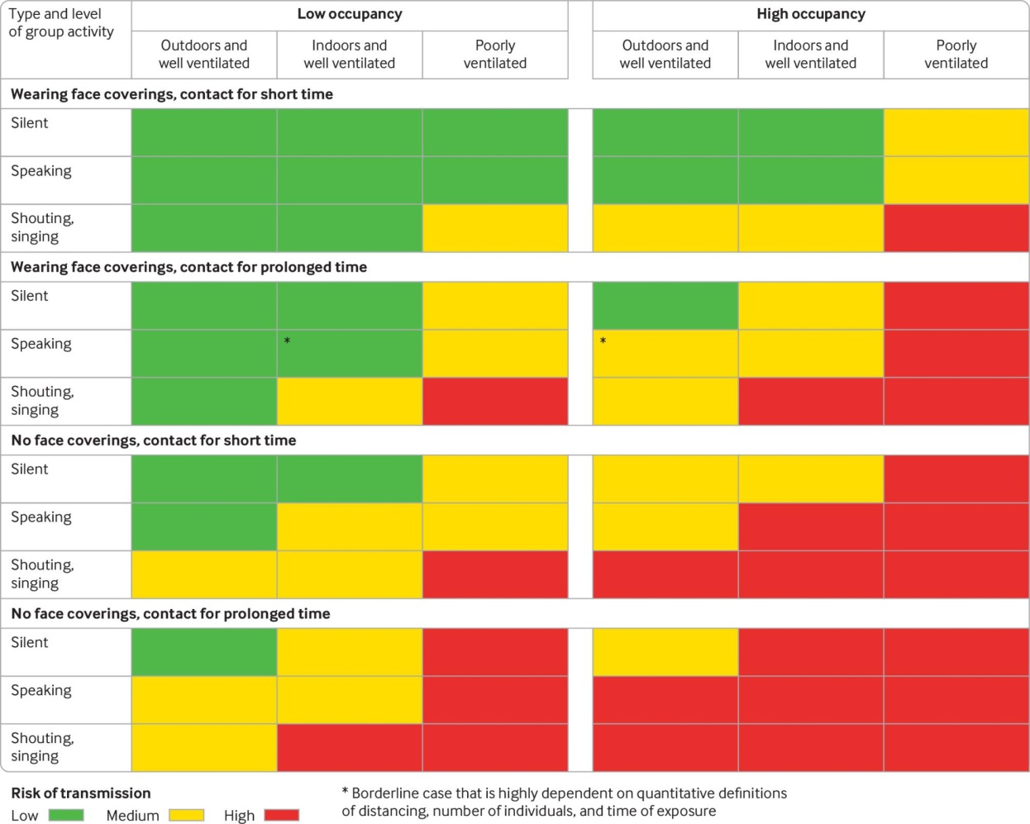
Sometimes, don’t need numbers at all
COVID transmission risk ~ Occupancy * Ventilation * Activity * Mask? * Contact.time
A complex 5-way table, whose message is clearly shown w/o numbers
A semi-graphic table shows the patterns in the data
There are 1+ unusual cells here. Can you see them?
From: N.R. Jones et-al (2020). Two metres or one: what is the evidence for physical distancing in covid-19? BMJ 2020;370:m3223, doi: https://doi.org/10.1136/bmj.m3223

Slide 48
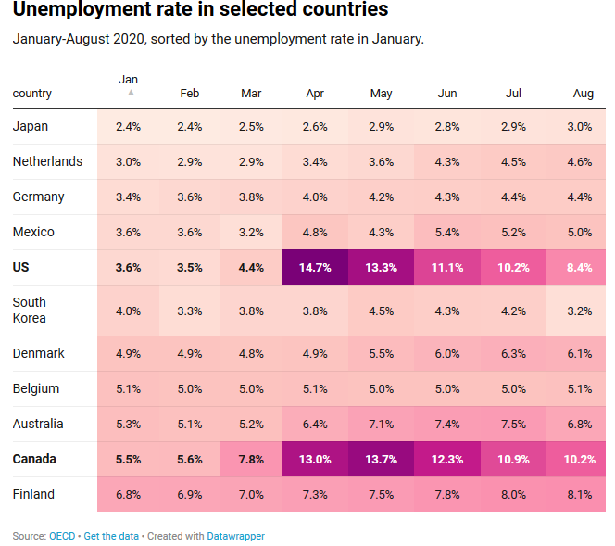
Visual table ideas: Heatmap shading
Heatmap shading: Shade the background of each cell according to some criterion
The trends in the US and Canada are made obvious
NB: Table rows are sorted by Jan. value, lending coherence
Background shading ~ value:
US & Canada are made to stand out.
Tech note: use light text on a darker background

Slide 49
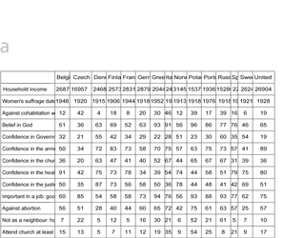
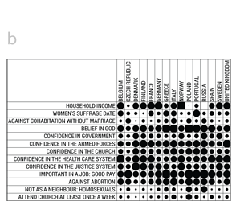
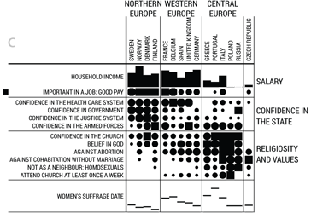
Bertifier: Turning tables into graphs
attitudes & attributes
encode values by size & shape
Table: attitudes and attributes by country
Visual: encode values by size, shape
Sort & group by themes, country regions
Bertifier: Bertin’s reorderable matrix
See: http://www.aviz.fr/bertifier

Slide 50

Example: Household tasks
Who does what in households?
Size of symbols in a balloon plot shows the frequencies
Who_does_it?
Alternating Husband Jointly Wife
Breakfeast 36 15 7 82
Dinner 11 7 13 77
Dishes 24 4 53 32
Driving 51 75 3 10
Finances 13 21 66 13
Holidays 1 6 153 0
Insurance 1 53 77 8
Laundry 14 2 4 156
Main_meal 20 5 4 124
Official 46 23 15 12
Repairs 3 160 2 0
Shopping 23 9 55 33
Tidying 11 1 57 53
Rows and columns were permuted to show the relationship more clearly

Slide 51

Graphical annotation
Statistical tests usually presented in tables
But sometimes can add this info to a graphic
Should I call this beast a "grable"? or a "taphic"?
Does this try to do too much?
Would you ever want to publish something like this?
ggstatsplot::ggbetweenstats(ISLR::Wage, race, wage)

Slide 52

Novel graphic ideas
Likert scale data is often difficult to display
Making them dynamic or interactive lets viewers compare response categories
Note: chart titles, subtitles, … help make this self-explanatory

Slide 53

Show the trend
100% stacked bar charts of racial resentment survey vs. age (binned: 5 years)
An overlaid smoother of the responses encoded to 0-1 scale shows trend w/ age
Q: How much does the smoothed curve add to understanding?
Image source: https://bsky.app/profile/xangregg.bsky.social/post/3m7dttgtggs2a
Data source: https://tischcollege.tufts.edu/research-faculty/research-centers/cooperative-election-study

Slide 54

Pies with too many slices
Pie charts are often used to show frequencies of a variable
When there are many categories, you can rescue with better labels & interactivity
Even better, classify these into broader categories:
Common (hanging, drowning, …)
Emotional (grief, shame, madness, …)
Political (assassination, …)
Source: https://www.reddit.com/r/writing/comments/3vf1g1/causes_of_death_in_shakespeares_plays/

Slide 55

Hierarchical data: Sankey diagram
A Sankey diagram shows how a total of the 8.3 billion tonnes of plastic ever produced by humanity has ended up either being totally discarded, incinerated or still in use.
This graphic form allows to show how larger categories are split, e.g., used once -> discarded, incinerated, recycled.
Q: Can you see how to “read” this chart?
Source: https://bsky.app/profile/infobeautiful.bsky.social/post/3m7ispw2gyh2j

Slide 56


Data, pictures, models & stories
Goal: Tell a credible story about some real data problem
data
Gender bias
Measles vaccination
Global warming
…
story

Slide 57



Data, pictures, models & stories
Two paths to enlightenment
model
data
Model-based
visualization
summary
Exploratory
story

Slide 58

Data, pictures, models & stories
Now, tell the story!
model
data
Model-based
visualization
summary
Exploratory
story
inference

Slide 59

Gender Bias at UC Berkeley?
Science, 1975, 187: 398--403
Notes:
Methods for studying gender or racial discrimination in hiring, promotion, salary are now well developed.
Many universities and large corporations have mechanisms for equity, affirmative action and, in the case of salary, anomaly adjustment.
An initial salvo that got wide attention was a 1975 study on graduate admissions by Peter Bickel and others.

Slide 60


2 × 2 Frequency Tables: Fourfold displays
odds ratio (θ) = 1.84
Males nearly twice as likely to be admitted
Is this a “significant” association?
Is it evidence for gender bias?
How to measure strength of association?
How to visualize?
Fourfold display:
quarter circles, area ~ frequency
ratio of areas: odds ratio (θ)
confidence bands: overlap iff θ ≈ 1
visualize significance!

Slide 61

2 × 2 × k Stratified tables
The data arose from 6 graduate departments
No difference between males & females, except in Dept A where women more likely to be admitted!
Design:
small multiples
encode direction by color
encode signif. by shading

Slide 62

Mosaic matrices
Scatterplot matrix analog for categorical data
All pairwise views
Small multiples → comparison
The answer: Simpson’s Paradox
Depts A, B were easiest
Applicants to A, B mostly male
∴Males more likely to be admitted overall

Slide 63

Measures & models
If the focus is on the association between gender and admission for each department
the odds ratio: odds(Admit|Male) / odds(Admit|Female) is a good summary
odds = Pr(Admit) / Pr (Reject)
OR = odds(Admit|M) / odds(Admit|F)
OR = 1 → M/F equally likely admitted
LOR = log(OR): 0 → M/F equally likely
admitted
Std errors & CIs provide individual signif tests
Models provide a comprehensive summary
Now, we can tell the story !

Slide 64


Graphical methods for categorical data
These share similar ideas & scope with methods for quantitative data

Slide 65
Plots: Data, Model, Data+Model
Data plots: well-known. Help to answer:
What do the data look like?
Are there unusual features? (outliers, non-linear relations)
What kinds of summaries would be useful?
Model plots
What does the model look like? (plot predicted values)
How does the model change when parameters change? (plot competing models)
How does the model change when the data is changed? (influence plots)
Data+Model plots
How well does model fit the data? (focus on residuals)
Does model fit uniformly good/bad, or just in some regions?
Model uncertainty: show confidence regions
Data support: where is data too thin to make a difference?

Slide 66
Summary
Categorical data involves some new ideas
Discrete variables: unordered or ordered
Counts, frequencies as outcomes
New / different data structures & functions
tables – 1-way, 2-way, 3-way, … table(), xtabs()
similar in matrices or arrays matrix(), array()
datasets:
frequency form
case form
Graphical methods: often use area ~ Freq
Consider: graphical comparisons, effect order
Models: Most are ≅ natural extensions of lm()

